Slide 1
Management information systems
MIS applications
Petr Suchánek
Management information systems
DAMIA

Slide 2
Outline of the lecture
Transaction processing systems (TPS)
Knowledge work system (KWS)
Decision support system (DSS)
Executive information system (EIS)
Office automation systems

Slide 3
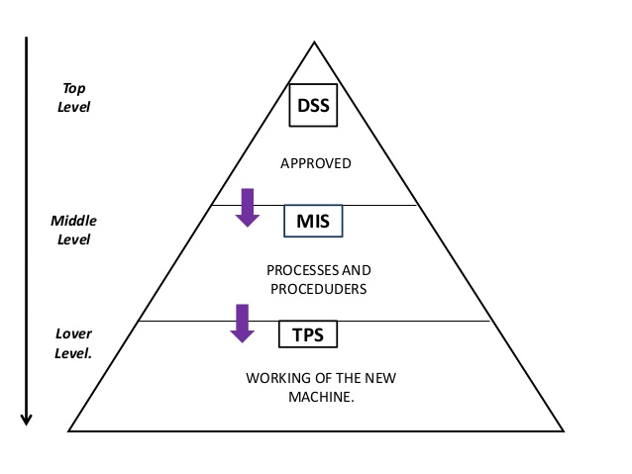
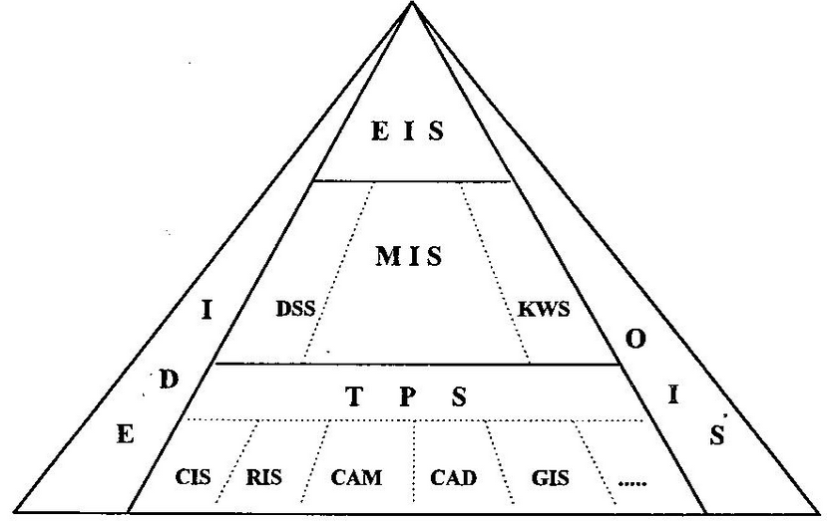
MIS Applications*/**
*https://www.slideshare.net/17791/mis-lelavati-hos-dssmistps
**https://is.mendelu.cz/eknihovna/opory/zobraz_cast.pl?cast=4756

Slide 4
MIS applications
Transaction processing system – TPS
A transaction process system (TPS) is an information processing system for business transactions involving the collection, modification and retrieval of all transaction data. Characteristics of a TPS include performance, reliability and consistency. TPS is also known as transaction processing or real-time processing.*
A transaction process system and transaction processing are often contrasted with a batch process system and batch processing, where many requests are all executed at one time. The former requires the interaction of a user, whereas batch processing does not require user involvement. In batch processing the results of each transaction are not immediately available. Additionally, there is a delay while the many requests are being organized, stored and eventually executed. In transaction processing there is no delay and the results of each transaction are immediately available. During the delay time for batch processing, errors can occur. Although errors can occur in transaction processing, they are infrequent and tolerated, but do not warrant shutting down the entire system.*
To achieve performance, reliability and consistency, data must be readily accessible in a data warehouse, backup procedures must be in place and the recovery process must be in place to deal with system failure, human failure, computer viruses, software applications or natural disasters.*
*https://www.techopedia.com/definition/707/transaction-process-system-tps

Slide 5
MIS applications
TPS – features*
Rapid response – fast performance with rapid results
Reliability – well designed backup and recovery with a low failure rate
Inflexibility – treat every transaction equally. It may be used many times each day which means it has to be precise and inflexible
Controlled processing – maintain specific requirements for the roles and responsibilities of different employees.
In order to qualify as a TPS, transactions made by the system must pass the ACID test.
Atomicity - A transaction’s changes to the state are atomic: either all happen or none happen. These changes include database changes, messages, and actions on transducers.
Consistency - TPS systems exist within a set of operating rules (or integrity constraints). The actions taken as a group do not violate any of the integrity constraints associated with the state.
Isolation - Even though transactions execute concurrently, it appears to each transaction T, that others executed either before T or after T, but not both.
Durability - Once a transaction completes successfully (commits), its changes to the state survive failures.
*https://www.slideshare.net/udaysharma10/transaction-processing-system-presentation

Slide 6
MIS applications
TPS – Batch vs. Real-Time Processing*
In a batch processing system, transactions are accumulated over a period of time and processed as a single unit, or batch. For example, a store may update its sales records every day after the store closes. Or, a payroll system may process all the time cards every two weeks to determine employee earnings and produce paychecks. Whatever the time period in a batch system, there is some time delay between the actual event and the processing of the transaction to update the records of the organization.
In a real-time processing system, transactions are processed immediately as they occur without any delay to accumulate transactions. Real-time processing is also referred to as online transaction processing, or OLTP. In this case, the records in the system always reflect the current status.
A good example of a real-time processing system would be airline ticket reservations. When you book a ticket and select a seat, that booking is made right away, and nobody else can get that same seat even a second later. Any changes you make to your reservation are also updated in real time. Another example is the stock market. When you submit an order to buy a stock, that order is processed immediately and not at the end of the day.
While real-time processing is often more efficient and in some cases necessary, batch processing may be more effective. In the case of a payroll system, there is really no need to keep track of how much an employee has earned every minute of the day and doing this every two weeks is likely sufficient.
*http://study.com/academy/lesson/transaction-processing-systems-tps-manual-and-automated-systems.html

Slide 7
MIS applications
Knowledge work system - KWS*
Knowledge Management systems are the set of processes developed in an organization to create, gather, store, maintain, and disseminate the firm's knowledge.
The major information systems that support knowledge management are office systems, knowledge work systems, group collaboration systems, and artificial intelligence systems
Knowledge work systems help create and integrate new knowledge within the organization. Knowledge management systems codify knowledge and experience, make the collected knowledge and experience available when and where it is needed, and provide links to external sources of knowledge.
*https://www.slideshare.net/Piyush_Tripathi/knowledge-work-system

Slide 8
MIS applications
Knowledge work system - KWS*
Knowledge workers perform three key roles that are critical to the organization and to the managers who work within the organization:
Keeping the organization current in knowledge;
Serving as internal consultants regarding the areas of their knowledge;
Acting as change agents.
Knowledge workers rely on traditional office systems but often require highly specialized knowledge work systems with powerful graphics, analytical tools, and communications and document management capabilities.
These systems require great computing power, access to external databases, easy-to-use interfaces, and optimization for the specific tasks to be performed.
*https://www.slideshare.net/Piyush_Tripathi/knowledge-work-system

Slide 9
MIS applications
Knowledge work system - KWS*
Knowledge worker productivity demands that we ask the question: “What is the task?”
It demands that we impose the responsibility for their productivity on the individual knowledge workers themselves. Knowledge workers have to manage themselves. They have to have autonomy.
Continuing innovation has to be part of the work, the task and the responsibility of knowledge workers.
Knowledge work requires continuous learning on the part of the knowledge worker, but equally continuous teaching on the part of the knowledge worker.
Productivity of the knowledge worker is not – at least not primarily – a matter of the quantity of output. Quality is at least as important.
Finally, knowledge worker productivity requires that the knowledge worker is both seen and treated as an ‘asset’ rather than a ‘cost’. It requires that knowledge workers want to work for the organization in preference to all other opportunities.”
*https://www.whatsbestnext.com/2012/02/6-characteristics-of-knowledge-work/

Slide 10
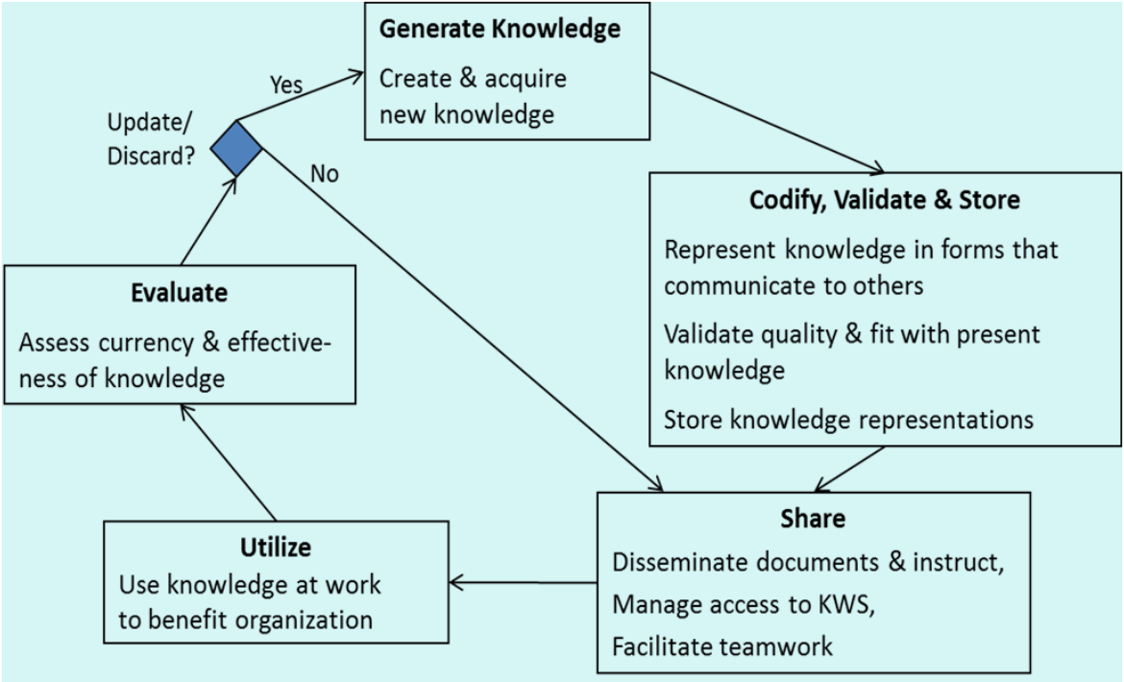
MIS applications
Knowledge work system - KWS*
*www.umanitoba.ca/faculties/.../Ch11-KnowledgeAndKWS.pdf

Slide 11
MIS applications
Knowledge work system - KWS*
Example of KWS
Computer Aided Design (CAD) / Computer aided manufacturing (CAM) Systems - Provide engineers, designers, and factory managers with precise control over industrial design and manufacturing.
Computer aided manufacturing (CAM) - Computer-aided manufacturing (CAM) is an application technology that uses computer software and machinery to facilitate and automate manufacturing processes. CAM is the successor of computer-aided engineering (CAE) and is often used in tandem with computer-aided design (CAD).**
Virtual Reality Systems - Provide drug designers, architects, engineers, and medical workers with precise, photorealistic simulations of objects.
Investment Workstations - High-end PCs used in financial sector to analyze trading situations instantaneously and facilitate portfolio management.
*https://www.whatsbestnext.com/2012/02/6-characteristics-of-knowledge-work/
**https://www.techopedia.com/definition/4698/computer-aided-manufacturing-cam

Slide 12
MIS applications
Knowledge work system - KWS
Computer Aided Design (CAD) Systems
CAD (computer-aided design) software is used by architects, engineers, drafters, artists, and others to create precision drawings or technical illustrations. CAD software can be used to create two-dimensional (2-D) drawings or three-dimensional (3-D) models.*
CAD allows for simple and accurate automation and/or process modeling (known as Mechanical Design Automation). Traditionally MDA was not possible without first building a physical prototype of every part in the system and then assembling it to check functionality. The ability to digitally model and automate a prototype before ever generating a physical model adds enormous efficiency to manufacturing processes and cost reduction benefits.**
CAD allows for the ability to conduct Computer Aided Manufacturing (CAM). For example, integrating CAD technology with Computer Numerical Control (CNC) machines or Additive Manufacturing processes (3D printers) e.g. Fused Deposition Modeling (FDM) machines.**
CAD takes into account material properties and interactivity characteristics between different materials.**
CAD allows for highly accurate dimensional analysis and mathematical scalability using vector graphic technology (digital images based on mathematical formulas).**
CAD provides highly precise part tolerance (much lower margin of error between parts).**
*http://whatis.techtarget.com/definition/CAD-computer-aided-design
**https://www.creativemechanisms.com/blog/everything-you-need-to-know-about-computer-aided-design-cad

Slide 13
MIS applications
Knowledge work system - KWS
Computer Aided Manufacturing (CAM) Systems*
Computer-aided manufacturing (CAM) is an application technology that uses computer software and machinery to facilitate and automate manufacturing processes. CAM is the successor of computer-aided engineering (CAE) and is often used in tandem with computer-aided design (CAD).
In addition to materials requirements, modern CAM systems include real-time controls and robotics.
CAM reduces waste and energy for enhanced manufacturing and production efficiency via increased production speeds, raw material consistency and more precise tooling accuracy.
CAM uses computer-driven manufacturing processes for additional automation of management, material tracking, planning and transportation. CAM also implements advanced productivity tools like simulation and optimization to leverage professional skills.
Depending on enterprise solution and manufacturer, CAM may present inadequacies in the following areas:
Manufacturing process and usage complexity;
Product Lifecycle Management (PLM) and modern enterprise integration;
Machine process automation.
*https://www.techopedia.com/definition/4698/computer-aided-manufacturing-cam

Slide 14
MIS applications
Knowledge work system - KWS
Virtual reality systems
The definition of virtual reality comes, naturally, from the definitions for both ‘virtual’ and ‘reality’. The definition of ‘virtual’ is near and reality is what we experience as human beings. So the term ‘virtual reality’ basically means ‘near-reality’. This could, of course, mean anything but it usually refers to a specific type of reality emulation.*
How is virtual reality achieved?*
Although we talk about a few historical early forms of virtual reality elsewhere on the site, today virtual reality is usually implemented using computer technology. There are a range of systems that are used for this purpose, such as headsets, omni-directional treadmills and special gloves. These are used to actually stimulate our senses together in order to create the illusion of reality.
This is more difficult than it sounds, since our senses and brains are evolved to provide us with a finely synchronised and mediated experience. If anything is even a little off we can usually tell. This is where you’ll hear terms such as immersiveness and realism enter the conversation. These issues that divide convincing or enjoyable virtual reality experiences from jarring or unpleasant ones are partly technical and partly conceptual. Virtual reality technology needs to take our physiology into account. For example, the human visual field does not look like a video frame. We have (more or less) 180 degrees of vision and although you are not always consciously aware of your peripheral vision, if it were gone you’d notice. Similarly when what your eyes and the vestibular system in your ears tell you are in conflict it can cause motion sickness. Which is what happens to some people on boats or when they read while in a car.
*https://www.vrs.org.uk/virtual-reality/what-is-virtual-reality.html

Slide 15
MIS applications
Knowledge work system - KWS
Features of virtual reality systems*
There are many different types of virtual reality systems but they all share the same characteristics such as the ability to allow the person to view three-dimensional images. These images appear life-sized to the person.
Plus they change as the person moves around their environment which corresponds with the change in their field of vision. The aim is for a seamless join between the person’s head and eye movements and the appropriate response, e.g. change in perception. This ensures that the virtual environment is both realistic and enjoyable.
A virtual environment should provide the appropriate responses – in real time- as the person explores their surroundings. The problems arise when there is a delay between the person’s actions and system response or latency which then disrupts their experience. The person becomes aware that they are in an artificial environment and adjusts their behaviour accordingly which results in a stilted, mechanical form of interaction.
The aim is for a natural, free-flowing form of interaction which will result in a memorable experience.
*https://www.vrs.org.uk/virtual-reality/what-is-virtual-reality.html

Slide 16
MIS applications
Decision support system (DSS)
A decision support system (DSS) is a computer program application that analyzes business data and presents it so that users can make business decisions more easily. It is an "informational application" (to distinguish it from an "operational application" that collects the data in the course of normal business operation).Typical information that a decision support application might gather and present would be:*
Comparative sales figures between one week and the next
Projected revenue figures based on new product sales assumptions
The consequences of different decision alternatives, given past experience in a context that is described
A decision support system may present information graphically and may include an expert system or artificial intelligence (AI). It may be aimed at business executives or some other group of knowledge workers.
*http://searchcio.techtarget.com/definition/decision-support-system

Slide 17
MIS applications
Decision support system (DSS)*
Components of DSS
Data Base Management System (DBMS);
Model Based Management System (MBMS);
Dialog Generation &Management System (DGMS).
Types of DSS systems can be separated into seven broad categories, each aiding decision making by different methods:
Data Driven DSS;
Model-driven DSS;
Knowledge Driven DSS;
Document Driven DSS;
Communication Driven DSS;
Inter & Intra-organizational DSS;
New Breed of DSS.
* https://www.slideshare.net/paramalways/decision-support-system-1943516

Slide 18
MIS applications
Decision support system (DSS)
Management Requirement of DSS
Allocating Resources;
Preparing Budgets;
Observation of Results;
Evaluation of Result;
Modification of Activites And Resources.
* https://www.slideshare.net/paramalways/decision-support-system-1943516

Slide 19
MIS applications
Executive information systems (EIS)*
An executive information system (EIS) is a decision support system (DSS) used to assist senior executives in the decision-making process. It does this by providing easy access to important data needed to achieve strategic goals in an organization. An EIS normally features graphical displays on an easy-to-use interface.
Executive information systems can be used in many different types of organizations to monitor enterprise performance as well as to identify opportunities and problems.
Early executive information systems were developed as computer-based programs on mainframe computers to provide a company’s description, sales performance and/or market research data for senior executives. However, senior executives were not all computer literate or confident. Moreover, EIS data was only supporting executive-level decisions but not necessarily supporting the entire company or enterprise.
Current EIS data is available company- or enterprise-wide, facilitated by personal computers and workstations on local area networks (LANs). Employees can access company data to help decision-making in their individual workplaces, departments, divisions, etc.. This allows employees to provide pertinent information and ideas both above and below their company level.
The typical EIS has four components: hardware, software, user interface and telecommunication.
*https://www.techopedia.com/definition/1016/executive-information-system-eis

Slide 20
MIS applications
Executive information systems (EIS)*
Advantages of Executive Information System
Executives use that information, along with their experience, knowledge, education, and understanding of the corporation and the business environment as a whole, to make their decisions.
Executives are more inclined to want summarized data rather than detailed data (even though the details must be available). ESS rely on graphic presentation of information because it's a much quicker way for busy executives to grasp summarized information.
It provides timely delivery of company summary information;
It provides better understanding of information;
It filters data for management;
It provides system for improvement in information tracking;
It offers efficiency to decision makers.
*https://www.slideshare.net/inam12/executive-information-system-28709086

Slide 21
MIS applications
Executive information systems (EIS)*
Features that relate to tactical decision making
They provide a drill-down feature which gives a manager the opportunity to find out more information necessary to take a decision or discover the source of a problem.
They provide analysis tools.
They must be integrated with other facilities to help manage the solving of problems and the daily running of the business.
They integrate data from a wide range of information sources, including company and external sources such as market and competitor.
They have to be designed according to the needs of managers who do not use computers frequently. They should be intuitive and easy to learn.
*https://www.slideshare.net/inam12/executive-information-system-28709086

Slide 22
MIS applications
Office automation systems (OAS)*
Office automation systems (OAS)
OAS are configurations of networked computer hardware and software. A variety of office automation systems are now applied to business and communication functions that used to be performed manually or in multiple locations of a company, such as preparing written communications and strategic planning. In addition, functions that once required coordinating the expertise of outside specialists in typesetting, printing, or electronic recording can now be integrated into the everyday work of an organization, saving both time and money.
Types of functions integrated by office automation systems include
electronic publishing;
electronic communication (electronic mail, voice mail, faksimile, videoconferences);
electronic collaboration;
image processing;
office management.
*https://www.slideshare.net/inam12/executive-information-system-28709086

Slide 23
MIS applications
Office automation systems (OAS)*
Electronic publishing
Electronic publishing systems include word processing and desktop publishing. Word processing software, (e.g., Microsoft Word, Corel Word-Perfect) allows users to create, edit, revise, store, and print documents such as letters, memos, reports, and manuscripts. Desktop publishing software (e.g., Adobe Pagemaker, Corel VENTURA, Microsoft Publisher) enables users to integrate text, images, photographs, and graphics to produce high-quality printable output. Desktop publishing software is used on a microcomputer with a mouse, scanner, and printer to create professional-looking publications. These may be newsletters, brochures, magazines, or books.
Electronic Communication
Electronic communication systems include electronic mail (e-mail), voice mail, facsimile (fax), and desktop videoconferencing.
*http://www.encyclopedia.com/computing/news-wires-white-papers-and-books/office-automation-systems

Slide 24
MIS applications
Office automation systems (OAS)*
Electronic Mail
E-mail is software that allows users, via their computer keyboards, to create, send, and receive messages and files to or from anywhere in the world. Most e-mail systems let the user do other sophisticated tasks such as filter, prioritize, or file messages; forward copies of messages to other users; create and save drafts of messages; send "carbon copies"; and request automatic confirmation of the delivery of a message. E-mail is very popular because it is easy to use, offers fast delivery, and is inexpensive. Examples of e-mail software are Eudora, Lotus Notes, and Microsoft Outlook.
Voice Mail
Voice mail is a sophisticated telephone answering machine. It digitizes incoming voice messages and stores them on disk. When the recipient is ready to listen, the message is converted from its digitized version back to audio, or sound. Recipients may save messages for future use, delete them, or forward them to other people.
*http://www.encyclopedia.com/computing/news-wires-white-papers-and-books/office-automation-systems

Slide 25
MIS applications
Office automation systems (OAS)*
Facsimile
A facsimile or facsimile transmission machine (FAX) scans a document containing both text and graphics and sends it as electronic signals over ordinary telephone lines to a receiving fax machine. This receiving fax recreates the image on paper. A fax can also scan and send a document to a fax modem (circuit board) inside a remote computer. The fax can then be displayed on the computer screen and stored or printed out by the computer's printer.
Desktop Videoconferencing
Desktop videoconferencing is one of the fastest growing forms of videoconferencing. Desktop videoconferencing requires a network and a desktop computer with special application software (e.g., CUSeeMe) as well as a small camera installed on top of the monitor. Images of a computer user from the desktop computer are captured and sent across the network to the other computers and users that are participating in the conference. This type of videoconferencing simulates face-to-face meetings of individuals.
*http://www.encyclopedia.com/computing/news-wires-white-papers-and-books/office-automation-systems

Slide 26
MIS applications
Office automation systems (OAS)*
Electronic Collaboration
Electronic collaboration is made possible through electronic meeting and collaborative work systems and teleconferencing. Electronic meeting and collaborative work systems allow teams of coworkers to use networks of microcomputers to share information, update schedules and plans, and cooperate on projects regardless of geographic distance. Special software called groupware is needed to allow two or more people to edit or otherwise work on the same files simultaneously.
Teleconferencing is also known as videoconferencing. As was mentioned in the discussion of desktop videoconferencing earlier, this technology allows people in multiple locations to interact and work collaboratively using real-time sound and images. Full teleconferencing, as compared to the desktop version, requires special-purpose meeting rooms with cameras, video display monitors, and audio microphones and speakers.
*http://www.encyclopedia.com/computing/news-wires-white-papers-and-books/office-automation-systems

Slide 27
MIS applications
Office automation systems (OAS)*
Telecommuting and Collaborative Systems
Telecommuters perform some or all of their work at home instead of traveling to an office each day, usually with the aid of office automation systems, including those that allow collaborative work or meetings. A microcomputer, a modem, software that allows the sending and receiving of work, and an ordinary telephone line are the tools that make this possible.
Telecommuting is gaining in popularity in part due to the continuing increase in population, which creates traffic congestion, promotes high energy consumption, and causes more air pollution. Telecommuting can help reduce these problems. Telecommuting can also take advantage of the skills of homebound people with physical limitations.
Studies have found that telecommuting programs can boost employee morale and productivity among those who work from home. It is necessary to maintain a collaborative work environment, however, through the use of technology and general employee management practices, so that neither on-site employees nor telecommuters find their productivity is compromised by such arrangements. The technologies used in electronic communication and teleconferencing can be useful in maintaining a successful telecommuting program.
*http://www.encyclopedia.com/computing/news-wires-white-papers-and-books/office-automation-systems

Slide 28
MIS applications
Office automation systems (OAS)*
Image Processing
Image processing systems include electronic document management, presentation graphics, and multimedia systems. Imaging systems convert text, drawings, and photographs into digital form that can be stored in a computer system. This digital form can be manipulated, stored, printed, or sent via a modem to another computer. Imaging systems may use scanners, digital cameras, video capture cards , or advanced graphic computers. Companies use imaging systems for a variety of documents such as insurance forms, medical records, dental records, and mortgage applications.
Presentation graphics software uses graphics and data from other software tools to create and display presentations. The graphics include charts, bullet lists, text, sound, photos, animation, and video clips. Examples of such software are Microsoft Power Point, Lotus Freelance Graphics, and SPC Harvard Graphics.
Multimedia systems are technologies that integrate two or more types of media such as text, graphic, sound, voice, full-motion video, or animation into a computer-based application. Multimedia is used for electronic books and newspapers, video conferencing, imaging, presentations, and web sites.
*http://www.encyclopedia.com/computing/news-wires-white-papers-and-books/office-automation-systems

Slide 29
MIS applications
Office automation systems (OAS)*
Office Management
Office management systems include electronic office accessories, electronic scheduling, and task management. These systems provide an electronic means of organizing people, projects, and data. Business dates, appointments, notes, and client contact information can be created, edited, stored, and retrieved. Additionally, automatic reminders about crucial dates and appointments can be programmed. Projects and tasks can be allocated, subdivided, and planned. All of these actions can either be done individually or for an entire group. Computerized systems that automate these office functions can dramatically increase productivity and improve communication within an organization.
*http://www.encyclopedia.com/computing/news-wires-white-papers-and-books/office-automation-systems

Slide 30
Compulsory and recommended references
LAUDON, K.C. and J.P LAUDON, 2015. Management Information Systems: Managing the Digital Firm (14th Edition). New York: Pearson Publishing. ISBN 978-0133898163.
http://www.bestpricecomputers.co.uk/glossary/transaction-processing-systems.htm
http://www.umanitoba.ca/faculties/management/faculty/btravica/2000/Ch11-KnowledgeAndKWS.pdf
https://paginas.fe.up.pt/~als/mis10e/ch11/chpt11-3bullettext.htm
https://www.slideshare.net/sursayantan92/decision-support-systemdss
https://www.slideshare.net/inam12/executive-information-system-28709086
https://www.slideshare.net/midhunchakkaravarthy3/office-automation-sysmtems

