Slide 1

Mathematics in economics
Lecture 5
Mgr. Jiří Mazurek, Ph.D.
Mathematics in Economics/PMAT

Slide 2
Lecture 5
Extremes of a function of two real variables
Local vs global extremes.
Bounded vs unbounded extremes.
Necessary condition for the extreme:
A point satisfying equalities above is called a stationary
(critical) point. However, this condition is not sufficient

Slide 3
Lecture 5
Extremes of a function of two real variables
In a critical point can be maximum, minimum or an inflection
point. To decide which situation occurrs, we use the second
derivatives and a matrix called hessian:
H_{f}(x,y) =
,
Then we use Sylvester´s theorem.

Slide 4
Lecture 5
Extremes of a function of two real variables
We denote: D1 = and D2 = Hf(C). Then:
If D2>0, then we have an extreme. Moreover,
If D1>0, we have a minimum, if D1<0, we have a maximum.
IF D2<0, we have an inflection point.
If D2 = 0, we cannot decide.

Slide 5
Lecture 5
Extremes of a function of two real variables
- Problem 1
Find extremes of the function .
Solution:
We start with the first derivatives:
Both derivatives must be 0, which yields the critical point
C [0,0].

Slide 6
Lecture 5
Extremes of a function of two real variables
- Problem 1 – cont.
Now we compute all second derivatives and hessian:
We substitute point C into hessian: Hf(0,0) = .
Because D2<0, the point C is an inflection point.
H_{f}(x,y) =
.

Slide 7
Lecture 5
Extremes of a function of two real variables
- Problem 2
Find extremes of the function .
Solution:
We start with the first derivatives:
Both derivatives must be 0, which yields the critical point
C [1/2,1/2].

Slide 8
Lecture 5
Extremes of a function of two real variables
- Problem 2 – cont.
Now we compute all second derivatives and hessian:
Substituting point C into hessian yields the same result.
Because D2 < 0, the point C is an inflection point.
H_{f}(x,y) =
.

Slide 9
Lecture 5
Extremes of a function of two real variables
- Problem 3
Find extremes of the function .
Solution:
We start with the first derivatives:
Both derivatives must be 0, which yields the critical point
C [0,0].

Slide 10
Lecture 5
Extremes of a function of two real variables
- Problem 3 – cont.
Now we compute all second derivatives and hessian:
Because D2 = 0, We cannot decide the nature of C.
But how do we know it is certainly a minimum?
H_{f}(C) =
H_{f}(x,y) =
.

Slide 11
Lecture 5
Problem 4
Find the maximum of the revenue function:
Solution:
We start with the first derivatives:
Both derivatives must be 0, which yields the critical point
C [12.5,2].

Slide 12
Lecture 5
Problem 4 – cont.
Now we compute all second derivatives and hessian:
Because D2 > 0, we have an extreme.
Because D1 <0, we have a maximum.
H_{f}(x,y) =
H_{f}(C) =
.

Slide 13
Lecture 5
Problems to solve – 1 (Assignment 7)
Find extremes of the following functions:
.

Slide 14
Lecture 5
Indefinite integral
Integration is a reverse procedure to differentiation.
Notation:
Legend:
…. Integration sign
f(x) …. Integrated function
C …. Integration constant
.

Slide 15
Lecture 5
Indefinite integral - cont
Indefinite integral is a linear operator:
We compute integrals with the use of formulas above, and
with the use of the table of elementary integrals, see
the next slide.
.

Slide 16
Lecture 5
Indefinite integral – elementary integrals
.

Slide 17
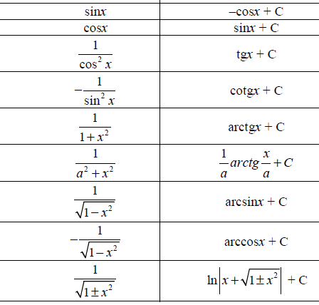
Lecture 5
Indefinite integral – elementary integrals
.

Slide 18
Lecture 5
Indefinite integral - examples
=
.
.

Slide 19
Lecture 5
Indefinite integral - examples
.

Slide 20
Lecture 5
Indefinite integral – integration methods
For more complicated integration we use sutitable
integration methods:
Method per partes
Partial fractions
Substitutions
All these methods will be demonstrated on examples.
.

Slide 21
Lecture 5
Indefinite integral – rational functions
By a rational function we mean the function of the form:
where P(x) and Q(x) are polynomials.
In the first step we find the roots xi of the denominator in order
to rearrange the denominator into a product.
.

Slide 22
Lecture 5
Indefinite integral – rational functions – cont.
Then, the situation splits into three possible cases:
All roots of a denominator are single. Then we obtain the
following partial fractions:
2. Some root, for example x1, is of order higher than 1:
.

Slide 23
Lecture 5
Indefinite integral – rational functions – cont.
3. A denominator or its part given as a quadratic polynomial
has no roots:
Coeffcients in numerators are unknown and must be computed
by clearing a denomiantor and solving a subsequent equation.
.

Slide 24
Lecture 5
Integration of rational functions – Problem 1
Solve: .
Solution: The rational function is of case 1, with roots -2 and 1.
Therefore, we obtain the following division into partial fractions:
Now we clear the denominator:
And we get two equations:
.

Slide 25
Lecture 5
Integration of rational functions – Problem 1-cont.
Solving the equation yields: .
Hence:
Now, we can integrate:
.
We will continue in Lecture 6.

Slide 26
Lecture 5
Thank you for your attention!
.

