Slide 1

Enterprise Theory – balance sheet
.
Ing. Tomáš Pražák, Ph.D.

Slide 2
An entrepreneur is a person who seizes business opportunities, has an idea and entrepreneurial resources, is capable of effectively combining them, and is willing to bear full responsibility and reasonable business risks.

Slide 3
  Introduction to Assets and Liabilities
Definition of assets: Resources owned by a company that have economic value.
Definition of liabilities: Obligations or debts that a company owes.
Importance: Understanding them is crucial for analyzing the financial health of a business.

Slide 4
  Types of Assets
Current Assets: Cash, receivables, inventory (convertible to cash within a year).
Fixed Assets: Buildings, machinery, equipment (long-term investments).
Intangible Assets: Patents, trademarks.
Financial assets (e.g., shares in other business entities, securities intended for long-term investment).

Slide 5
  Types of Liabilities
Current Liabilities: Accounts payable, short-term loans (due within
a year).
Long-term Liabilities: Bonds payable, mortgages (due after one year).
Contingent Liabilities: Potential obligations (e.g., lawsuits).

Slide 6
  The Relationship Between Assets and Liabilities
The role of equity: Assets = Liabilities + Equity.
Equity represents the ownership value in a company (Shareholders' Equity and Owners‘Equity).
Essentially, equity is what would be left for the owners (shareholders) if the company sold off all its assets and paid all its debts.

Slide 7
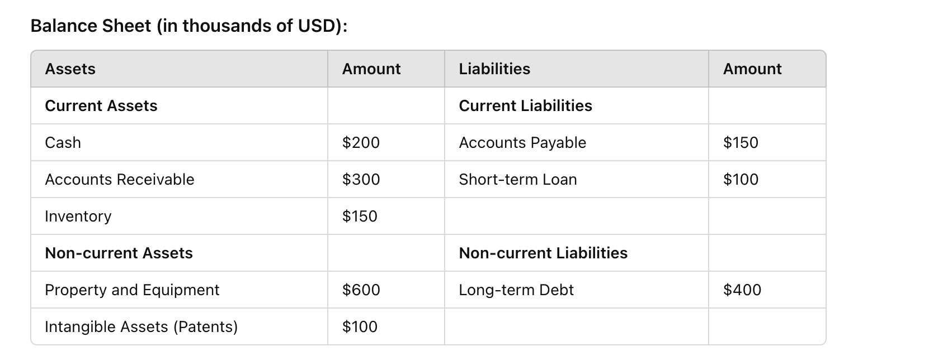
  The Relationship Between Assets and Liabilities
Equity?

Slide 8
Finished products
Semi-finished products
Liabilities to suppliers
Receivables
Liabilities to employees
Current account
Overdraft loan
Cash
Financial investments
Machinery and equipment
Bank loan

Slide 9
From the following accounting items, create a balance sheet for the company Perpetum, a.s.:
Long-term tangible assets: 5,200,000 CZK
Inventory: 2,800,000 CZK
Receivables from trade relations: 1,900,000 CZK
Equity: 4,000,000 CZK
Liabilities from trade relations: 2,300,000 CZK
Bank loans: 3,600,000 CZK

Slide 10
Solution:
Balance Sheet
Credit [thousands CZK] |  | Debit [thousands CZK]
Long-term tangible assets | 5 200 | Equity | 4 000
Inventory | 2 800 | Liabilities | 2 300
Receivables | 1 900 | Bank loans | 3 600
Total Credit | 9 900 | Total Debit | 9 900

Slide 11
During the observed month, the following business transactions took place:
Cashless sale of a printing press (long-term asset) for 1,400,000 CZK (payment due in 30 days).
Purchase of materials for 200,000 CZK (payment due in 25 days).
Create the balance sheet.

Slide 12
Credit [thousands CZK] |  | Debit [thousands CZK]
Long-term tangible assets | 3 800 | Equity | 4 000
Inventory | 3 000 | Liabilities | 2 500
Receivables | 3 300 | Bank loans | 3 600
Total Credit | 10 100 | Total Debit | 10 100

