Slide 1

Enterprise Theory : Costs

Slide 2
Basic cost groups consist of:
  operating costs:
    material consumption
    Power or energy consumption
    consumption and use of external works and services (production cooperation, telecommunications, consulting, repair, etc. services)
    personal expenses (wage expenses including health and social insurance)
    depreciation of long-term tangible and intangible assets
  financial costs (interest, insurance premiums, taxes)
  extraordinary costs (shortage, damage, natural disasters)
Notes:
csvukrs
2

Slide 3
Example
Decide whether it is an operational, financial or extraordinary expense:
car depreciation
paper consumption in the production of magazines
consumption of office supplies
shortfall in the cash register
insurance premiums against natural disasters
internet service fee
exchange rate loss
social insurance
Notes:
csvukrs
3

Slide 4
Breakdown of costs according to place of origin and responsibility (unit and overhead costs)
Where did the costs occur and who is responsible for their occurrence?
Classification by internal company departments:
  Production costs:
    technology costs:
      unit costs (directly related to the performance unit (t, kg, piece,...), proportional dependence on production volume)
      overheads
    costs of service, provision and management - overhead costs
  Non-production costs:
    sales management
    administrative overhead
    supply overhead etc.
Notes:
csvukrs
4

Slide 5
Cost breakdown (direct and indirect costs)
what the costs were spent on (which products and services)
very important for the business world, because it can find out:
  profitability (profitability) of individual items of products and services provided
  how individual products or services contribute to the creation of the economic result (profit) and thereby influence the range of products and services on offer
  whether to operate the given service in-house or rather to buy the given service (outsourcing)
  the minimum price for the business area
we monitor costs depending on the method of assigning costs to cost bearers (per performance, so-called calculation unit):
  direct costs (unit costs and overheads that are directly related to a certain product)
  indirect costs (common to a group of products, i.e. overhead costs that cannot be assigned to a specific product)
Notes:
csvukrs
5

Slide 6
Example
Determine whether it is a direct cost or an indirect cost:
  paper consumption in book production
  company management salaries
  consumption of office paper
  brand promotion
  power consumption
  material warehouse cleaning costs
  social insurance
  water, sewage, waste disposal
Notes:
csvukrs
6

Slide 7
Breakdown of costs depending on changes in production volume
it makes sense when managing costs for a period of less than 1 year
variable costs – their amount depends on the volume of production
fixed costs – their amount is not tied to the volume of production
F
N _{in} , n _{in}
N _{in} [CZK]
F [CZK]
n _{in} [CZK/pc, bm ]
f [CZK/piece, bm, …]
Production volume Q [pcs, bm, …]
1
Production volume Q [pcs, bm, …]
Notes:
csvukrs
7

Slide 8
Example
Decide whether it is a fixed or variable cost in each of the following cases:
  monthly wages of company management
  paper consumption in book production
  gas consumption for heating the production hall
  cost of purchasing goods (store)
  brand promotion
  electricity consumption in an office building
  internet connection fee
  petrol consumption of a taxi car
  gasoline consumption in a car used for the needs of executives
Notes:
csvukrs
8

Slide 9

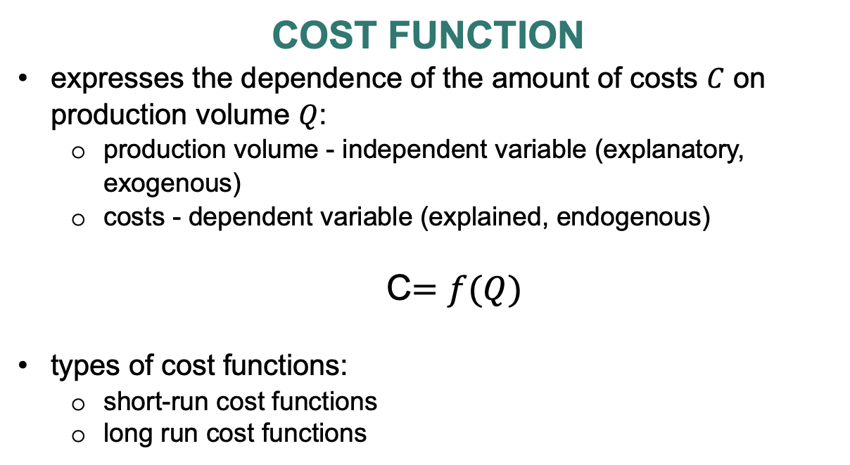
Cost function
expresses the dependence of the amount of costs $C$ on production volume $Q$:
  production volume - independent variable (explanatory, exogenous)
  costs - dependent variable (explained, endogenous)
  C$=f(Q)$
types of cost functions:
  short-run cost functions
  long run cost functions

Slide 10
C = f ( Q ) = ( v x Q ) + F
C = V + F
where
F … total fixed costs [CZK]
v … unit variable costs [CZK/piece, CZK/kg, CZK/l, …]
V … total variable costs
Q … volume of production [pcs, kg, l, …]

Slide 11
Assignment: Determine the cost function for the production of 10,000 A piece of candy.
Cost item | The amount of costs [CZK] | Variable costs [CZK] | Fixed costs [CZK]
Material consumption | 66,000 | 60,000 | 6,000
Wages of pastry chefs | 45,000 | 15,000 | 30,000
Administrative staff salary | 20,000 |  | 20,000
Technological energy (production equipment drive) | 15,000 | 15,000
Non-technological energy | 1000 |  | 1000
Depreciation of tangible fixed assets | 20,000 |  | 20,000
TOTAL | 167,000 | 90,000 | 77,000
C = (v x Q ) + F
V = v x Q
v = V/ Q

Slide 12

Solution:
Cost item | The amount of costs [CZK] | Variable costs [CZK] | Fixed costs [CZK]
Material consumption | 66,000 | 60,000 | 6,000
Wages of pastry chefs | 45,000 | 15,000 | 30,000
Administrative staff salary | 20,000 |  | 20,000
Technological energy (production equipment drive) | 15,000 | 15,000
Non-technological energy | 1000 |  | 1000
Depreciation of tangible fixed assets | 20,000 |  | 20,000
TOTAL | 167,000 | 90,000 | 77,000
F = 77 000 CZK
v $=\frac{90 000}{10 000}=9$
C $=9Q+77 000$

Slide 13
Thank you for your attention ☺

