Slide 1

The Enterprise theory
-
Cost function
Sales
Net profit
.
Tomáš Pražák

Slide 2
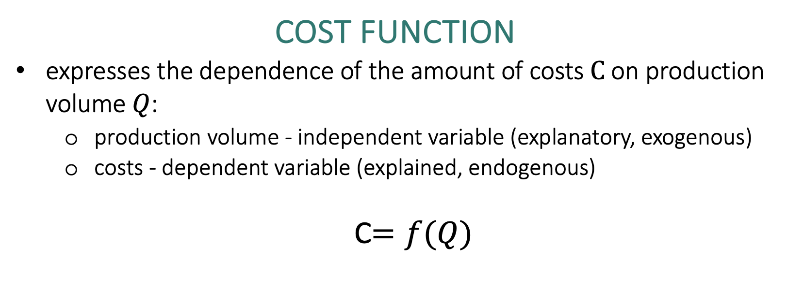
Cost function
expresses the dependence of the amount of costs$C$ on production volume $Q$:
  production volume - independent variable (explanatory, exogenous)
  costs - dependent variable (explained, endogenous)
  C$=f(Q)$

Slide 3
C = f ( Q ) = ( v x Q ) + F
C = V + F
where
F … total fixed costs [CZK]
v … unit variable costs [CZK/piece, CZK/kg, CZK/l, …]
V … total variable costs
Q … volume of production [pcs, kg, l, …]

Slide 4
  Use of cost functions in business practice
how the amount of costs changes depending on the volume of production
which part of the costs is dependent on the volume of production and which is not
the starting point for a more qualified decision in a number of areas:
  determine the amount of costs corresponding to different volumes of production
  competently determine the economic result
  determine what volume of production ensures the desired profit

Slide 5
Example: Lovers of theatrical performances of the children's theater can purchase a year-long season ticket for 2 children. The price of this season ticket is CZK 2,000. The entrance fee for one performance for one child in a popular line in the theater is 150 CZK.
What are the costs associated with visiting three shows with/without a season ticket if two children go to the theater?
How many times does a pair of children have to visit the theater to make the purchase of a season ticket worth it?

Slide 6
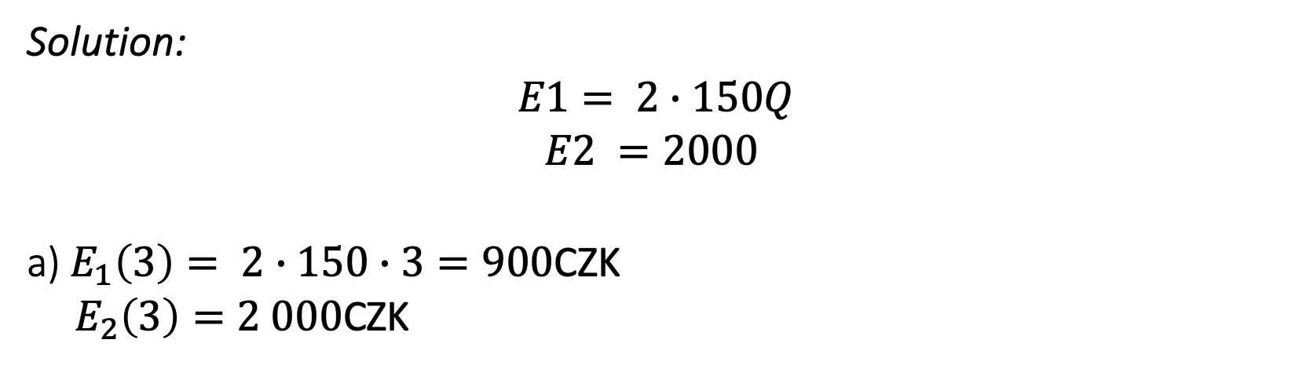
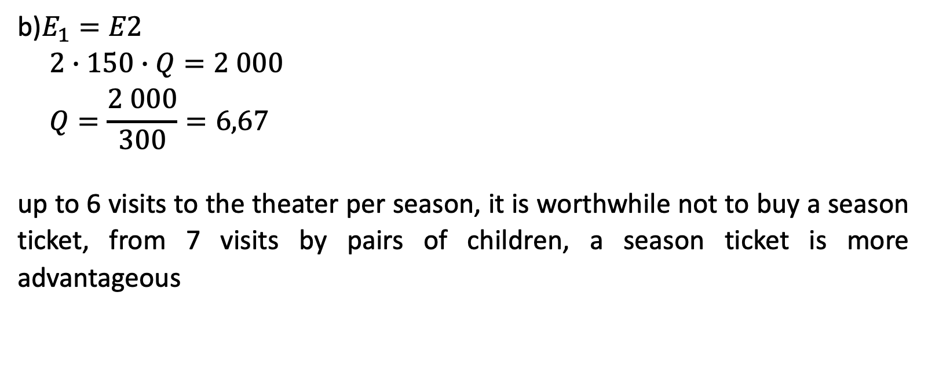
Solution:
$$E1= 2∙150Q$$
$$E2 =2000$$
a) $E_{1}\left(3\right)= 2∙150∙3=900$CZK
${ E}_{2}\left(3\right)=2 000$CZK
b)$E_{1}=E2$
$$2∙150∙Q=2 000$$
$$Q=\frac{2 000}{300}=6,67$$
up to 6 visits to the theater per season, it is worthwhile not to buy a season ticket, from 7 visits by pairs of children, a season ticket is more advantageous

Slide 7
The two-period method
it only works with data on two periods - with the maximum production volume Q _{MAX} and with a minimum production volume Q _{MIN} and their corresponding costs C _{QMIN} and C _{QMAX}
we insert the data into the general form of the cost function and then solve the resulting system of two linear equations
it should not be a period however extraordinary
C _{Qmax} = (v x Q _{max} ) + F
C _{Qmin} = (v x Q _{min} ) + F

Slide 8
Example: The following table shows data on production volumes and total costs in individual months of last year of the company XYZ, s.r.o. Use the two-period method to determine the cost function.
 | Production volume [pcs] | Costs [CZK]
January | 10,500 | 165,000
February | 9,500 | 148,000
March | 9,000 | 145,000
April | 10,600 | 151,000
May | 10,400 | 163,000
June | 9,200 | 148,000
July | 8,500 | 135,000
August | 9,600 | 145,000
September | 10,000 | 167,000
October | 10,800 | 158,000
November | 11,000 | 162,000
December | 10,900 | 161,000

Slide 9
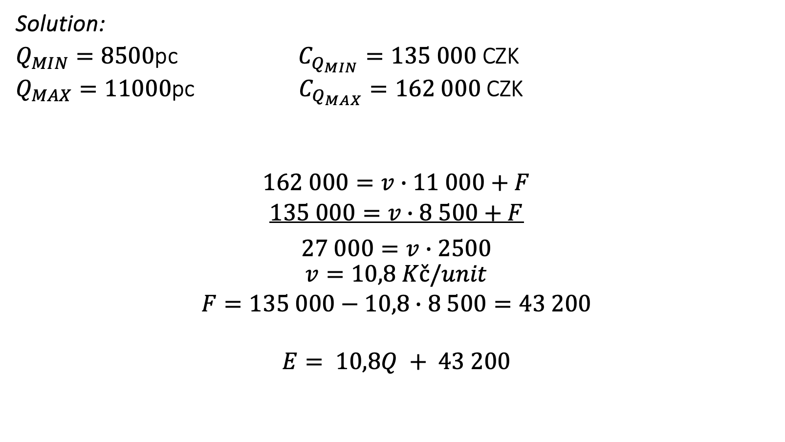
Solution:
$Q_{MIN}=8500$pc $C_{Q_{MIN}}=135 000$CZK
$Q_{MAX}=11000$pc $C_{Q_{MAX}}=162 000$ CZK
$$162 000=v∙11 000+F$$
$$135 000=v∙8 500+F$$
$$\begin{matrix}27 000=v∙2500 \\ \begin{aligned}v=10,8 Kč/unit \\ F=135 000−10,8∙8 500=43 200 \\ \\ E= 10,8Q + 43 200\end{aligned}\end{matrix}$$

Slide 10
Sales
S = (p x Q )
where
p ... selling price per piece [CZK/piece]
Q … volume of production [pcs, kg, l, …]

Slide 11
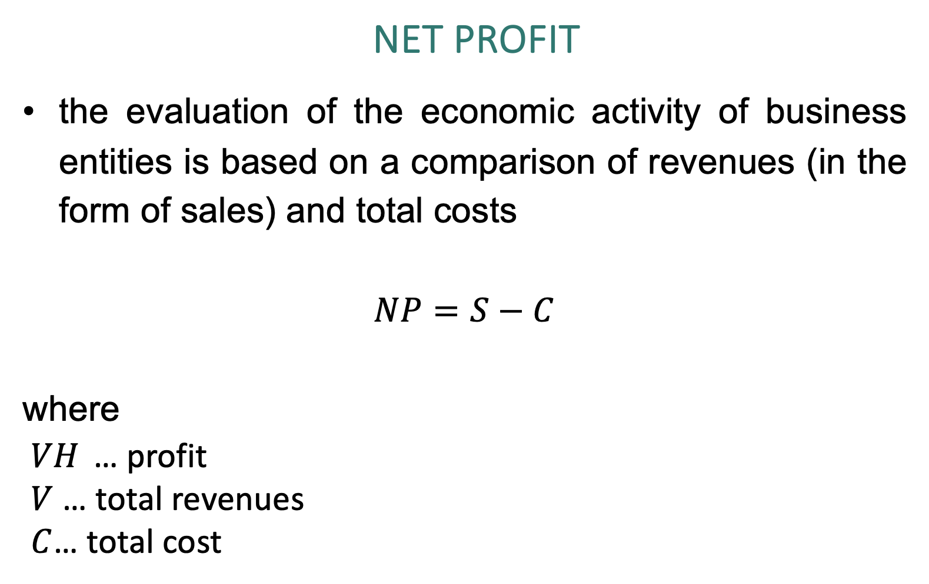
NET Profit
the evaluation of the economic activity of business entities is based on a comparison of revenues (in the form of sales) and total costs
$$NP=S−C$$
where
$VH$ … profit
$V$ … total revenues
$C$… total cost

Slide 12
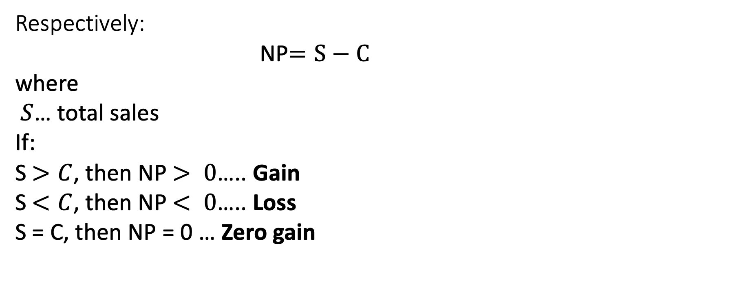
Respectively:
NP$=S−C$
where
$S$… total sales
If:
S$>C$, then NP$> 0$….. Gain
S$<C$, then NP$< 0$….. Loss
S = C, then NP = 0 … Zero gain

Slide 13

If we substitute
S$= p  Q$
C$=V+ F$
C$=v  Q + F$
to NP
then
NP$=(p ∗ Q) –\left(v ∗ Q+ F\right)$

Slide 14
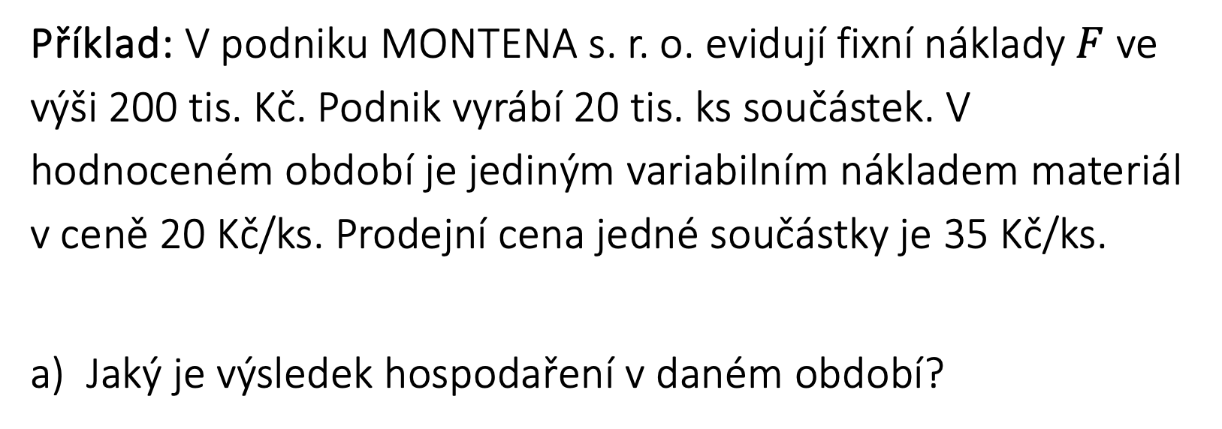
Example: In the company MONTENA s.r.o. they record fixed costs $F$in the amount of 200 thousand. CZK. The company produces 20 thousand pcs of components. In the evaluated period, the only variable cost is material at a price of CZK 20/piece. The selling price of one component is 35 CZK/pc.
What is the economic result in the given period?

Slide 15
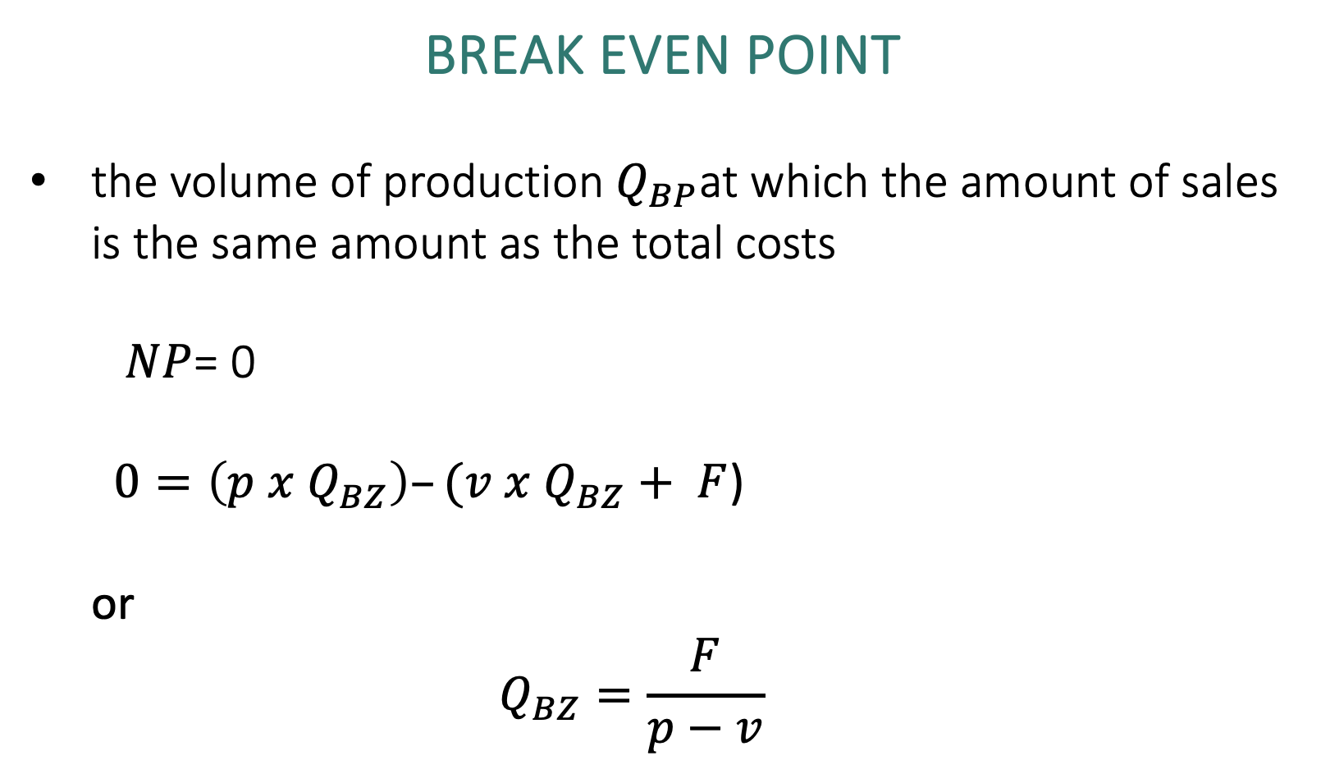
Break Even point
the volume of production $Q_{BP}$at which the amount of sales is the same amount as the total costs
  $NP$= 0
  $0=\left(p x Q_{BZ}\right)–(v x Q_{BZ}+ F$)
  or
  $$Q_{BZ}=\frac{F}{p−v}$$

Slide 16
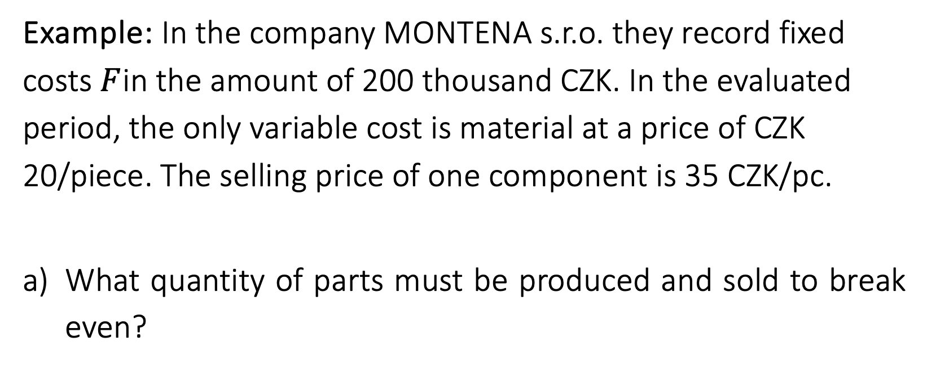
Example: In the company MONTENA s.r.o. they record fixed costs $F$in the amount of 200 thousand CZK. In the evaluated period, the only variable cost is material at a price of CZK 20/piece. The selling price of one component is 35 CZK/pc.
What quantity of parts must be produced and sold to break even?

