Slide 1

The Enterprise theory
-
Purchasing and inventory management
.

Slide 2
  purchase
one of the basic corporate functions
it is implemented by all types of businesses
organizationally secured by the purchasing department

Slide 3
Stages of the buying process
purchase initiation
specification of requirements (necessity, nature, scope)
market analysis of possible suppliers
selection of a suitable supplier
wording of the order
implementation of logistics activities associated with the entry of the delivery into the company
delivery payment
supplier performance evaluation

Slide 4
  Stocks
  current assets of the business
  the result of a purchase or business activity
  they always bind themselves with funds
  To have or not to have? Can you do business without inventory?

Slide 5
  Types of supplies
I. Classification of stocks by species
production stocks:
  raw materials, basic material, operating substances, spare parts, packaging
  tangible assets whose consumption period is less than 1 year
work in progress inventory
stocks of finished goods
goods

Slide 6
II. Breakdown of stocks according to functional components
current stock – to ensure expected consumption in the period between two deliveries
insurance stock – to cover possible deviations in supplies or consumption
technological stock – if the material needs to be modified before it is released for consumption, its amount results from the production technology

Slide 7
seasonal ( occasional ) supply – compensates for expected fluctuations in supply or consumption
speculative stock - to achieve an extraordinary profit by a suitable purchase
emergency stock - ensures the survival of the business in the event of unforeseen events

Slide 8
III. Breakdown of stocks according to capacity calculations
minimum stock – stock status at the moment before a new delivery
maximum stock – the highest stock level reached at the time of a new delivery
immediate stock :
  actual physical inventory - the actual stock level in the warehouse
  disposition stock – actual stock reduced by already applied requirements for delivery (goods ready for dispatch)
  balance stock – disposition stock increased by the size of stock deliveries ordered but not yet received (material on the way)

Slide 9
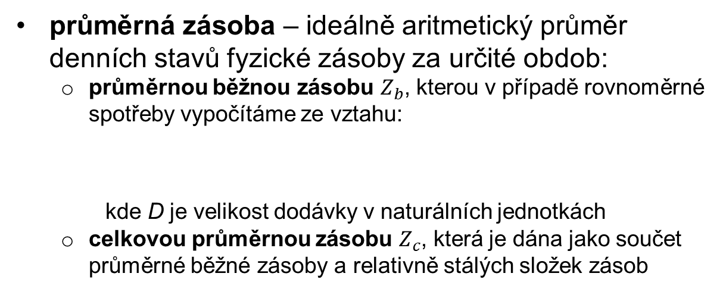
average stock – ideally the arithmetic average of daily physical stock levels for a certain period:
  the average current stock $Z_{b}$, which in the case of uniform consumption is calculated from the relationship:
where D is the delivery size in natural units
  total average inventory $Z_{c}$, which is given as the sum of average current inventory and relatively constant inventory components

Slide 10
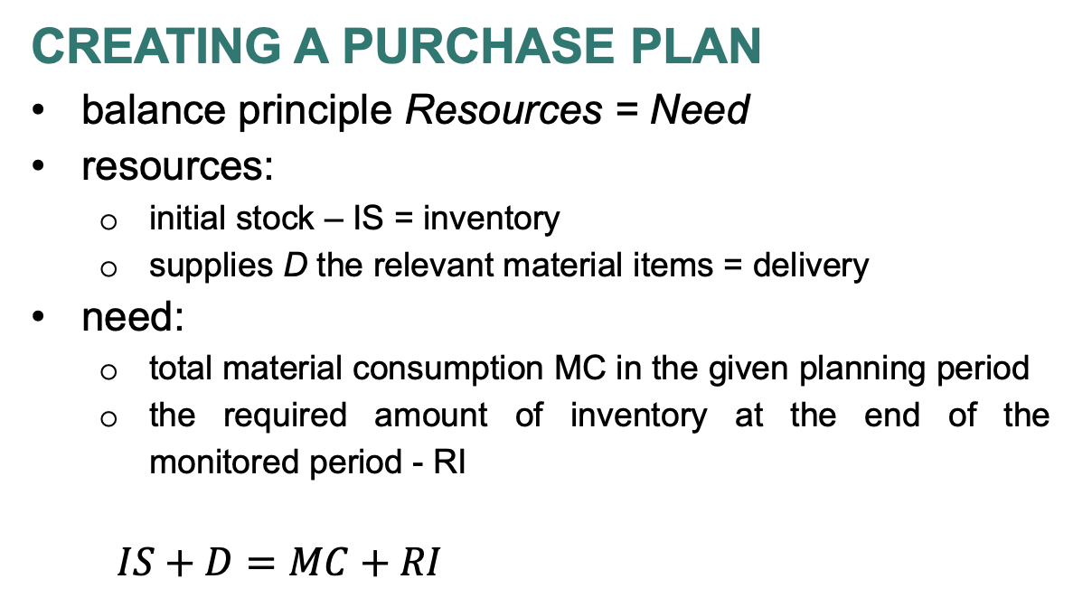
  Creating a purchase plan
balance principle Resources = Need
resources:
  initial stock – IS = inventory
  supplies D the relevant material items = delivery
need:
  total material consumption MC in the given planning period
  the required amount of inventory at the end of the monitored period - RI
  $IS+D=MC+RI$

Slide 11
  The hotel is planning shopping activities for the next month of November. On average, 600 liters of juice are consumed in the hotel per day. Juices are stored in 0.5 l bottles. At the end of November, the hotel plans to have a stock of 2,500 bottles. At the beginning of November, this stock will be 2,600 bottles. How many bottles of juice must the hotel order for November?

Slide 12
  Resources = Needs
  No. inventory + purchase (delivery) = consumption + ending inventory
  2600 + x = 36000 + 2500
  Purchase = 35,900 pcs

Slide 13
The Enterprise theory
-
Calculation
.
Tomáš Pražák
Lecturer

Slide 14
Calculation
calculation of costs, margin, profit, price or other value quantity for a product, work or service or for an activity or operation (calculation unit)
displays in relation to each other both in kind and value-expressed performance unit
the most important tool of economic management

Slide 15
Purpose of costing
assign costs to the cost bearer (product, service, order), i.e. to the calculation unit
direct costs:
  direct allocation per unit of output or per cost center
indirect costs:
  before scheduling on the performance unit of their allocation to end centers
  they cannot be directly assigned to the performance unit - use of the costing schedule base

Slide 16
    Simple division calculation
    in the case of linear dependence of costs in single-type production of products or services (energy production, lemonade, mineral extraction)
    the cost per unit n _{j} can be found directly by dividing the cost N by the output Q

Slide 17
Example:
The selected company deals with the packaging of Grilling Mixture per 25g of the delivered spice mixture. Material costs were CZK 14,000 for 54 kg of seasoning mixture. The company incurred wage costs in the amount of CZK 10,000 and other overhead costs (depreciation of the packaging line, share of administrative staff costs) in the amount of CZK 15,000. What will be the cost of producing one 25g bag of the mixture?

Slide 18
Solution:
We add up all incurred costs (material, wages and other costs) and divide them by the required calculation unit of 25 g /bag.
TC = 14,000 + 10,000 + 15,000 = 39,000 CZK
Number of units per 25 g = 54,000 g / 25 g = 2,160 bags
Cost per unit = 39,000 /2,160 = CZK 18.05/pc

Slide 19
Typical calculation formula
1. | Direct material (raw materials, material, semi-finished products, purchased products)
2. | Direct wages (wages of operating workers, bonuses, bonuses, allowances, additional payments)
3. | Other direct costs (technological fuels and energy, depreciation, transport costs, repairs, technical development costs, etc.)
4. | Production overhead (technological and general) (costs related to the management of production activities, process maintenance)
Σ (1st-4th) | Own production costs
5. | Administrative overhead (may include supply overhead) (related to the management and administration of the organization)
Σ (1st-5th) | Own performance costs
6. | Sales costs (may be part of administrative overhead) (shipping, advertising, promotion, sales)
Σ (1.-6.) | Full cost of performance
7. | Business result - profit/loss + margin
Σ (1.-7.) | Price (production)

Slide 20
The following production items for a medium-sized candle are given:
the production plan is 10,000 units,
material consumption is 0.05 kg of beeswax at 1000 CZK/kg per 1 piece,
time consumption is 18 min/piece,
hourly wage rate = 150 CZK/hour,
manufavturing overhead budget = CZK 45,000 for the entire production plan,
administrative overhead budget = CZK 60,000 for the entire production plan,
other direct costs 31.5% of social and health insurance,
the margin is 30% of the full own cost of performance.
Create a preliminary calculation:
Calculation formula line | Type of cargo | Calculation of the load per unit | Cost per unit (CZK/piece)
1 | material
2 | employee salary
3 | other direct costs
4 | manufacturing overhead
Σ
5 | administrative overhead
Σ
7 | Margin - profit margin
Σ | costs

Slide 21
Calculation formula line | Type of cargo | Calculation of the load per unit | Cost per unit (CZK/piece)
1 | material | 0.05*800 | 50
2 | employee salary | 150/60*18 | 45
3 | other direct costs | 0.315*45 | 14,175
4 | manufacturing overhead | 45,000/10,000 | 4.50
Σ |  |  | 113,675
5 | administrative overhead | 60,000/10,000 | 6
Σ |  |  | 119,675
7 | Margin - profit margin | 119.675*0.3 | 35.9025
Σ | price |  | 155.58

