Slide 1
Introduction to MS Project
Software solution for your project planning and managing
MS Project
Project Management

Slide 2
How the lecture will be conducted?
The lecture is divided into three blocks, where each block introduces an issue (setting up your project in MS Project)
Then an example of a project in MS Project is presented. After each block there is a quiz for feedback on whether you have understood everything.
We use MS Teams, a shared whiteboard for your engagement and reactions.
The class is supplemented with quizzes in vevox, the link is always in the presentation.

Slide 3
Contents
PART (30 min.)
Demonstrating the importance of software usage in project planning.
2. PART (30 min.)
Demonstration of basic project setup in MS Project. Students try their own project setup (templates, new project) with MS Project.
3. PART (30 min.)
Explaining project settings (calendar, schedule), individual tabs and functionalities using a project example

Slide 4
Learning objectives
After studying this topic, you should be able to:
You will understand the logic of the application and the step-by-step creation of the project.
Perform basic setup of your project in MS Project.
Phase a project into multiple phases, understand the importance of phasing a project and dividing it into multiple parts.
Work through the basic definition and setup of a project in MS project.
Understand the importance of software support in project planning.

Slide 5
Key readings
You can find support in the following sources:
Book – Chatfield and Johnson (2016). MS Project 2016 Step by Step (Part 1, Part 2, Part 3)
https://www.tutorialspoint.com/ms_project/ms_project_create_new_plan.htm
https://ppm.express/blog/newbie-guide-how-to-start-using-microsoft-project-in-2023/
MS Project Tutorials – basic setup and calendars:
https://www.youtube.com/watch?v=sYy-iFzz1Eo
https://www.youtube.com/watch?v=tuCrTKMPu_Y

Slide 6
Learning tutorials
https://www.tutorialspoint.com/ms_project/ms_project_quick_guide.htm
https://support.microsoft.com/en-gb/office/basic-tasks-in-project-8fdbf020-a9e1-45e4-bf15-23a8d2b6797d
https://ppm.express/blog/newbie-guide-how-to-start-using-microsoft-project-in-2023/

Slide 7
When we talk of project management, we refer to the application of skills, processes, methods, knowledge, and experience to achieve your project goals. It ensures that the final deliverables are constrained to specific reasonable timelines and budgets.
You need the right instruments or tools to successfully manage your PM activity.
Various programs exist for this purpose, the key among them being Microsoft Project.
A planning program is indispensable if larger projects need to be planned on a regular basis. Besides planning activities over time, the costs of a project are also monitored with MS Project software.
PART 1
Planning with the computer
Everything in our life is a project – small, medium, or large it’s always the same steps, but the different scopes of work and efforts.

Slide 8
Microsoft Project
The Microsoft Project is a good option if you’re looking for a powerful project management tool that enables teams to organize and manage their projects of all sizes.
Project managers using MS Project Desktop save their information as mpp files, so they can share it with other team members to use it separately when the project evolves; or they export it to MS Project Online to use it on cloud-based software.
MS Project Online targets multiple users where you can assign tasks, track time, and look into other related project elements. The desktop version targets mainly project managers who get to use it in defining and tracking tasks.

Slide 9
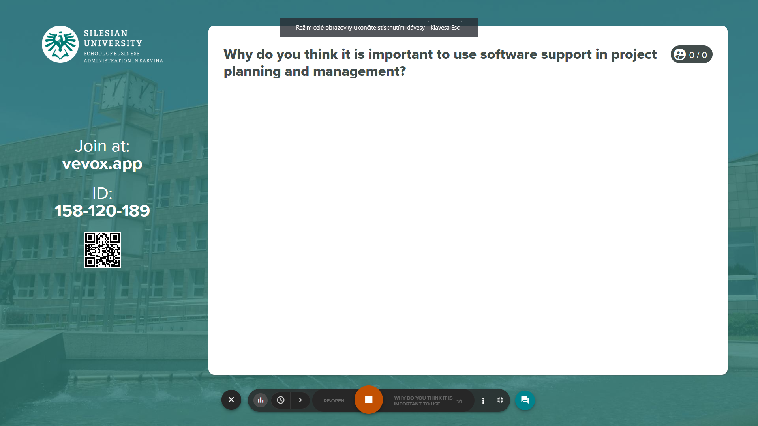
Why software solution for project management?
Vevox questions

Slide 10
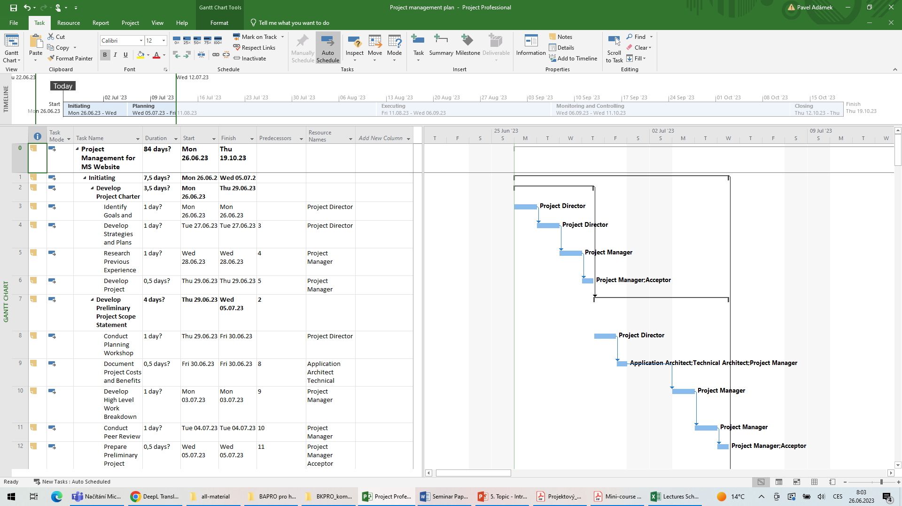
What does a project look like in MS Project?

Slide 11
How to create and manage your project schedule
After you complete the initial thinking about your project’s objectives, it’s time to put together a schedule.
When you start a new schedule, you add tasks and organize them efficiently so that the project end date occurs as soon as possible. So, the first step will be to create a new project (let’s start from the beginning).
You can start by creating a new project from a template – many of these templates have been created by industry experts to help you get started.

Slide 12
How to create and manage your project schedule
The user interface of MS Project is given by tabs, which are designed to be used in relation to the different phases of the project lifecycle:
the Project tab for setting up the project,
the Task and Resource tabs for scheduling and tracking, respectively, and
the Report and View tabs are helpers when preparing project status reports or printouts.

Slide 13
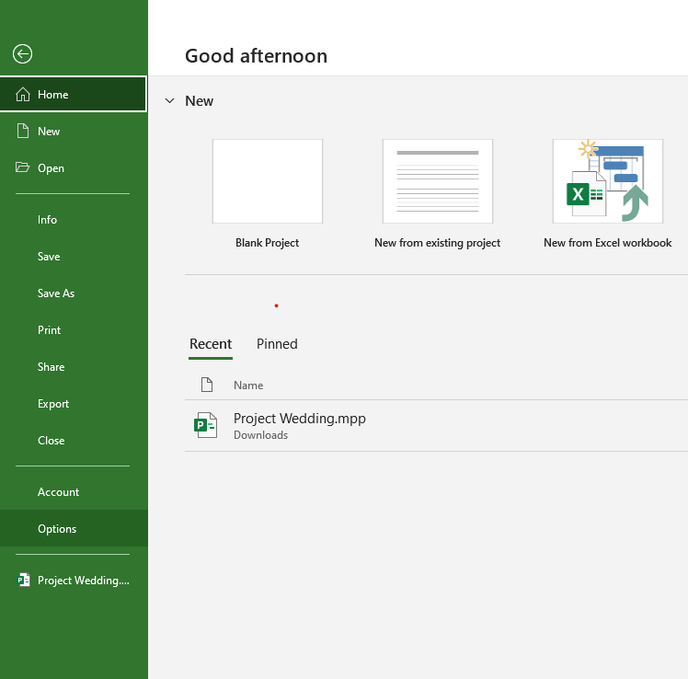
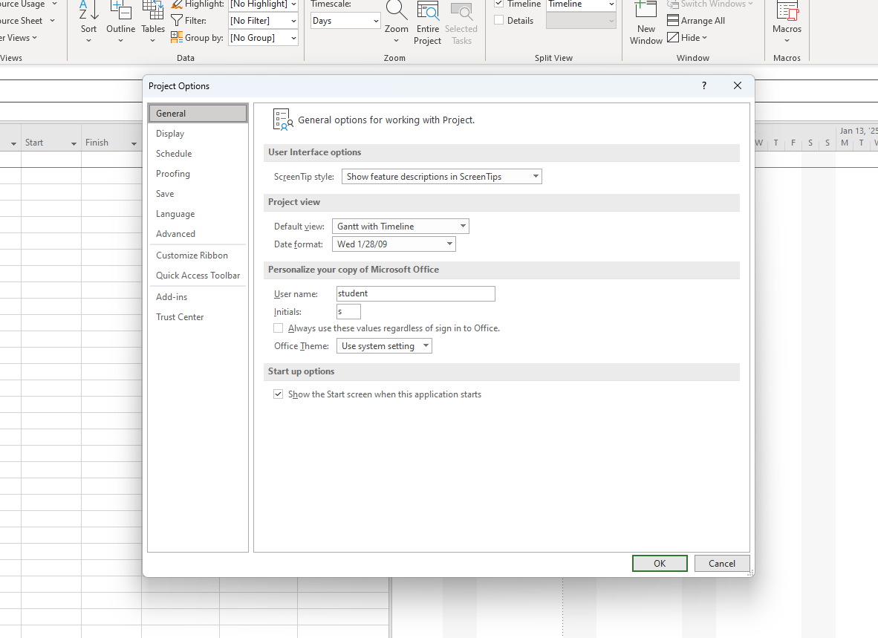
How to create and manage your project schedule
The File tab then acts as an access point to Backstage. In this interface, we work with the project file and change the application's behavior settings.
Specifically, we find here tools for saving the file to different formats, print control, means for securing with server solutions (SharePoint server, Project Server).
The options dialog allows you to change the generic properties of MS Project. It is possible to specify data calculation methods (e.g. conditions for critical path calculation or time unit conversions), modify data display (date, time), or change standard application settings (effort-driven function, scheduling mode selection), etc. MS Project UI.

Slide 14
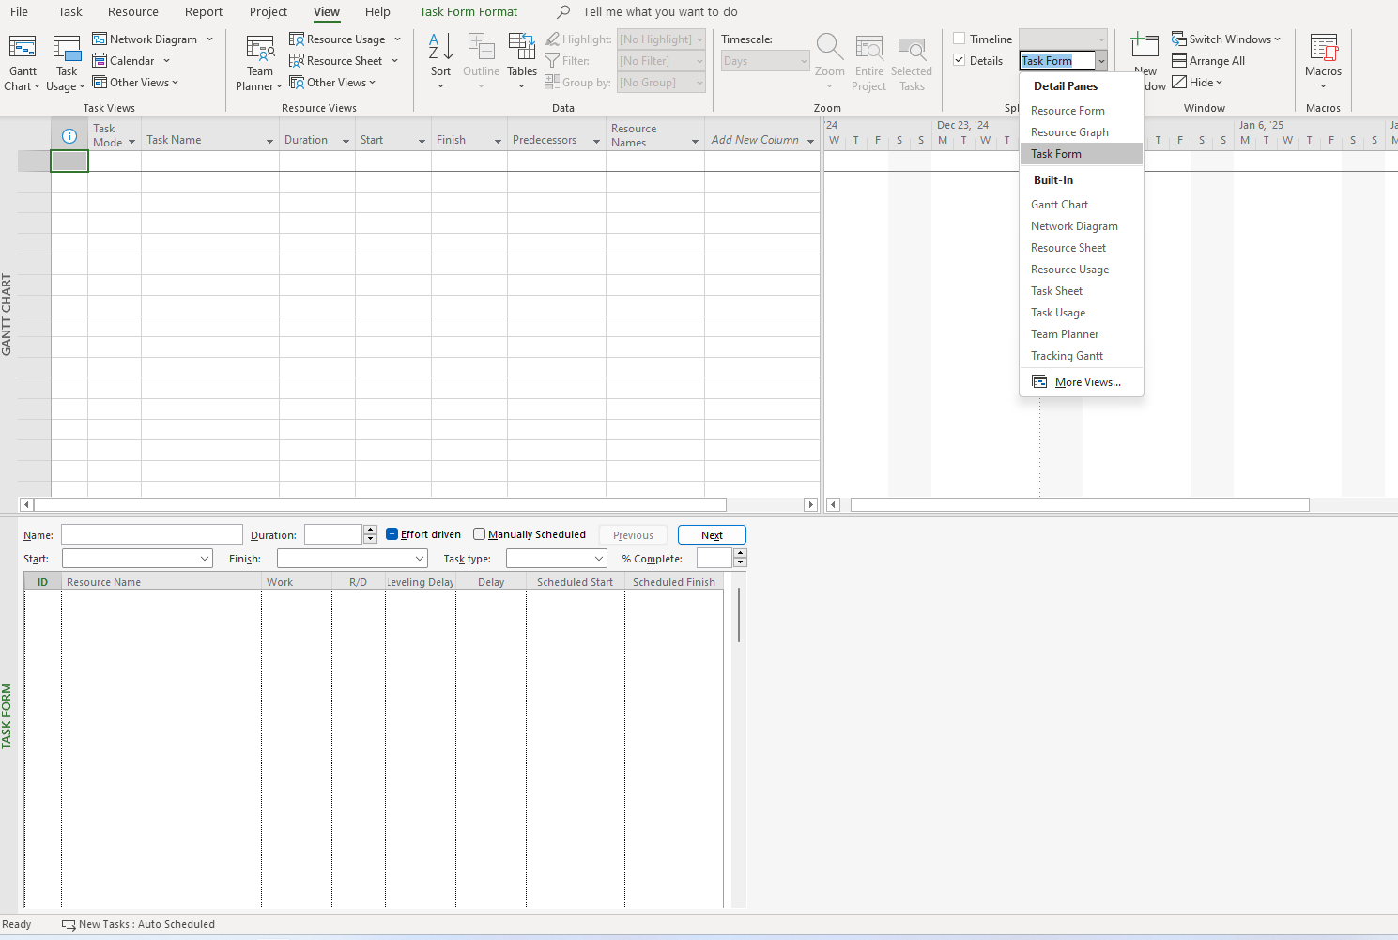
How to create and manage your project schedule
You can assign the lower part of the window to a data entry form in addition to a specific view.
To split the window, check the Details box on the View tab or on the Task and Source tabs in the Properties group, where you select Split View.
In the application, you can open multiple project files at once, or you can open a single project in multiple windows with different views. To switch between file windows, that is, to select different document windows to work with, use the Views tab in the Window group.

Slide 15
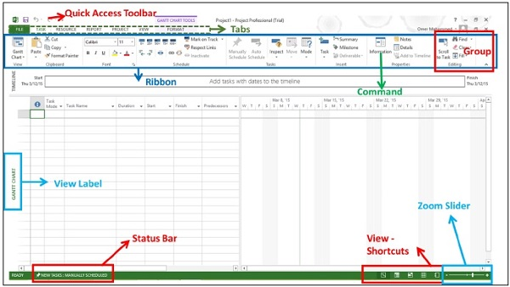
Establishing a project MS Project UI
The screen should have the MS Project interface displayed. The major part of this interface are:
Quick Access Toolbar − A customizable area where you can add the frequently used commands.
Tabs on the Ribbon, Groups − the ribbon having multiple tabs, each holding a toolbar bearing buttons and occasionally other controls. Toolbar controls have heterogeneous sizes and are classified in visually distinguishable Groups.
Commands − The specific features you use to perform actions in Project. Each tab contains several commands. If you point at a command you will see a description in a tooltip.
View Label − This appears along the left edge of the active view. Project includes lots of views like Gantt Chart view, Network Diagram view, Task Usage view, etc.
View Shortcuts − This lets you switch between frequently used views in Project.
Zoom Slider − Simply zooms the active view in or out.
Status bar − Displays details like the scheduling mode of new tasks (manual or automatic) and details of filter applied to the active view.

Slide 16
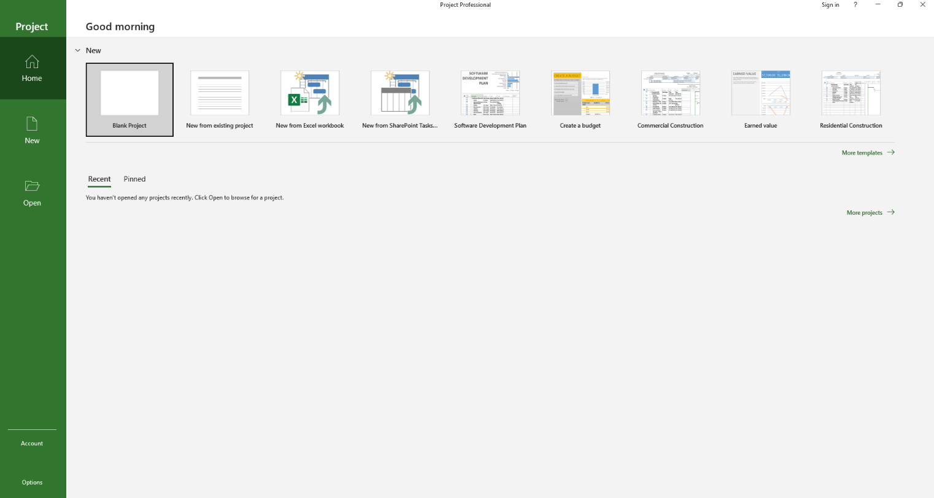
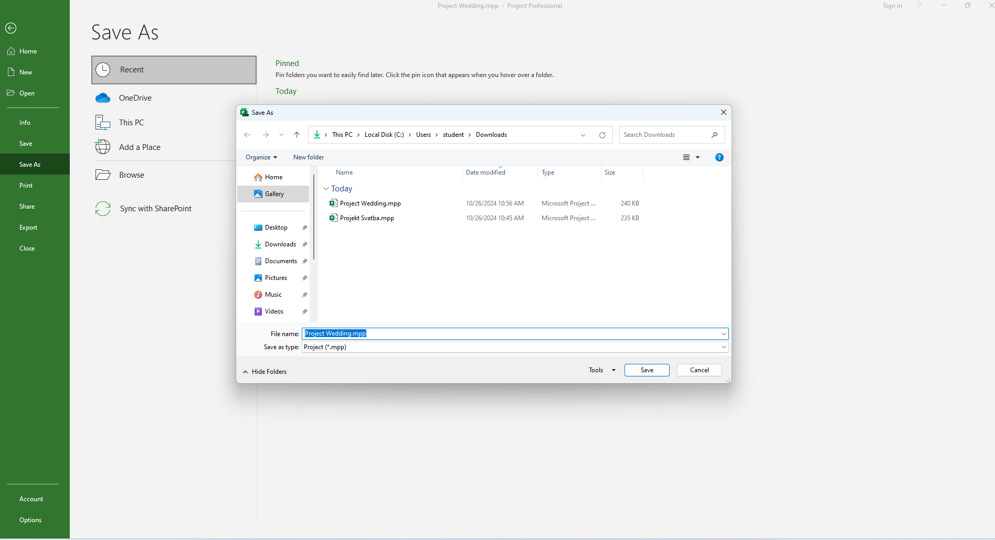
Establishing a project MS Project - example
Project Wedding
Files with tasks saved in Interactive Syllabus and IS – materials for study – lectures
Open MS Project – Blank Project
File – save as – save under Project Wedding
With type .mpp

Slide 17
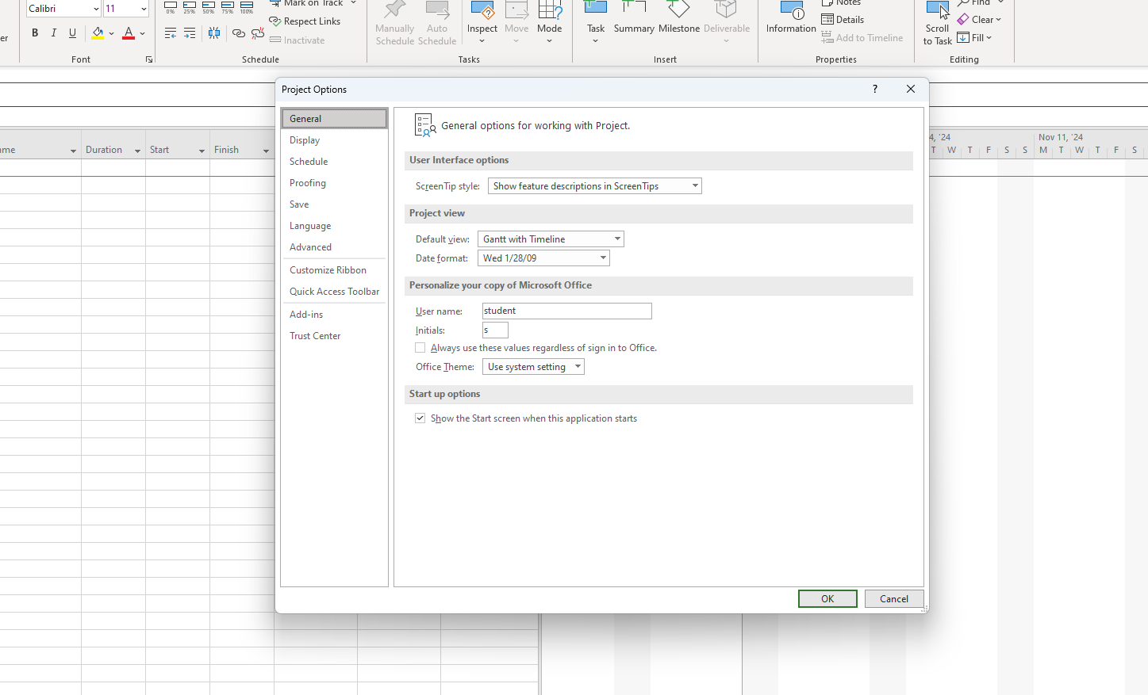
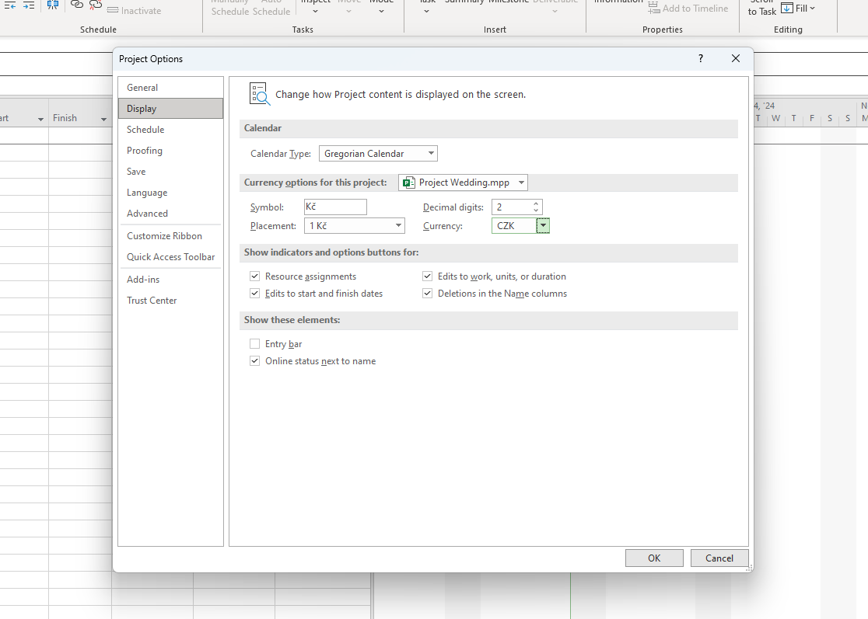
Establishing a project MS Project - example
Important!
MS Project has similar functions to MS Ecel – you can add/delete/copy rows and colums
We need to set up the project’s general settings:
Go to:
File – Options – General – Set up Date Format
Set up Display settings:
Go to:
File – Options – Display – Set up currency section for this project and currency

Slide 18
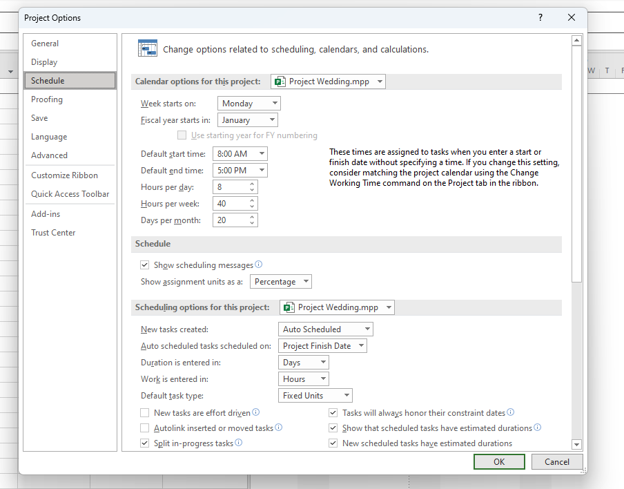
Establishing a project MS Project - example
We need to set up the project’s schedule settings:
Go to:
File – Options – Schedule
Calendar options for this project
Check week “starts on” and “Fiscal year
Starts in”
Set “Default start/end time
Set “Hours per day/week and “Days per
Month”
Scheduling options for this project
New tasks created – MUST BE AUTO
SCHEDULED
If done, OK

Slide 19
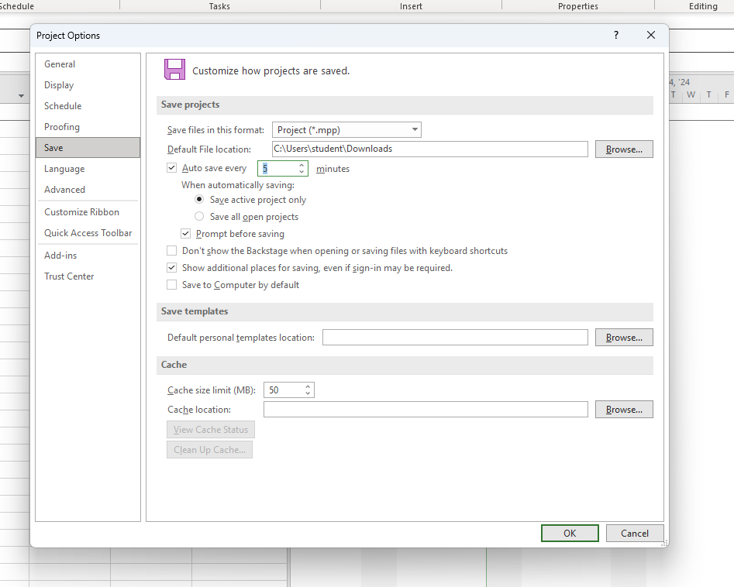
Establishing a project MS Project - example
We need to set up the project’s options “SAVE”:
Go to:
File – Options – Save
Save files in this format: *.mpp
Default file location:
Auto save every: 5mins or as you wish
If done, OK

Slide 20
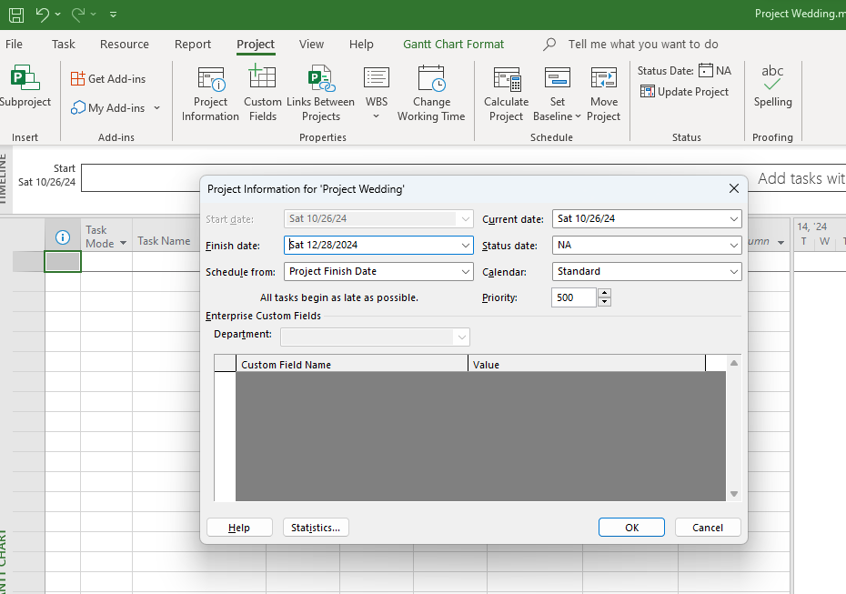
Establishing a project MS Project - example
We need to set up the project’s Information about project:
Go to:
Project – Project information
Project can be scheduled from either:
Project start date/
Project finish date
Set Start date or Finish date according to choosing previous “Schedule from”
Our project is going to start from “Project finish date”
Our finish date will be on the 28/12/2024
If done, OK

Slide 21
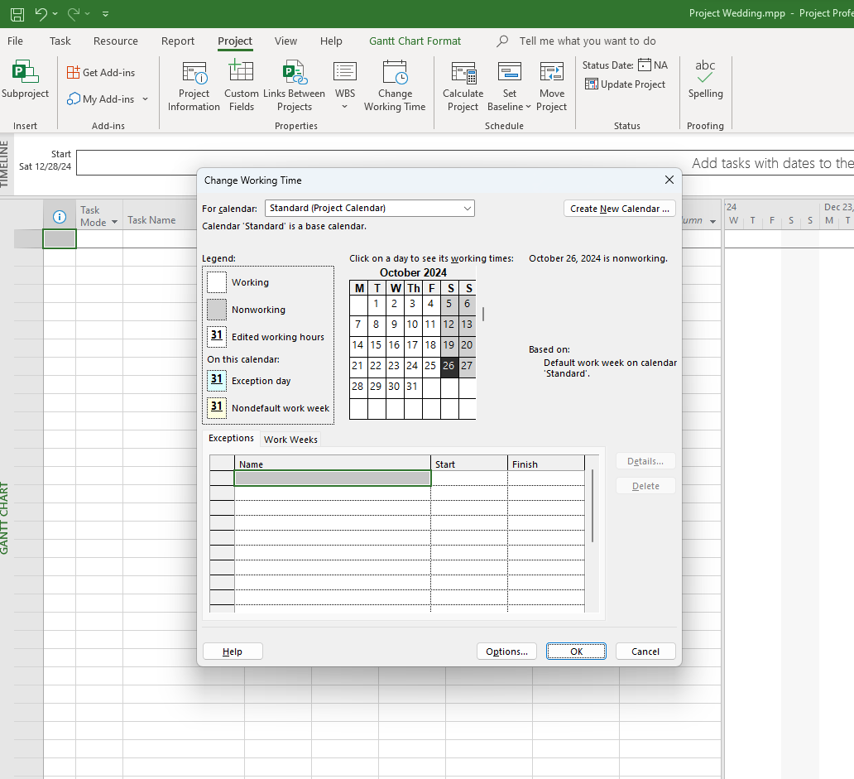
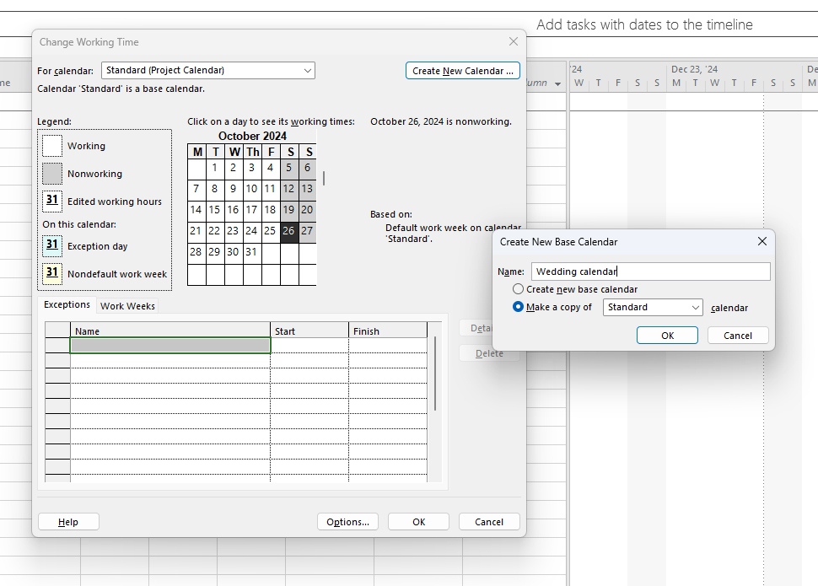
Establishing a project MS Project - example
We need to set up the project’s Calendar:
Go to:
Project – Change Working Time
We can see window with settings of New Calendar/Exceptions/Work Weeks
Press Create New Calendar
Set your new calendar name: Wedding calendar
Choose “make a copy of Standard calendar”
In “For calendar” will automatically appear your newly created calendar.
If done, OK

Slide 22
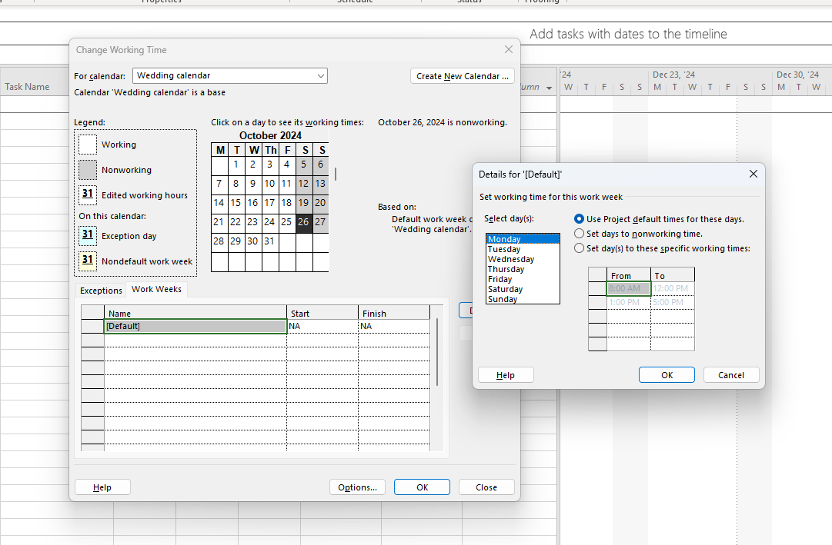
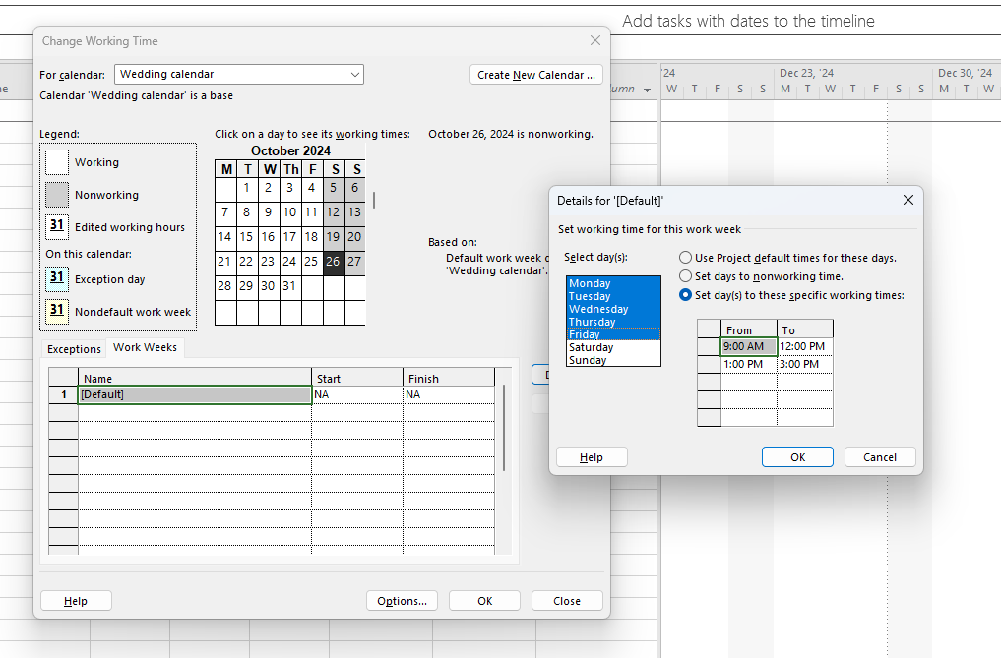
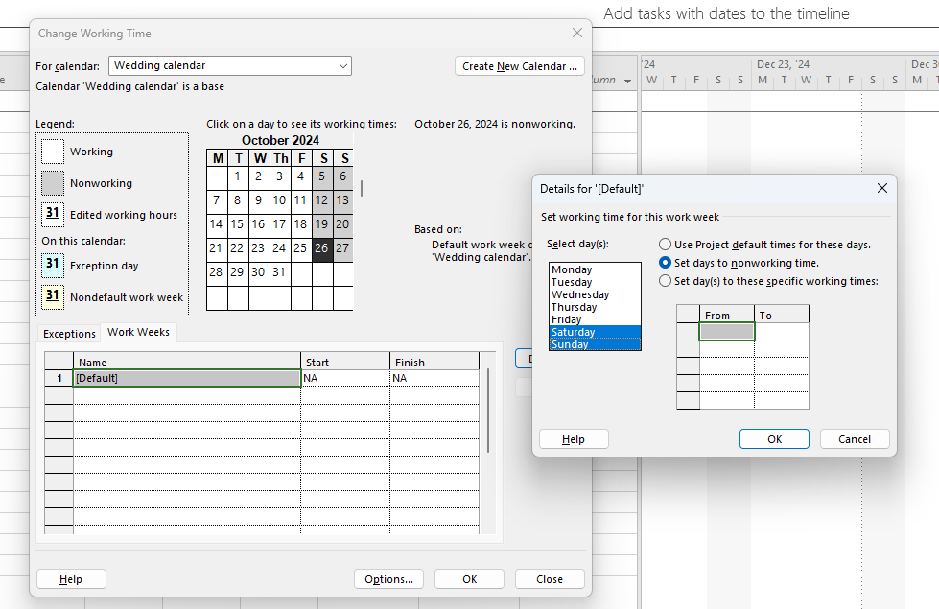
Establishing a project MS Project - example
We need to set up the your own working hours:
Go to:
We are still in Project – Change Working Time
Check if in “For calendar” is your own calendar Wedding calendar
Press “Work Weeks”
Small window will pop up
In here you can adjust the working hours for
each day of the week
As you can see the working hours are as we
set at the beginning in the “Options”.
We will set the working hours from 9am to 12pm and from 1pm to 3pm from Monday to Friday.
Highlight the days and then set days to these specific working hours
Then do the same for the weekend days and set them as nonworking days.
If done, OK

Slide 23
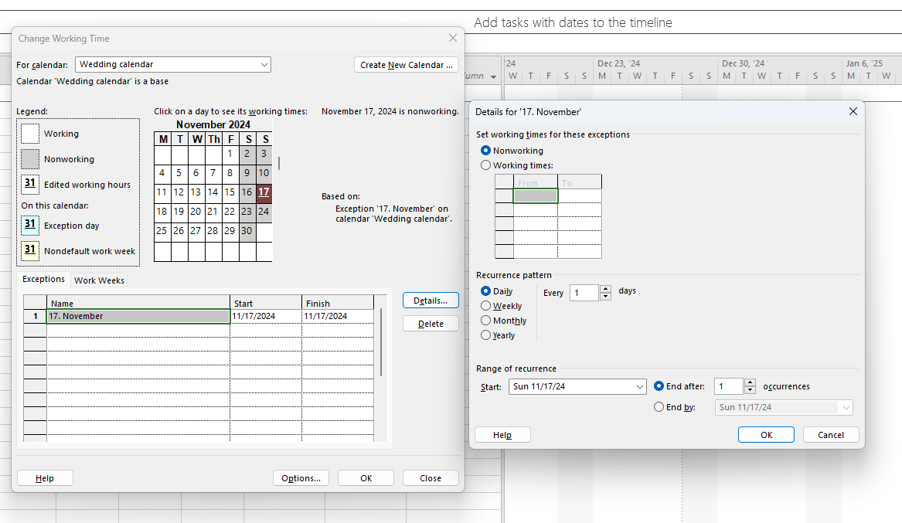
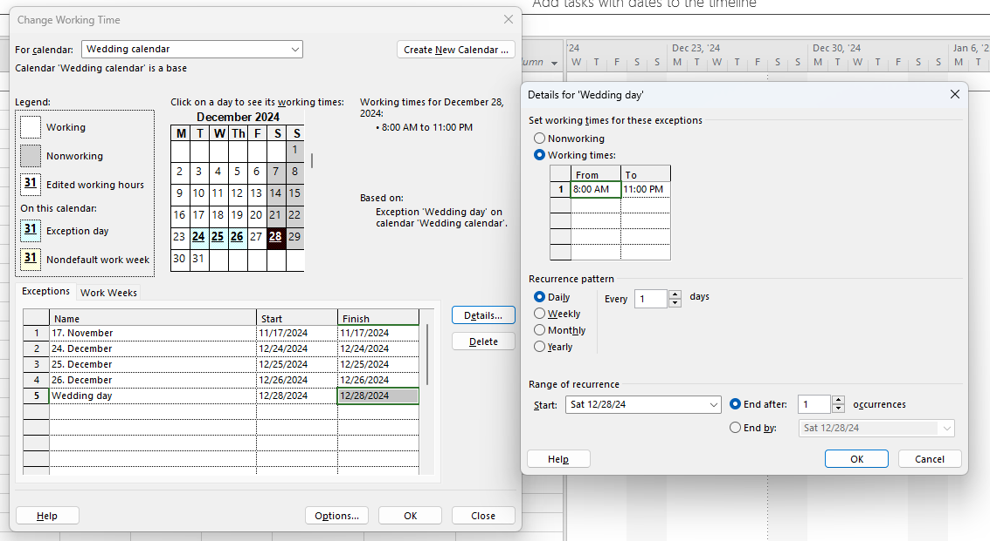
Establishing a project MS Project - example
We need to set up the your own Exceptions:
Go to:
We are still in Project – Change Working Time
Press “Exceptions”
In here you can add exceptions to your calendar
MS project doesn’t know our bank holidays or other days we will not work.
Write a name for your exception and choose start and end date, then press Details.
Small window will pop up.
Here we can set for the specific day, if it is working or nonworking. If working we put working times and we can set how often this will occur down in Recurrence pattern and Range of recurrence.
We will do 5 exceptions:
17. November – nonworking days
24. December, 25. December, and 26. December – working days from 9am to 12pm
Wedding day – working day from 8am to 11pm
You can see the days with exceptions are of different color.
If done, OK

Slide 24
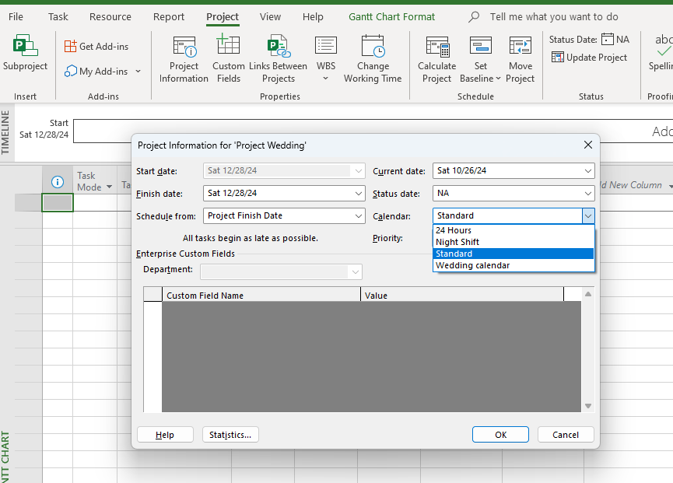
Establishing a project MS Project - example
We need to set up your own Wedding calendar for your project:
Go to Tab:
Project – Project Information
In Calendar change your calendar from Standard to Wedding calendar
If done, OK

Slide 25
Establishing a project MS Project - example
In this step you write down all your tasks of your project
In column task name you list all your tasks of your project one by one
If later you find you need to add more, you just enter new row and write in new task

Slide 26
Establishing a project MS Project - example
You can see that in previous slide the duration is set to one day.
The next step is to change the duration of each of your task.
You can see in the Gantt chart how the blue lines are changing their length according the duration.
You need to check that the Task mode is auto scheduled all the time

Slide 27
Establishing a project MS Project - example
Next step is to make connections between your tasks
There are 3 ways how you can make connections
Highlight two tasks you need to connect and press “chain icon”.
You can see that connection formed.

Slide 28
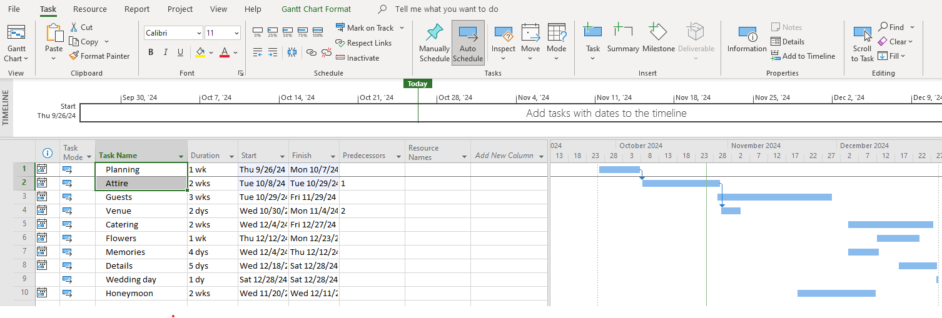
Establishing a project MS Project - example
2. Way is to write in the Predecessors the number ID of the previous task
ID number of each task is on the very left side of the table.

Slide 29
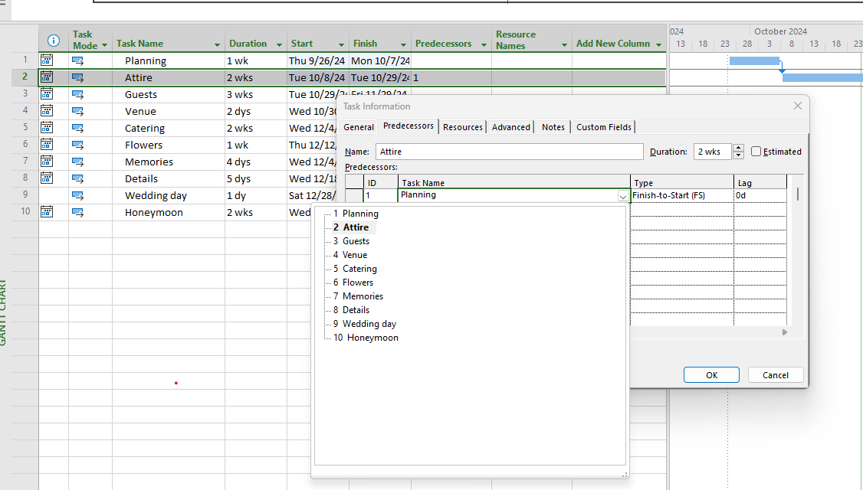
Establishing a project MS Project - example
3. Way is to double click on the task you need to connect.
New window will appear and on the tab Predecessors you click on the Task name and choose the task that needs to be connected.
Then, OK

Slide 30
Establishing a project MS Project - example
Now we need to establish Task dependency between the tasks
You double click on the arrow between two tasks
Small window will pop up and you choose the type of dependency. The are four and in the next slide I will explain them.
You can also choose this dependency when you double click on the Task name and choose tab Predecessors and in Type choose the right dependency.

Slide 31
Establishing a project MS Project - example
Four types of Task dependency between the tasks
Finish to Start (FS) – Task 2 will start after Task 1 is finished
Finish to Finish (FF) – Task 1 and Task 2 will finish at the same time, they do not necessarily need to have same start time
Start to Start (SS) – Task 1 and Task 2 start at the same time, they do not need to finish at the same time
Start to Finish (SF) – Task 1 will start after Task 2 is finished

Slide 32
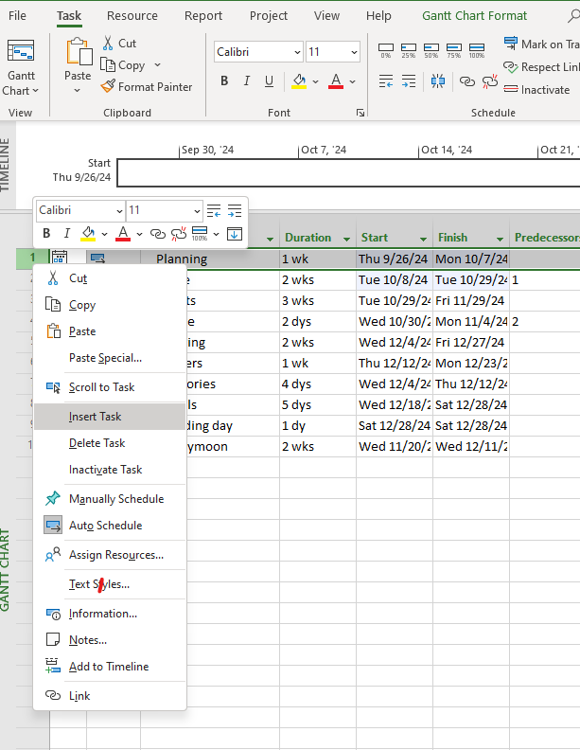
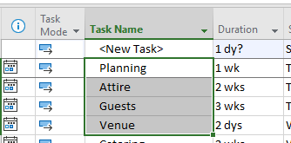
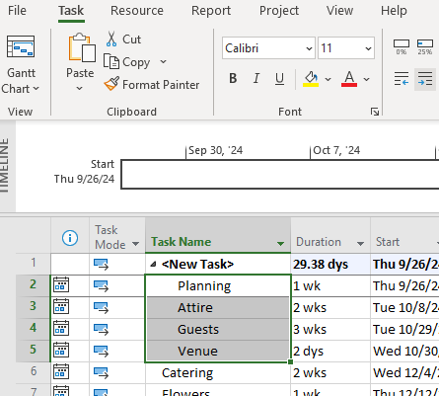
Establishing a project MS Project - example
Now we can set indentation of tasks.
You can first divide your task into stages or phases by adding rows right above the section you need to divide.
It will appear as New task, so you rewrite the name
Then you put in the block all the tasks that belongs under the first section and your press following icon
You can see that the first task is in bold and the rest tasks have moved little to the right.

Slide 33
Establishing a project MS Project - example
This is how it looks like with dividing into sections with indentation.

Slide 34
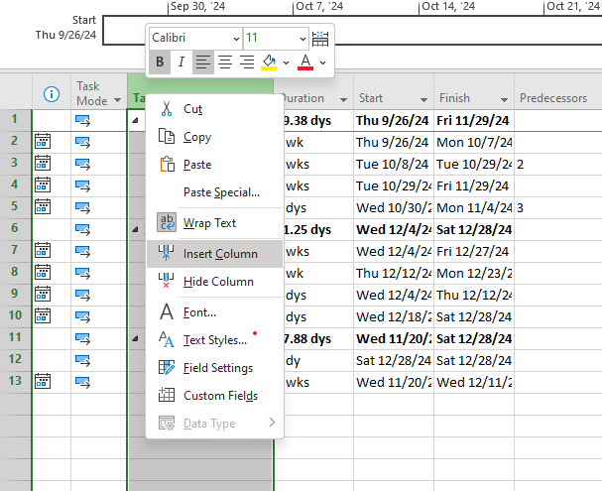
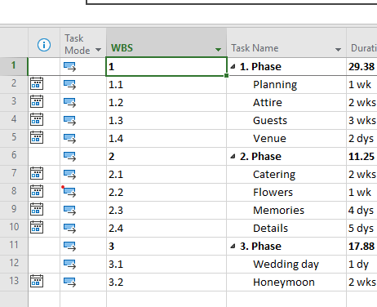
Establishing a project MS Project - example
You can also create numbering of your tasks.
Right click on the Task name column and choose Insert column
Then choose name WBS
The numbering will be created

Slide 35
Establishing a project MS Project - example
Another way how to number your tasks is to enter it in front of each task
Go to Gantt Chart Format – click Outline number
The numbers will be created in front of the name of the task

Slide 36
Establishing a project MS Project - example
You can watch following videos on how to set up MS Project:
https://www.youtube.com/watch?v=_uaFyYIwAyU&list=PLzj7TwUeMQ3g_ABHdUU7RoGJJm-YFr4_Y&index=1
There are 18 parts to this topic.

Slide 37
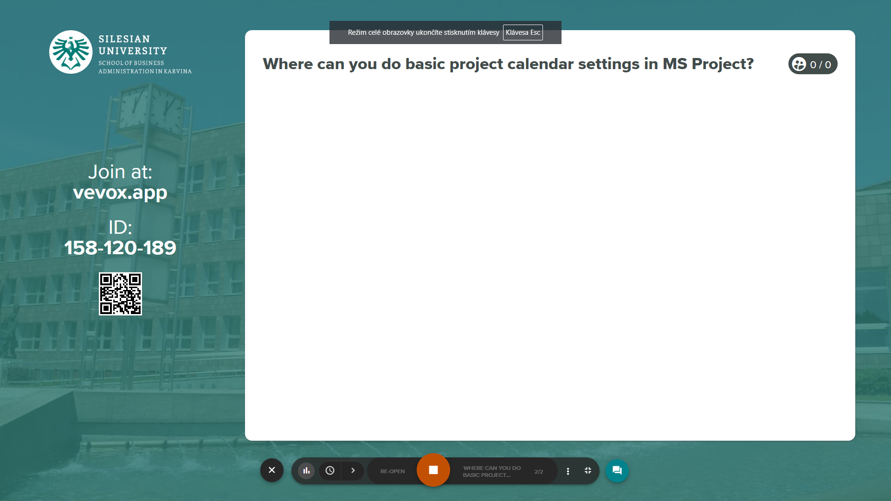
MS Project
Vevox questions

Slide 38
RECAP
MS Project allows you to create a new project, use available templates.
When setting up a project in MS Project, it is necessary to create a basic project calendar, define the working time of the project, its start.
Each work resource can have its own calendar.
In the calendar it is possible to set non-working hours, holidays and other exceptions.

