Slide 1
Project Costs and Project Budget
Approaches to estimating project budget
Project costs, cost determination method
Risk budget, tolerance budget, change budget
Project Management
Lucie Reczzkova
B304
Reczkova@opf.slu.cz
Office hours: Wednesday 10-11.30

Slide 2
Contents
PART
Project budgeting, project costs, cost determination method
2. PART
Different forms of budget and their importance (cost, change, tolerance)

Slide 3
Learning objectives
After studying this topic, you should be able to:
To recognise different types of budgets and cost structures.
Gain an overview of project cost estimating Methods.
Use the knowledge to build a complete project budget and its possible methods of creation.

Slide 4
Key readings
You can find support in the following sources:
Book – Chatfield and Johnson (2016). MS Project 2016 Step by Step (Part 5 Set up resource, Part 6 Assign resources to tasks)
Book – PMBOK Guide . Chapter 7 (p. 231 Project Cost Management)

Slide 5
The budget for a project is the combined costs of all activities, tasks, and milestones that the project must fulfil.
In short: it’s the total amount of money you’ll need to finish the project that should be approved by all the stakeholders involved.
It helps set expenditure expectations and is critical in getting project approval, ensuring funds are ready at the right time, and measuring performance.
It’s a dynamic document, continuously monitored, reviewed, and updated throughout the project.
PART 1
Project Budgeting
„Every project, no matter how big or small, involves costs.“

Slide 6
Approaches to estimating a project budget
Cost planning and project budgeting is part of the planning phase and builds on project scheduling and resource planning.
The project budget consists of a cost side and a revenue side; it can be defined as the total amount of funds allocated to a project, usually divided into expenditure categories and phased over time.
Part of budget planning is therefore cost planning as well as revenue planning (or other sources of cost coverage).
For profitable projects, revenues exceed costs. Revenue > Costs
For non-profit projects, we should be able to cover our costs. Revenue = Costs
We can start with cost planning, so we compile a cost budget and then look for sources of coverage.

Slide 7
Approaches to estimating a project budget
Project costs
Costs can be broken down from different perspectives. To compile a budget plan, it is appropriate to first determine the direct costs, which are directly related to the implementation of the project. Examples of direct costs are shown in tab. 1.
Tab. 1: Direct costs
Type of direct cost | Example
personnel costs for project staff | wages, public health insurance and social security contributions, pension contributions
material costs | sand, cement, papers, toners
purchase of services | rental of training facilities, translations and interpreting
travel project staff | fares, meals, air tickets, accommodation
acquisition, rental of tangible assets | computers, cars, cranes, furniture
acquisition, rental of intangible assets | purchase of licenses, software, patents
subcontracting costs | construction of a storage hall by a construction company

Slide 8
Approaches to estimating a project budget
Project costs
Indirect Costs are those that cannot be clearly assigned to a specific project; these are the common costs of the whole organization.
The organization's management determines how much of the organization's total indirect costs will be allocated to individual projects. Examples of indirect costs are shown in tab. 2.
Tab 2: Indirect costs
Type of indirect cost | Example
indirect personnel costs | part of the personnel costs of the organization's management
operation of buildings | part of the cost of heating, energy consumption, cleaning, repairs of buildings used by the organization
costs for the organization's support departments | part of the costs of marketing, accounting organization
taxes and fees | part of the taxes and fees paid by the organization

Slide 9
Approaches to estimating a project budget
2. Cost determination methods
In practice, we may encounter many approaches and methods of cost valuation, from more or less "expert" estimates to complex mathematical procedures. The choice of method always depends on the type of project, its scope and degree of complexity.
The main input for determining the costs of the project is a list of activities and an estimate of their duration, prepared during time planning. We know the total duration of the activity from the overview of activities, we must specify it in more detail when planning costs.
E.g. we count 30 hours in the time planning for dredging the foundations for the house. When creating a budget, we must divide this time into individual components. We will have to estimate:
• number of hours of excavator work,
• number of hours of dredger's work,
• mileage of the car transporting the soil,
• number of working hours of a truck driver,
• number of working hours of auxiliary workers.
The quality of the cost estimate depends on both the quality of the time estimate and the quality of the unit cost estimate. We get the cost of dredging the foundations for the house by multiplying the number of hours the excavator works by the cost per hour of work. The cost per hour of excavator work may include a proportion of the rent or depreciation, part of the cost of repairs, fuel, etc. When determining the budget of project costs, we can use the processed cost calculations of the organization, which express the cost per unit of output (e.g. for an hour of excavator work, for an hour of teaching a lecturer).

Slide 10
Approaches to estimating a project budget
Cost determination methods
E.g. we count 30 hours in the time planning for dredging the foundations for the house. When creating a budget, we must divide this time into individual components. We will have to estimate:
• number of hours of excavator work,
• number of hours of dredger's work,
• mileage of the car transporting the soil,
• number of working hours of a truck driver,
• number of working hours of other workers.
The quality of the cost estimate depends on both the quality of the time estimate and the quality of the unit cost estimate.
We get the cost of dredging the foundations for the house by multiplying the number of hours the excavator works by the cost per hour of work. The cost per hour of excavator work may include a proportion of the rent or depreciation, part of the cost of repairs, fuel, etc. When determining the budget of project costs, we can use the processed cost calculations of the organization, which express the cost per unit of output (e.g. for an hour of excavator work, for an hour of teaching a lecturer).

Slide 11
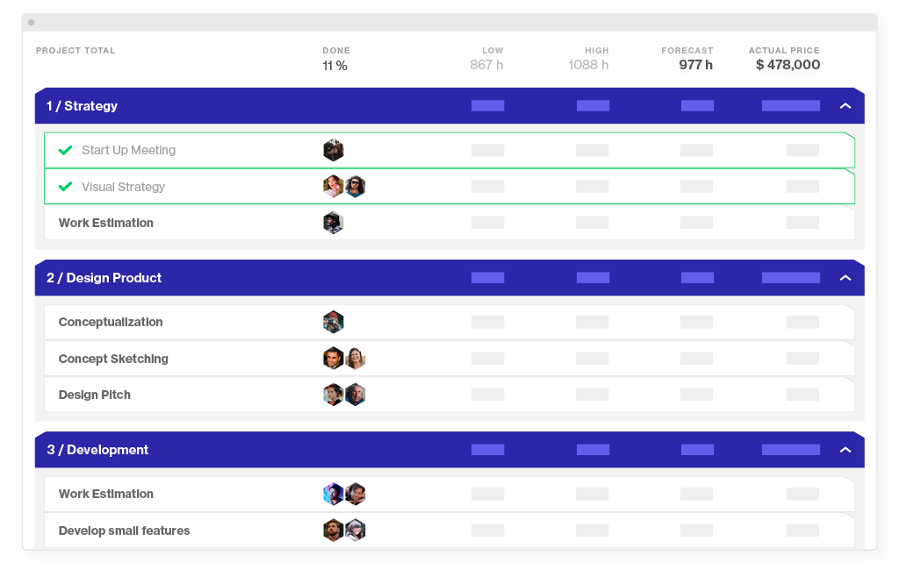
Approaches to estimating a project budget
Bottom-up estimation
This process starts with zero total costs and adds the cost for each item in the hierarchical structure of work (WBS). The result is the sum of costs for the entire project.
By calculating the cost of each individual WBS item (which we should have cost-calculated), we create a very accurate cost estimate.
A side effect is also high-quality input information for deciding whether it is more advantageous for us to provide some outputs internally or externally.
The downside of the bottom-up approach is that it takes plenty of time to go down to the smallest detail of the project.
The bottom-up method is very time consuming, so it is also more expensive, but by using it we reduce the risk of incorrect estimation of costs.
71% of tasks are created after the project’s start date. In reality, project requirements change even before the project starts.

Slide 12
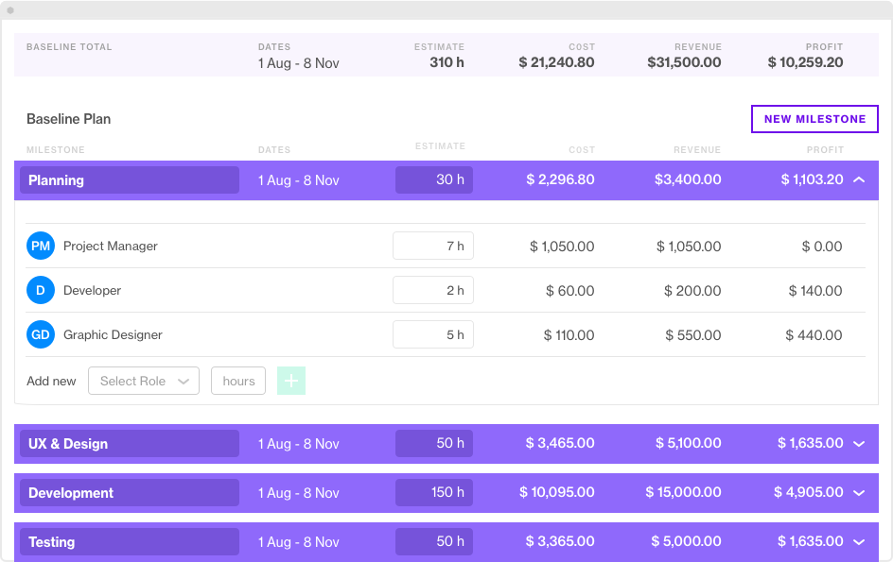
Approaches to estimating a project budget
Top-down estimation
Top-down estimation is opposite to the bottom-up approach
It starts with the project budget total and involves breaking it down into smaller chunks.
Top-down estimation is typically used when you have a fixed price project with the budget set in stone.
The main disadvantage of this approach is loose estimations at the project initiation phase.
It is difficult to accurately predict the budget before you understand the scope of work and have a project plan.

Slide 13
Approaches to estimating a project budget
Analogous estimation
This process is based on information about past activities, considers the actual costs of previous projects and applies them to the current project. In doing so, it considers the scope and size of the current project and other variables.
When estimating costs, historical information of the organization is widely used, e.g. final budgets of previous projects that have implemented a similar type of costs,
public or commercial databases on prices, e.g. publicly accessible databases of average wages of individual professions or price lists of construction works.
When estimating the costs that will be realized by purchasing from an external entity (e.g. the services of a project auditor), it is appropriate to carry out a price survey when sending the cost budget by sending a preliminary request to three potential suppliers.
This approach is not very time consuming but is less accurate.

Slide 14
Approaches to estimating a project budget
Expert estimates
In projects, we often encounter expert estimates, where the project manager or team members use costs and knowledge of the issue to estimate costs. This option is most often used in cases where it is too time consuming or expensive to determine prices from verifiable sources.
Three-point estimation
Three-point estimation is one of the most sensible and pragmatic techniques as it takes into account a weighted average based on the best, worst, and most likely case budget scenarios and encourages you to think from multiple perspectives. Thus, you can figure out a realistic cost estimation.
The upside of the three-point estimation technique is that you can reduce the risk of going over budget.

Slide 15
Approaches to estimating a project budget
Parametric estimation
Parametric modelling uses a mathematical model based on known parameters, which may vary depending on the type of work performed. The parameter can be, for example, the cost per cubic meter, the cost per hour of work of the excavator, etc. There are two types of parametric estimation:
Regression analysis. It represents a statistical approach to estimating future values, which is based on past values.
Learning curve. It is based on the simple assumption that, with repeated work, workers learn to work faster and with less error rate, thus reducing the cost of producing another unit. This estimate is parametric because it is based on repetitive activities carried out in the project over and over again. Unit costs decrease as the workforce experience increases, as it reduces the time required to complete the activity.

Slide 16
Creating a financial reserve to cover unexpected or higher costs.
Cost risk is one of the most common project risks. It can arise from poor budget planning and inaccurate cost estimation.
Cost risk is the risk of exceeding the budget for a project or failing to deliver fair value to offset costs. In addition, you may face higher costs due to internal or external factors. But what exactly are those?
PART 3
Risk budget, tolerance budget, change budget

Slide 17
Risk budget
Internal risks occur due to inner actions within the business. For example, underestimating the amount of work needed for a project is likely to result in an extended schedule, which adds to the project’s cost.
The longer the project is, the more it costs. That also means this risk is related to not only schedule but also performance and quality.
External cost risks include risks that occur outside of the business. That may include changes to regulations or industry standards, or banking charges. Although you can’t control these issues, you can mitigate their impact on your project.
The biggest problem with these risks is that you can’t predict their likelihood of occurrence. Sub-groups of external cost risks include economic, political, and natural risks.

Slide 18
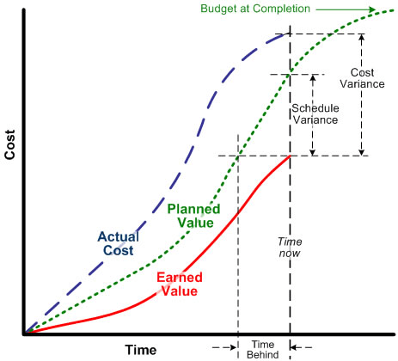
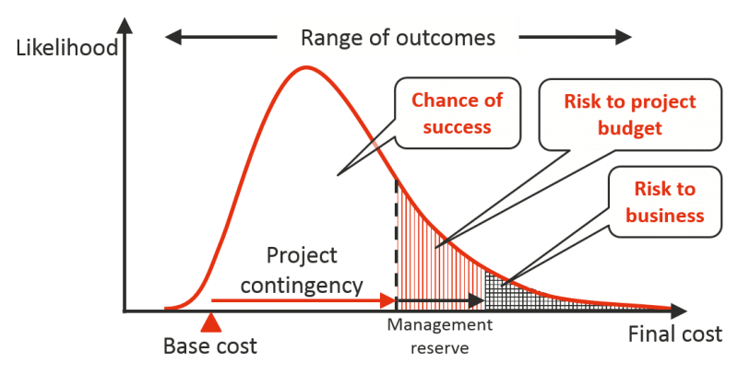
Risk budget -10 Effective tips to manage project cost risks
Pay attention to the areas where costs may increase (direct, indirect, overhead costs)
Include contingencies in your project budget
Create a thorough risk management plan
Start a project risk register to track risks
Determine the likelihood and impact of each risk
Outline the Work Breakdown Structure (WBS)
Measure performance with Earned Value Management (EVM)
Compare vendors and suppliers for the project
Avoid increasing the scope of the project
Use project management software to monitor costs

Slide 19
Tolerance Budget
A tolerance budget is a range within which you can spend without having to report back to your sponsor or ask for more money.
Tolerance budget is set at the beginning of you project but is particularly useful at the end of a project as you near the delivery date.
If you have a budget of £80,000 with a tolerance of 10 per cent and you complete the project for £85,000 you have still delivered within the parameters set by your sponsor. A budget tolerance of 10 per cent means you can deliver the project 10 per cent over cost without having to get special permission to do so.
Tolerance is a range, normally specified as a +/- percentage of total program (or stage) budget, which you can spend without needing to return to the steering group to ask for further funds.

Slide 20
Change budget
Change orders in projects are not the exception are very common during the whole project. How well you can adjust your budget to a scope change depends on how well you budgeted the project in the first place. This budget needs to be approved.
Four project management events that prompt a change to the budget.
RE-BASELINING IS REQUIRED - The project management approach changes during the work, there might be a significant enough impact on the performance measurement baseline to re-forecast the budget.
SCOPE CHANGES - A change to requirements is very likely to mean a change to the budget. The financial impact of the change should be considered as part of the change control process. By the time the change is approved, the project team should have a good idea of what the difference that will make to the forecasted costs. The easiest thing to do when a work package is removed from scope is to adjust the budget down based on the budget allocated to that work package.
CONTRACT CHANGES – Changes in contracts may evolve over the life of the project.

