Slide 1

Marketing
Marketing environment

Slide 2

What is marketing environment?
All what surrounds and influence company
Clever marketing managers are capable of reactions to company surroundings

Slide 3
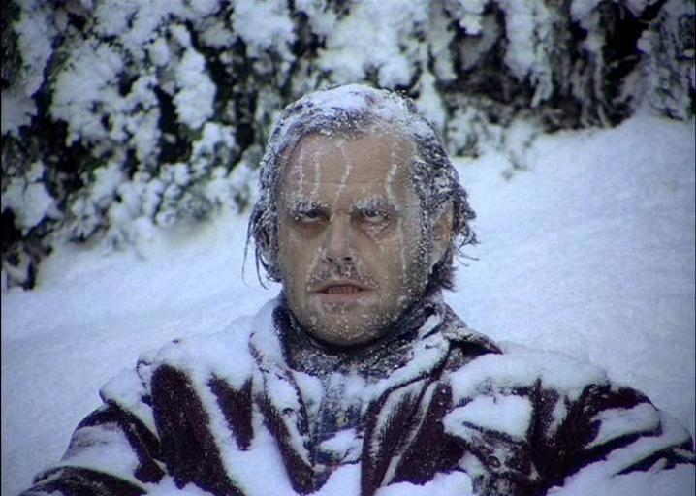
Reactivity
In the human body there is quiet lot of reaction mechanisms to its surroundings ready to produce action.
When temperature drops human blood circulates faster to warm important body parts.
The same applies to marketers. Companies which cannot react to its surroundings will face fundamental threats to its existence.

Slide 4


Slide 5


Slide 6
What is in company surroundings?
And what can influence its performance?

Slide 7
Environment onion
Company
Internal environment
Micro level
Macro level

Slide 8
Macro level
Political forces
Economic forces
Social and cultural forces
Technology
Laws and regulations
Environmental forces

Slide 9
Political forces
Represents connection between business and politics.
Monitoring and in some cases also influencing political landscape.
3 times higher chance for companies to survive during financial crisis with connection to political power.
Government influence heavily economic development by declaring programme priorities.
For some industries it is a crucial decision to be followed and evaluated at all time.

Slide 10

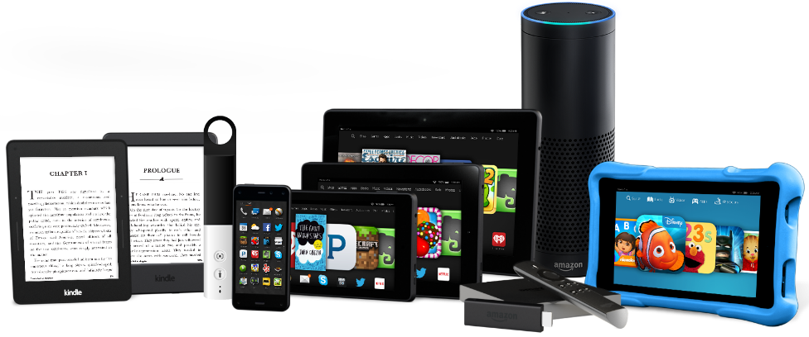
Economic forces
Economic growth
Income distribution
Purchasing power
Industry data
Employment rate
Taxes
Inflation rate
Currency rates changes
Notes:
Crisis: Food nebo non-food?

Slide 11

Social and cultural forces
Higher life expectancy
Money-rich Time-poor families
Faster return after maternity leave
Higher awarness about environmental challanges
Homogenisation of needs on global level
Higher divorce rate
Singles
Postponing marriage and babies
Smaller families

Slide 12


Traditional family setup collapse

Slide 13

Technology
Digitalisation
Robotisation
Sharing economy
Social networks
New media
Personal productivity tools
Cloud computing
Artificial inteligence
Virtual reality
Augmented reality

Slide 14
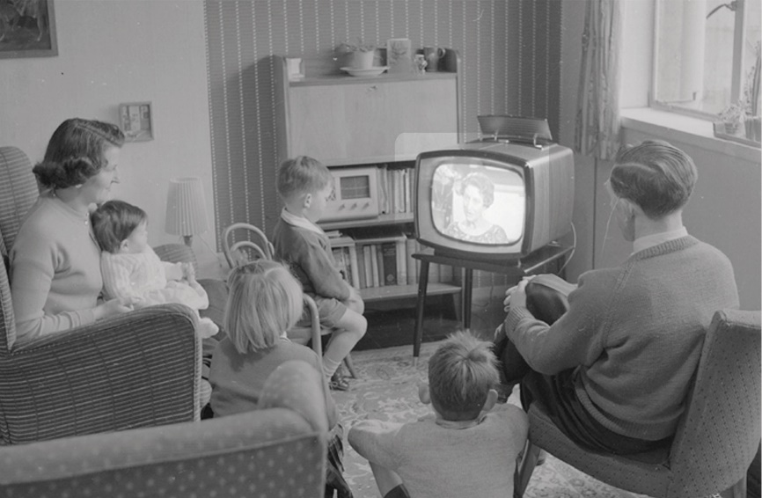

Information consumption settings

Slide 15
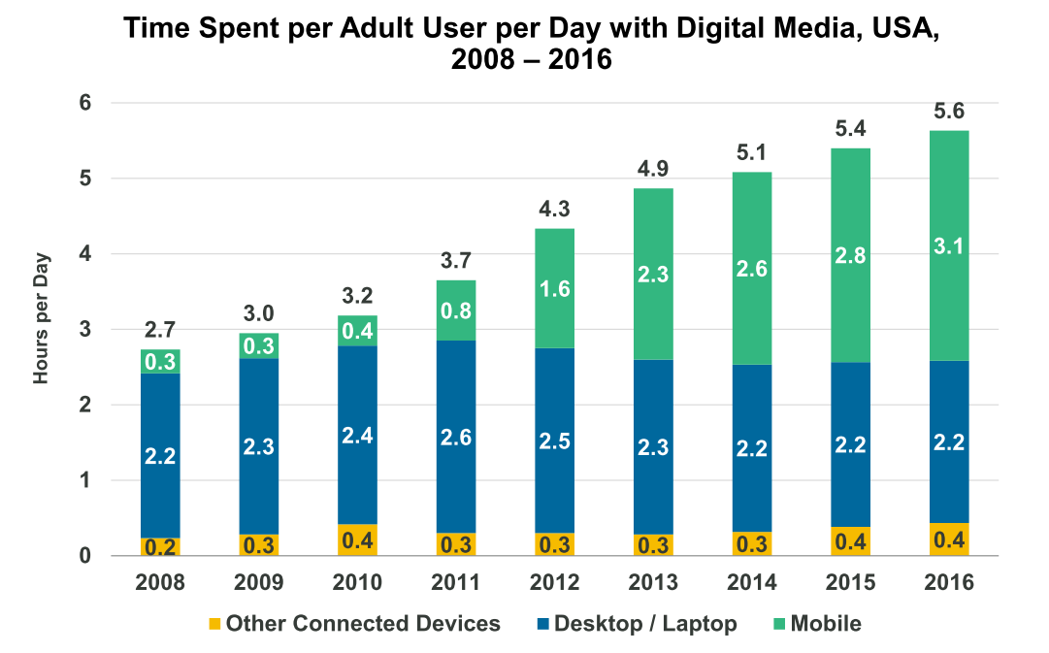

Slide 16



















Uber, Airbnb
Facebook, Instagram
WhatsApp, Viber
Youtube, Netflix
Booking, Kiwi
Evernote, Pocket
Dropbox, Google Drive
Spotify, Soundcloud
Khan Academy, TED
How these brands disrupted their industries?

Slide 17
Laws and regulations
Country specific:
  Zákon č. 455/1991 Sb. o živnostenském podnikání
  Obchodní zákoník č. 513/1991 Sb.
  Zákon o ochraně spotřebitele č. 634/1992 Sb.
  Zákon o účetnictví č. 563/1991 Sb.
  Zákon o daních z příjmů č. 586/1992 Sb.
  Zákon o DPH č. 235/2004 Sb.
  Daňový řád č. 280/2009 Sb.
EU Legislation
GDPR

Slide 18
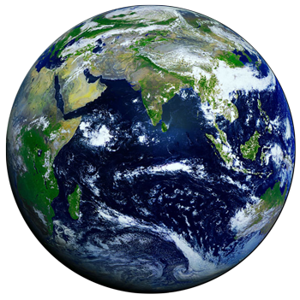
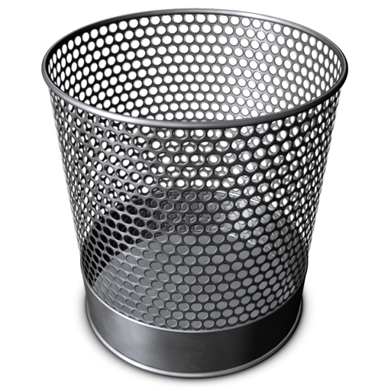
Environmental challenges
Climate change
Pollution
Scarce resources
Recycling
Animal testing
Clean water
Plastics
Notes:
Reduce – Reuse – Recykle

Slide 19
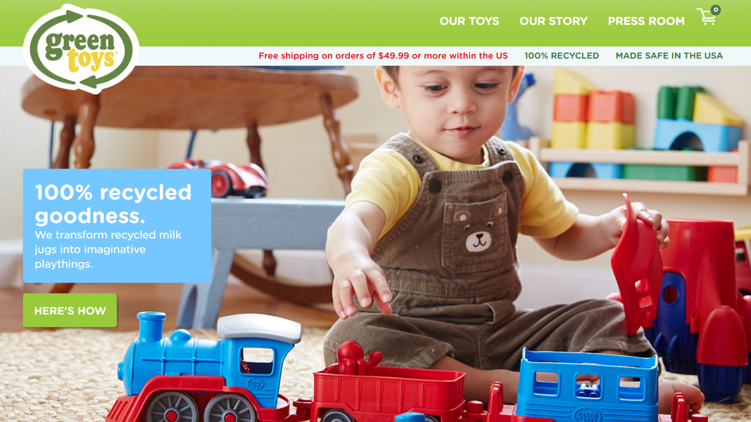
Notes:
Greentoys.com

Slide 20
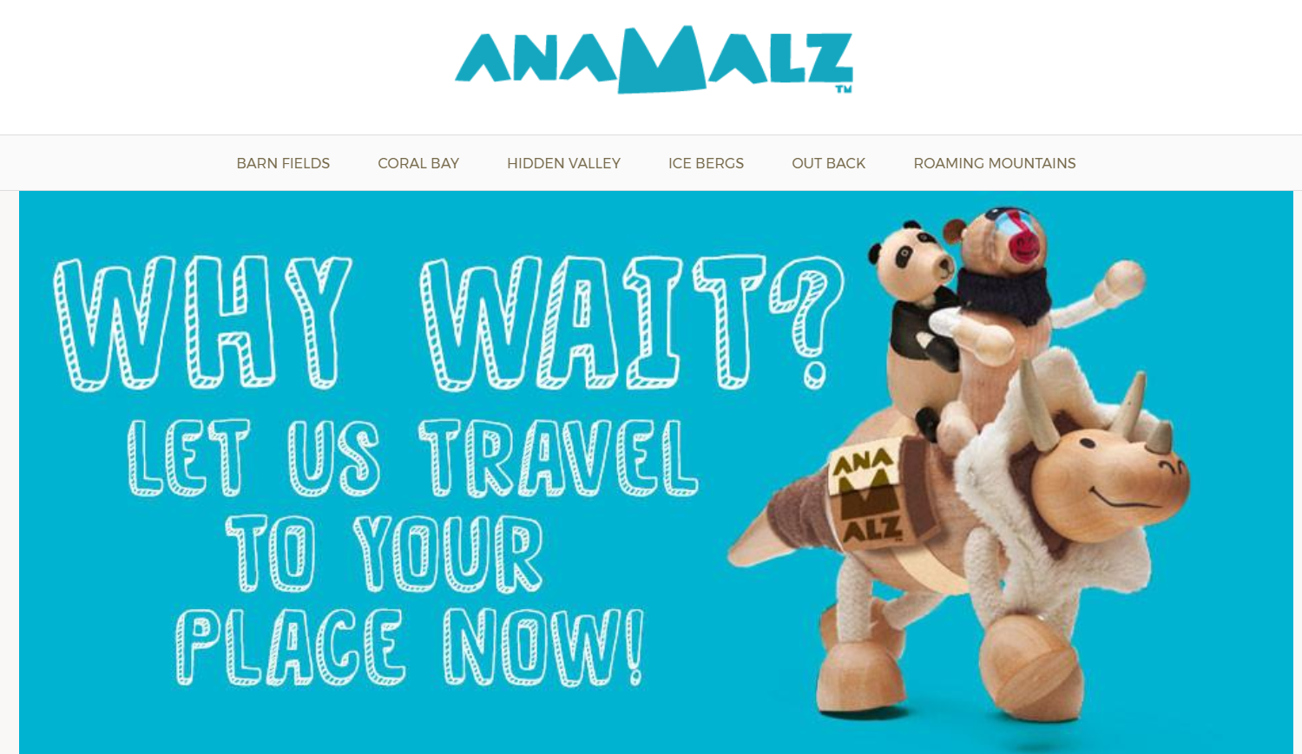
Notes:
Anamalz.com

Slide 21
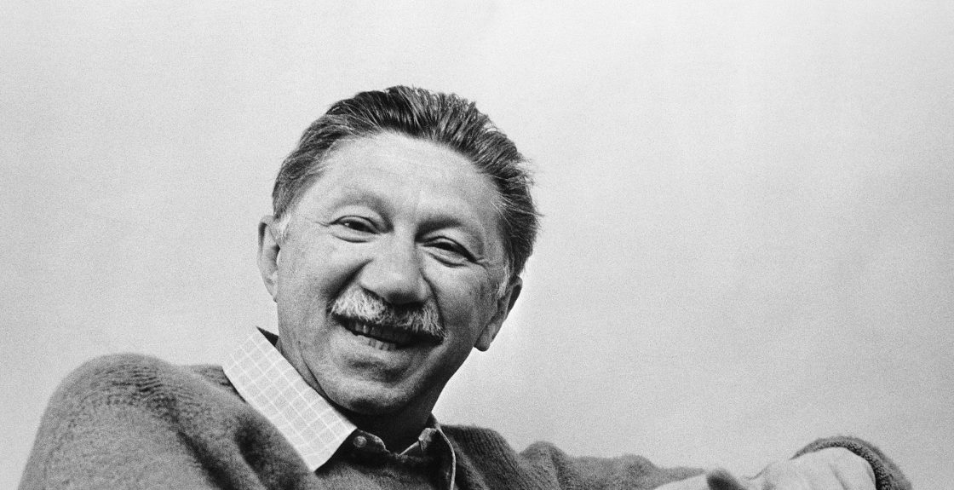
Notes:
Maslow

Slide 22
Micro level
Customers
Competition
Collaborators

Slide 23
Micro level - Customers
Customer behaviour
  Loyalty
    Retention and acquisition strategies
  Satisfaction surveys
    Satisfaction/importance matrix
CRM Database
  Personification
  Overview

Slide 24
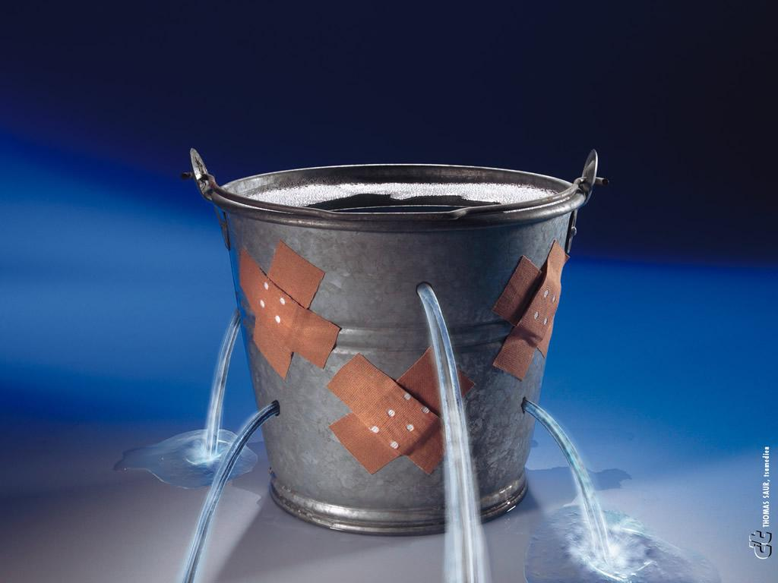
Micro level - Customers
Loyalty

Slide 25
Micro level - Customers
Nice to have
Strategic advantages
High
Satisfaction
Acceptable disadvantages
Strategic disadvantages
Low
Low
High
Importance

Slide 26
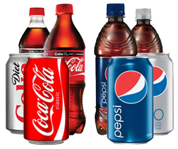
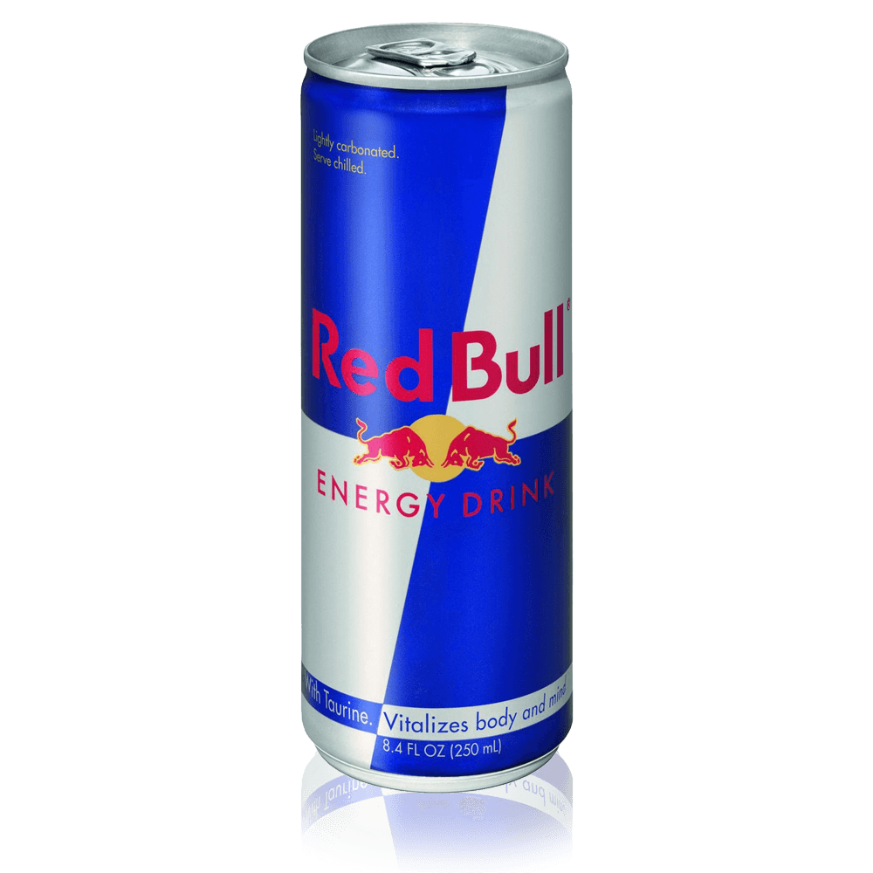

Micro level - Competition
Who is competitor for a cinema?
There are two types of competition
  Direct
  Indirect
Indirect competitors are more difficult to identify and are easier to fail to notice!
Notes:
Source: B. Sharp, Marketing

Slide 27
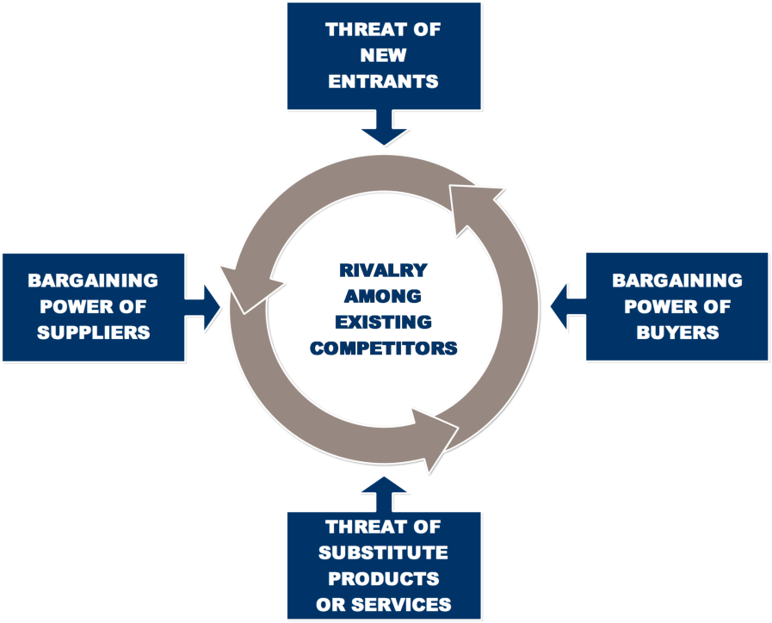
Micro level - Competition
Porter model
5 Competitive forces

Slide 28
Micro level - Collaborators
Suppliers
Retailers
Producent
Wholesaler
Retailer
Customer

Slide 29
Internal environment
Employees
Equipment
Finances
Processes

Slide 30
Analytical tools for environmental scanning
PESTLE
5C
COMPANY ANALYSIS
⇩
SWOT

Slide 31
SWOT analysis
Assessing strengths and weaknesses as internal facts.
Assessing threads and opportunities as external factors.
Strengths and weaknesses have to be relative to competition on the market!
There should be always only facts and factors important for company value chain.

Slide 32
SWOT - how to do it?
Positive
Negative
Strengths
Weaknesses
Internal
S
W
Opportunities
Threats
External
O
T

Slide 33
SWOT analysis further evaluation
TOWS matrix
+/- matrix

Slide 34
Plus / minus matrix
 | S1 | S2 | S3 | S4 | W1 | W2 | W3 | W4 | Standings
O1 | +++ | 0 | + | 0 | - | 0 | 0 | 0 | 3
O2 | + | 0 | 0 | 0 | 0 | - | - | 0 | 4
O3 | 0 | ++ | ++ | + | 0 | --- | 0 | - | 1
O4 | 0 | + | + | 0 | 0 | 0 | 0 | - | 5
O5 | + | + | ++ | 0 | - | 0 | -- | 0 | 2
T1 | 0 | 0 | - | - | 0 | 0 | - | - | 3
T2 | --- | 0 | 0 | 0 | --- | -- | 0 | --- | 1
T3 | -- | 0 | - | 0 | --- | - | 0 | 0 | 2
T4 | 0 | 0 | - | 0 | 0 | - | 0 | 0 | 5
T5 | - | 0 | 0 | 0 | 0 | - | 0 | - | 4
Standings | 1 | 3 | 2 | 4 | 2 | 1 | 4 | 3

Slide 35
TOWS matrix - consequences
Strengths
Weakness
SO strategy
Use strengths to grab the opportunity
WO strategy
Use opportunities to eliminate weaknesses
Opportunity
ST strategy
Use strengths to eliminate thread
WT strategy
?
Thread

Slide 36
Recap

Slide 37

Thank you for your attention

