Slide 1

Place and convenience
The aim of the lecture is to explain the place element of marketing mix. How goods are delivered and made available for customers and also how services can be offered conveniently.
Ing. Kateřina Matušínská, Ph.D.
Ing. Martin Klepek, Ph.D.
Principles of Marketing
Subject code

Slide 2

Outline of the lecture
Basic concept of retail
Distribution strategies
Retail typology
Empirical retail laws

Slide 3
Retail and wholesale
Retailing is a way of selling usually smaller volume to the final end consumer – i.e. doing „small sales“. In the retail sector, there are many different forms of store types, such as the sale rack, self-service stores, supermarkets, hypermarkets, department stores, outlets etc.
The opposite to a retail is wholesaler who represents the sale and distribution of goods on a large scale, often just to retail sales network and NOT the final end consumer. It may be a direct trade between producers and other traders or trade between specialty shops of particular assortment and retailers. Wholesale sales units are mostly supplying other wholesale or retail network.

Slide 4
Retailing
Retail environment has a high degree of competition (depending on assortment) and a significant downward pressure on consumer prices.
Depending on the field and assortment it may not be decided purely by price, but also by other factors (luxury, prestige, brand, current trends, different bonuses, competitions and previous positive experiences, etc.).

Slide 5
Wholesale
Wholesale prices are always lower than retail prices, which are increased by the appropriate retail margin. This margin must cover transportation to stores, fixed costs for a place in shops, storage, electricity, salaries of clerks, in some cases funds for sales promotion (advertising).
The partnership of wholesale supplier and retail purchaser is advantageous for both parties, because the supplier gets specific number of sales of its products (easy to plan production). The concern that the goods in question are sold is taken over by the buyer, who buys it at wholesale prices and aims to sell at retail prices thus generating revenue.

Slide 6
Wholesale
Wholesale units usually have the form of large warehouses, storage of raw materials, transshipment of goods and materials, supplemented by any necessary administrative and operational background.
They are sometimes supplemented by a retail store intended for the local population and employees of the company. Some wholesale equipment may also be linked to commercial packaging premises, devices designed for drying vegetables, fruit ripening (bananas), nuts roaster, additional adjusting of goods, etc., including a number of additional technical services (e.g. transport, logistics, handling, maintenance, etc.).

Slide 7
Distribution channels
PRODUCER |  |  |  | CUSTOMER
PRODUCER |  |  | RETAIL | CUSTOMER
PRODUCER |  | WHOLESALE |  | CUSTOMER
PRODUCER |  | WHOLESALE | RETAIL | CUSTOMER
PRODUCER | WHOLESALE | MIDDLEMAN OR BROKER | RETAIL | CUSTOMER

Slide 8
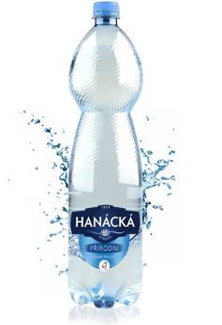
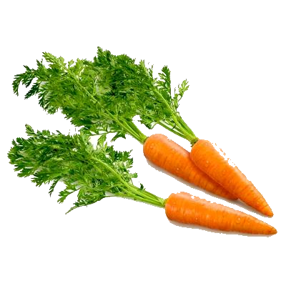
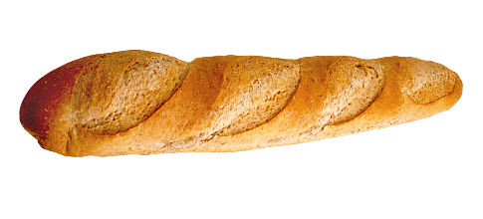
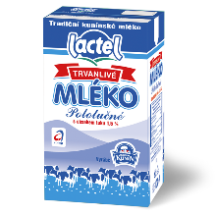
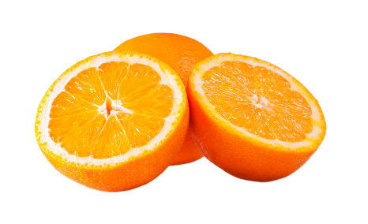
Distribution strategies
Intensive distribution
  sales through as many stores as possible
  in order to make the product commercially available
  FMCG – fast moving consumer goods
    Frequent consumption items that are cheap and expensive purchased habitually or goods of an emergency character

Slide 9
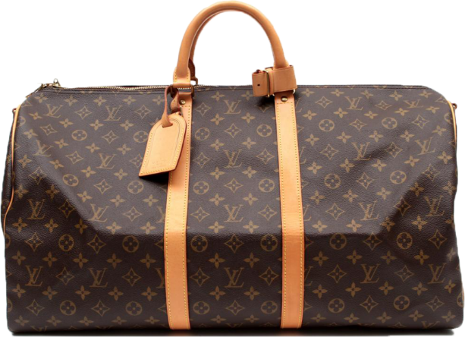

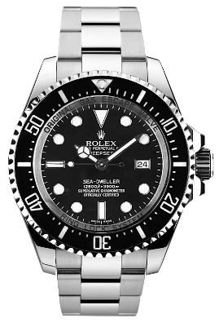

Distribution strategies
Exclusive distribution
sales of products through a very limited number of retailers
expensive and luxury goods
it has its psychological justification, because it promotes the exceptional nature of the goods

Slide 10
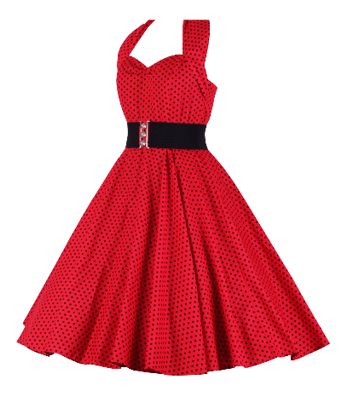
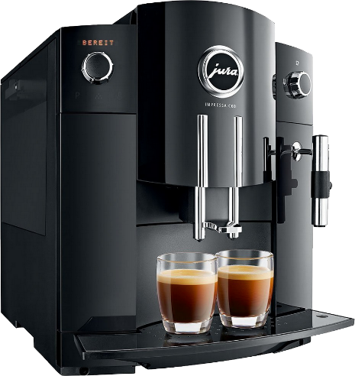
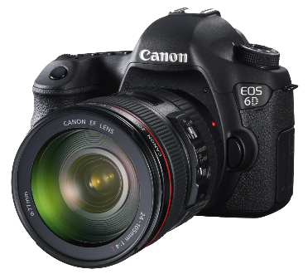
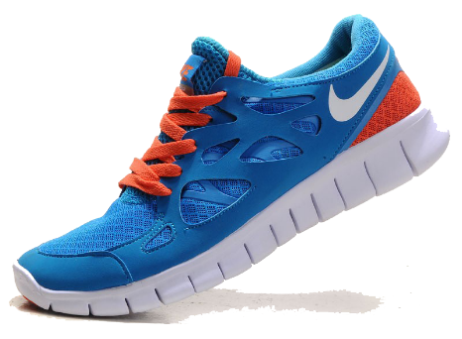
Distribution strategies
Selective distribution
the manufacturer cooperates with a larger number of distributors
occasional consumer goods that are bought after careful comparison
clothing, footwear, consumer electronics

Slide 11
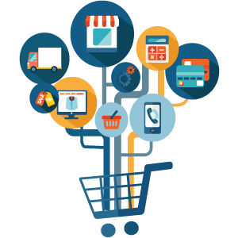
Typology of retail stores
Department Store
Supermarkets / Hypermarkets
Warehouse retailers
Speciality retailers
Speciality warehouse
Convenienec store
Discount retailer
E-tail

Slide 12
1. Department store
This type of retailer is often the most complex offering a wide range of products and can appear as a collection of smaller retail stores managed by one company.
The department store retailers offer products at various pricing levels.
This type of retailer adds high levels of customer service by adding convenience enabling a large variety of products to be purchased from one retailer.

Slide 13
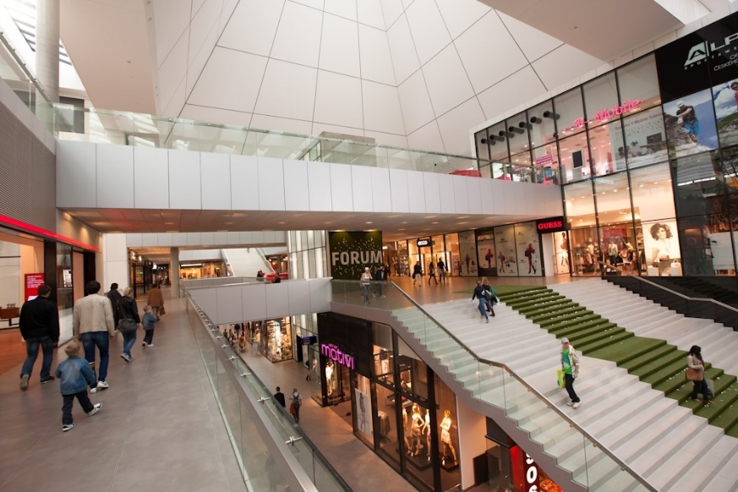
1. Department store
Range of products: wide, deep including food, restaurant (refreshment), "comprehensive shopping under one roof„
Prices: medium and higher at medium and higher quality goods
Localization: city centers, regional shopping malls
Trends: stagnation due to the market saturation

Slide 14
2. Supermarket/Hypermarket
Generally this type of retailer concentrates in supplying a range of food and beverage products.
However many have now diversified and supply products from the home, fashion and electrical products markets too.
Supermarkets and hypermarkets have significant buying power and therefore often retail goods with reasonable margin.
Supermarkets: 400 - 2 500 m2
Hypermarkets: from 2 500 m2

Slide 15
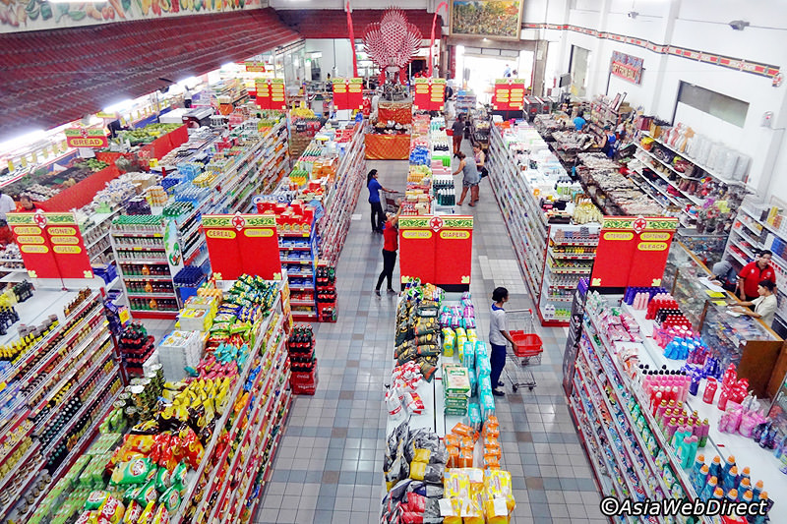
2. Supermarket/Hypermarket
Range of products: comprehensive range of food and basic non-food goods
Prices: medium at a standard quality level of goods
Localization: residential areas with an accessibility range of 400 - 700 m according to the density of the area, city boundaries with access roads and parking
Form of sale: self-service combined with counter sale
Trend: slows down due to saturation of the market, rebuilding and innovations are starting

Slide 16
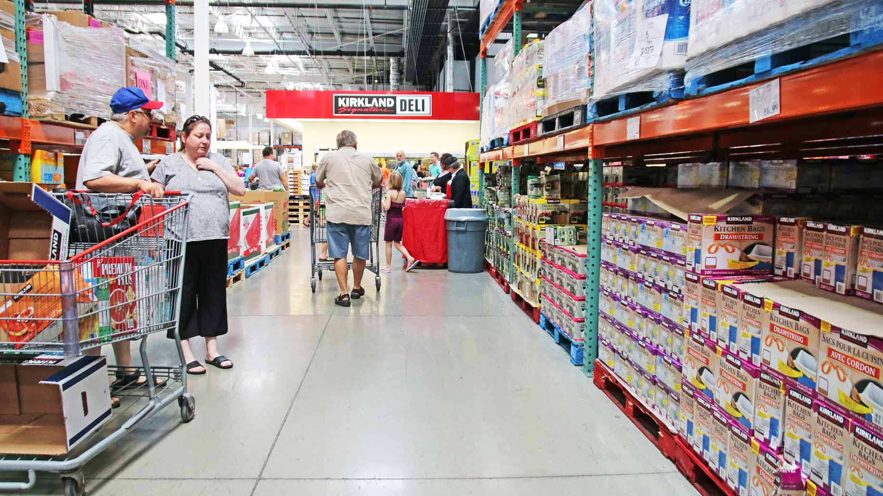
3 Warehouse retailers
This type of retailer is usually situated in retail or Business Park and where premises rents are lower.
This enables this type of retailer to stock, display and retail a large variety of good at very competitive prices.

Slide 17
3 Warehouse retailers
Range of products: comprehensive range of food and basic non-food goods
Prices: lower due lower logistic expenses
Localization: suburbs, city exits with access roads and parking
Form of sale: self-service
Trends: stagnation due to increasing customer convenience requirements

Slide 18
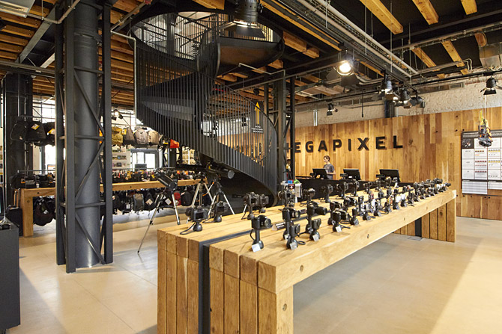
4 Speciality retailers
Specialising in specific industries or products, this type of retailer is able to offer the customer expert knowledge and a high level of service.
They also add value by offering accessories and additional related products at the same outlet.
Examples are cycling, skiing, office supplies, footwear, fashion, computer technology, cosmetics, photo.

Slide 19
4 Speciality retailers
Range of products: very narrow with considerable depth, goods of occasional and long-term consumption prevail
Prices: higher, sales with specialized services (costs of professional staff)
Localization: city centers and shopping malls, departent stores
Trend: growing

Slide 20
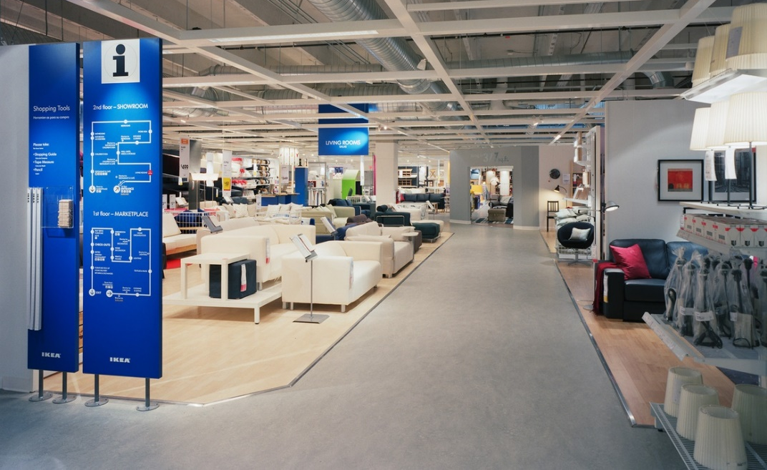
5 Speciality warehouse
Specialising in specific industries or products, this type of retailer is able to offer the customer expert knowledge and a high level of service.
From 800m2 and more.
Examples are IKEA, HORNBACH, DECATHLON, OBI, SCONTO.

Slide 21
5 Speciality warehouse
Range of products: very narrow with considerable depth
Prices: low to medium
Localization: suburbs, city exits with access roads and parking
Form of sale: self-service
Trends: fast development at the expense of specialized stores

Slide 22
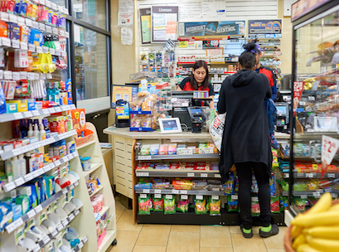
6. Convenience retailer
Usually located in residential areas this type of retailer offers a limited range of products at premium prices due to the added value of convenience.
Some of them has long open hours and provide customers with products of daily consumption.

Slide 23
6. Convenience retailer
Range of products: medium wide with a small depth, focusing on daily necessities with a significant dominance of food
Prices: higher
Localization: countryside and less dense urban areas
Form of sale: self-service combined with counter sale
Trends: decrease due to the concentration of supermarkets and shopping centers

Slide 24
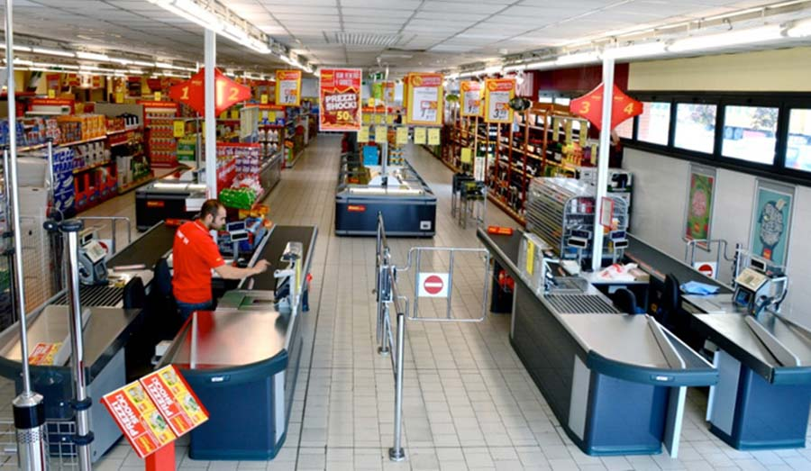
7. Discount retailer
This type of retailer offers a variety of discounted products.
They offer low prices on less fashionable branded products from a range of suppliers by reselling end of line at discounted prices.

Slide 25
7. Discount retailer
Range of products: up to 800 items, narrow with a small depth
Prices: lower
Localization: residential areas with an accessibility range of 400 - 700 m according to the density of the area, city boundaries with access roads and parking
Form of sale: self-service
Trends: stagnation

Slide 26
8. E-tailer
This type of retailer enables customers to shop on-line via the internet and buy products which are then delivered.
This type of retailer is highly convenient and is able to supply a wider geographic customer base.
E-tailers often have lower rent and overheads so offer very competitive pricing.

Slide 27
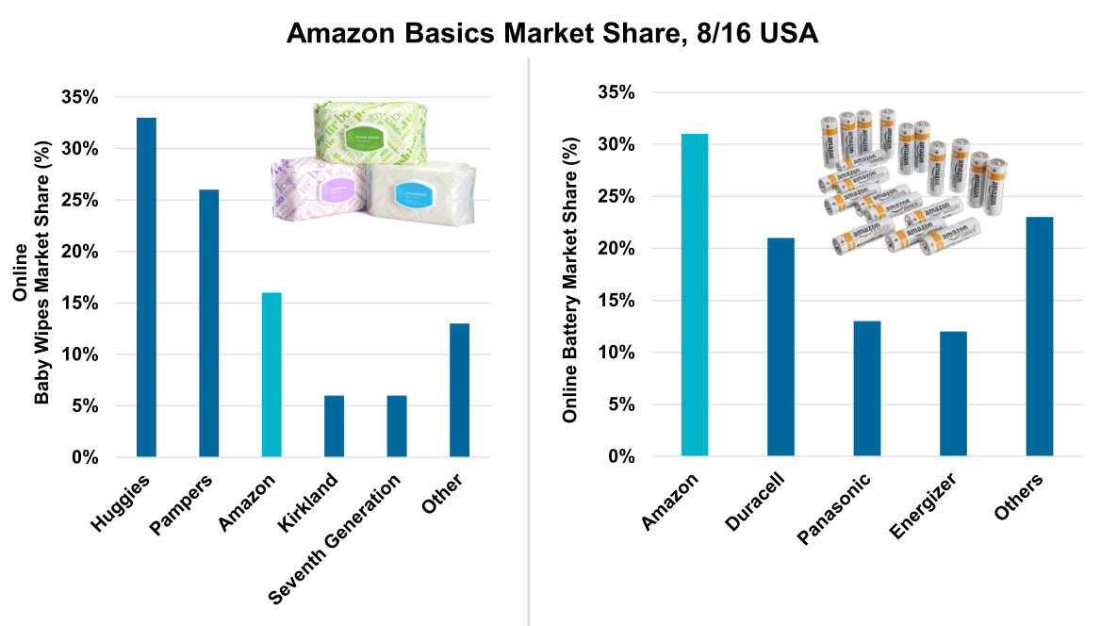
8. E-tailer

Slide 28
8. E-tailer
E-tail is emerging and complementing (not replacing) brick and mortar.
Drugs, fresh fruits and vegetables are convenient to buy offline.
Electronics, hobby and books are good examples of e-tail use.

Slide 29
How to compete in retail?
Retail market is saturated in most developed countries
Competition is continuously trying to out-do each other with: better locations, new stores, improved layouts, technology, etc.
Larger market share store chains have larger customer bases (penetration) and slightly higher loyalty (both average purchase frequency and average share of department store shopping trips)

Slide 30
Retail laws
Repeat-purchasing patterns that occur in brand buying also occur in store choice.
Studies shows this repetitive choices in many areas: Supermarket chains, Department stores, Petrol stations, Fast-food chains and Women's fashion boutiques.
It underlines the logic of habitual buying in category of FMCG

Slide 31
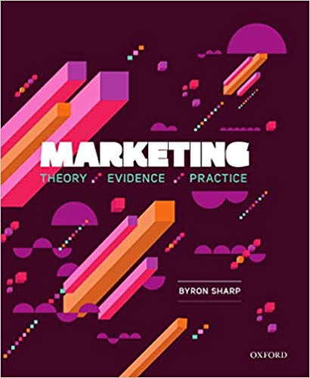
Retail laws
Purchase goals
Mental and physical availability
Limited time
Many short trips
Selective purchasing
Top-selling items
Colors and symbols
Specials
Set paths

Slide 32
1. Purchase goals
Shoppers go to stores because the stores have something they want to buy.
Almost everyone enters a store with a purchase goal in mind (very often specific brand).
This mental list does not preclude them from buying other things.
Retailer advertising almost always shows product.
Primary source of shopper dissatisfaction is not being able to find the product they wanted to buy.

Slide 33
2. Mental and physical availability
Mental and physical availability largely determine store choice.
Customers need to know about you and you must be at hand.
They miss your competitor on their way to your store only if it is not in their mental availability (store exist, store sells what they want).
Stores need to advertise to build memory structures.

Slide 34
3. Limited time
Shoppers only spend a certain amount of time in store.
If the entire purchase process takes time, customers buy less.
When they find what they need quickly, they tend to look after other goods.
At a time when most of the bite shopping time search products, customers spend much less money.

Slide 35
4. Many short trips
People make many short shopping trips and fewer longer shopping trips
15% shopping trips are to buy single item, even in supermarkets.
50% of them are for 5 or less items.
Frequently purchased items should not move – it extends search time.
Visible category and clearly labeled diagram of selling space.

Slide 36
5. Selective purchasing
A typical household buys only 300 to 400 stock-keeping units from supermarket in an entire year.
Shoppers are very loyal to their set of favorite products.
Supermarkets offers up to 60 thousands of those items.
The amount the customer chooses the strategy of repeat purchases in places where he knows where to find products.
Again, be careful with moving products.

Slide 37
6. Top-selling items
While typical supermarket sells 30.000 to 50.000 items, the top-selling 1000 items will make up about half of the supermarket‘s sales
Best selling products should be accessible, not hidden in the most remote corner, as some traders do.
If you are a repeat purchase, and I am selective, I do not pay attention to surrounding products.

Slide 38
7. Colors and symbols
Shoppers read very little in store – instead they react to colours and symbols.
Eye-tracking studies show that customers read very little, and i so, they carefully choose what to read – to save their shopping time.
Colors and symbols are ways to streamline shopping with minimal time loss for the customer.

Slide 39
8. Specials
Shoppers have been trained to buy specials
Highlighting discounts, special offers, news, best selling goods, etc. can help in this effort.
Brand sold in special offer must be known - research shows that people who do not have a brand in mind rarely respond to these offers.

Slide 40
9. Set paths
Shoppers follow pathways of open space, and the checkout is a magnet.
Shoppers speed up towards checkouts.
Monitoring customer pathways is an important part of the design shopping area.
In heat maps we can see most frequently visited space for important products.

Slide 41

Summary
Place in marketing mix plays a role of transfering the possession of a goods or services from the provider to the final customer. In goods category the most common example of the process is a retailing where consumers buy their products. To understand retailing one have to be able to define wholesale and the distribution channels which these two form.
There are three types of distribution strategy depending on the characteristics of a goods. Intensive, selective and exclusive. There is also 8 types of retail setting raging form supermarket to convenience store.
We have also introduced nine retail laws created based on the empirical data from the longitudinal research of Ehrenberg-Bass institute.

Slide 42
End of presentation
THANKS FOR YOUR ATTENTION.

