Slide 1
Price
The aim of the lecture is to explain the pricing principles in marketing context. How are the prices percieved by customers and how this can be beneficial for marketers.
Ing. Kateřina Matušínská, Ph.D.
Ing. Martin Klepek, Ph.D.
Principles of Marketing
Subject code

Slide 2
Outline of the lecture
Definition of a price
Three elementary pricing methods
Pricing strategies
Pricing biases
Psychological pricing

Slide 3
Price definition
The price placed on a good or service has a direct effect on sales revenue (revenue=volume*price) and therefore the profit od loss of a firm (profit=revenue-costs).
Price is the only element of the marketing mx that has such immediate effect on the bottom line.
Common pressure is to reduce prices in order to help raise sales volumes. Lowering prices generally increase sales, but it is also likely to reduce profit.
Changing prices is therefore much more complex than one would expect.

Slide 4
How to create a price
Cost-Oriented Methods
In practice, they are often used.
Costs determine the lower price limit.
It leads to a mismatch between the interests of the customer and the company.
Pricing adjusted to cost.
Competitive methods
Concentration on monitoring and adjustment of competition prices.
Frequent in price leader markets.
Demand-oriented methods
Based on psychological and behavioural processes in consumer decision making.
The price is perceived as part of the customer's decision at the time of purchase.

Slide 5
Price penetration strategy
Penetration or go to market strategy.
It is based on a very low price.
Fast market penetration and market share control.
Helping brands to get bought by firsttime users.

Slide 6
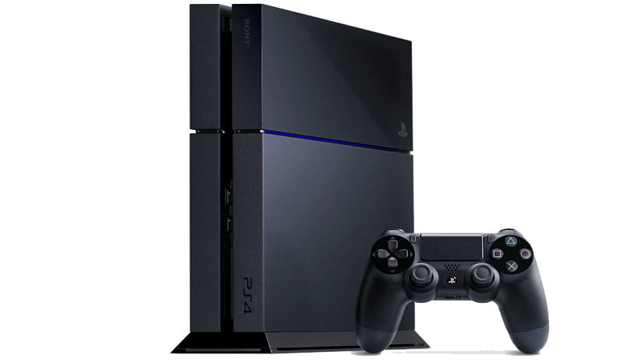
Skimming strategy
In a short period.
High price on a fairly small market.
New customers adapt to the price.
In a long period.
High profits are likely to attract competition.
The price cut will keep sales at the desired values.
Branded and fashionable goods, technological novelties (gaming consoles, tablets, smartphones).

Slide 7
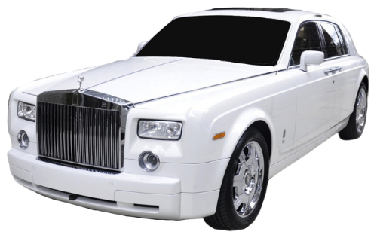
Premium pricing
High price throughout the product life cycle.
Decreasing the price would be perceived by customers as a loss of prestige.
Luxury brands (fashion, cars, jewelry, watches).
Premium price assumptions:
The customer believes the goods are good quality.
The product will allow it to reflect the social status of luxury.
The cost of product failure is too high.

Slide 8
Skimming and premium pricing
They are a strategy of high prices.
The use of a high price carries certain assumptions:
The product is unique, patent-protected
Production is difficult
The high price does repels certain customer segments
The market is too small to attract competition
The product requires highly qualified staff

Slide 9
Types of the market and pricing process
B2B - Business to Business
The price is usually determined for each contract in particular.
Part of hard business bargaining.
B2C - Business to customer
Fixed prices for all within the market.
Prices are public and information accessible.
B2G - Business to Government
The price is set in tenders and public contracts.

Slide 10
Baseball bat and ball cost 11 €.
Bat cost 10 € more than ball.
How much the ball costs?

Slide 11
Pricing biases
Baseball bat and ball cost 11 €.
Bat cost 10 € more than ball.
How much the ball costs?
1 + 11 = 12
0,5 + 10,5 = 11

Slide 12
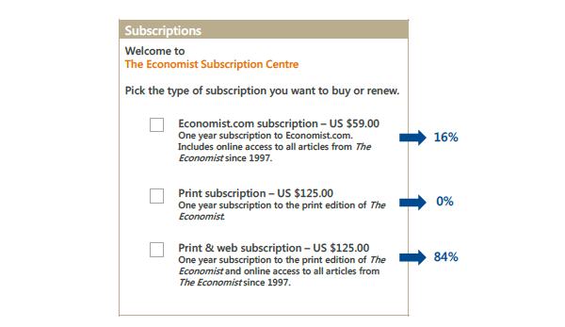
Relativity principle

Slide 13
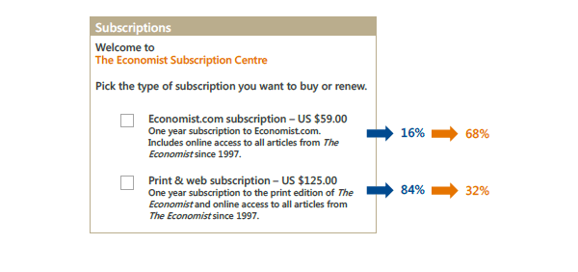
Relativity principle

Slide 14
The Economist Subscription problem
Of the original high interest in the $ 125 (84%) printed and online subscription, the only version of interest-only version dropped to just 32%.
An anchor in the form of unnecessary options in the middle affected the overall perception of the offer.
An attractive third option (online + print) not only compared to the other (printed version only), but also with the first variation of online subscription.

Slide 15
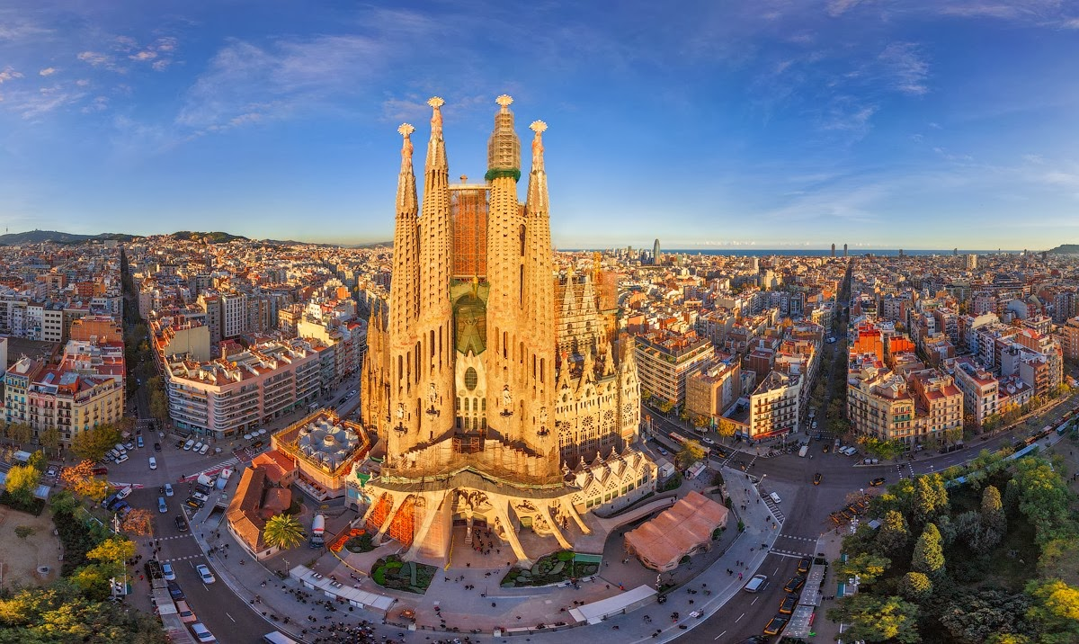
Where do you want to travel?

Slide 16
Paris or Barcelona?
Your choice
Trip to Barcelona All-inclusive, free transportation, you have to pay for your morning coffee,
Trip to Barcelona All-inclusive, free transportation,
Trip to Paris All-inclusive, free transportation,
2nd choice becomes more attractive compared to 1st choice and even compared to the 3rd one.
Ariely on irationality:
https://www.ted.com/talks/dan_ariely_asks_are_we_in_control_of_our_own_decisions/transcript#t-816260

Slide 17
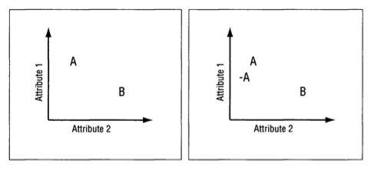
Anchoring
In the left side of this illustration we see two options, each of which is better on a different attribute. Option (A) is better on attribute 1-let’s say quality. Option (B) is bet­ter on attribute 2-let’s say beauty. Obviously these are two very different options and the choice between them is not simple. Now consider what happens if we add another op­tion, called (-A) (see the right side of the illustration). This option is clearly worse than option (A), but it is also very similar to it, making the comparison between them easy, and suggesting that (A) is not only better than (-A) but also better than (B).

Slide 18
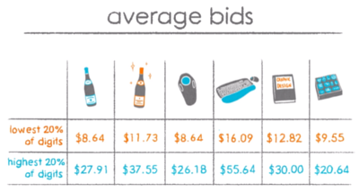
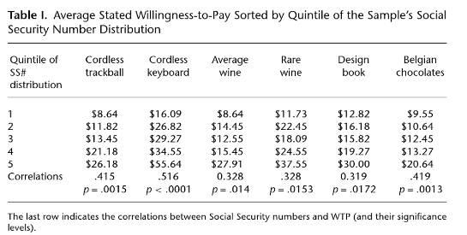
People lack preexisting subjective probability distributions over unknown quantities
Students were shown six products (see picture) with a short description without mentioning the real price on the market.
After this demonstration, student researchers asked if they would buy the product at a price equivalent to the last two digits of their social security number (similar to the US Social Security Number).
For example, if this number ended in 25, it was $ 25.
Following this Yes / No answer, students were asked to indicate how much they would be willing to pay for each product.
As we can see in the table, what the ending of their social security number influenced their willingness to pay a certain amount for the product in all product categories.

Slide 19
Name-Letters and Birthday-Numbers: Implicit Egotism Effects in Pricing
Implicit egoism, resulting from positive associations, affects the consumer's appraisal of product prices.
In other words, how we perceive the numbers that are associated with ourselves is reflected in the evaluation of those numbers in the area of market price.
It means an increased preference for prices with endings equal to their own date of birth.
Coulter and Grewal (2014)

Slide 20
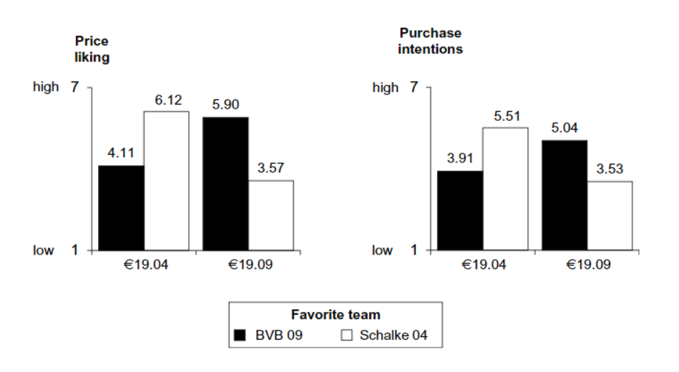
Price liking and favourite football team
We conceptually replicate Coulter and Grewal’s (2014) study on the birthday–number effect in pricing, according to which customers exhibit a preference for prices resembling their own birthday.
We find that this effect extends beyond the self to other objects customers have associations with (e.g., sports teams) and that this effect is bi-directional - e.g., increasing or decreasing purchase intentions - depending on the valence of the customer’s association.
Housemann-Kopetzky and Köcher (2017)

Slide 21
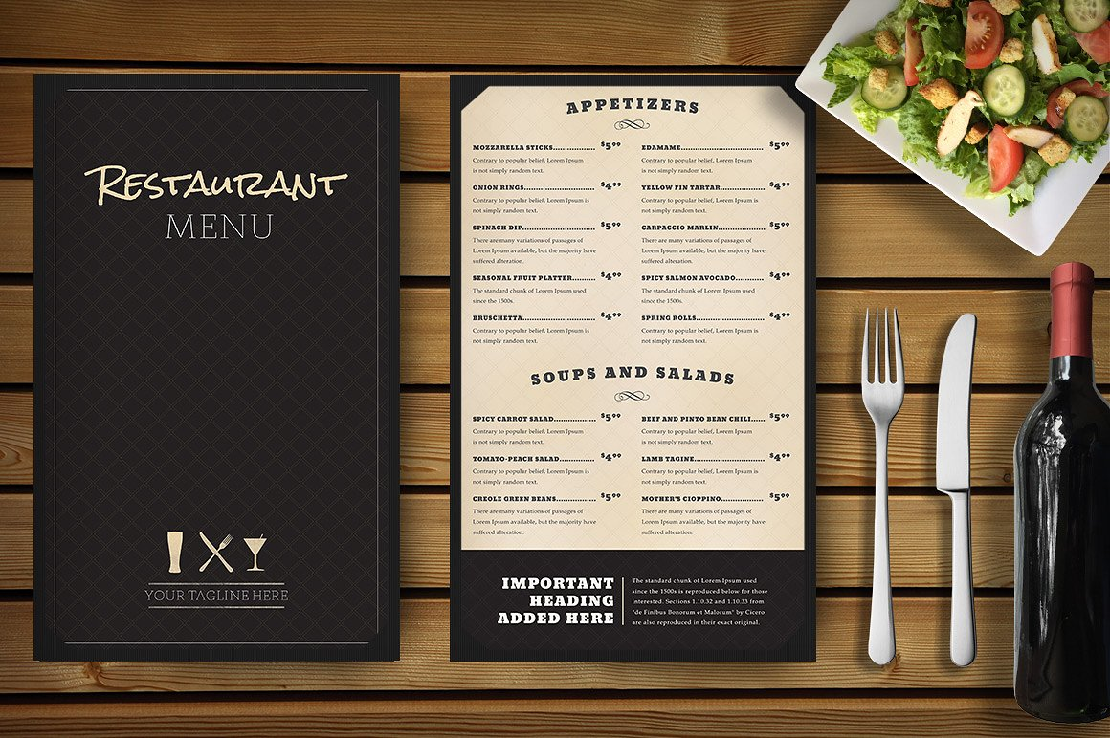
Removing currency denomination increases sales
15,-
vs
15,- €

Slide 22
Commas and periods in price
1345 vs 1,345
Commas make the price a little longer and so make it seem 'bigger'. Removing the comma makes the number physically smaller and so can seem less.
A similar effect happens with decimal points. For example $123 seems less than $123.00, mostly because it is shorter.

Slide 23
Fonts in pricing – how to promote price reduction?
Before 100 $ Now 79 $
vs
Before 100 $ Now 79 $
The second option would feel like greater price reduction.

Slide 24
Consolidated surcharges
584 £
+ 10% tax
+ 3% shipping
584 £
+ 13% tax + shipping

Slide 25
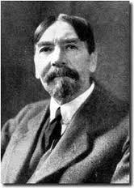
Price effects
Substitution effect
Increase in price = reduction in demand
Veblen effect
Increase in price = Increase in demand
Guttenberg effect
Small increase in price = no change
Radical increase in price = hectic changes
Thorstein Veblen 1857 - 1929

Slide 26
Psychological price development
Consumers perceive mostly the first digit of the price and how many numbers it has. They do not care much about halter items. The meaning of the penny (cent) parts of the price increases with the strength of the currency.
This effect is magnified by the price tags where these items are printed in smaller font (3.98 €).
Prices down to the last cents indicate to the consumer that the goods are sold at the lowest possible price.
The importance of setting the right price increases with the development of Internet servers to compare goods (Heureka.cz, Zbozi.cz).

Slide 27
Psychological price development
Price tactics
Using 1.99 instead of 2
All for XX, -
Monthly payments instead of the total price
Free stuff (X + 1 action)
Deploying high prizes and subsequent "drastic" DISCOUNT

Slide 28
Summary
Price is the only element of the marketing mix that has such immediate effect on the bottom line. Common pressure is to reduce prices in order to help raise sales volumes. Lowering prices generally increase sales, but it is also likely to reduce profit. Changing prices is therefore much more complex than one would expect.
There are three major approaches to set prices: Cost-oriented methods, competitive methods, demand-oriented methods. Price can serve several strategies. First the penetration price helps products to gain quick market share through affordable trials. Skimming serves to get the most from early adopters and then be available also for majority. Last, the premium pricing is a signal for customers about the superior and premium quality of a products.
Price perception is largely influenced by various psychological and cognitive biases such as anchoring or implicit egoism.

Slide 29
End of presentation
THANKS FOR YOUR ATTENTION.

