Slide 1

Product
The aim of the lecture is to explain the core ideas around product its typology and how the product delivers value to the customers.
Ing. Kateřina Matušínská, Ph.D.
Ing. Martin Klepek, Ph.D.
Principles of Marketing
Subject code

Slide 2

Outline of the lecture
Definition of a product and its layers and levels
Deifferences between goods and services
Service characteristics
Product lifecycle and brand portfolio management
Product assortment
New product development

Slide 3
Product characteristics
The goal of the marketer is to help customers to meet their own goals.
Means for meeting customers needs and goals are products.
If the customer's goal is to move from point A to point B, he can own a car (goods) or use public transport or a taxi (service).
Both products achieve our customer's goal.

Slide 4
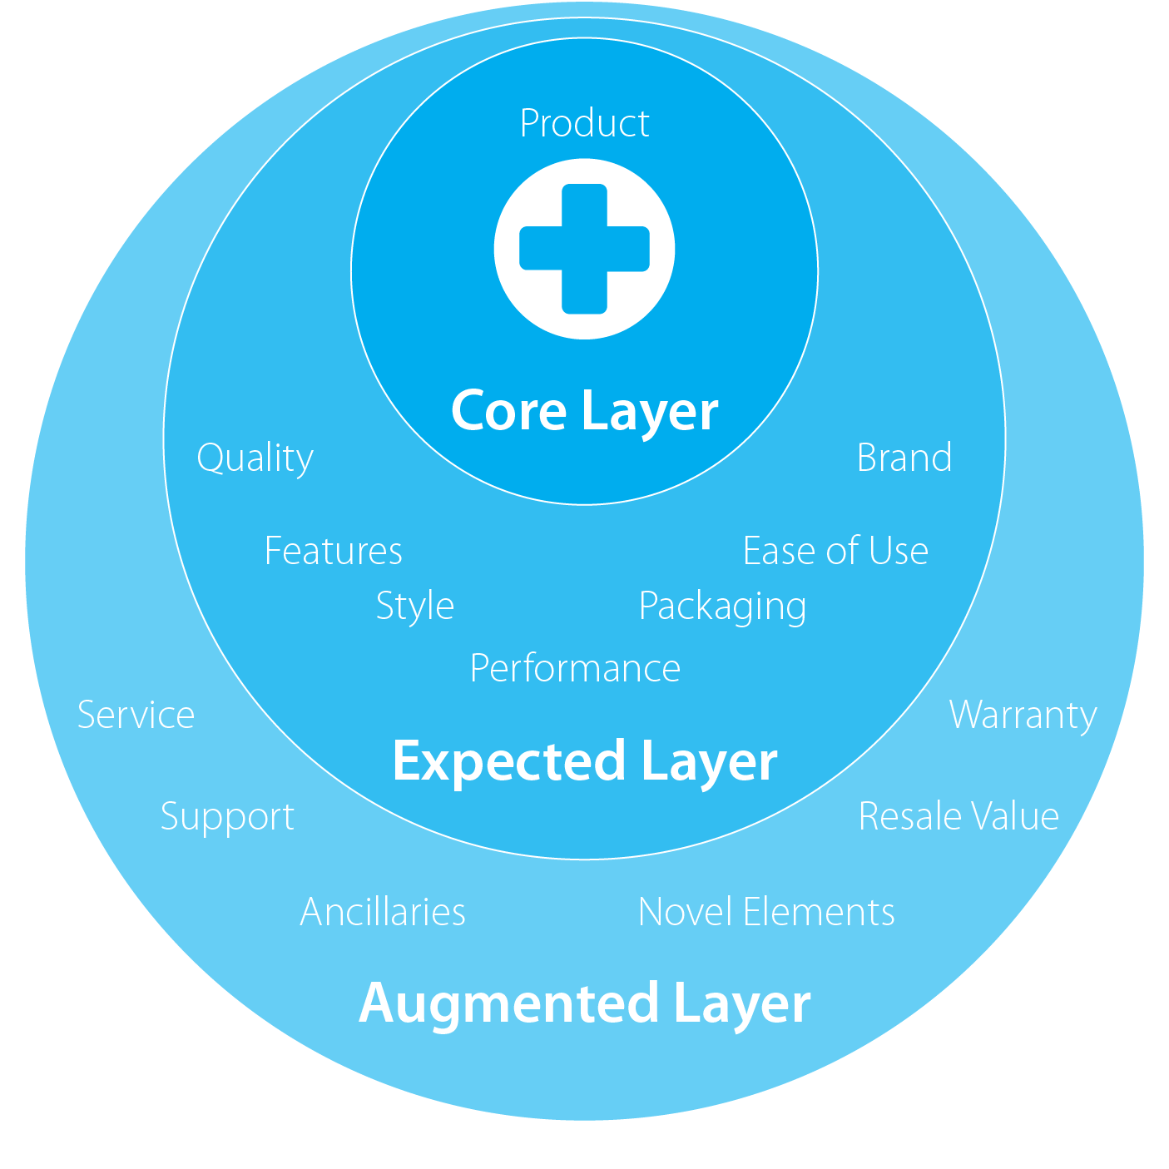
Product layers
Core
Expected
Augmented

Slide 5
Product levels
CORE PRODUCT
  The service or benefit the customer is really buying.
BASIC PRODUCT
  The core benefit transformed into a basic product.
EXPECTED PRODUCT
  Set of attributes and conditions buyers normally expect when they purchase this product.
AUGMENTED PRODUCT
  That exceeds customer expectations.

Slide 6

Product layers – bike example
Core benefit
Basic product
Expected product
Augmented product

Slide 7
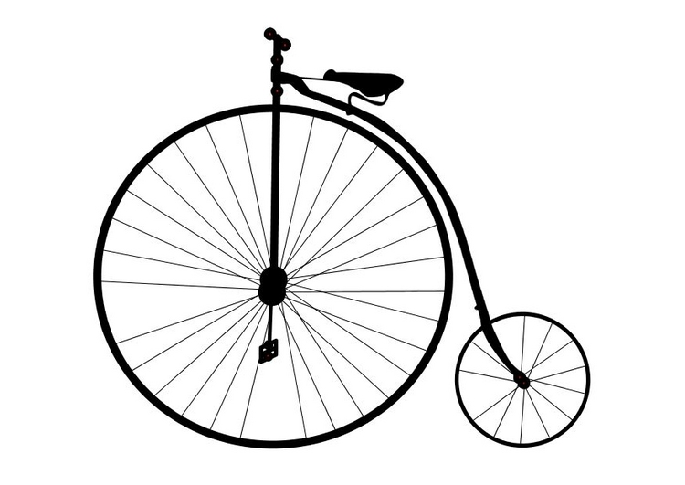
Product layers – bike example
Core benefit
Basic product
Expected product
Augmented product

Slide 8
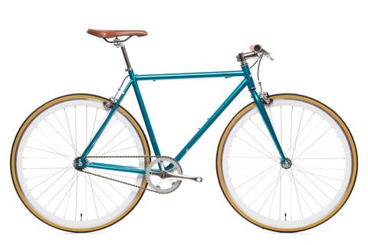
Product layers – bike example
Core benefit
Basic product
Expected product
Augmented product

Slide 9
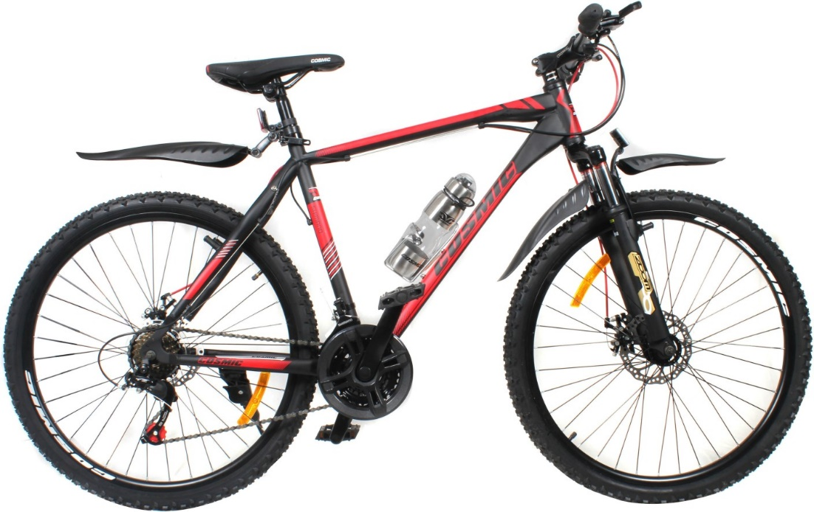
Product layers – bike example
Core benefit
Basic product
Expected product
Augmented product

Slide 10
Product Classification
Nondurable goods are tangible goods normally consumed in one or a few uses, such as beer and shampoo. Because these goods are purchased frequently, the appropriate strategy is to make them available in many locations, charge only a small markup, and advertise heavily to induce trial and build preference.
Durable goods are tangible goods that normally survive many uses: refrigerators, machine tools, and clothing. Durable products normally require more personal selling and service, command a higher margin, and require more seller guarantees.

Slide 11
Product Classification
Services are intangible, inseparable, variable, and perishable products that normally require more quality control, supplier credibility and adaptability. Examples include haircuts, legal advice, and appliance repairs.
Goods are tangible, can be stored for later sell, do not differ piece by piece very much, and can be sold second hand. Production is separated from consumption. Examples include toys, smartphones, and fast-moving consumer goods.

Slide 12
Two types
Goods | Services
A physical commodity | A process or activity
Tangible | Intangible
Homogenous | Heterogeneous
Production and distribution are separated from the consumption | Production, distribution and consumption are simultaneous processes
Can be stored | Cannot be stored
Transfer of ownership is possible | Transfer of ownership is not possible

Slide 13
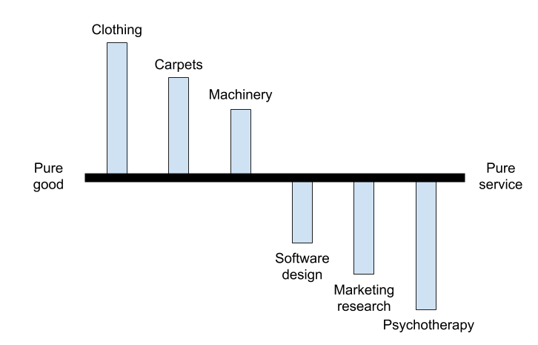
Good-service continuum

Slide 14
Service examples
Health care – hospital, medical practice, dentistry, eye care.
Professional services – accounting, legal, architectural.
Financial services – banking, investment advising, insurance.
Hospitality – restaurant, hotel, bed & breakfast, ski resort, rafting.
Travel – air lines, travel agencies, theme park
Others – hair styling, pest control, lawn maintenance, counseling services.

Slide 15
Service differences
Intangibility
Heterogeneity
Inseparability
Perishability

Slide 16
Intangibility:
Services are intangible and do not have a physical existence.
Hence services cannot be touched, held, tasted or smelt.
This is most defining feature of a service and that which primarily differentiates it from a product.
Also, it poses a unique challenge to those engaged in marketing a service as they need to attach tangible attributes to an otherwise intangible offering.

Slide 17
Heterogeneity/Variability:
Given the very nature of services, each service offering is unique and cannot be exactly repeated even by the same service provider.
While products can be mass produced and be homogenous the same is not true of services. e.g.: All burgers of a particular flavor at McDonalds are almost identical.
However, the same is not true of the service rendered by the same counter staff consecutively to two customers.

Slide 18
Inseparability:
This refers to the fact that services are generated and consumed within the same time frame. E.g.: a haircut is delivered to and consumed by a customer simultaneously unlike, say, a takeaway burger which the customer may consume even after a few hours of purchase.
Moreover, it is very difficult to separate a service from the service provider. E.g.: the barber is necessarily a part of the service of a haircut that he is delivering to his customer.

Slide 19
Perishability:
Services cannot be stored, saved, returned or resold once they have been used.
Once rendered to a customer the service is completely consumed and cannot be delivered to another customer. e.g.: A customer dissatisfied with the services of a barber cannot return the service of the haircut that was rendered to him.
At the most he may decide not to visit that particular barber in the future.

Slide 20

Extension of marketing mix for services:
Product,
Price,
Place,
Promotion,
Processes,
People,
Physical evidence.

Slide 21
Consumption differences goods and services
MARKETING
PRODUCTION
CONSUMPTION
OUTCOME CONSUMPTION
PROCESS CONSUMPTION
PRODUCTION
MARKETING?
CONSUMPTION

Slide 22
What is the role of marketing in services?
Matching the production (service) process with consumption process
Result is that consumers perceive good service quality and value
Than they are willing to continue he relationship with the service provider
PRODUCTION
MARKETING?
CONSUMPTION

Slide 23
What remains?
Market research
Pricing
Advertising
Marketing communication
PRODUCTION
MARKETING?
CONSUMPTION

Slide 24
What is new?
Relationship management
Customer processes analysis
Customer databases
Feedback
PRODUCTION
MARKETING?
CONSUMPTION

Slide 25
Excercise
YOU ARE RICE MERCHANT IN CHINA COUNTRYSIDE
The city you operate is located in distant area, so expansion to other cities is not possible.
You basically cannot improve anyhow the rice, all farmers have the same conditions and type of seed available.
Price reduction brings only short term sales however in a long run it brings price wars leaving all the farmers bleeding financially.
What can you do to beat your competition?
(Grönroos, Ch. 2015. Service management and marketing)

Slide 26
Excercise – where your solution falls?
FOCUS ON REVENUE
FOCUS ON
CONSUMERS‘
RESOURCES AND
PROCESSES
FOCUS ON FIRM‘S
RESOURCES AND
PROCESSES
FOCUS ON COSTS

Slide 27
From goods dominant do service dominant
Changing the economic ratios and the advanced economies' orientations towards the service sector is coming up with a series of assessments of product thinking effectiveness.
In theory, we have two approaches:
  Goods-dominant logic
  Service-dominant logic

Slide 28
Service dominant logic
Tangible products do not exist
The product is always strongly connected to the benefit
This tangible product only generates the benefit
We say "This product has made us a service"
The logic of service helps businesses perceive the true value that product generates.

Slide 29
Service dominant logic
Logic | Goods-Dominant | Service-Dominant
Main Idea | Goods | Service
Focus | Product | Experience
Improvement | Product features | Solution
Means for the transaction | Price | Value proposition
Communication style | Promotion | Dialogue
Marketing goals | Market | Co-create value

Slide 30
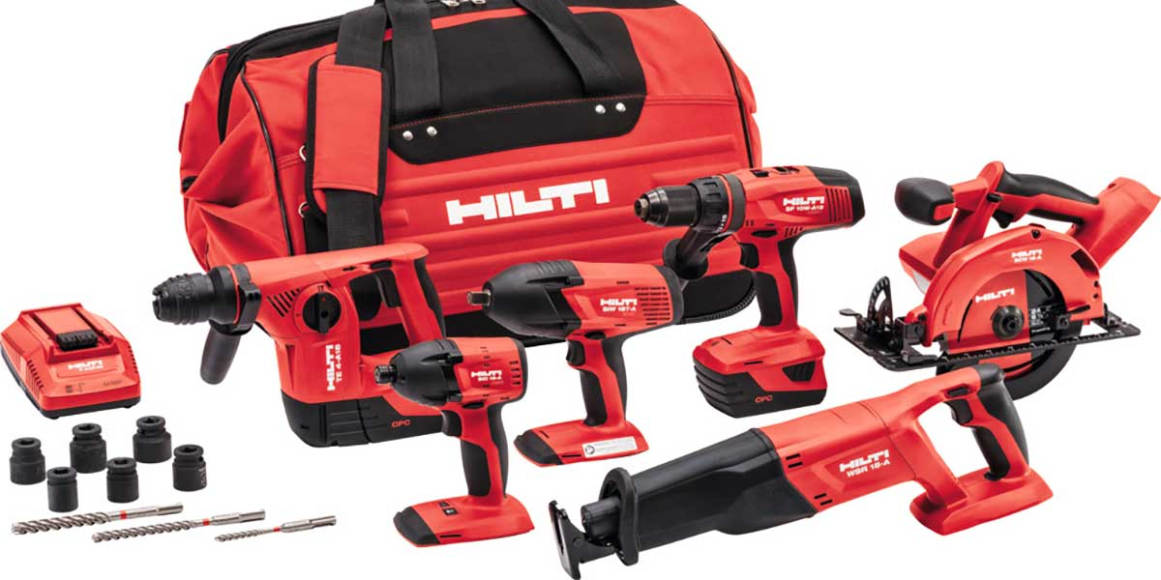
Case study: Hilti

Slide 31
Case study
The Swiss firm Hilti is a manufacturer of high quality professional electronic tools.
Customers are mainly construction companies.
Thanks to the fierce competition, which was able to produce at a lower cost, large orders were dropping significantly.
Hilti responded by changing the business model from product to service thinking.
Providing large developers and construction companies with rental of machinery.
Ensured delivery of the specified quantity and type of tools directly to the construction.

Slide 32
Case study
Construction companies do not have to buy, own and maintain tools.
The client's need is access to tools rather than tool ownership.
Clients can concentrate on what they do best and that's building and not caring for tools.
Set up a regular company income from contracts for rental of tools.
Hilti also provides service and that machines are always functional and available.
For this added value, the customer is willing to pay - he is sure that the construction will not be blocked due to machine failures.
No delay mean no fine for delayed constructions.
https://www.youtube.com/watch?time_continue=11&v=VxSObyUhqNY

Slide 33
Product Lifecycle
Development
Introduction
Growth
Maturity
Decline
Quantity
Sales
Time
Earnings after taxes

Slide 34
Product Lifecycle and Product Portfolio Management
Development
Introduction
Growth
Maturity
Decline
Sales volume
Development
Introduction
Growth
Time

Slide 35
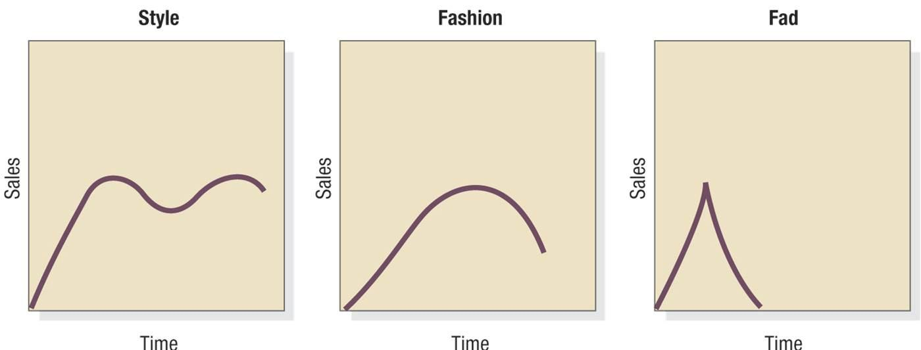
Non-standard product lifecycles

Slide 36
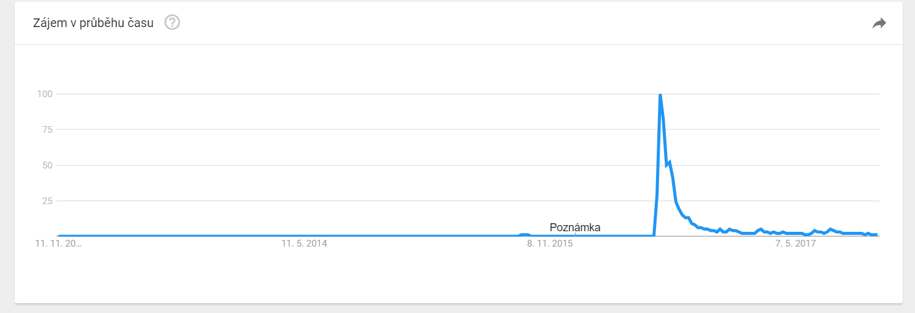
Could you guess a fad?

Slide 37
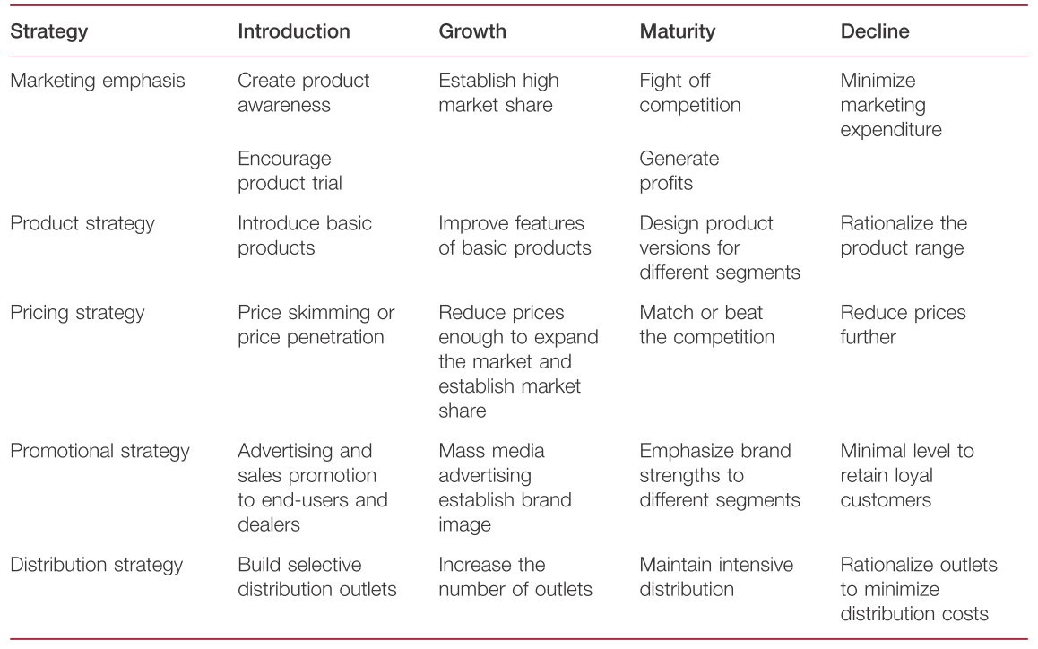
Stages and strategies (Fad was Pokemon Go)

Slide 38
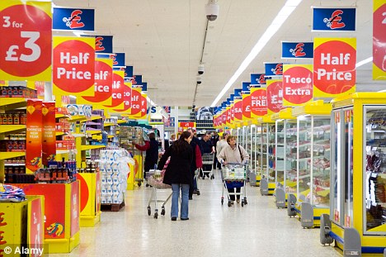
Product portfolio / assortment
Width of product portfolio
  How many product categories we offer
Depth of product portfolio
  How many brands are in product categories

Slide 39


Product portfolio / assortment
In the food store, the breakdown of meat and sausages, milk and dairy products, pastries, fruits and vegetables etc. is the width of the assortment.
The division of milk and dairy products into milk, cheese, yoghurt, etc. is still the width of the assortment.
The division of yoghurts according to flavours, brands, etc. is the depth of the assortment.

Slide 40









Brand portfolio

Slide 41
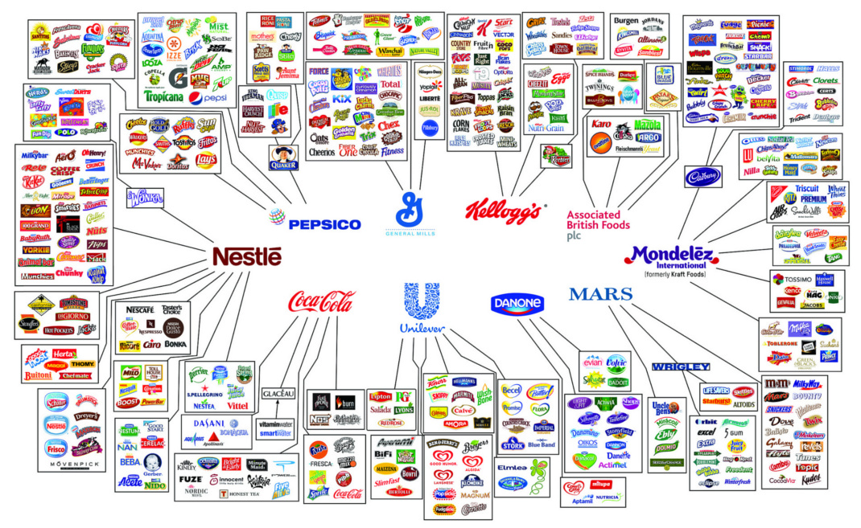
Brand portfolio

Slide 42
BCG Matrix
Most famous portfolio analysis is Boston Consulting Group Matrix .
Logic: profitability of different strategic business units (brands or products) is aligned with share and growth.
Result: Model BCG which sort brands
Question marks
Dogs
Stars
Cash cows

Slide 43
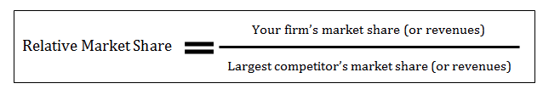
BCG Matrix
Market growth rate | High | STARS Growing profit | QESTION MARKS Low profit
 | Low | CASH COWS Highest profit | DOGS Lowest profit
 |  | High | Low
 |  | Relative market share
20%
10%
0%
10x
1x
0,1x

Slide 44
BCG Model
Stars
  Requires lots of investments and managing effort
  Strong competition in the segments
Cash Cows
  Established well functioning units.
  Generates valuable profits for other unists.
Question marks
  Requires extensive investments to maintain market share.
  Management have to decide which of these will progress to Stars.
Dogs
  Can generate sufficient amount of profits to survive.
  Has no bright future ahead of them.

Slide 45
BCG Model
Question
marks
Stars
Cash cows
Dogs
Sales
Introduction
Growth
Maturity
Decline
Time

Slide 46
BCG Model
Stars
Question mark
Market growth rate
Cash cow
Dogs
Relative market share

Slide 47
Product development
It is obvious that the company's range is not static, but the products need to be changed purposefully.
Companies need to develop new products and services due to rapid changes in consumer consciousness, technology and competition.
In addition, the products have a limited life and the company has to look for new products to replace the older ones.
The result is product innovations.

Slide 48
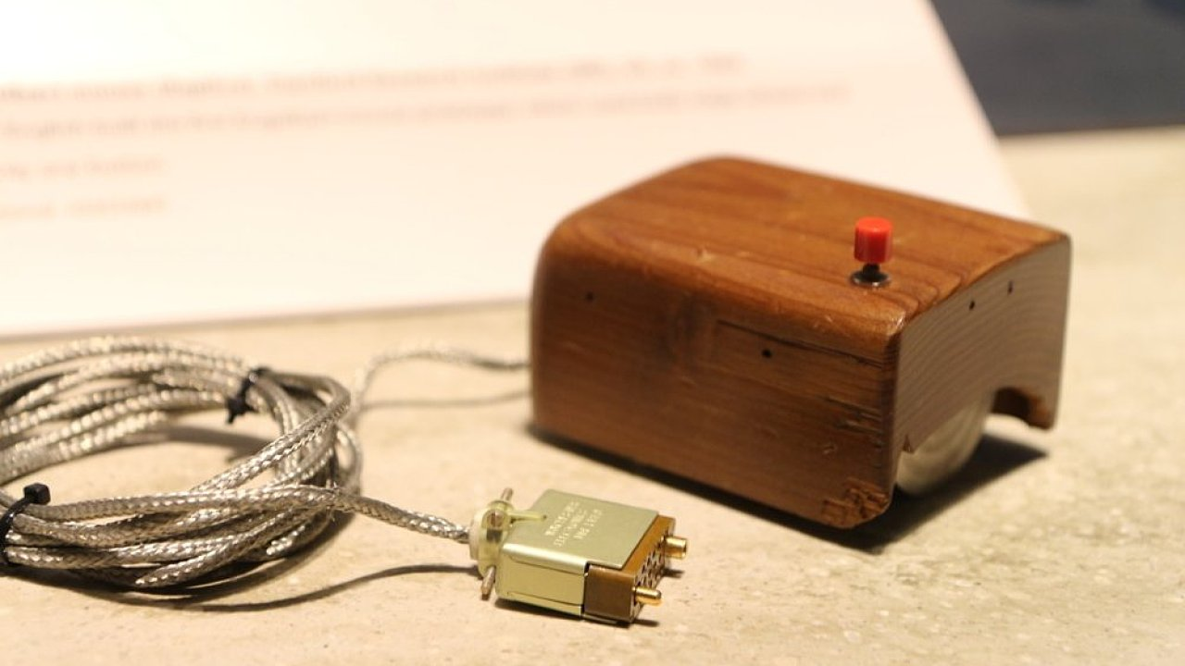
Product development

Slide 49
Product development
Product innovation includes various activities - product improvement, new product development, product expansion, or product line upgrades.
New products can be established by the company in two ways:
  acquisition - purchase of an entire company, patent or production license from someone else,
  development of new products in its own development department.
These are the make or buy decisions.

Slide 50
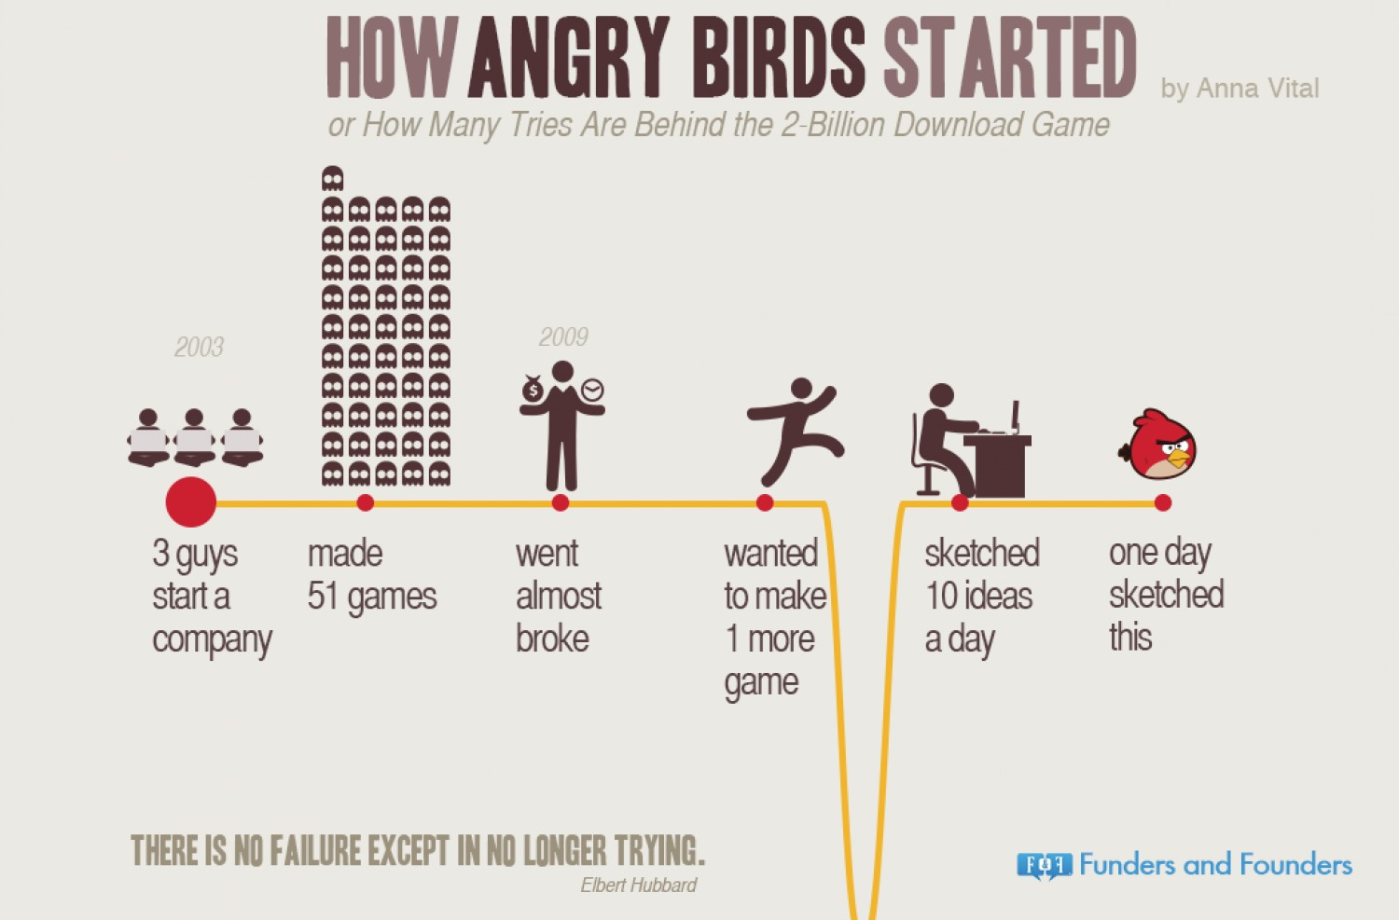
Product development

Slide 51
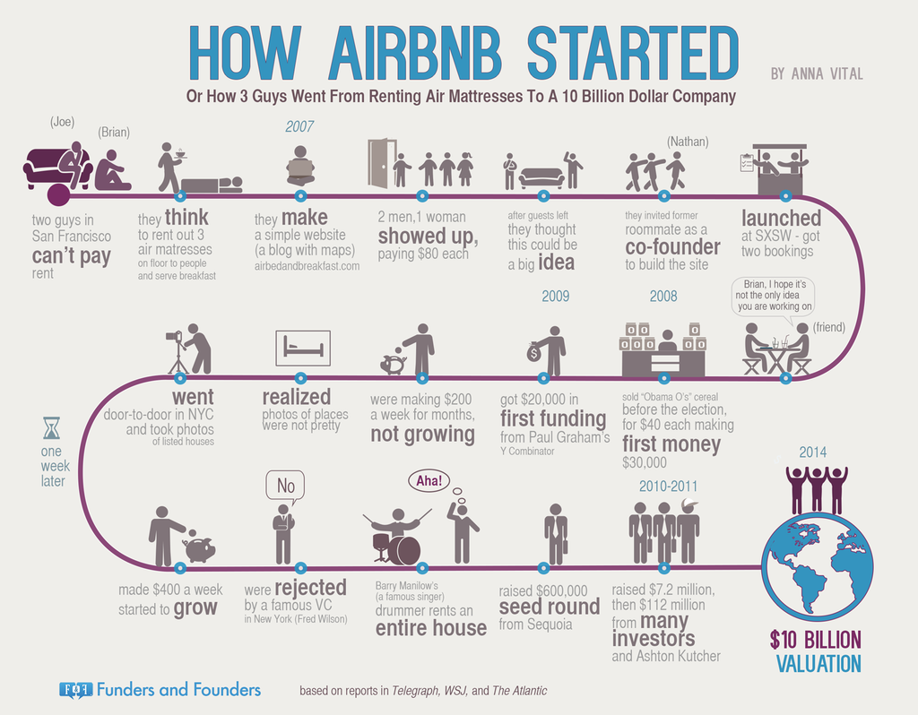
Product development

Slide 52
New product development process
Generate ideas
Idea screening
Creating a concept or prototype
Creating a marketing strategy
Business analysis
Product development
Test Marketing
Commercialization

Slide 53
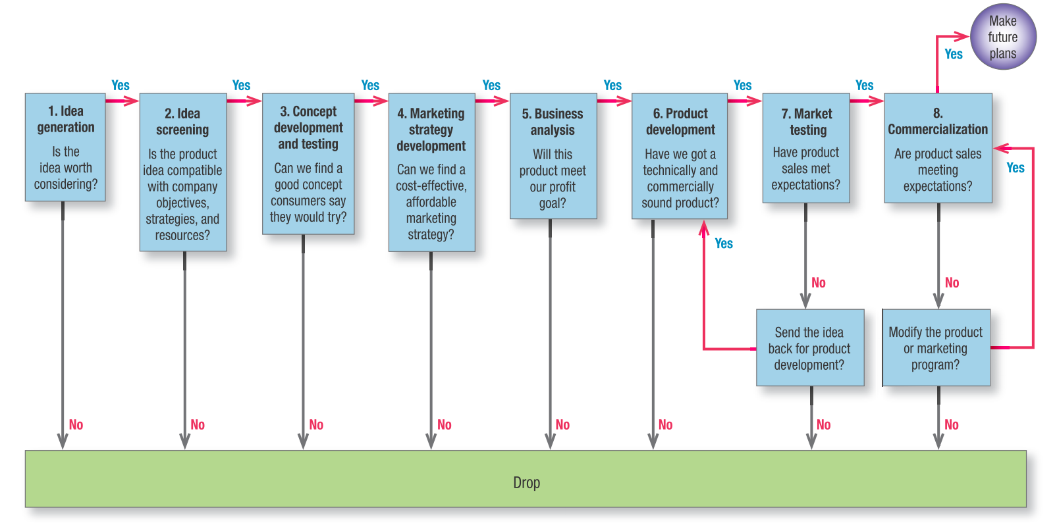
New product development process

Slide 54
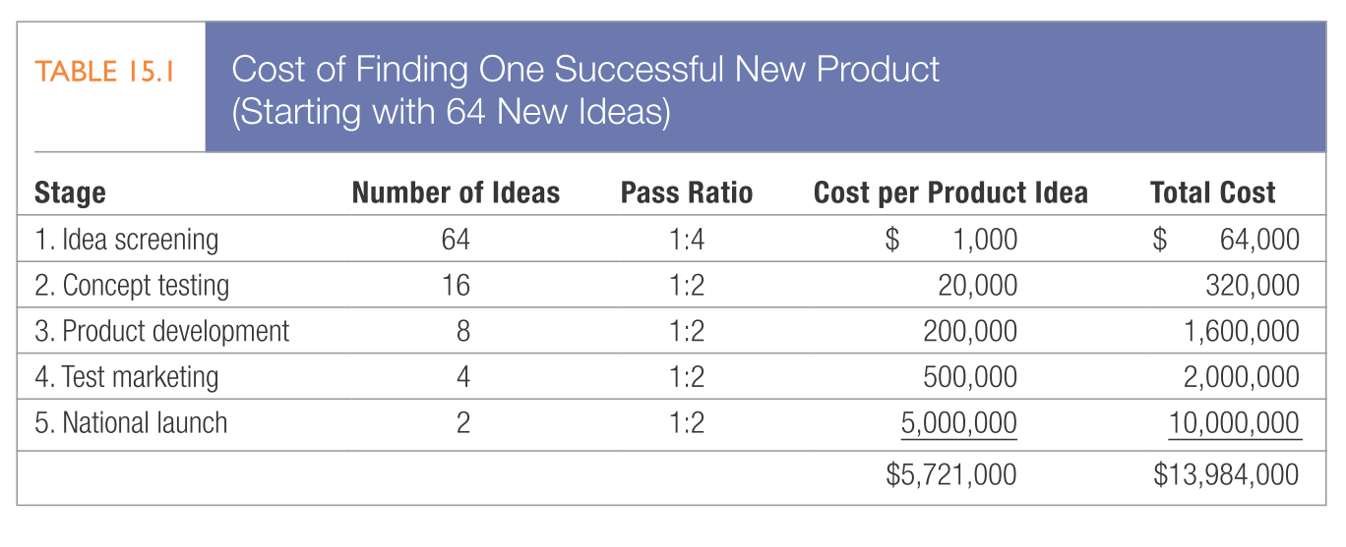
New product development costs

Slide 55
Design Thinking
At the center of attention is man, not technology or product.
Active engagement of a company to create a product with customers.
Empathy
User testing
Innovation is understood as applied creativity to a problem where results can be measured - market share, profitability

Slide 56
New methods for product development
Crowdsourcing
  Drawing an idea from people
  Customers or fans
  This form of product development has been enabled thanks to technological development
Crowdfunding
  Financing development
  Product launch financing
  Kickstarter or Indiegogo
  A relatively safe way combining market validation and product introduction

Slide 57

Summary
Products include more than just tangible goods. Broadly defined, products include physical objects, services, events, persons, places, organizations, ideas or mixes of these entities. Throughout this presentation, we use the term product broadly to include any or all of these entities. Thus, an Apple iPad, a Toyota Avensis and a tin of Dulux paint are products. But so are a skiing holiday, HSBC banking services and advice from your doctor. Because of their importance in the world economy, services are given our special attention. Services are a form of product that consists of activities, benefits or satisfactions offered for sale that are essentially intangible and do not result in the ownership of anything. Examples are banking, hotel, airline, retail, accounting and home repair services.

Slide 58
End of presentation
THANKS FOR YOUR ATTENTION.

