Slide 1
THE MEANING OF CORPORATE SOCIAL RESPONSIBILITY
INTRODUCTION OF CORPORATE RESPONSIBILITY
Ing. Pavel Adámek, Ph.D.
CORPORATE SOCIAL RESPONSIBILITY/PEM-NACSR

Slide 2
CORPORATE SOCIAL RESPONSIBILITY
What do you expect from the subject Corporate Social Responsibility (CSR)?
☺…..

Slide 3
THE MEANING OF CORPORATE SOCIAL RESPONSIBILITY
Outline of the lecture
Definitions of corporate responsibility
Carroll’s Pyramid of Corporate Social Responsibility
Drivers pushing business towards CSR
Triple Bottom Line

Slide 4
THE MEANING OF CORPORATE SOCIAL RESPONSIBILITY
WHY CORPORATE RESPONSIBILITY?
The entirety of CSR can be discerned from the three words this phrase contains: corporate, social, and responsibility.
CSR covers the relationship between corporations (or other non-profit organizations) and societies with which they interact.
CSR provides a framework that helps firms embrace decisions and adjust the internal strategic planning process to maximize the long-term viability of the organization.

Slide 5
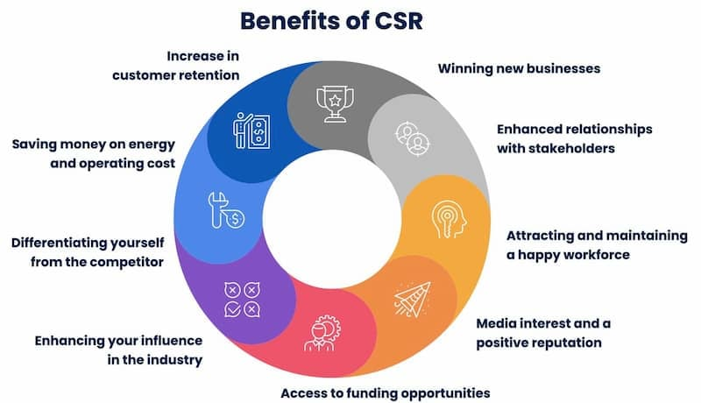
THE MEANING OF CORPORATE SOCIAL RESPONSIBILITY
WHY CORPORATE RESPONSIBILITY?

Slide 6
THE MEANING OF CORPORATE SOCIAL RESPONSIBILITY
WHY CORPORATE RESPONSIBILITY?
Business and organizations do not operate in a vacuum. Their relationship to the society and environment in which they operate is a critical factor in their ability to continue to operate effectively. It is also increasingly being used as a measure of their overall performance.
Organizations around the world, and their stakeholders, are becoming increasingly aware of the need for, and benefits of, socially responsible behavior. The objective of social responsibility is to contribute to sustainable development.
An organization’s commitment to the welfare of society and the environment has become a central criterion in measuring its overall performance and its ability to continue operating effectively.

Slide 7
THE MEANING OF CORPORATE SOCIAL RESPONSIBILITY
WHY CORPORATE RESPONSIBILITY?
The history of CSR is strongly intertwined with the emergence over the past forty years of the environment as a worldwide concern and the eventual transformation of the term into “sustainable development” which incorporates social issues alongside environmental and development ones.
This is because sustainable development has been translated into a managerial approach - CSR which integrates the businesses’ financial performance with their externalities for human development and the environment.

Slide 8
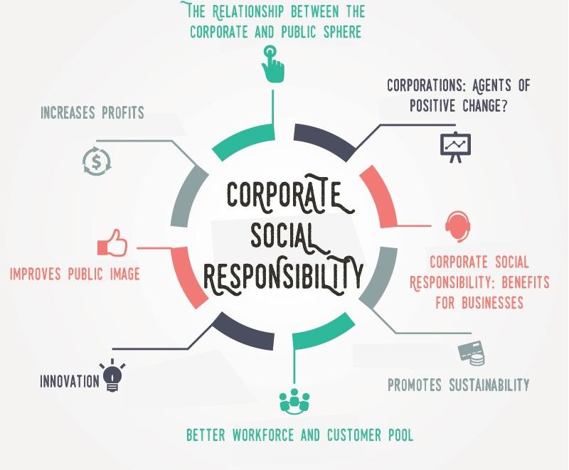
THE MEANING OF CORPORATE SOCIAL RESPONSIBILITY
WHY CORPORATE RESPONSIBILITY?
In the interest of enterprises - CSR provides important benefits to companies in risk management, cost savings, access to capital, customer relationships, HR management, and their ability to innovate.
In the interest of the (EU) economy - CSR makes companies more sustainable and innovative, which contributes to a more sustainable economy (circular economy=circularity).
In the interests of society - CSR offers a set of values on which we can build a more cohesive society and base the transition to a sustainable economic system.

Slide 9
THE MEANING OF CORPORATE SOCIAL RESPONSIBILITY

Slide 10
THE MEANING OF CORPORATE SOCIAL RESPONSIBILITY
WHY CORPORATE RESPONSIBILITY?
Importance of corporate social responsibility
CSR can help you improve your business performance, increase competitive advantage and build trust with customers and employees.
It can also help you achieve operational cost savings, by avoiding costs of wasted energy or unnecessary fees..
Perhaps most importantly, CSR gives your company and your brand a positive image of a reputable ethical business.

Slide 11
THE MEANING OF CORPORATE SOCIAL RESPONSIBILITY
CISCO – CSR Strategy
https://www.cisco.com/c/m/en_us/about/csr/esg-hub/governance/strategy.html

Slide 12
THE MEANING OF CORPORATE SOCIAL RESPONSIBILITY
WHY CORPORATE RESPONSIBILITY?
Features of Corporate Social Responsibility
The United Nations Industrial Development Organization notes that the common functions of corporate social responsibility include:
Responsible sourcing of materials and supplies.
Employee, vendor, customer and community engagement and relations.
Adherence to labor standards.
Environmental protection and management.
Anti-corruption measures.
Upholding social equity, gender equity and other human rights Goals.
Conservation of resources, like water and energy, in production.

Slide 13
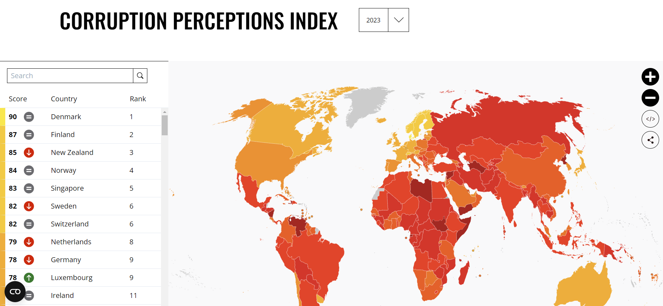
3 pilíře CSR
Source:
https://www.transparency.org/en/cpi/2023

Slide 14
THE MEANING OF CORPORATE SOCIAL RESPONSIBILITY
1. DEFINITIONS OF CORPORATE RESPONSIBILITY
The lack of commonly agreed definition of CSR.
The term CSR is often used interchangeably with others, including corporate responsibility, corporate citizenship, business in society, social enterprise, sustainability, sustainable development, triple bottom line, social value-added, strategic philanthropy, corporate ethics, and in some cases also corporate governance.
There are also clear links between these terms and those relating to socially responsible investments, community investing, social capital, and collaborative governance…

Slide 15
THE MEANING OF CORPORATE SOCIAL RESPONSIBILITY
1. DEFINITIONS OF CORPORATE RESPONSIBILITY
Corporations have a Responsibility to those groups and individuals that they can affect, i.e. its stakeholders, and to society at large. Stakeholders are usually defined as customers, suppliers, employees, communities and shareholders or other financiers. (Financial Times Lexicon, lexicon.ft.com)
CSR is a concept whereby companies integrate social and environmental concerns in their business operations and in their interactions with their stakeholders on a voluntary basis. (European Commision)
CSR is the proposition that companies are Responsible not only for maximizing profits, but also for recognizing the needs of such stakeholders as employees, customers, demographic groups and even the regions they serve. (PricewaterhouseCoopers)

Slide 16
THE MEANING OF CORPORATE SOCIAL RESPONSIBILITY
1. DEFINITIONS OF CORPORATE RESPONSIBILITY
Corporate Social Responsibility is the continuing commitment by business to contribute to economic development while improving the quality of life of the workforce and their families as well as of the community and society at large. (World Business Council for Sustainable Development)
CSR is a commitment to improve community well-being through discretionary business practices and contributions of corporate resources; and „Corporate social initiatives are major activities undertaken by a corporation to support social causes and to fulfil commitments to corporate social responsibility”. (Kotler, P., Lee, N. 2005)
Causes that can be supported through these initiatives are those that contribute to: (a) community health, safety, education, and employment; (b) the environment; (c) community and economic development and other basic human needs.

Slide 17
THE MEANING OF CORPORATE SOCIAL RESPONSIBILITY
1. DEFINITIONS OF CORPORATE RESPONSIBILITY
Carroll (1979) “The social responsibility of business encompasses the economic, legal, ethical, and discretionary expectations that society has of organizations at a given point in time.”
Carroll (1983) “In my view, CSR involves the conduct of a business so that it is economically profitable, law abiding, ethical and socially supportive. To be socially responsible… then means that profitability and obedience to the law are foremost conditions to discussing the firm’s ethics and the extent to which it supports the society in which it exists with contributions of money, times and talent. Thus, CSR is composed of four parts: economic, legal, ethical and voluntary or philanthropic.”

Slide 18
THE MEANING OF CORPORATE SOCIAL RESPONSIBILITY
1. DEFINITIONS - SUMMARY
Facts can be summarized in the summary, which is characterized by the basic facts of corporate social responsibility:
CSR is a voluntary act (adoption of CSR is entirely voluntary, beyond legislation);
the concept is "partially" surrounded by areas of social, environmental and economic;
concept may have implications in improving living, working and environmental conditions of all stakeholders.

Slide 19
THE MEANING OF CORPORATE SOCIAL RESPONSIBILITY
2. Carroll’s Pyramid of Corporate Social Responsibility
Carroll (1991) organized different corporate social responsibilities as a four-layered pyramid model and called it the pyramid of responsibilities.
The four different responsibilities - economical, legal, ethical and philanthropic are the layers of the pyramid.
The pyramid of responsibilities should be seen as a whole and the different parts should not be separated.

Slide 20
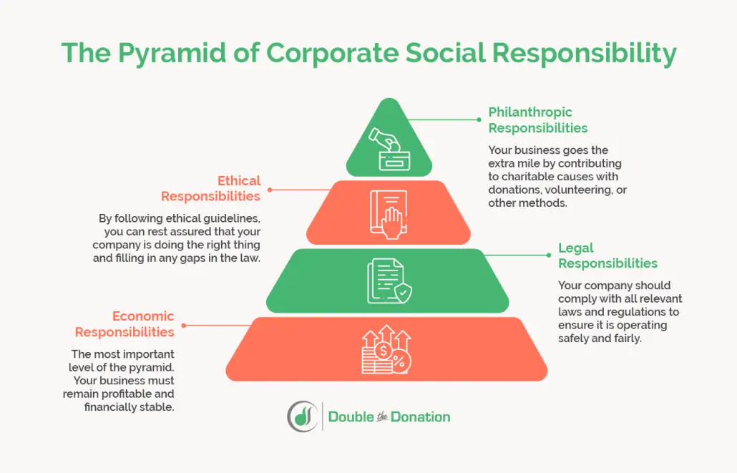
The Corporate Social Responsibility Hierarchy
Developed by Archie B. Carroll in 1991.
Demonstrates on organization's hierarchy of responsibilities.
He asserted that only by carrying out all of these responsibilities together would effective CSR be achieved.

Slide 21
THE MEANING OF CORPORATE SOCIAL RESPONSIBILITY
2. Carroll’s Pyramid of Corporate Social Responsibility
To be profitable as a company, minimize cost and maximize sales or make sensible strategic decisions are at the base of economic responsibilities. Economic performance is required by the society.
The second layer is the legal responsibilities and it is also required by society. In these responsibilities' companies are expected to obey the law, because the law mirrors show the society regards as accepted or unaccepted.
The difference of the ethical responsibilities from the first two responsibilities is that the ethical responsibilities are not required but expected by society.
The philanthropic responsibilities stand at the top of the pyramid and to be a good corporate citizen and improve the quality of life for the society is the aim of these responsibilities.

Slide 22
THE MEANING OF CORPORATE SOCIAL RESPONSIBILITY
3. DRIVERS PUSHING BUSINESS TOWARDS CSR
The shrinking role of government - In the past, governments have relied on legislation and regulation to deliver social and environmental objectives in the business sector. Shrinking government resources, coupled with a distrust of regulations, has led to the exploration of voluntary and non-regulatory initiatives instead.
Demands for greater disclosure - a growing demand for corporate disclosure from stakeholders, including customers, suppliers, employees, communities, investors, and activist organizations.
Increased customer interest - evidence that the ethical conduct of companies exerts a growing influence on the purchasing decisions of customers.

Slide 23
THE MEANING OF CORPORATE SOCIAL RESPONSIBILITY
3. DRIVERS PUSHING BUSINESS TOWARDS CSR
Growing investor pressure - investors are changing the way they assess companies' performance and are making decisions based on criteria that include ethical concerns.
Competitive labour markets - employees are increasingly looking beyond paychecks and benefits, and seeking out employers whose philosophies and operating practices match their own principles. In order to hire and retain skilled employees, companies are being forced to improve working conditions.
Supplier relations - as stakeholders are becoming increasingly interested in business affairs, many companies are taking steps to ensure that their partners conduct themselves in a socially responsible manner. Some are introducing codes of conduct for their suppliers, to ensure that other companies' policies or practices do not tarnish their reputation.

Slide 24
THE MEANING OF CORPORATE SOCIAL RESPONSIBILITY
4. TRIPLE BOTTOM LINE
The term was coined by John Elkington in 1994 and later used in his 1997 book "Cannibals With Forks: The Triple Bottom Line Of 21st Century Business" describing the separate financial, social and environmental "bottom lines" of companies.
The Triple Bottom Line (TBL), in congruence with sustainable development and corporate social responsibility, incorporates three dimensions, often referred to as the three Ps, people, planet and profit.
Triple Bottom Line works on the assumption that the corporation is a member of the moral community, and this gives it social responsibilities.

Slide 25
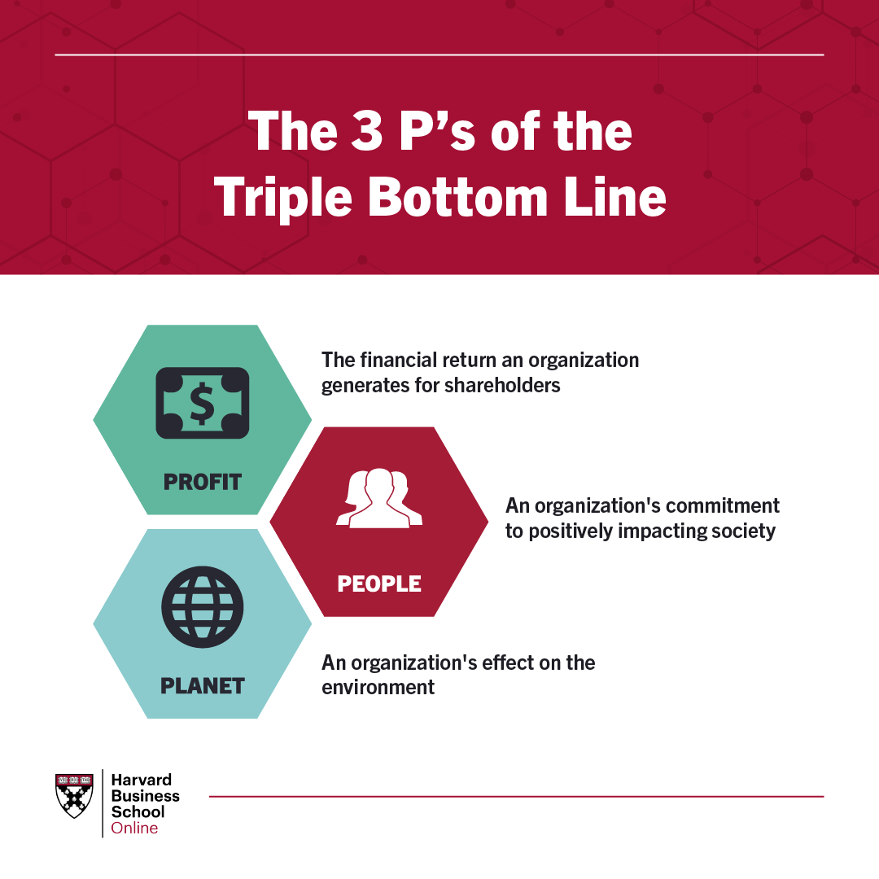
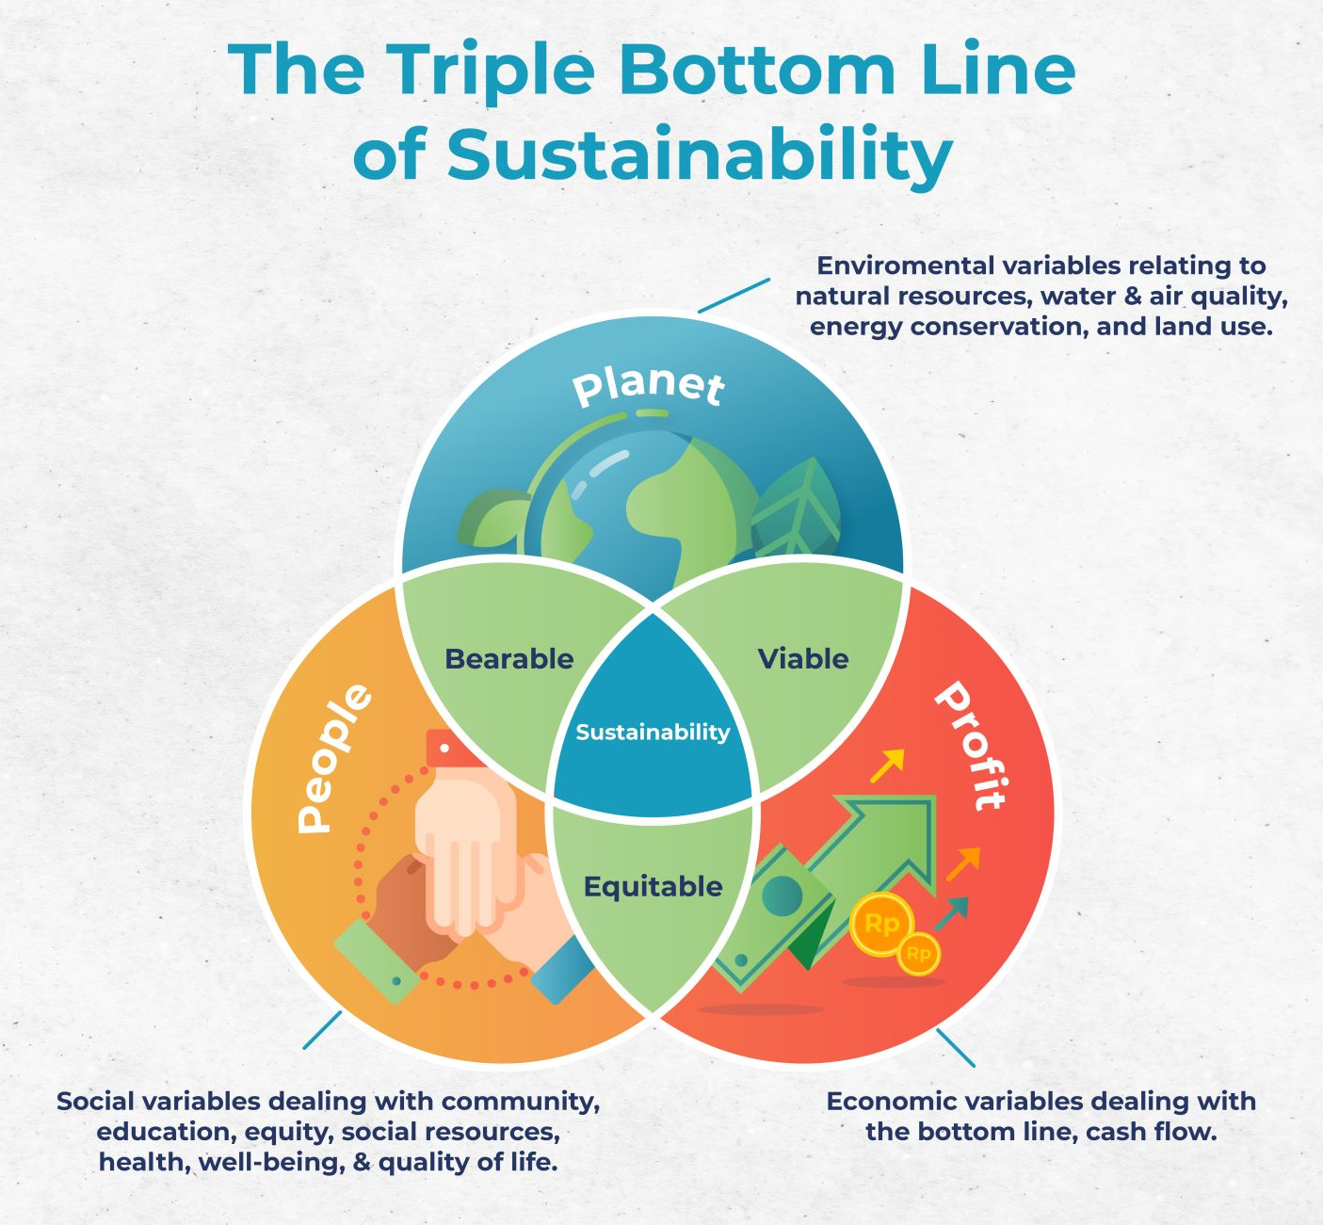
2. Core Elements of Corporate Social Responsibility
The triple bottom line (TBL, John Elkington, 1994) is a business concept that states firms should commit to measuring their social and environmental impact—in addition to their financial performance—rather than solely focusing on generating profit.
Profit – Economic pillar
People – Social pillar
Planet – Environmental pillar

Slide 26
THE MEANING OF CORPORATE SOCIAL RESPONSIBILITY
4. TRIPLE BOTTOM LINE
This theory focuses on sustainability, and requires that any company weigh its actions on three independent scales: economic sustainability, social sustainability, and environmental sustainability.
The triple bottom line is a form of corporate social responsibility dictating that corporate leaders tabulate bottom-line results not only in economic terms (costs versus revenue) but also in terms of company effects in the social realm, and with respect to the environment.
Many organizations have adopted the TBL framework to evaluate their performance in a broader perspective to create greater business value.

Slide 27
THE MEANING OF CORPORATE SOCIAL RESPONSIBILITY
4. TRIPLE BOTTOM LINE
Economic sustainability must focus on the long term because this is the nature of a persistent company. A decision which creates an economic boon in the short-term, but causes long-term harm, would likely reduce this bottom line to such a degree that the action would be untenable.
Social sustainability gives precedence on the balance of economic power in the society. Competition in the business arena is common, and encouraged, behavior, but maximizing the bottom line in social terms requires that a business foster an environment in which all can succeed.
The requirement of environmental sustainability stems from the recognition that resources are not infinite, and leads to the reasoning that too much degradation will worsen the lives of ourselves, our children and so on.

Slide 28
THE MEANING OF CORPORATE SOCIAL RESPONSIBILITY
4. TRIPLE BOTTOM LINE
The challenges of putting the TBL into practice relate to the measurement of social and ecological categories. Despite this, the TBL framework enables organizations to take a longer-term perspective and thus evaluate the future consequences of decisions.
Calculating the TBL
The 3Ps do not have a common unit of measure. Profits are measured in euros, dollars… What is social capital measured in? What about environmental or ecological health? Finding a common unit of measurement is one challenge.
Some advocate monetizing all the dimensions of the TBL, including social welfare or environmental damage.

Slide 29
THE MEANING OF CORPORATE SOCIAL RESPONSIBILITY
4. TRIPLE BOTTOM LINE
Calculating the TBL
Another solution would be to calculate the TBL in terms of an index.
In this way, one eliminates the incompatible units issue and, as long as there is a universally accepted accounting method, allows for comparisons between entities, e.g., comparing performance between companies, cities, development projects or some other benchmark.

Slide 30
THE MEANING OF CORPORATE SOCIAL RESPONSIBILITY
4. TRIPLE BOTTOM LINE
Economic Measures - economic variables ought to be variables that deal with the bottom line and the flow of money. It could look at income or expenditures, taxes, business climate factors, employment, and business diversity factors. Specific examples include:
Personal income
Cost of underemployment
Establishment churn
Establishment sizes
Job growth
Employment distribution by sector
Percentage of firms in each sector
Revenue by sector contributing to gross state product

Slide 31
THE MEANING OF CORPORATE SOCIAL RESPONSIBILITY
4. TRIPLE BOTTOM LINE
Environmental Measures - environmental variables should represent measurements of natural resources and reflect potential influences to its viability. It could incorporate air and water quality, energy consumption, natural resources, solid and toxic waste, and land use/land cover. Ideally, having long-range trends available for each of the environmental variables would help organizations identify the impacts a project or policy would have on the area. Specific examples include:
Sulfur dioxide concentration
Concentration of nitrogen oxides
Selected priority pollutants
Excessive nutrients
Electricity consumption
Fossil fuel consumption
Solid waste management
Hazardous waste management
Change in land use/land cover

Slide 32
THE MEANING OF CORPORATE SOCIAL RESPONSIBILITY
4. TRIPLE BOTTOM LINE
Social Measures - social variables refer to social dimensions of a community or region and could include measurements of education, equity and access to social resources, health and well-being, quality of life, and social capital. The examples listed below are a small snippet of potential variables:
Unemployment rate
Female labor force participation rate
Median household income
Relative poverty
Percentage of population with a post-secondary degree or certificate
Average commute time
Violent crimes per capita
Health-adjusted life expectancy

Slide 33
THE MEANING OF CORPORATE SOCIAL RESPONSIBILITY
summary of the lecture
Businesses worldwide are increasingly worried about the impact of their business activities on society.
By its very nature CSR is a complex, multiform phenomenon emerging as the interface between enterprises and society.
Social and environmental consequences have started to being weighed against economic gains and short-term profit against long-term prosperity by the businesses in order to maintain long-term sustainable growth and development.

Slide 34
We can share our thoughts and ask questions ☺
Pavel Adámek
adamek@opf.slu.cz

