Slide 1

EVOLUTION OF CORPORATE SOCIAL RESPONSIBILITY
HISTORY OVERVIEW OF CORPORATE SOCIAL RESPONSIBILITY APPROACHES
Ing. Pavel Adámek, Ph.D.
CORPORATE SOCIAL RESPONSIBILITY/PEM-NACSR

Slide 2
EVOLUTION OF CORPORATE SOCIAL RESPONSIBILITY
Outline of the lecture
Introduction
CSR in the 1960s
CSR in the 1970s
CSR in the 1980s
CSR in the 1990s
CSR in the 21st century
European and international influences on CSR

Slide 3

EVOLUTION OF CORPORATE SOCIAL RESPONSIBILITY
1. INTRODUCTION
The concept of CSR was originally coined in the 1930s by two Harvard University professors A. A. Berle and C. G. Means. In the book The Modern Corporation and Private Property, they advocate upholding the rights of shareholders, and greater transparency and accountability in large organisations where ‘ownership’ and ‘control’ are separated due to regulatory instruments.
The focus on this changing notion of ‘private property’ towards public ownership of corporations was initiated soon after the Wall Street crash of 1929 when the ideologies of capitalism revealed corporate irresponsibility.

Slide 4
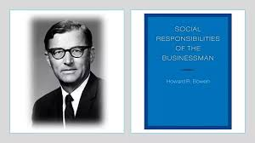
EVOLUTION OF CORPORATE SOCIAL RESPONSIBILITY
1. INTRODUCTION
Bowen expected businesses to produce social goods:
  higher standards of living;
  widespread economic progress and security;
  order, justice and freedom, and finally;
  the development of the individual person.
In his view, CSR includes responsiveness, stewardship, social audit, corporate citizenship and rudimentary stakeholder theory.
In academic literature, formal writings on CSR are evident for the first time in Bowen's (1953) Social Responsibilities of the Businessman.
He defines CSR as: The obligations of businessmen to pursue those policies, to make those decisions or to follow those lines of action which are desirable in terms of the objectives and values of our society.

Slide 5
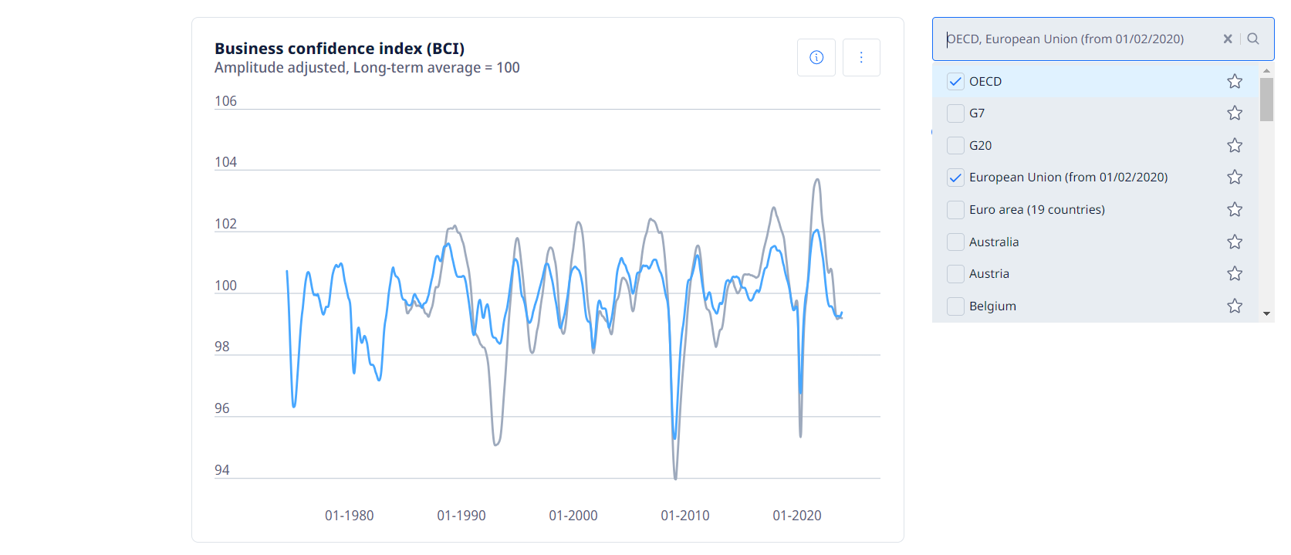
EVOLUTION OF CORPORATE SOCIAL RESPONSIBILITY
Business confidence index (BCI) is a standardised confidence indicator providing an indication of future developments in business, based upon opinion surveys on developments in production, orders and stocks of finished goods in the manufacturing sector.
Source: OECD, 2024 https://www.oecd.org/en/data/indicators/business-confidence-index-bci.html?oecdcontrol-b2a0dbca4d-var3=1974-06&oecdcontrol-b2a0dbca4d-var4=2024-01&oecdcontrol-cf46a27224-var1=OECD%7CEU27_2020

Slide 6
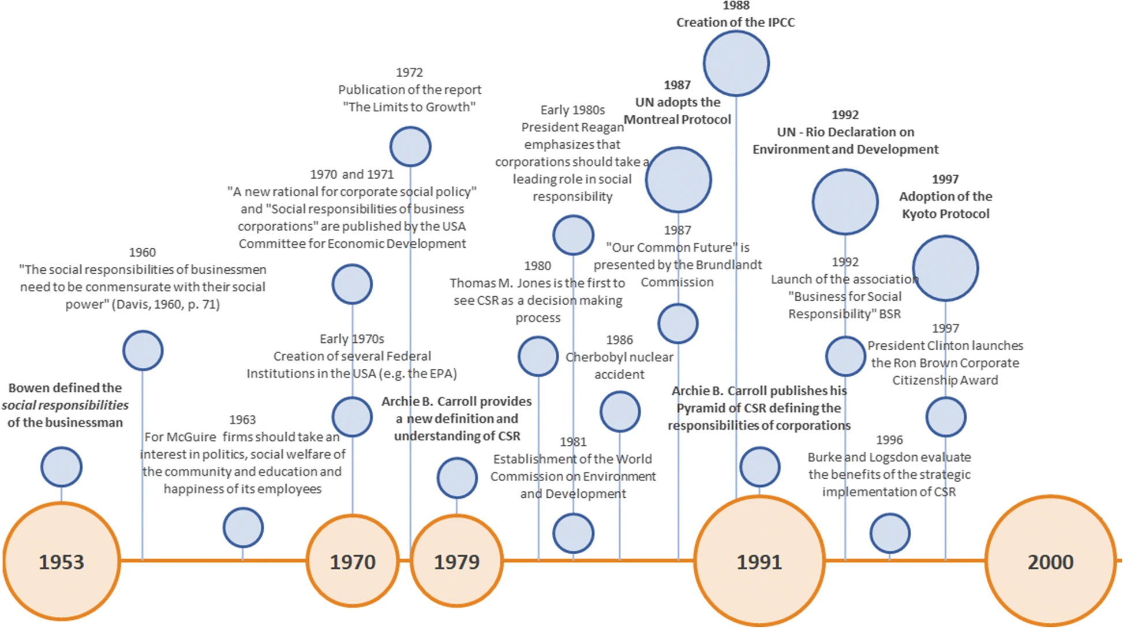
The Evolution of CSR - Timeline of key CSR events
Source: Latapí Agudelo, M.A., Jóhannsdóttir, L. & Davídsdóttir, B. A literature review of the history and evolution of corporate social responsibility. Int J Corporate Soc Responsibility 4, 1 (2019).

Slide 7
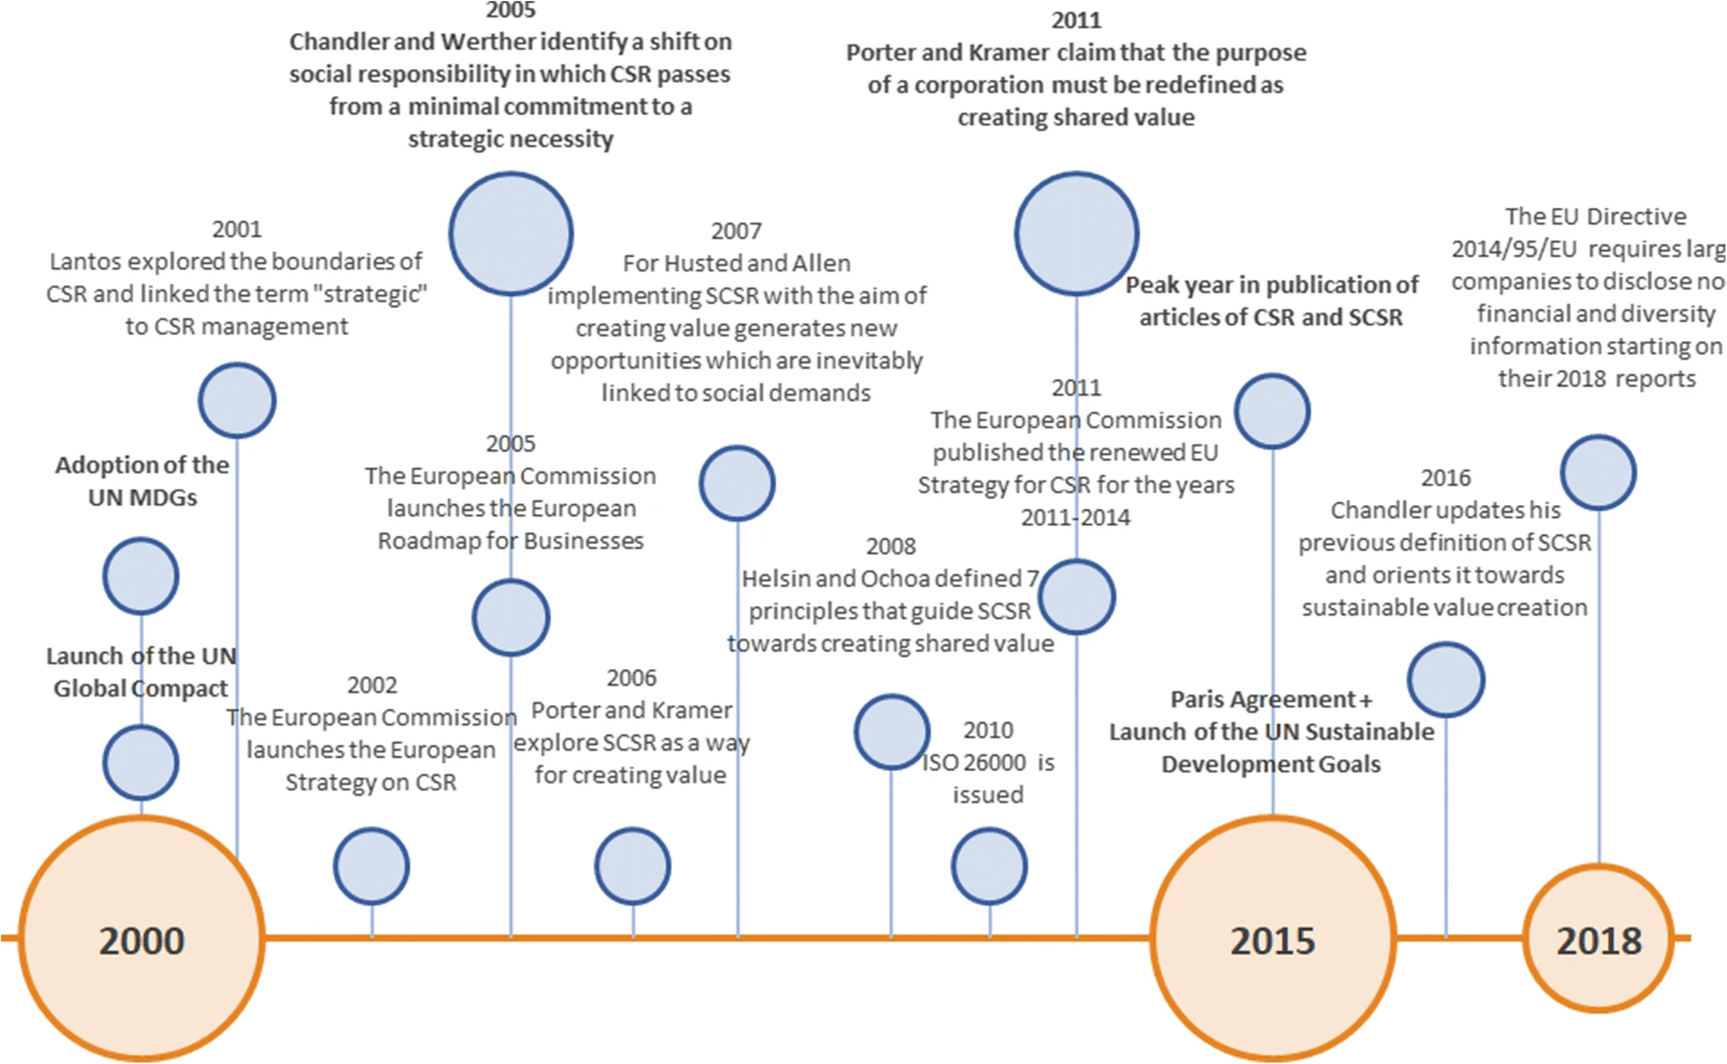


The Evolution of CSR - Timeline of key CSR events
Source: Latapí Agudelo, M.A., Jóhannsdóttir, L. & Davídsdóttir, B. A literature review of the history and evolution of corporate social responsibility. Int J Corporate Soc Responsibility 4, 1 (2019).

Slide 8
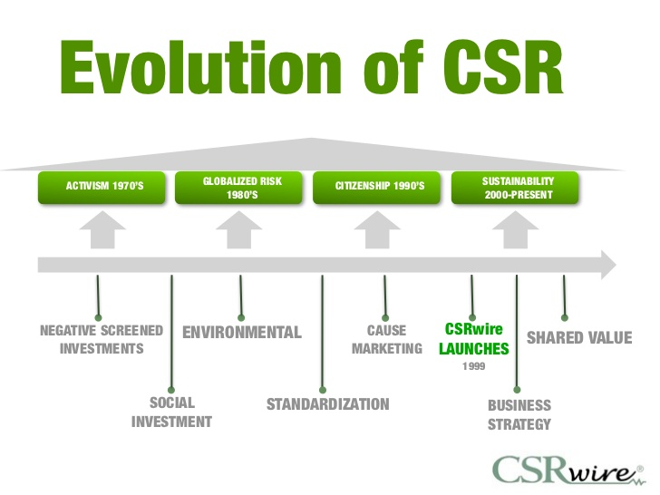
EVOLUTION OF CORPORATE SOCIAL RESPONSIBILITY
Timeline of Corporate Responsibility

Slide 9
EVOLUTION OF CORPORATE SOCIAL RESPONSIBILITY
2. CSR in the 1960s
There was significant formalisation of the concept during this period.
Some prominent important representatives of the decade were Keith Davis, Joseph W. McGuire, William C. Frederick and Clarence C. Walton.
Each has their own interpretations of CSR but all of them unanimously agree on the fact that business responsibility should exceed the economic interests of the organisation.

Slide 10
EVOLUTION OF CORPORATE SOCIAL RESPONSIBILITY
2. CSR in the 1960s
Davis (1960) suggests that ‘social responsibility refers to the businessmen's decision and action taken for reasons, at least, partially beyond the firm's direct economic and technical interest’.
  CSR being a nebulous idea, he believed, could possibly bring enduring economic gains to the organisation as a return for its socially responsible stance.
  His ‘Iron law of responsibility' states: 'social responsibilities of businessmen need to be commensurate with their social power', echoing the significance of 'social values' and 'corporate power.
Frederick (1960) defines it as the use of society’s resources, economic and human, in such a way that the whole society derives maximum benefits beyond the corporate entities and their owners. His explanation clearly indicates that the responsibility of management is not just creating wealth for the business, but for the society too.

Slide 11
EVOLUTION OF CORPORATE SOCIAL RESPONSIBILITY
2. CSR in the 1960s
Further attempts by McGuire (1963) to elaborate the construct ‘CSR’, support Frederick’s approach by focussing on the firm’s obligations extending beyond the economic and legal domains, to include employee and community welfare and the political and educational needs of the society.
Following this, the notion of 'voluntarism' was acknowledged for the first time by Walton (1967) in his book Corporate Social Responsibilities. Walton was of the opinion that the social responsibility of a corporation always includes a certain degree of voluntarism, since companies have to accept that costs are involved in social actions without any measurable economic return.
He also argues that external stakeholders have a different set of priorities and enterprises have choices, voluntary actions to meet the expectations of external stakeholders.

Slide 12
EVOLUTION OF CORPORATE SOCIAL RESPONSIBILITY
2. CSR in the 1960s
The real debate was instigated when Friedman (1962) strongly opposed the doctrine of CSR as ‘fundamentally subversive’. According to him, the only responsibility of the management is to maximise the profits of its owners and shareholders. As an economist, he believed, only individuals can have responsibilities.
These approaches indicate that firms and businessman are expected to look at concerns that are wider than the technical and economic aspects of the organisation.
Such theories can be considered as the basic foundations of the modern CSR.

Slide 13
EVOLUTION OF CORPORATE SOCIAL RESPONSIBILITY
3. CSR in the 1970s
The first reference to stakeholders was made in Harold Johnson’s (1971) Business in contemporary society: framework and issues. The conventional of CSR is identified by Johnson as being that ‘a socially responsible firm is one whose managerial staff balances a multiplicity of interests instead of striving only for larger profits for its shareholders’.
The second pluralistic definition according to Johnson (1971) is that ‘social responsibility assumes that the prime motivation of the business firm is profit maximisation; the business seeks multiple goals rather than only profit maximisation’.
This can be perceived as a forerunner of stakeholder theory on CSR participation.

Slide 14
EVOLUTION OF CORPORATE SOCIAL RESPONSIBILITY
3. CSR in the 1970s
One of the most important contributions to the definition of CSR was made by the Committee for Economic Development (CED) in 1971. The CED articulated a triple concentric model of the concept. The inner circle includes the clear-cut basic responsibilities for the efficient execution of economic functions like productivity, job and economic growth reflecting.
CED Model
Inner circle: Clear- cut basic responsibilities.
Intermediate circle: Exercise economic function with awareness of social values.
Outer circle: Newly emerging responsibilities that business should strive to become more broadly involved in for improvement of social environment.

Slide 15
EVOLUTION OF CORPORATE SOCIAL RESPONSIBILITY
3. CSR in the 1970s
This shift in the paradigm of CSR from ‘the philosophical and moral obligation’ (CSR1) to ‘the managerial and organizational action’ (CSR2) was later documented by Frederick (1978).
While CSR1 tends to be reactive, responding to the business environment and social pressures, CSR2 is proactive and anticipatory, aiming to impact and change enterprise environments and thereby business performance.
  Within a CSR2 conception of CSR, it is the business which decides on the level of its social response and economic issues take clear precedence over social issues.
In response to the CED’s (1971) separation of economic and the broader social responsibilities across stakeholders, Davis (1973) contended that CSR is a firm’s response to issues beyond the narrow economic, technical and legal requirements of a firm and therefore it begins where the law ends.

Slide 16
EVOLUTION OF CORPORATE SOCIAL RESPONSIBILITY
3. CSR in the 1970s
Eells and Walton (1974) took a broader view of corporate activities which could be assumed as moving towards the concept of social license that was to emerge more fully nearly thirty years later.
  They suggested that a corporate executive must remain grounded in his philosophy, open in his attitude and able to take decisive actions that are immediately profitable and compatible with the accepted values of his society.
Sethi (1975) expounded a similar idea based on enterprises as an integral part of the society. He proposed a three-tiered model that classified corporate behaviour in terms of increasing levels of commitment by enterprises, namely, social obligation (a response to legal and market constraints); social responsibility (congruent with societal norms); and social responsiveness (adaptive, anticipatory and preventive).

Slide 17
EVOLUTION OF CORPORATE SOCIAL RESPONSIBILITY
3. CSR in the 1970s
Towards the middle of this period, Ackerman and Bauer (1976) proposed a sociological view of CSR.
They define the social responsibility of an enterprise in terms of its impact on its constituencies: its employees, customers, owners, vendors, and the immediate and larger communities.
Three major contributions to the debate on CSR:
  the success of CSR programs is dependent on the chief executive officers of large companies and owners in SMEs, who should be champions in displaying business Responsibility,
  enterprises should be proactive,
  both external and internal stakeholders can participate in CSR.

Slide 18
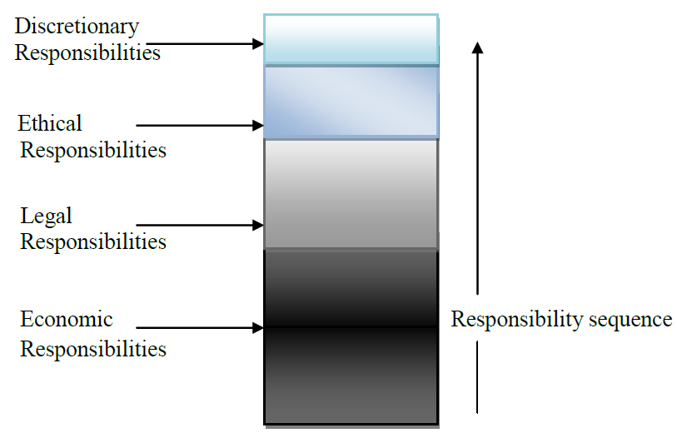
EVOLUTION OF CORPORATE SOCIAL RESPONSIBILITY
3. CSR in the 1970s
A step towards addressing this confusion was taken by Carroll after putting forward a comprehensive explanation of CSR.
Carroll (1979) developed a four-part corporate social performance model that accommodates Friedman’s (1970) view of the responsibilities of the firm. The component parts are focused on the capitalistic and societal expectations.
Social Responsibility categories
Source: Carroll (1979)

Slide 19
EVOLUTION OF CORPORATE SOCIAL RESPONSIBILITY
4. CSR in the 1980s
One of the first noteworthy definitions in the 1980s was that of Thomas M. Jones. He defines CSR as the ‘notion that corporations have an obligation to constituent groups and society other than stockholders and beyond that prescribed by law and union contract’.
He acknowledges that business and society are interwoven as opposed to being distinct entities. Carroll points out that a key part of the above definition is how ‘this obligation is broad and voluntary’.
In 1981, Frank Tuzzolino and Barry Armandi developed a more effective tool for assessing CSR using Carroll’s definition of CSR and Maslow’s (1954) hierarchy of needs model.
  They explained the different needs of various organisations. Their organisational need hierarchy did not redefine CSR, but suggested that organisations, like individuals, have needs they want to fulfil.

Slide 20
EVOLUTION OF CORPORATE SOCIAL RESPONSIBILITY
4. CSR in the 1980s
Numerous representatives had tried to develop tools for assessing CSR by the time Freeman (1984) published his landmark book Strategic Management: A Stakeholder Approach.
Freeman’s book provides the basis for stakeholder theory which is widely accepted by contemporary business organisations as a useful way of investigating an organisational approach to CSR.
Though the book is classified as one focusing on strategic management, its most substantial impact has been in the fields of business and society, corporate social responsibility and eventually business ethics.

Slide 21
EVOLUTION OF CORPORATE SOCIAL RESPONSIBILITY
4. CSR in the 1980s
Wartick and Cochran (1985) developed another model based on Carroll’s (1979) construct of corporate social performance, acknowledging the primacy of economic performance.
Their corporate social performance model extends the three-dimensional integration of responsibility, responsiveness and social issues that Carroll (1979) had previously introduced as a framework of principles, processes and policies.
They argue that Carroll’s CSR definition embraces three ethical components: social responsibility, which should be thought of as principles; social responsiveness, which should be thought of as processes; and social issues management, which should be thought of as policies.

Slide 22
EVOLUTION OF CORPORATE SOCIAL RESPONSIBILITY
4. CSR in the 1980s
Epstein (1987) defines CSR as ‘achieving outcomes from organizational decisions concerning specific issues which have beneficial rather than adverse effects on pertinent corporate stakeholders’.
He viewed the three concepts – social responsibility, social responsiveness and business ethics as ‘corporate social policy processes’.
He explains CSR as the achievement of certain outcomes but when viewed with other constructs, such as business ethics and social responsiveness, it was part of the process.

Slide 23
EVOLUTION OF CORPORATE SOCIAL RESPONSIBILITY
5. CSR in the 1990s
The prominent themes which continued to grow and take centre stage in the 1990s include corporate social performance (CSP), stakeholder theory, business ethics, sustainability and corporate citizenship.
Wood (1991) criticises Carroll’s (1979) approach as involving steps and phases of responsibility.
She views the responsibilities defined by Carroll as being delimited and therefore she considers them to be ‘isolated domains’.
Based on the interconnection between the firm and the society, Wood (1991) superimposes the responsibility categories of CSR with three levels of analysis and allocates principles to them through her own interpretation.

Slide 24
EVOLUTION OF CORPORATE SOCIAL RESPONSIBILITY
5. CSR in the 1990s
Wood suggests that the principle of legitimacy becomes effective on the ‘institutional’ level which states a business must not use its power without justified reasons.
From the ‘organisational’ level, the principle of public Responsibility suggests firms will be responsible for their actions which affect the society directly or indirectly.
Finally, on the ‘individual’ level, managers need to be constantly aware of the need to act according to moral points of view.
Wood (1991) even turned Carroll's (1979) responsibility pyramid upside down to include the interconnection between corporations and society.

Slide 25
EVOLUTION OF CORPORATE SOCIAL RESPONSIBILITY
5. CSR in the 1990s
Simultaneously, Wood assigned the pyramid with three distinct levels – the principle of corporate social responsibility, the principle of corporate social responsiveness and the outcomes of corporate behaviour.
This model proposes that the moral responsibilities of individual managers to make ethical decisions are the basis of CSR components, followed by the organisation's obligation to obey social and legal norms.
Global influences on CSR continued in the 1990s as the roles of business and government continued to blur. In 1997, Solomon argued:
  „New businesses are often the most powerful institutions in the world and the expanse of social responsibility has enlarged to include areas formerly considered as the domain of governments ... The more powerful businesses become, the more responsibility for the well being of the world it will be expected to bear.“

Slide 26
EVOLUTION OF CORPORATE SOCIAL RESPONSIBILITY
5. CSR in the 1990s
As the new millennium approached, Carroll (1999) also suggested that the CSR concept will remain as an essential part of the business language and practice because it is a vital underpinning to many of the theories and is continually consistent with what the public expects of the business community today.

Slide 27
EVOLUTION OF CORPORATE SOCIAL RESPONSIBILITY
6. CSR in the 21st CENTURY
The 21st century has been dominated by several wide-ranging topics including international trade, concerns over energy supply, global warming, the explosion in telecommunications, a growing concern with international terrorism and an escalation of social issues which first became prominent in the 1990s.
Along with the development of global business, recent literature appears to be moving away from a US-dominated discourse to a more international one.
Representatives like Maignan and Ralston (2002), Aaronson (2003), Perrini et al. (2006) and Lucas et al. (2001) studied CSR in France, Netherlands, UK, Italy and Australia. They extended the debate to other countries and compared national perceptions of CSR along with its role in the global society.

Slide 28
EVOLUTION OF CORPORATE SOCIAL RESPONSIBILITY
6. CSR in the 21st CENTURY
Another group of researchers attempted to establish the relationship between social performance and the financial outcome of the organisations.
Orlitzky (2005) found participation in socially responsible activities reduces the financial risk of businesses.
For the first time, several studies of this period aimed to examine CSR in SMEs (Grayson 2004; Spence et. al. 2000; Spence and Rutherford 2003; Tilley 2000). Jenkins (2004) and Castka et al. (2004) criticise the word 'corporate' in the term CSR as misleading because it fails to accommodate and appreciate socially responsible actions undertaken by smaller organisations.

Slide 29
EVOLUTION OF CORPORATE SOCIAL RESPONSIBILITY
6. CSR in the 21st CENTURY
After exploring the characteristics of SMEs in comparison to large organisations, Spence (2007) justifies implementing CSR policies that consider the capacities and capabilities of both the business sectors.
In 2006, Francesco Perrini came up with a suggestion for the use of theories to investigate CSR. He suggested that CSR in large firms should be based on stakeholder theory while CSR in SMEs should be understood through the application of social capital theory.
Later, Russo and Perrini (2009) modified the above conclusion and restated it as ‘social capital and stakeholder theory should be taken as alternative ways of explaining CSR in large organisations and SMEs’. They also opined that SME-CSR relations are better explained in terms of social capital, although it should be accompanied by the stakeholder view of the firm.

Slide 30
EVOLUTION OF CORPORATE SOCIAL RESPONSIBILITY
6. CSR in the 21st CENTURY
Finally, the following statement of Horrigan (2007, p. 85) best portrays the status of CSR at the end of 21st century’s first decade:
  It is also a story of the emergence of a distinctive CSR movement. Both the developer and developing worlds are rapidly reaching the point where they must decide if today’s global CSR movement is a passing social fad, a threat to economically efficient corporate capitalism, an intrinsic element of corporate responsibility, or even a key to humanity’s long-term survival.

Slide 31
EVOLUTION OF CORPORATE SOCIAL RESPONSIBILITY
7. European and international influences on CSR
In the context of national and international developments, Corporate Social Responsibility is becoming an increasingly important element on national and transnational policy agendas.
An ever more diverse range of businesses are adopting CSR strategies as a core part of their business model. In addition to heightened publicity around this issue, the profile of CSR is at least partly due to the emphasis placed on responsible business conduct on the EU policy agenda.
The adoption and dissemination of international standards is also mirrored in developments at the national level. These have gained further recognition as a result of a number of high profile examples of human rights violations in business practice with devastating consequences.

Slide 32
EVOLUTION OF CORPORATE SOCIAL RESPONSIBILITY
7. European and international influences on CSR
The 2011 Commission Communication invited Member States to “develop or update their own plans or national lists of priority actions to promote CSR in support of the Europe 2020 strategy, with reference to recognised CSR principles and guidelines and in cooperation with enterprises and other stakeholders…”.
In this context, the Commission also undertook to “create with Member States in 2012 a Peer Review mechanism for national CSR policies”.
This compendium is one of the outcomes of the Peer Reviews on CSR which took place 2013.

Slide 33

EVOLUTION OF CORPORATE SOCIAL RESPONSIBILITY
TODAY - UN SDGs

Slide 34
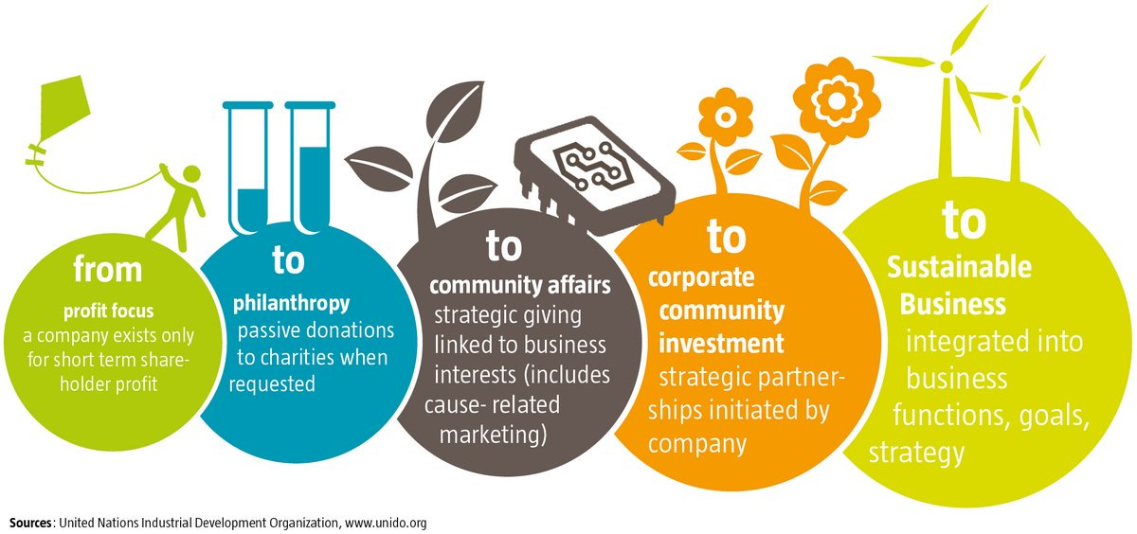
EVOLUTION OF CORPORATE SOCIAL RESPONSIBILITY
summary of the lecture

Slide 35
EVOLUTION OF CORPORATE SOCIAL RESPONSIBILITY
summary of the lecture
The concept of corporate social responsibility (CSR) has a long and varied history. It is possible to trace evidences of the business community’s concern for society for centuries. Formal writing on social responsibility, however, is largely a product of the 20th century, especially the past 50 years.
Howard Bowen’s (1953) book Social Responsibilities of the Businessman, stands out during this period. It was proposed that Bowen deserves the appellation of the Father of Corporate Social Responsibility.
The most notable contributions to the definitional construct during the 1970s included the works of Johnson, the CED, Davis, Steiner, Eells and Walton, Sethi, Preston and Post, and Carroll.

Slide 36
EVOLUTION OF CORPORATE SOCIAL RESPONSIBILITY
summary of the lecture
In the 1980s, we witnessed fewer original definitions of CSR, more attempts to measure and conduct research on CSR, and alternative thematic frameworks.
Wood (1991) expanded and set forth a CSP model that captured CSR concerns. During that time, there was a continuation of a trend begun earlier to operationalize the CSR concept and to articulate other concepts that were consistent with CSR theory.
The CSR concept will remain as an essential part of business language and practice, because it is a vital underpinning to many of the other theories and is continually consistent with what the public expects of the business community today.

Slide 37
EVOLUTION OF CORPORATE SOCIAL RESPONSIBILITY
summary of the lecture
It appears that the CSR concept has a bright future because at its core, it addresses and captures the most important concerns of the public regarding business and society relationships.
Recomended study
  Naomi Williamson, Astrid Stampe-Knippel, Tina Weber, 2014. Corporate Social Responsibility - National Public Policies in the European Union, CSR Compendium 2014, European Commission
  Blowfield, Murray, 2014. Corporate Responsibility, Oxford University pres, (chapter 2)

