Slide 1

STAKEHOLDER MANAGEMENT AND ENGAGEMENT
MEANING AND ORIGINS STAKEHOLDER – INFLUENCE ON CSR APPROACH
Ing. Pavel Adámek, Ph.D.
CORPORATE SOCIAL RESPONSIBILITY/PEM-NACSR

Slide 2
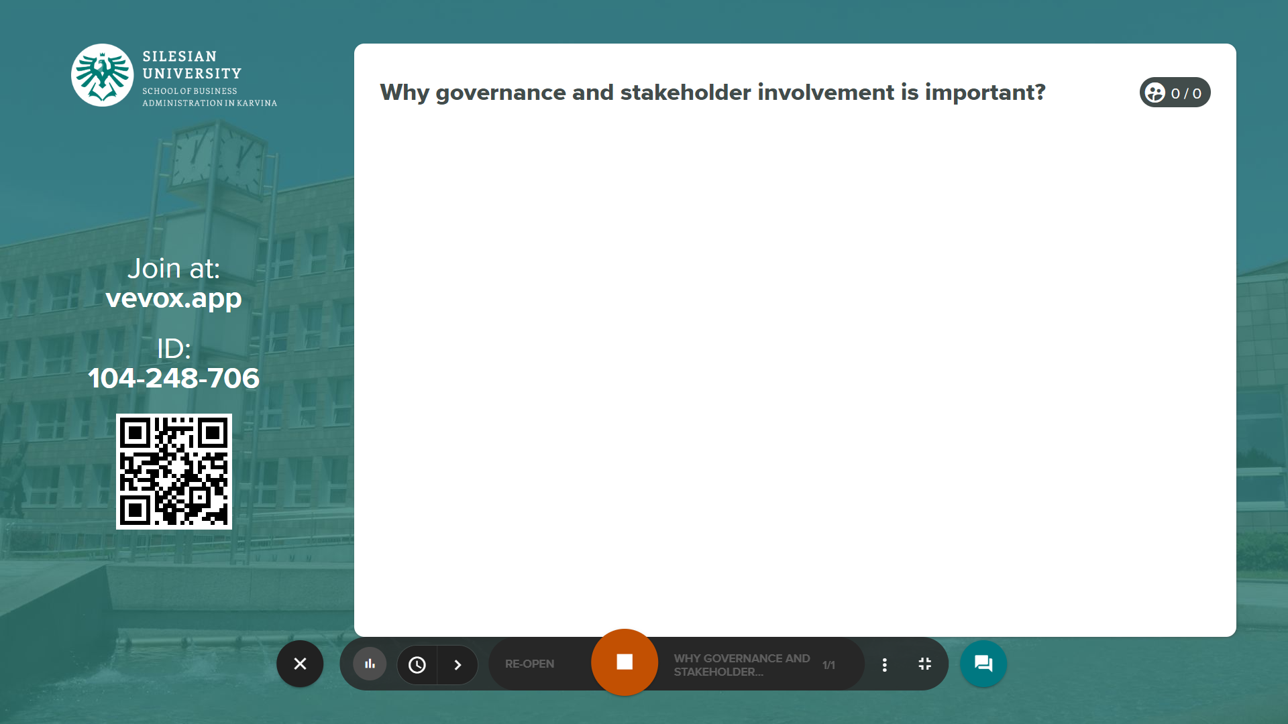
A stakeholder approach to CSR
The stakeholders´ participation
Four Levels of commitment to the stakeholder approach
Research examples – influence of CSR activities towards stakeholders

Slide 3
STAKEHOLDER MANAGEMENT AND ENGAGEMENT
Learning outcomes from the lecture:
gain knowledge of stakeholder identification,
to have knowledge of how to create a stakeholder matrix and identify relationships with individual stakeholders,
to be able to apply stakeholder analysis and to link stakeholders' interests to the company's strategy.

Slide 4
STAKEHOLDER MANAGEMENT AND ENGAGEMENT
Outline of the lecture
A stakeholder approach to CSR
The stakeholders´ participation
Four Levels of commitment to the stakeholder approach
Research examples – influence of CSR activities towards stakeholders

Slide 5
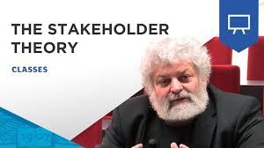
STAKEHOLDER MANAGEMENT AND ENGAGEMENT
INTRODUCTION
Stakeholder theory challenges the traditional view of the firm: shareholders/stockholders are the owners of the company. An inclusive stakeholder approach makes commercial sense, allowing the firm to maximize shareholder wealth, while also increasing total value added.
Today, CSR is focused on a stakeholder model which has become widely accepted among contemporary business organizations.
Stakeholder theory argues that there are other parties involved with a legitimate “stake” in business decisions, including:
  Communities and their governmental bodies
  NGOs and other community groups
  Employees and unions
  Suppliers and customers

Slide 6
STAKEHOLDER MANAGEMENT AND ENGAGEMENT
INTRODUCTION
Organizations are expected to mange responsibly an extended web of stakeholder interest across increasingly permeable organization boundaries and acknowledge a duty of care towards traditional interest groups as well as silent stakeholders – such as local communities and the environment.
CSR cannot be imposed against the will of enterprises, but can only be promoted together with them under involvement of their stakeholders.
For most small and medium-sized enterprises, especially microenterprises, the CSR process is likely to remain informal and intuitive.
Large companies operate on international markets, they have to be responsible for stakeholders and more competitive to survive on these markets.

Slide 7
STAKEHOLDER MANAGEMENT AND ENGAGEMENT
INTRODUCTION
Stakeholder Identity, Power and Legitimacy
In general, who are the new stakeholders making claims on the business enterprise?
What are their “missions”?
What is the source of their legitimacy?
What are their goals in a particular domain that affects our business?
What is the source, “location” and legitimacy of their power in a particular situation?
How likely are they to use their power in a given situation?

Slide 8
STAKEHOLDER MANAGEMENT AND ENGAGEMENT
1. A stakeholder approach to CSR
The first definition of stakeholder approach was articulated by Edward Freeman, who in his 1984 book Strategic Management: A Stakeholder Perspective developed what has come to be known as stakeholder theory. https://www.youtube.com/watch?v=epxmG3YRgok
Stakeholder theory addresses the question of what or who really matters to corporations.
Like stakeholder theory, CSR implies that an organization identifies its various stakeholder groups and then attempts to balance their respective needs within the organization´s overall strategy.
Management should not only consider its shareholders in the decision making process, but also anyone who is affected by business decisions.

Slide 9
STAKEHOLDER MANAGEMENT AND ENGAGEMENT
1. A stakeholder approach to CSR
Clarkson´s typology of stakeholders is the most widely cited and accepted.
Clarkson (1995) distinguishes primary and secondary stakeholders.
Primary stakeholders are those “without whose continuing participation the corporation cannot survive as a going concern” (shareholders and investors, employees, customers and suppliers, and also governments and communities „that provide infrastructures and markets, whose laws and regulations must be obeyed, and to whom taxes and other obligations may be due”);
whereas secondary stakeholders are “those who influence or affect, or are influenced or affected by, the corporation, but they are not engaged in transactions with the corporation and are not essential for its survival“.

Slide 10
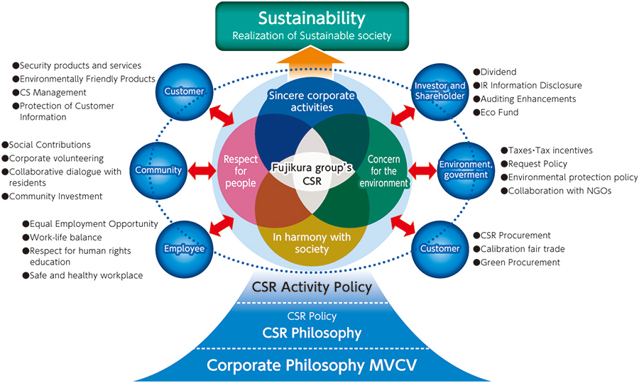
STAKEHOLDER MANAGEMENT AND ENGAGEMENT
1. A stakeholder approach to CSR
Source: http://www.fujikura.co.jp/eng/csr/group_csr/communication.html
Fujikura corporation – stakeholders in detail

Slide 11
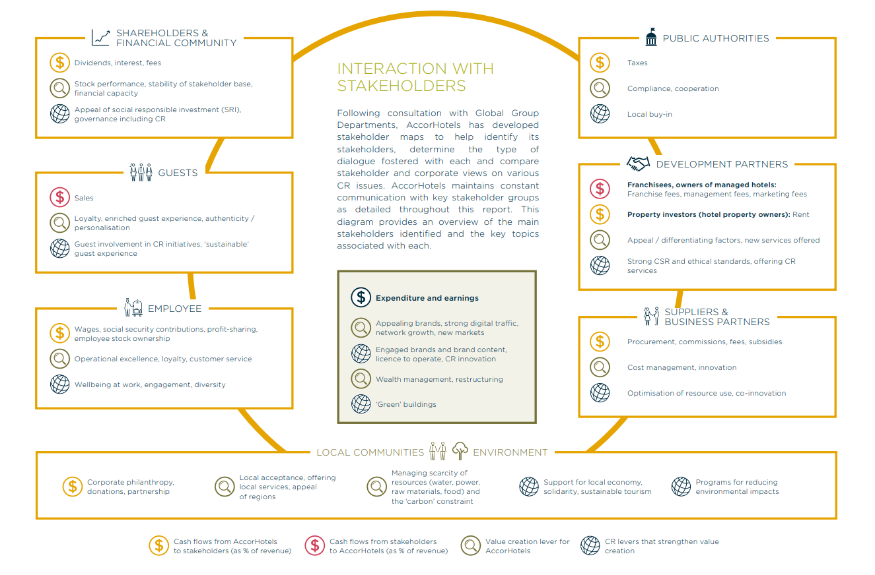
STAKEHOLDER MANAGEMENT AND ENGAGEMENT
1. A stakeholder approach to CSR
Source: https://images.jobsataccor.com.au/wp-content/uploads/AccorHotels-Corporate-Responsibility-Report-2017.pdf
ACCOR HOTELS

Slide 12
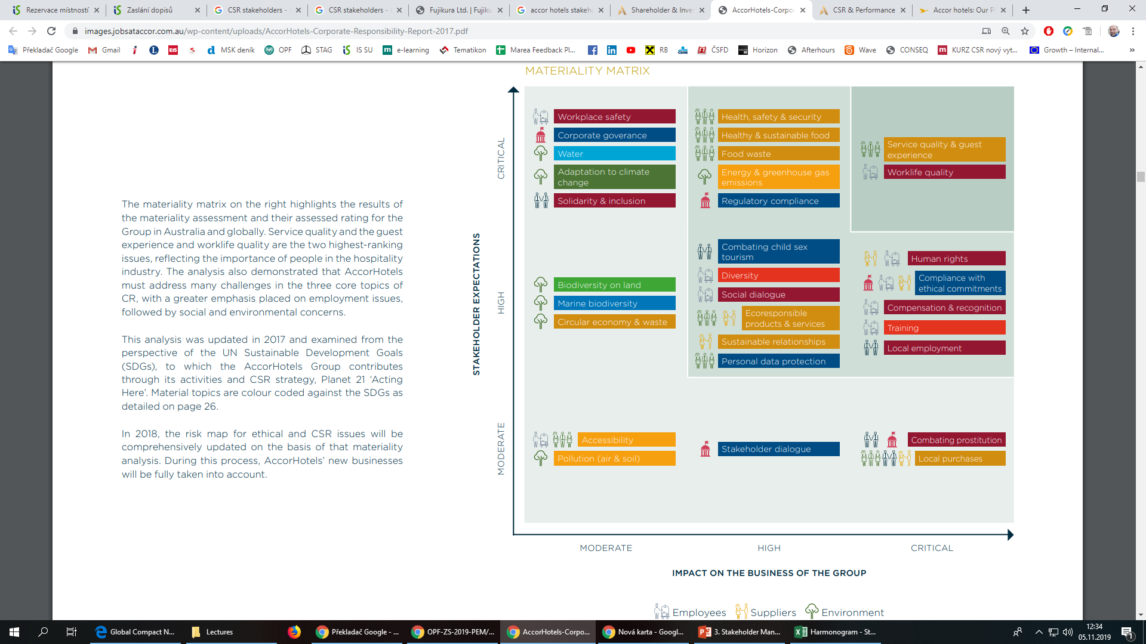
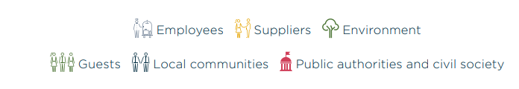
STAKEHOLDER MANAGEMENT AND ENGAGEMENT
1. A stakeholder approach to CSR
Source: https://images.jobsataccor.com.au/wp-content/uploads/AccorHotels-Corporate-Responsibility-Report-2017.pdf
ACCOR HOTELS

Slide 13
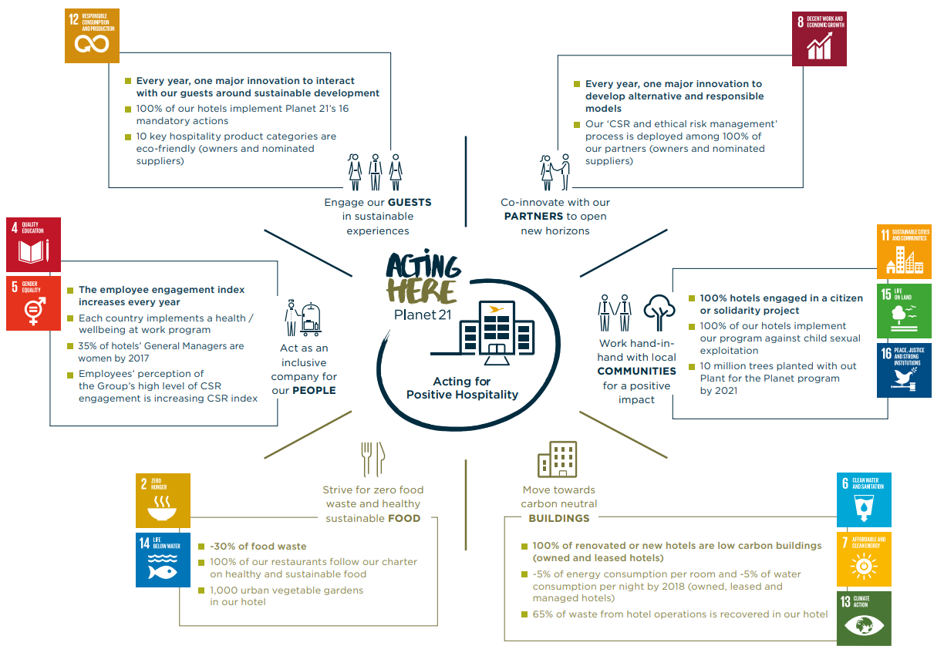
STAKEHOLDER MANAGEMENT AND ENGAGEMENT
1. A stakeholder approach to CSR
Source: https://images.jobsataccor.com.au/wp-content/uploads/AccorHotels-Corporate-Responsibility-Report-2017.pdf
ACCOR HOTELS

Slide 14
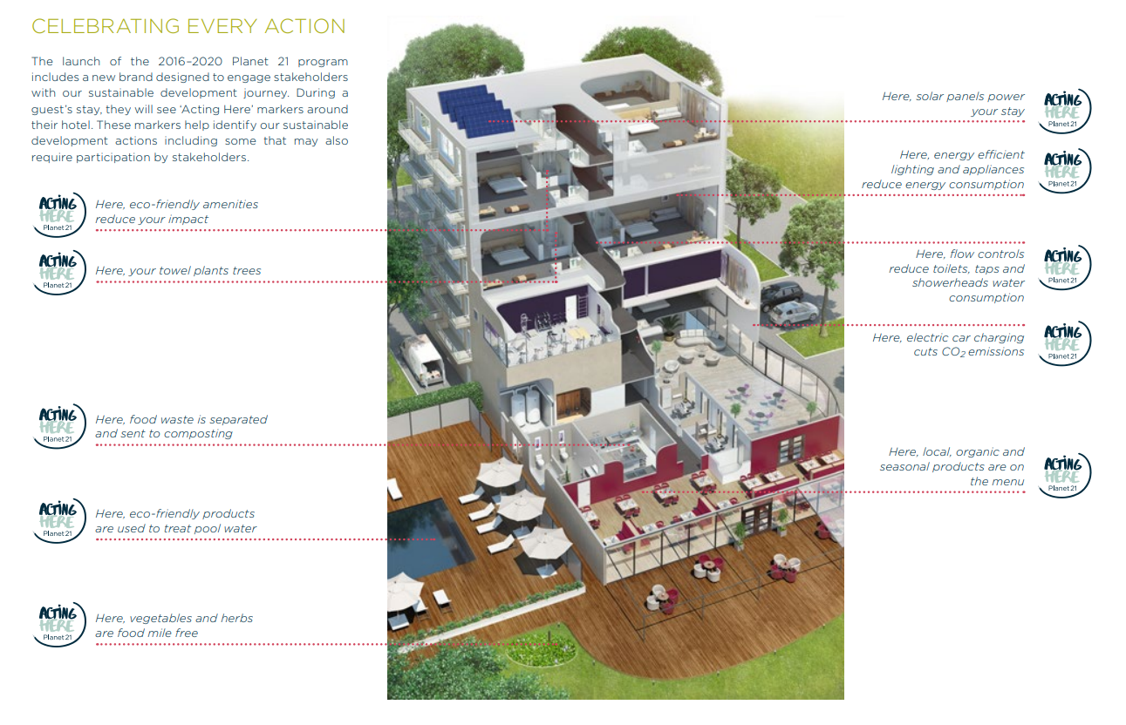
STAKEHOLDER MANAGEMENT AND ENGAGEMENT
1. A stakeholder approach to CSR
Source: https://images.jobsataccor.com.au/wp-content/uploads/AccorHotels-Corporate-Responsibility-Report-2017.pdf
ACCOR HOTELS

Slide 15
STAKEHOLDER MANAGEMENT AND ENGAGEMENT
ACCOR HOTELS video
Corporate Responsibility ACCOR HOTELS
https://group.accor.com/en/commitment/sharing-our-knowledge/csr-and-performance

Slide 16
STAKEHOLDER MANAGEMENT AND ENGAGEMENT
1. A stakeholder approach to CSR
The difficulties in managing the relationships from the perspective of business management and stakeholders are issues such as:
  Divergent and often conflicting expectations between stakeholders.
  Contextual complexities, that are further complicated by varying interpretations arising out of different geographical regions and cultures.
  The challenge of identifying what might be considered to be “best practice” with regard to CSR stakeholder dialogue strategy and then communicating this to stakeholders.
Cumulatively, the expected benefits to organisations that succeed in meeting CSR expectations of key stakeholder groups are increased company revenue and profitability, lower costs, easier access to finance, and a greater capability to innovate.

Slide 17
STAKEHOLDER MANAGEMENT AND ENGAGEMENT
1. A stakeholder approach to CSR
These indicates which interest groups are for business crucial:
  how they are treated;
  whether the mechanism of strategic CSR is developed;
  how are inform its stakeholders (stakeholder dialogue) about targeted activities;
  how to evaluate these activities (feedback to management or owners);
  are these findings regularly used to promote the interests of the company or for the benefit of a comprehensive approach to CSR in all areas?

Slide 18
STAKEHOLDER MANAGEMENT AND ENGAGEMENT
2. THE stakeholderS´ PARTICIPATION
The role of stakeholder engagement
Engaging with stakeholders early ensures that issues addressed in the CR policy and report are the most meaningful.
The insights gained from this exchange also provide new business opportunities.
Corporate reputation is enhanced much more than by pushing forward the most charitable initiatives if these are unrelated to the main concerns of the stakeholders.
The usual forms of engagement measurement (outreach, media analysis, social media evaluation …) constitute very precious data for CSR reports. In particular those recommended in the AA1000 (materiality, inclusivity, completeness).

Slide 19
STAKEHOLDER MANAGEMENT AND ENGAGEMENT
2. THE stakeholderS´ PARTICIPATION
Phases and factors in engaging with stakeholders
Phases of managing stakeholder dialogue
  Selection of stakeholders
  Stakeholder dialog
  Interpretation of information from dialogue
  Decisions about company actions
  Response to the dialogue through activities
Key factors in acting on stakeholder dialogue
  Awareness that an issue exists
  Commitment to prioritize and resource an issue
  Capacity/availability of resources to tackle an issue
  Consensus amongst the company and its stakeholders over the issues and relevance of stakeholder dialogue in general

Slide 20
STAKEHOLDER MANAGEMENT AND ENGAGEMENT
2. THE stakeholderS´ PARTICIPATION
The stakeholders’ participation type covers information notification, specific consultation, communication and common action.
Information notification helps stakeholders gain a better understanding through information release and collect stakeholders' expectation.
Specific consultation is to understand and respond to the stakeholders’ expectation in a direct and effective approach through consultation on specific topics.
It includes survey of stakeholders, comments and suggestions collected from stakeholders, active response to stakeholders’ questions and participation in stakeholders' forum.

Slide 21
STAKEHOLDER MANAGEMENT AND ENGAGEMENT
2. THE stakeholderS´ PARTICIPATION
Communication is to make dialogues with the representatives of stakeholders to find out solutions and incorporate their advice into corporate decisions. It includes dialogues and meetings with stakeholders and high-level talks.
Common action is to deepen cooperation, integrate resources, complement each other’s advantages, jointly hedge risks and share benefits to achieve a win-win situation.
It includes cooperation agreement signing, cooperation to propel sustained development plan and jointly launch social welfare activities for cooperation alliance.

Slide 22
STAKEHOLDER MANAGEMENT AND ENGAGEMENT
2. THE stakeholderS´ PARTICIPATION
Managers perceive a variety of stakeholder groups. They give a high priority to a stakeholder, if they believe that this stakeholder has a legitimate claim, which calls for immediate action (i.e. urgent), and possesses the power to influence organization’s activities.
According to Mitchell et al.’s classification of stakeholders, if a stakeholder possesses only one of the three attributes, they are called latent stakeholders and have low stakeholder salience.

Slide 23
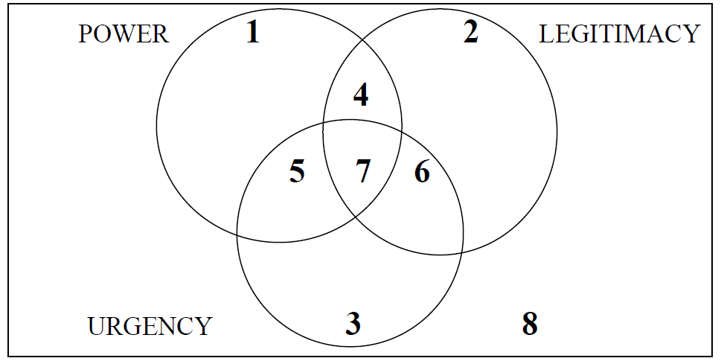
STAKEHOLDER MANAGEMENT AND ENGAGEMENT
2. THE stakeholderS´ PARTICIPATION
Model of stakeholder salience
Further, the dynamic qualities are accommodated by explaining how stakeholders can shift between classes by attaining or losing one or more attribute.

Slide 24
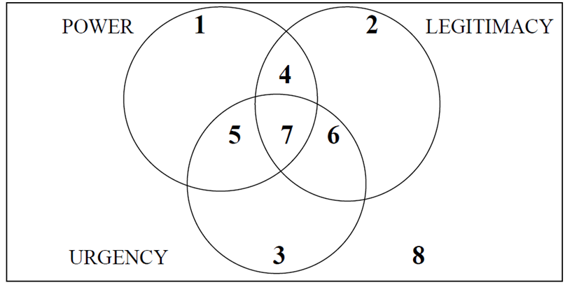
STAKEHOLDER MANAGEMENT AND ENGAGEMENT
2. THE stakeholderS´ PARTICIPATION
Among these latent stakeholders, if the only attribute is power, then they are called dormant stakeholders (Area 1);
if their only attribute is legitimacy, they are called discretionary stakeholders (Area 2),
and if their only attribute is urgency, then they are termed as demanding stakeholders (Area 3).
Stakeholder salience is moderate if two attributes are present and such stakeholders are called expectant stakeholders. Among the expectant stakeholders, those having power and legitimacy are dominant stakeholders (Area 4);
those having legitimacy and urgency are dependent stakeholders (Area 6) and those with power and urgency are called dangerous stakeholders (Area 5).
If all three elements are apparent in a stakeholder relationship (Area 7), then management have a clear and immediate mandate to attend and give priority to that stakeholder's claim. Stakeholders that have none of the three attributes are identified as non-stakeholders (Area 8).

Slide 25
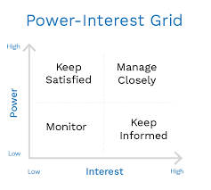
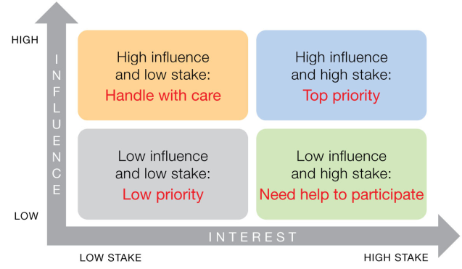
STAKEHOLDER MANAGEMENT AND ENGAGEMENT
Stakeholders matrix

Slide 26
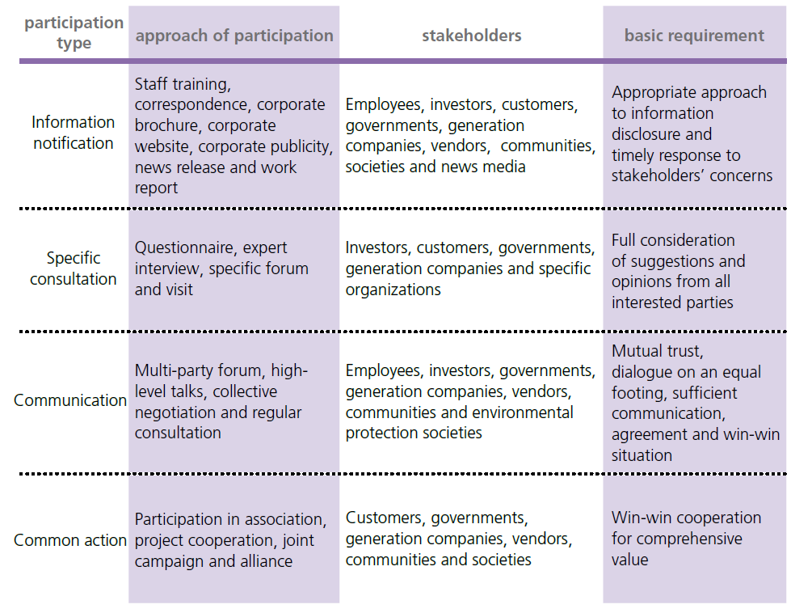
STAKEHOLDER MANAGEMENT AND ENGAGEMENT
2. THE stakeholderS´ PARTICIPATION
The approach of stakeholders´participation

Slide 27
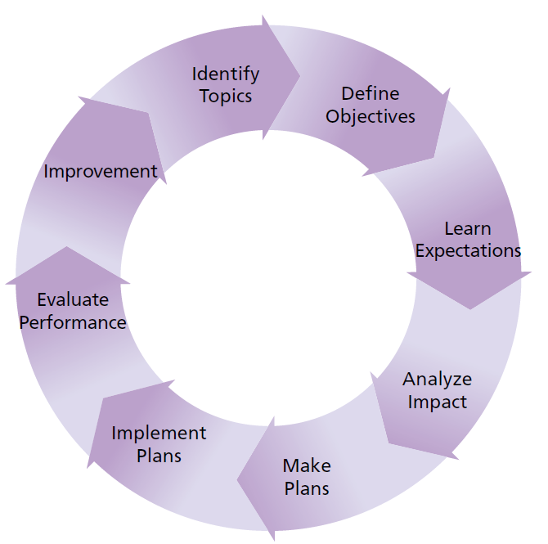
STAKEHOLDER MANAGEMENT AND ENGAGEMENT
Stakeholders’ participation procedures
Identify Topics: Collect and sort out subjects.
Define Objectives: Make clear the expectations on the role and result of stakeholders’ participation.
Learn Expectations: Expectations and requirements of stakeholders.
Analyze Impact: Analyze the possible impacts from stakeholders.
Make Plans: Specify participation rules, resource back-up and work plan.
Implement Plans
Evaluate Performance: Evaluate results and efficiency.
Improvement: Timely summarize experiences, optimize regulations and process and keep progressing.

Slide 28
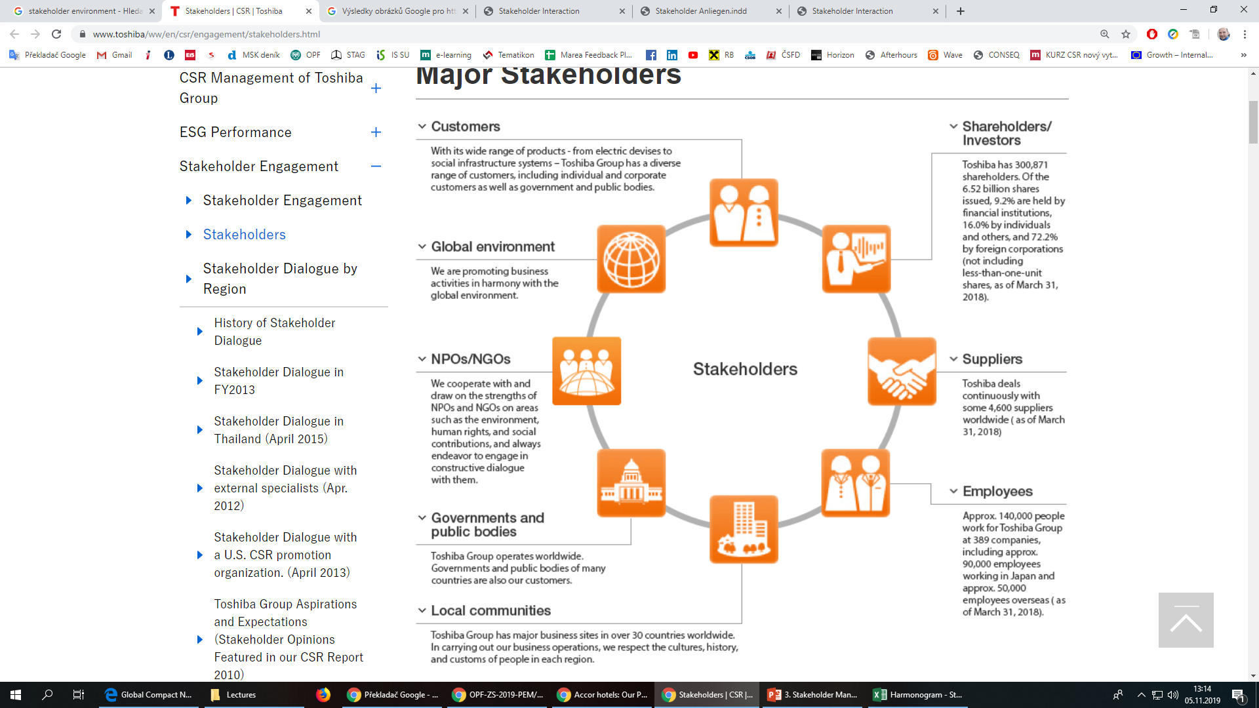
STAKEHOLDER MANAGEMENT AND ENGAGEMENT
A practitioner-based model of societal responsibilities
Source: https://www.toshiba/ww/en/csr/engagement/stakeholders.html
TOSHIBA – MAJOR STAKEHOLDERS

Slide 29
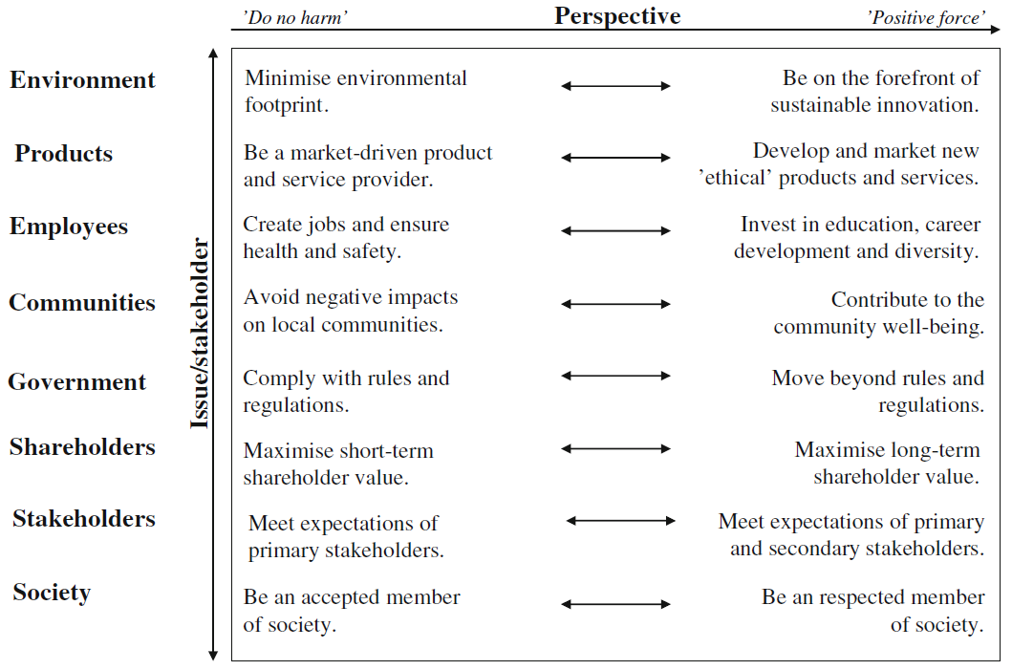
STAKEHOLDER MANAGEMENT AND ENGAGEMENT
Societal responsibilities as a continuum

Slide 30
STAKEHOLDER MANAGEMENT AND ENGAGEMENT
A practitioner-based model of societal responsibilities
The managers believe that the firm will be a good corporate citizen that creates value for the firm, the community and the wider society.
The responsibilities for the products/services, workforce and environment are closely linked to the firm’s internal operations, but also create value for a number of stakeholders in the firm’s environment.
Product and service provision satisfies customer needs, employees benefit from HR activities and environmental improvements make society better off.

Slide 31
STAKEHOLDER MANAGEMENT AND ENGAGEMENT
3. Four Levels of Commitment to the Stakeholder Approach
Company stakeholder responsibility requires that companies be committed to a stakeholder approach to management on the following four levels:
Basic Value Proposition - the entrepreneur or manager needs to understand how the firm can make the customer better off, and simultaneously offer an attractive value proposition to employees, suppliers, communities, and financiers.
  How do we make our stakeholders better off?
  What do we stand for?

Slide 32
STAKEHOLDER MANAGEMENT AND ENGAGEMENT
3. Four Levels of Commitment to the Stakeholder Approach
Sustained stakeholder cooperation - the competitive, macro-economic, regulatory, and political environments are so dynamic they necessitate constant revision of the initial stakeholder arrangements.
  What are the principles or values on which we base our everyday engagement with stakeholders?
An understanding of broader societal issues - today’s managers must recognize and respond to a rising number of international issues, without the moral compass of the nation, state or religion as a guide. A pro-active attitude is necessary towards all stakeholder groups.
  Do we understand how our basic value proposition and principles fit or contradict key trends and opinions in society?

Slide 33
STAKEHOLDER MANAGEMENT AND ENGAGEMENT
3. Four Levels of Commitment to the Stakeholder Approach
Ethical leadership - recent research points to a strong connection between ethical values and positive firm outcomes such as sustained profitability and high innovation.
Proactive ethical leadership is possible only if there exists a deep understanding of the interests, priorities, and concerns of the stakeholders.
  What are the values and principles that inform my leadership?
  What is my sense of purpose? What do I stand for as a leader?

Slide 34
STAKEHOLDER MANAGEMENT AND ENGAGEMENT
SUMMARY - Ten Principles of
Company Stakeholder Responsibility
Bring stakeholder interests together over time.
Recognize that stakeholders are real and complex people with names, faces and values.
Seek solutions to issues that satisfy multiple stakeholders simultaneously.
Engage in intensive communication and dialogue with stakeholders not just those who are “friendly”.
Commit to a philosophy of voluntarism - manage stakeholder relationships yourself, rather than leaving it to government.

Slide 35
STAKEHOLDER MANAGEMENT AND ENGAGEMENT
SUMMARY - Ten Principles of
Company Stakeholder Responsibility
Generalize the marketing approach.
Never trade off the interests of one stakeholder versus another continuously over time.
Negotiate with primary and secondary stakeholders.
Constantly monitor and redesign processes to better serve stakeholders.
Act with purpose that fulfills commitments to stakeholders. Act with aspiration toward your dreams and theirs.
Recomended study:
  Chandler, Werther, Jr. „Strategic Corporate Social Responsibility“, 2014, chapter 2.
  Blowfield and Murray, Corporate Responsibility, 2014 (chapter 9)
  https://simplystakeholders.com/stakeholder-matrix/
  https://askelsustainabilitysolutions.com/real-life-impact-5-stakeholder-engagement-success-stories/#4-starbucks

