Slide 1

RESPONSIBLE INVESTMENT
SRI PERFORMANCE, TYPES OF SRI, SUSTAINABLE INVESTING
Ing. Pavel Adámek, Ph.D.
CORPORATE SOCIAL RESPONSIBILITY/PEM-NACSR

Slide 2
RESPONSIBLE INVESTMENT
Outline of the lecture
Introduction of the Socailly Responsible Investment
Categories of Responsible Investment
The state of European SRI

Slide 3
RESPONSIBLE INVESTMENT
INTRODUCTION
Responsible investment is an approach to investing that aims to incorporate environmental, social and governance (ESG) factors into investment decisions, to better manage risk and generate sustainable, long-term returns.
Socially responsible investing (SRI) refers to financial contributions into investment tools designed to combine the traditional investment philosophy favoring profit-maximization with a values-based component seeking non-financial benefits.
Such non-financial benefits are often referred to as social returns.
  These social returns vary in scope but can be broadly defined as company policies and actions that enhance a socially responsible investor’s specific environmental, religious or social values.

Slide 4
RESPONSIBLE INVESTMENT
INTRODUCTION
The global momentum around responsible investment is driven by:
  recognition in the financial community that ESG factors play a material role in determining risk and return;
  understanding that incorporating ESG factors is part of investors’ fiduciary duty to their clients and beneficiaries;
  concern about the impact of short-termism on company performance, investment returns and market behavior;
  legal requirements protecting the long-term interests of beneficiaries;
  pressure from competitors seeking to differentiate themselves by offering responsible investment services as a competitive advantage;

Slide 5
RESPONSIBLE INVESTMENT
INTRODUCTION
The global momentum around responsible investment is driven by:
  beneficiaries becoming ever-more active and demanding transparency about where and how their money is being invested;
  value-destroying reputational risk from issues such as climate change, pollution, working conditions, employee diversity, corruption and aggressive tax strategies in a world of globalised and social media.
SRI has changed from an activity carried out by a small number of specialist retail investment funds (in the form of unit trusts and mutual funds), probably of negligible or minor economic importance, into an investment philosophy adopted by a growing proportion of large investment institutions, i.e. large pension funds and insurance companies.

Slide 6
RESPONSIBLE INVESTMENT
INTRODUCTION
What value does responsible investment create?
Three forms of value creation are identified below: financial value from both capital allocation and engagement; and non-financial value.
Financial value: ESG-driven capital allocation
The direct financial value for investors and their beneficiaries/clients created by active ESG strategies may take the form of:
returns in excess of a benchmark – derived in part from the more favourable sustainability exposure of the assets in which the strategy invests
reduced short-term risk – measured as volatility against a benchmark - as a result of ‘high-ESG’ companies being insulated from earnings shocks and market reactions linked to the internalisation of sustainability costs
reduced long-term risk - protection against the long-term risk of absolute loss of value – as a result of ‘high-ESG’ companies being strategically better positioned than others
lower share price volatility
a more stable, long-term shareholder base.

Slide 7
RESPONSIBLE INVESTMENT
INTRODUCTION
What value does responsible investment create?
Financial value: engagement
The financial value created by engagement may take the form of:
increased returns or reduced risk as a result of improved sustainability performance by the companies concerned
improved returns to the market as a whole as a result of internalising externalities.
Non-financial value
The non-financial value created by responsible investment might take the form of:
improved ESG performance by individual companies such as reduced emissions, fewer human rights breaches, increased job creation, and so on
improved ESG performance across the market as a whole as a result of policy engagement, for example better corporate disclosure
more stable markets provided that responsible investment achieves sufficient critical mass.

Slide 8
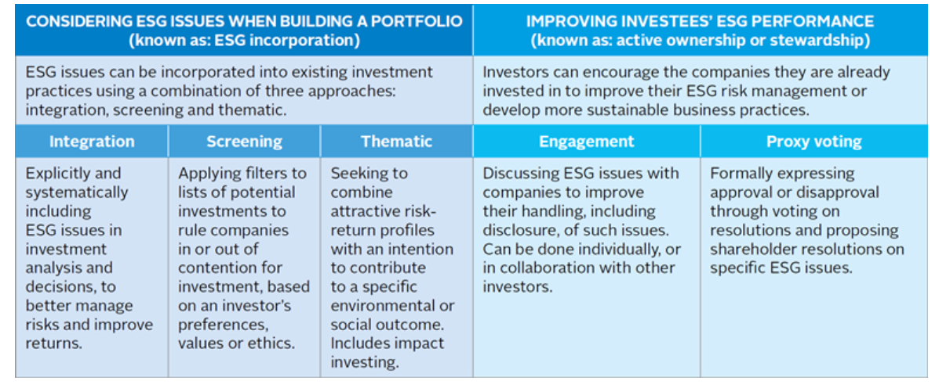
RESPONSIBLE INVESTMENT
INTRODUCTION
There are many ways to invest responsibly. Approaches are typically a combination of two overarching areas:
Source: https://www.unpri.org/pri/an-introduction-to-responsible-investment/what-is-responsible-investment

Slide 9
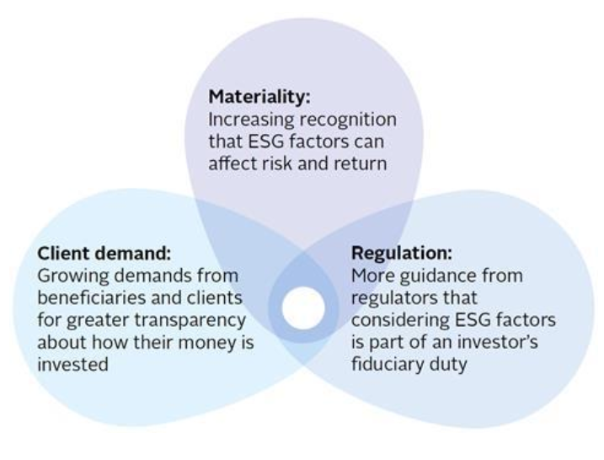
RESPONSIBLE INVESTMENT
Investing groups
Today, major institutional investment groups such as corporations, hedge funds, insurance companies, mutual funds, pension funds, religious institutions and universities, along with the environmentally/religiously/socially-motivated individual investor, are entering the realm of socially responsible investing.
Socially responsible investing is an umbrella term covering three core investing groups:
  environmentally-motivated investors,
  religiously-motivated investors and
  socially motivated investors.

Slide 10
RESPONSIBLE INVESTMENT
Investing groups
Environmentally-motivated investors seek corporate policies and actions that either benefit, or do no significant harm to, the environment – both in the Czech Republic and abroad.
Religiously-motivated investors are guided by specific faith-based issues such ethical treatment of employees.
Socially-motivated investors, on the other hand, desire company policies and practices that adequately address key social issues as well as corporate governance.

Slide 11
RESPONSIBLE INVESTMENT
Investing groups
While all three groups seek social returns along with capital appreciation, the major difference between the groups stems from the motivations behind their investment practices.
The history of SRI demonstrates that all three groups played a prominent role in the establishment of SRI as a major player in the twenty-first century investing landscape.
Investors actively seek to identify worthwhile projects that promise positive impact on society and/or the environment, besides adequate financial return. In the field of impact investing, terminologies and investment standards are still evolving.
  To date, assets under management by Principles for Responsible Investment (PRI) signatories now stands at more than US$59 trillion (signaling commitment to responsible investment).

Slide 12
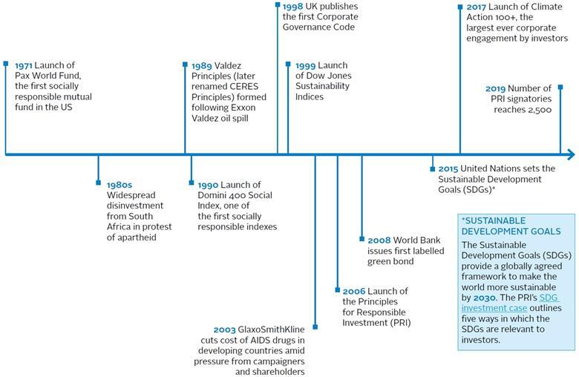
RESPONSIBLE INVESTMENT
Milestones in the evolution of responsible investment

Slide 13
RESPONSIBLE INVESTMENT
1. Introduction of the Socilly Responsible investment
What are environmental, social and governance (ESG) factors?
Examples of environmental, social and governance (ESG) factors are numerous and ever-shifting. They include impact objectives:
Environemental (E)
  Biodiversity conservation
  Energy and fuel efficiency
  Natural resources conservation
  Pollution prevention & waste management
  Sustainable energy
  Sustainable land use
  Water resources management

Slide 14
RESPONSIBLE INVESTMENT
1. Introduction of the Socilly Responsible investment
Social (S)
  Access to clean water
  Access to energy
  Access to financial services
  Access to education
  Affordable housing
  Agricultural productivity
  Capacity-building
  Community development
  Conflict resolution
  Disease-specific prevention and mitigation
  Employment generation
  Equality and empowerment
  Food security
  Generate funds for charitable giving
  Health improvement
  Income/productivity growth

Slide 15
RESPONSIBLE INVESTMENT
1. Introduction of the Socilly Responsible investment
Governance (G)
  Executive pay
  Bribery and corruption
  Political lobbying and donations
  Board diversity and structure
  Tax strategy

Slide 16
RESPONSIBLE INVESTMENT
1. Introduction of the Socilly Responsible investment
Reasons for using responsible investing
Performance - SRI can help to identify sustainable and profitable investment themes. If a company has a better ESG profile than its peer, it might be a positive indicator for its long-term potential for success.
Risk forecasting - the analysis of ESG factors is an opportunity for an active risk management. It can help to understand externalities and to predict whether a company is prepared for future risks and challenges. Especially the financial crisis have shown that a bad governance or high exposure to environmental risks can lead to significant losses for investors.
Risk diversification - specialized impact investment themes might have a low correlation with the traditional financial market and can therefore help to diversify a portfolio.

Slide 17
RESPONSIBLE INVESTMENT
1. Introduction of the Socilly Responsible investment
Reasons for using responsible investing
Reputation - for some investors it might be a reputation risk if they are investing in controversial companies that have a negative social or environmental impact. Therefore they have a strong interest to exclude such companies from their portfolio.
Linking Values to Value - especially charitable investors such as foundations have a strong concern with Responsible Investments because SRI allow them to achieve a “dual return”.
  Specific impact investment strategies such as microfinance or specialized renewable energy projects can generate a financial return as well as a direct, positive impact to the society.
Contribution to a sustainable development - incorporating ESG issues in the investment decision allows to invest in line with personal values and supporting companies and technologies that have a positive impact to the society.

Slide 18
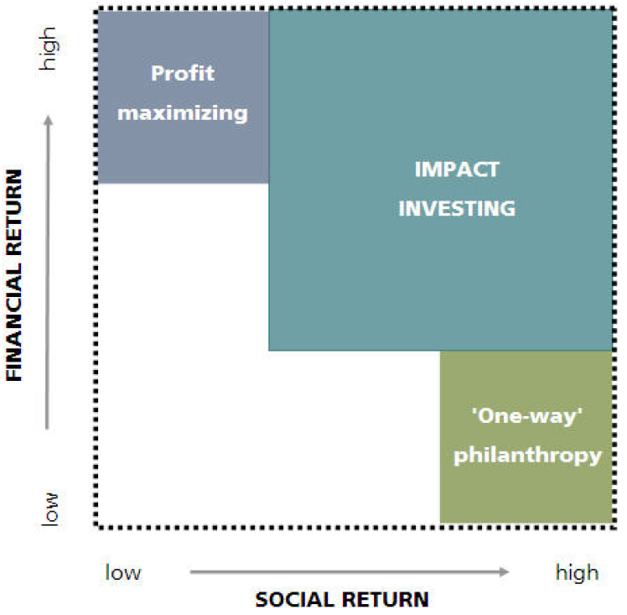
RESPONSIBLE INVESTMENT
1. Introduction of the SociAlly Responsible investment
Impact investing aims for both financial and social return
Impact investing is one of the most dynamic new asset classes to emerge in a generation and it offers the possibility to unite financial returns with social impact, in a market-driven and sustainable manner.
Source: UBS WMR

Slide 19
RESPONSIBLE INVESTMENT
2. Categories of RI
Responsible investing is traditionally divided into three core categories: social screening, shareholder advocacy and community investing.
These three categories are not mutually exclusive – for example, a socially responsible investor may practice social screening while also investing in community development projects.
The majority of socially responsible investors, however, focus on social screening and shareholder advocacy although community investing is growing in prominence as the SRI movement itself expands.

Slide 20
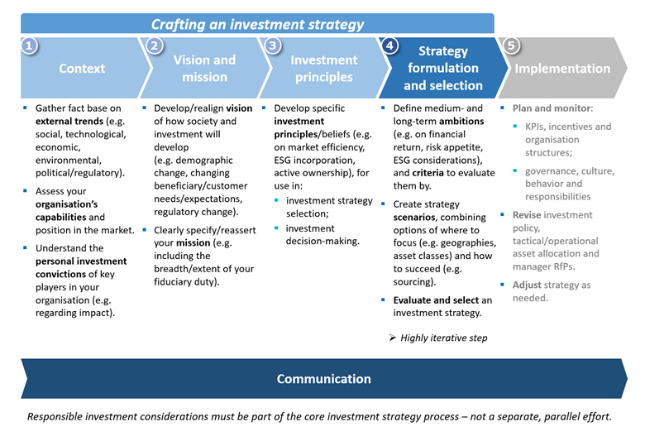
RESPONSIBLE INVESTMENT
Investment strategy

Slide 21
RESPONSIBLE INVESTMENT
2. Categories of SRI
Social screening is a means by which investors either divest a financial holding or invest in a particular company based on the company’s social record.
The basic premise underlying social screening is the idea that companies that meet the social standards required by SRI screens will be the most profitable and successful companies in the long-term.
Social screening can be divided into two types: negative screening and positive screening.

Slide 22
RESPONSIBLE INVESTMENT
2. Categories of SRI
Negative screening occurs when an investor divests a specific stock or industry group holding from a portfolio based on a company’s practices diverging from some criteria of social investment.
  Once an investor screens a stock out of a portfolio the ownership relationship between the company and the shareholder ends and often so does the investor’s ability or desire to institute social change at the organization.
  It is for this reason that many shareholders refuse to sell shares of a company with a poor social record and instead choose the path of shareholder activism.

Slide 23
RESPONSIBLE INVESTMENT
2. Categories of SRI
Positive screening occurs when an investor seeks out a specific stock or industry group and invests because of positive social policies and actions of the company.
  Many SRI organizations have created sophisticated software intended to search for just this type of investment opportunity.
  Companies that produce certain products – such as the “sin stocks” have a hard time meeting the criteria required to be included in a positive screen.
  Interestingly, even a company producing a more socially-accepted product will also miss the cut if such a company has poor corporate governance standards or employment practices.

Slide 24
RESPONSIBLE INVESTMENT
2. Categories of SRI
Forms of responsible investment
Ethical investment
Socially responsible investment (SRI)
Sustainable investment
Best in class (ESG) investment
ESG integration
Thematic investment
Green investment
Impact investing
Shareholder engagement

Slide 25
RESPONSIBLE INVESTMENT
2. Categories of SRI
Ethical investment
Ethical investment usually refers to negative or exclusionary screening of companies engaged in activities deemed unethical by the investor or that are contrary to certain international declarations, conventions and voluntary agreements.
Typical exclusions are alcohol, tobacco, pornography, certain weapons, nuclear power, and gross violations of human rights, or companies doing business in or with a particular country.
Exclusions can be based on religion, such as exclusion of companies manufacturing contraceptives or hospitals practicing abortions, or of companies engaged in activities contrary to sharia precepts; or on agreements such as the Universal Declaration of Human Rights, ILO’s Declaration on Fundamental Principles and Rights at Work, Rio Declaration on Environment and Development, and good-practice guidelines from these and numerous other sources.

Slide 26
RESPONSIBLE INVESTMENT
2. Categories of SRI
Socially responsible investment (SRI) refers to approaches that apply social criteria and environmental criteria in evaluating companies.
Social criteria cover things such as occupational health and safety performance, discriminatory hiring and promotion practices with respect to race or gender, community welfare, labour disputes, and so forth.
Environmental criteria cover areas such as quality of environmental management, GHG emissions, energy and resource eﬃciency, sourcing of raw materials, impacts on natural resources, land and ecosystems, waste and recycling, and are often standardised to company sales.
  Generally, SRI investors score companies along their chosen criteria, either for their investment universe as a whole or sector by sector; some apply differential sector-specific weightings, and all establish a hurdle for qualification or disqualification within their investment universe.

Slide 27
RESPONSIBLE INVESTMENT
2. Categories of SRI
Sustainable investment
Sustainable investment refers to portfolio composition based on the selection of assets that can be defined in some way as being sustainable or possible to continue into the long-term future.
If the criteria used are typical ESG issues, then sustainable investment is no different from best in class or integration funds.
But if the criteria are defined in terms such as ‘industries of the future’ or ‘net positive business operations’ the investment strategy may be thought of as an advanced mix of thematic and integration approaches.
Sustainable investment can also be interpreted as an uncompromising strategy that screens out assets considered to be inimical to long-term environmental and social sustainability.
  Examples include the majority of fossil energy based industries including tar sands and coal, too-big-to-fail financial institutions, and major investment banks. Examples of social goals such a fund might look for in companies could be those directed at reducing inequalities, providing job security and opportunities for advancement by employees.

Slide 28
RESPONSIBLE INVESTMENT
2. Categories of SRI
Green investment
Green investment refers to approaches that seek to invest capital in ‘green’ assets, whether these are funds, companies, infrastructure, projects and so on.
Typically this might include low carbon power generation and vehicles, smart grids, energy eﬃciency, pollution control, recycling, waste management and waste of energy, process innovation, and other technologies and processes that contribute to solving particular environmental problems.
Green investment can thus be subsumed within thematic investing.

Slide 29
RESPONSIBLE INVESTMENT
2. Categories
Impact investing
Impact investing refers to investments seeking a particular social or environmental objective, such as to provide employment in a community, promote access to low carbon energy, or support minority-owned businesses or businesses that employ people recovering from drug addiction or with disabilities.
Making sure that the investment achieves its defined impact, and measuring and tracking its progress lie at the heart of the investment proposition. Impact investment should not be confused with philanthropy, its purpose still being to meet the financial objectives of the investor.
Impact investment usually takes the form of investing in non- listed companies and is not determined by sector or theme. It is an increasingly popular model for socially conscious high net worth individuals.

Slide 30
RESPONSIBLE INVESTMENT
2. Categories of Responsible investing
The terms “social”, “ethical”, “responsible”, “socially responsible” and “sustainable” are all used in a multitude of overlapping and competing ways. There are divided into three areas according to EUROSIF:
  Responsible Investment (RI) is an area developing particularly among the institutional investors and remains most connected to the mainstream financial community.
    Responsible investors take into consideration the long-term influence of extra financial factors such as environmental, social and governance (ESG) issues in their investment decision-making.
    They integrate ESG factors into their stock portfolio analysis and management, bringing together social and sustainability indicators with traditional financial analysis.

Slide 31
RESPONSIBLE INVESTMENT
2. Categories of RI
Social Responsible Investment (SRI) is an important area for the retail financial sector and may incorporate ESG issues as well as criteria more closely linked to a values-based approach.
  For example, it can involve the application of pre-determined social or environmental values to investment selection. Investors choose to exclude or select particular companies or sectors because of their impact on the environment or stakeholders.
Sustainable Investment (SI) is a growing area where investors align their investments with emerging environmental and social realities.
  This area brings together those in the financial sector committed to the sustainability imperative along with those interested by the investment opportunities that the ongoing shift in regulations and market practices are creating.

Slide 32
RESPONSIBLE INVESTMENT
3. The state of European SRI
EUROSIF
is the leading European association for the promotion and advancement of sustainable and responsible investment across Europe, for the benefit of its members.
Eurosif’s purpose is to:
  Promote best practice in Sustainable and Responsible Investment (SRI) on behalf of its members
  Lobby for European regulation and legislation that supports the development of SRI
  Support its members in developing their sustainable and responsible investment business
  Promote the development of, and collaboration between SIFs across Europe
  Provide research and analysis on the development and trends within the SRI market across Europe
  Raise awareness of and increase demand for SRI throughout the European capital markets

Slide 33
RESPONSIBLE INVESTMENT
3. The state of European SRI - EUROSIF
However, despite Sustainable and Responsible Investments (SRI) having expanded significantly in the last few years, the State of our Planet is still deteriorating.
Scientific research repeatedly shows that we are nowhere near reversing negative Sustainability impacts, be it on the climate and biodiversity front. Therefore, more than ever, investors need to refocus their efforts on where they can generate positive environmental and social outcomes.
As recent academic research is showing, investors have valuable tools to generate ‘investor impact’ by influencing corporate behaviour through engagement and stewardship and redirecting capital towards sustainable businesses and projects.

Slide 34
RESPONSIBLE INVESTMENT
3. The state of European SRI - EUROSIF
Investors have a key role to play in transitioning the real economy towards a climate-neutral and more inclusive model of growth, consistent with the Paris Agreement and the UN SDGs. https://sdgs.un.org/goals (look at Goals)
Therefore, investors have increasingly integrated sustainability as part of their investment processes and in line with their fiduciary duty.
By integrating environmental, social, and governance (ESG) considerations in their Investment decisions, they aim at both mitigating risks and enhancing long-term return.

Slide 35
RESPONSIBLE INVESTMENT
3. The state of European SRI
The richness of variety of SRI shows the strength of the industry, as investors continue to show creativity in developing new products and in combining approaches.
The fast evolving nature of the industry, combined with a high degree of innovation, and the fragmentation of expectations on the ‘buy-side’ represent, however, real challenges to the future success of SRI, in particular when it comes to standardisation and comparability.
While the continued aggregate growth of all SRI strategies across Europe is welcome, there is considerable difference in growth at the country level, and some strategies remain concentrated around a few markets.

Slide 36
RESPONSIBLE INVESTMENT
3. The state of European SRI
In recent years, the European Union has positioned itself as the world leader in promoting a vision of sustainable finance.
The EU sustainable finance agenda, with the EU Taxonomy, the SFDR (Sustainable Finance Disclosure Regulation) and the Paris-Aligned Benchmarks, represents the worlds leading standard for financial market participants to address the challenges of climate change and social inequalities.
Eurosif believe we must increasingly look at the EU sustainable finance agenda through the prism of investor impact.
Currently, the European Union is expected to require €28 trillion of structural investments between now and 2050 to achieve carbon neutrality.

Slide 37
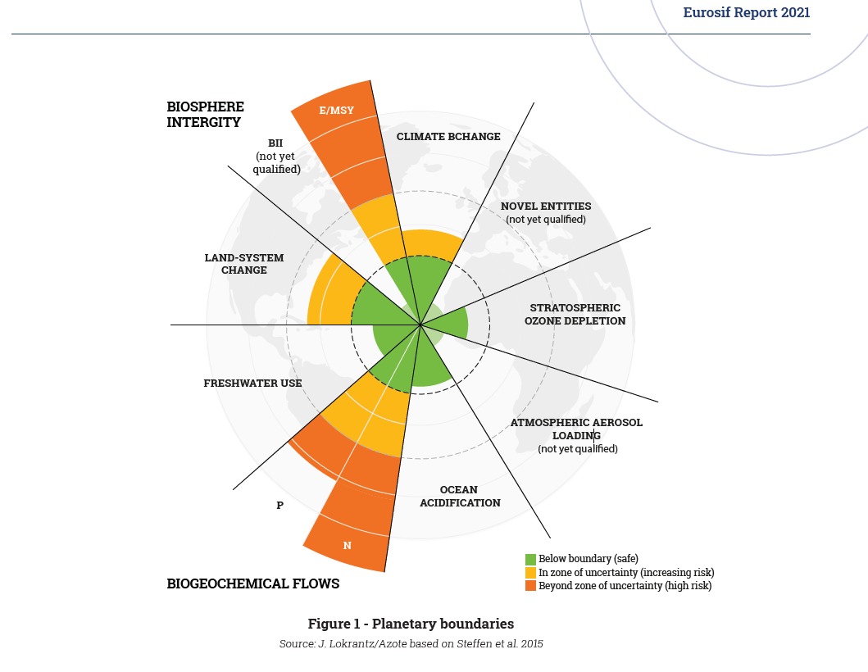
RESPONSIBLE INVESTMENT
EUROSIF – planetary boundaries

Slide 38
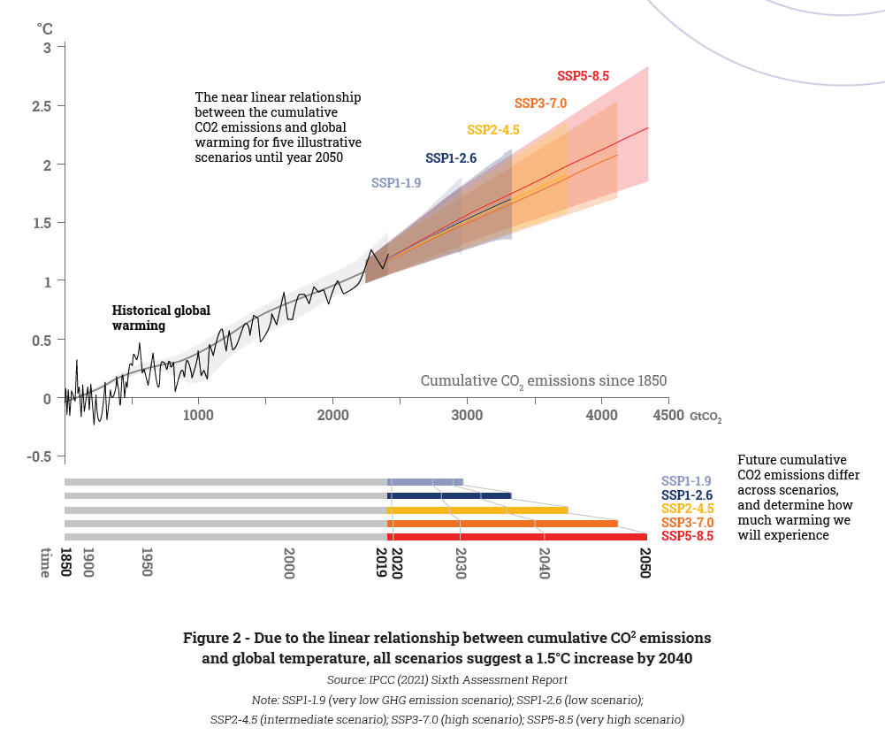
RESPONSIBLE INVESTMENT
EUROSIF – planetary boundaries

Slide 39
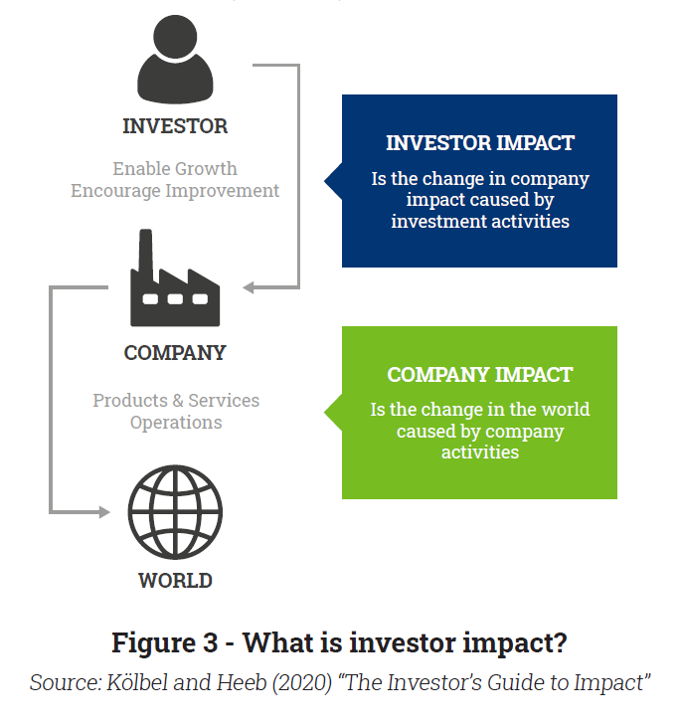
RESPONSIBLE INVESTMENT
Investor impact: what it means and how it
can be achieved
Investors can have positive real-world impacts only through the companies they invest in.
Shareholder engagement is the most reliable, empirically proven mechanism by which to realise improvements in corporate ESG practices, such as reductions in GHG emission in the value chain, decommissioning or decarbonising the activities that cause significant harm to climate mitigation, or improving the energy efficiency and circularity of production processes.

Slide 40
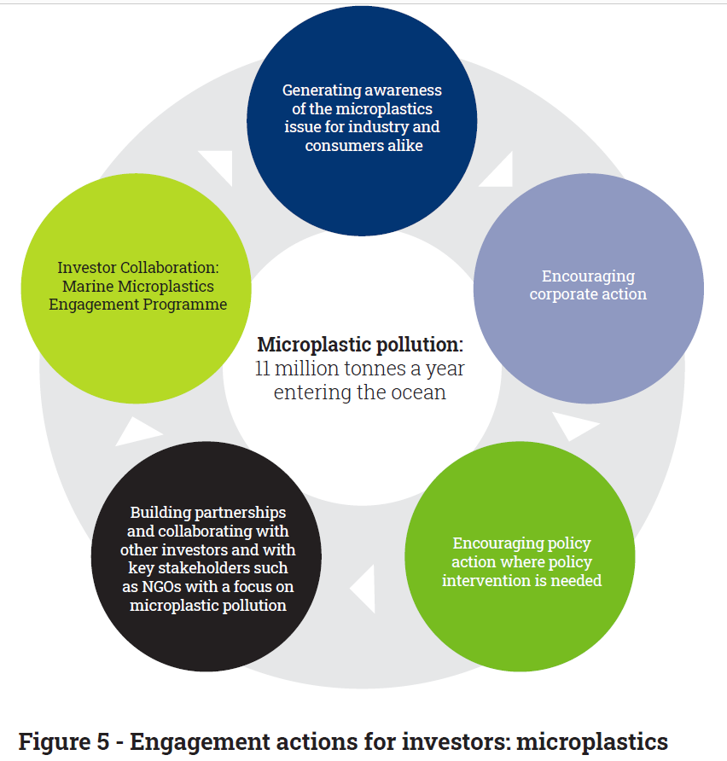
RESPONSIBLE INVESTMENT
Investor impact: what it means and how it
can be achieved
The importance of public policies and public-private partnerships to create appropriate market incentives.

Slide 41
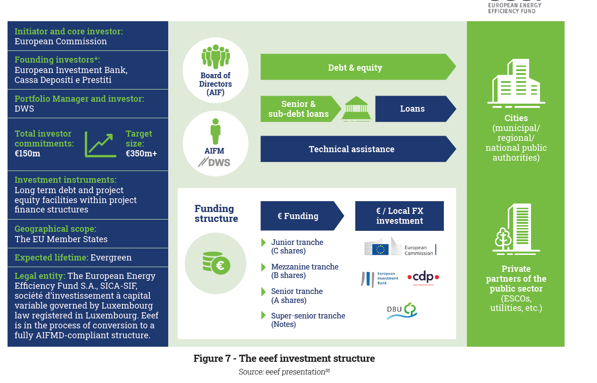
RESPONSIBLE INVESTMENT

Slide 42
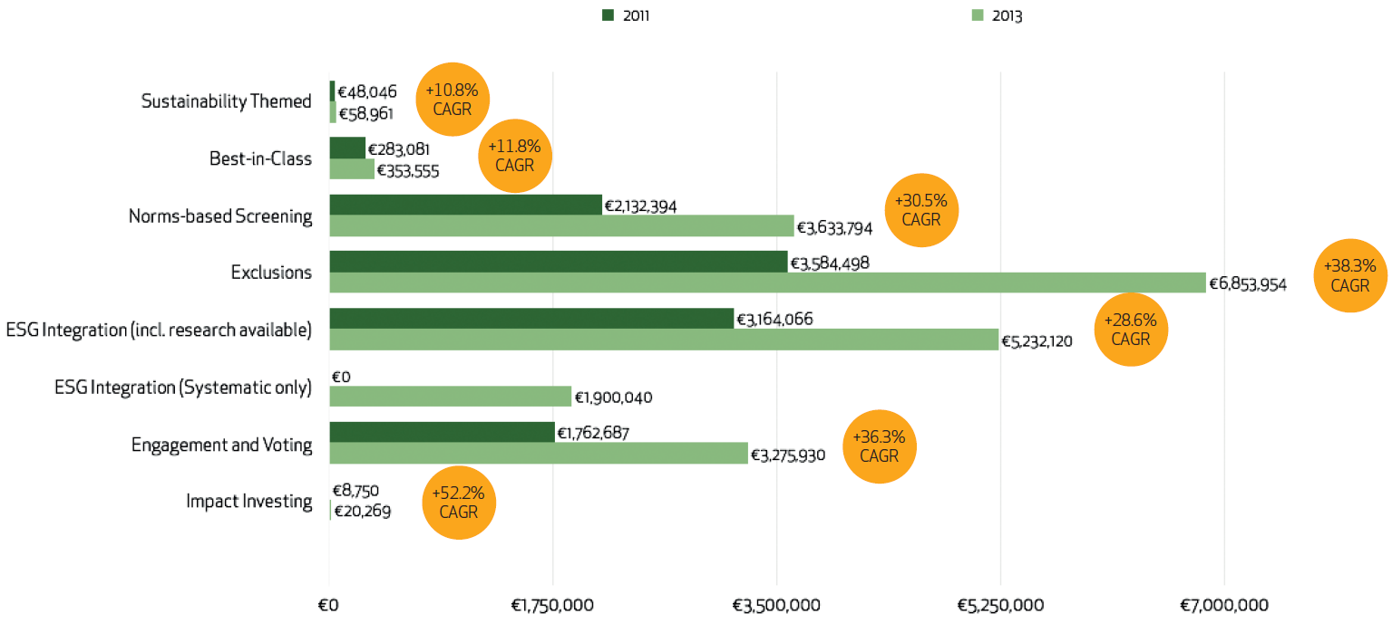
RESPONSIBLE INVESTMENT
3. The state of European SRI
Overview of SRI strategies in Europe
Source: Eurosif, 2013

Slide 43
RESPONSIBLE INVESTMENT
3. The state of European SRI
Sustainability themed investments cover a wide range of themes from climate change and energy efficiency to forests and water. Investors’ motivations may vary greatly, but it is typical to support particular industries transitioning to more sustainable consumption and production.
By nature, an despite its real potential to contribute to a more Sustainable economy, it has traditionally been one of the smaller of the SRI strategies across Europe.

Slide 44
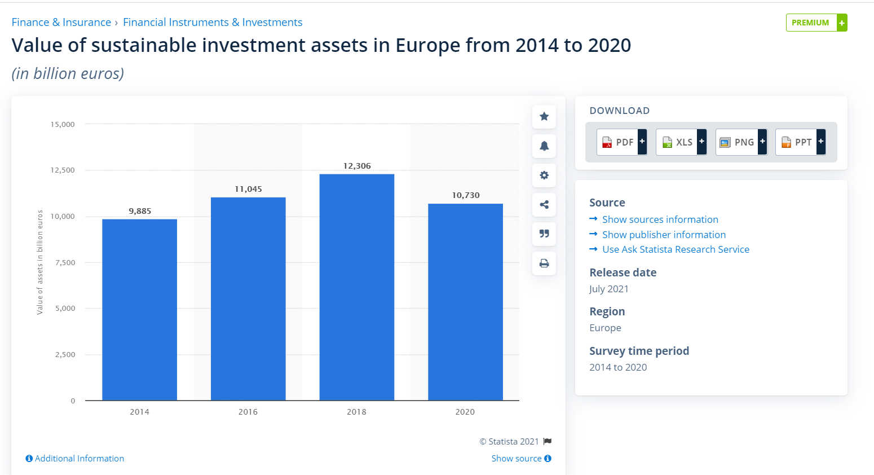
RESPONSIBLE INVESTMENT
3. The state of European SRI
Growth of sustainability themed investmens in Europe

Slide 45
RESPONSIBLE INVESTMENT
3. The state of European SRI
ESG integration in EU
ESG integration is defined as the explicit inclusion by asset managers of ESG risks and opportunities into traditional financial analysis and investment decisions based on a systematic process and appropriate research sources.
Eurosif has, for the first time, divided the activities performed by asset managers into three categories while attempting to allocate estimated assets to each:
  Category 1 (“non systematic ESG Integration”): ESG research and analyses made available to mainstream analysts and fund managers;
  Category 2: Systematic consideration/inclusion of ESG research/analyses in financial ratings/valuations by analysts and fund managers;
  Category 3: Mandatory investment constraints based on financial ratings/valuations derived from ESG research/ analyses (exclusions, under-weighting, etc.).

Slide 46
RESPONSIBLE INVESTMENT
summary of the lecture
The mainstreaming of SRI as it is adopted by institutional investors (not just by charities and other values based organisations or in dedicated SRI retail funds) is a major step in the maturing of SRI which offers the prospect of putting significant pressure on companies to adopt CSR.
Recomended study:
  European SRI Study 2021, EUROSIF
  Blowfield and Murray, 2014. Corporate Responsibility, Oxford University Press, chapter 10

