Slide 1

Retail management
Location, location and location

Slide 2
Location of a store
One famous retailer once said that the three major decisions in retailing are location, location, and location.
The easier it is to reach the store, the more store traffic a store will have and this will lead to higher sales.

Slide 3
Location of a store
Reaching the target market can be achieved through a store-based location in which the consumer travels to the store, or through a nonstore retailing format in which products and services are offered to the consumer at a more convenient or accessible location.
Regardless of whether retailers are planning a traditional store in geographic space or a virtual store in cyberspace, their first step is to develop a cost-effective way to reach the household and individual consumer that they have identified as their target market.

Slide 4
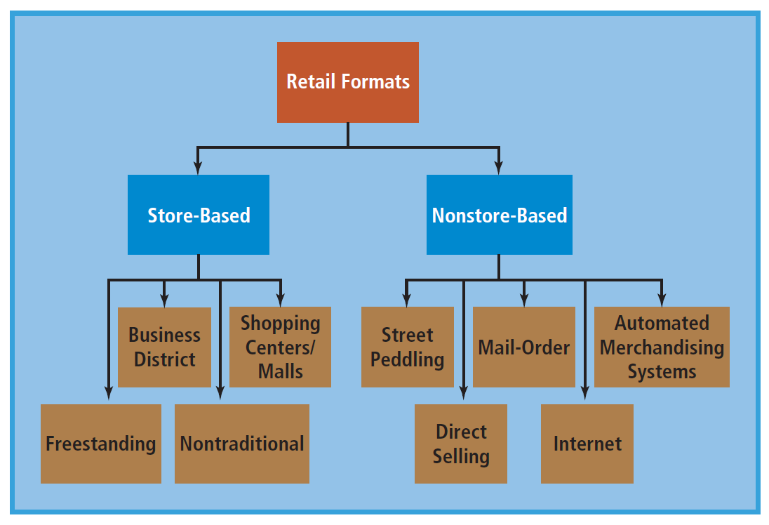

Slide 5
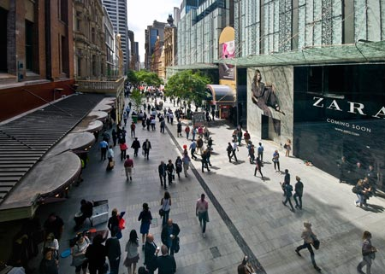
Central Business Districts
Usually an unplanned shopping area around the geographic point at which all public transportation systems converge.
Many traditional department stores are located in the CBD along with a good selection of specialty shops.
Beijing CBD: https://www.youtube.com/watch?v=KF3UNKvH5MY

Slide 6
Central Business Districts
The CBD has several strengths and weaknesses.
Among its strengths are easy access to public transportation; wide product assortment; variety in images, prices, and services; and proximity to commercial activities.
Some weaknesses to consider are inadequate (and usually expensive) parking, older stores, high rents and taxes, traffic and delivery congestion, potentially high crime rate, and the often-decaying conditions of many inner cities.

Slide 7

CBD - Prague example

Slide 8
Shopping centres
A shopping center, or mall, is a centrally owned and/or managed shopping district that is planned, has balanced tenancy, the stores complement each other in merchandise offerings, and is surrounded by parking facilities.
A shopping center has one or more anchor stores (dominant large-scale stores that are expected to draw customers to the center) and a variety of smaller stores.

Slide 9
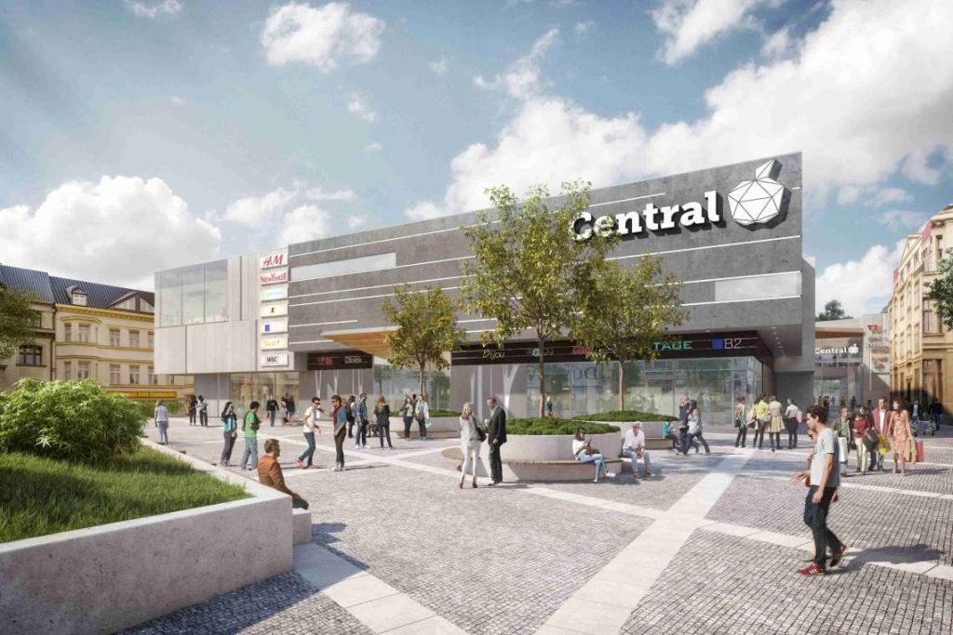
Shopping centres

Slide 10
Shopping centres
Advantages:
Heavy traffic resulting from the wide range of product offerings
Cooperative planning and sharing of common costs
Access to highways and availability of parking
Lower crime rate
Clean, neat environment

Slide 11
Shopping centres
Disadvantages:
Inflexible store hours (the retailer must stay open during mall hours and cannot be open at other times)
Restrictions as to what merchandise the retailer may sell
Inflexible operations and required membership in the center’s merchant organization
Possibility of too much competition and the fact that much of the traffic is not interested in a particular product offering

Slide 12
Freestanding location
A freestanding retailer generally locates along major traffic arteries without any adjacent retailers selling competing products to share traffic.
The difficulties of drawing, and then holding, customers to an isolated or freestanding store is the reason that only large, well-known retailers should attempt it.
Small retailers may be unable to develop a loyal customer base since customers are often unwilling to travel to a freestanding store that does not have a wide assortment of products and a local or national reputation.

Slide 13
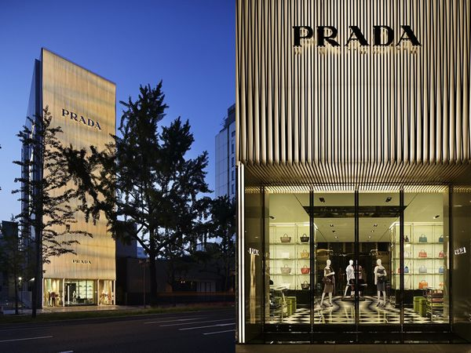
Freestanding location
A freestanding retailer generally locates along major traffic arteries without any adjacent retailers selling competing products to share traffic.
Prada's first freestanding store opens in Osaka, Japan

Slide 14
Freestanding location
Advantages:
Lack of direct competition
Generally lower rents
Freedom in operations and hours
Facilities that can be adapted to individual needs
Inexpensive parking

Slide 15
Freestanding location
Disadvantages:
Lack of drawing power of complementary stores
Difficulties in attracting customers for the initial visit
Higher advertising and promotional costs
Operating costs that cannot be shared with others
Stores that may have to be built rather than rented
Zoning laws that may restrict some activities

Slide 16
Nontraditional locations
A significant number of travelers spend several hours in airports and can use this time to purchase merchandise they might otherwise purchase in their local communities, many airport concourses now look like real regional malls, complete with national brands, casual dining, service kiosks, and entertainment-infotainment venues.

Slide 17
Geographic Information System (GIS)
A geographic information system (GIS) is a computerized system that combines physical geography with cultural geography.
It includes characteristics of the population such as age, gender, and income and man-made objects placed in that space, such as fixed physical structures (factories, stores, apartment buildings, schools, churches, houses, highways, railroads, airports, etc.) and mobile physical structures (e.g., cars and trucks).

Slide 18
Geographic Information System (GIS)
Recent advancements in GIS have allowed the retail analyst to also describe the lifestyle (activities, interests, opinions) of the residents of geographic areas.
This can be quite helpful in selecting locations for stores that are highly lifestyle sensitive

Slide 19
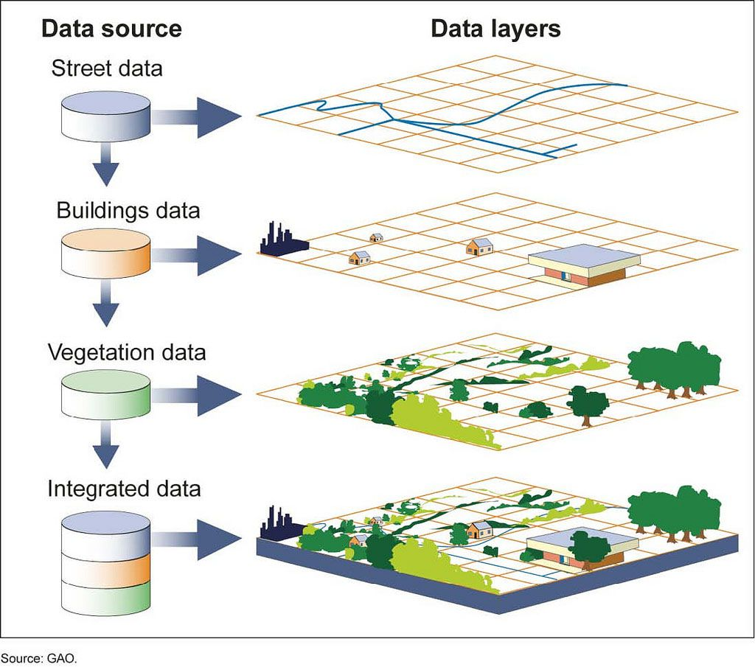
Geographic Information System (GIS)

Slide 20
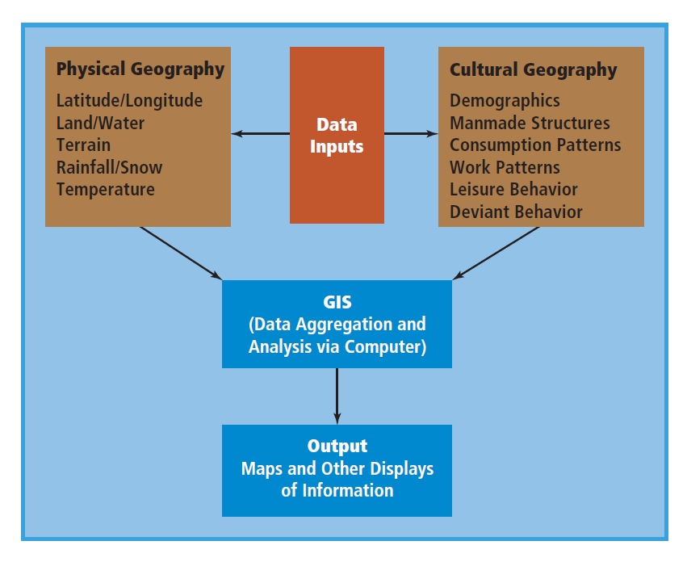
Geographic Information System (GIS)

Slide 21
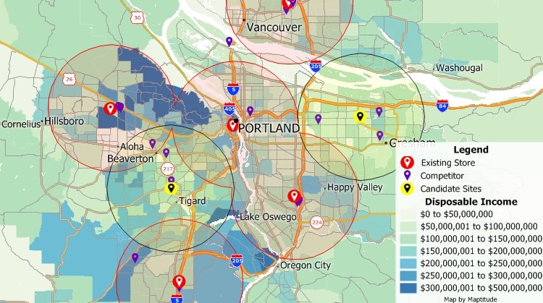

Slide 22
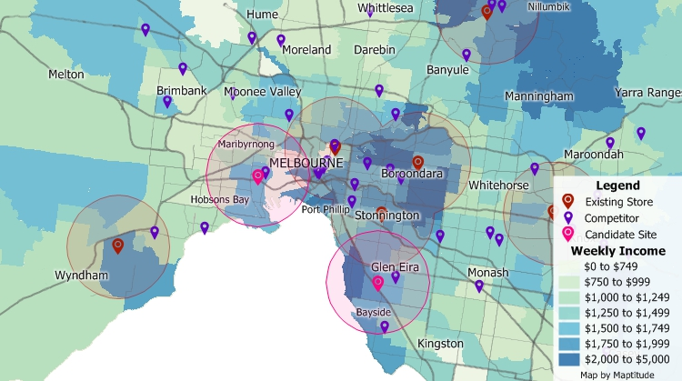

Slide 23
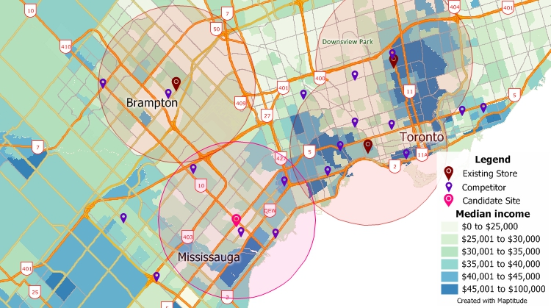

Slide 24
GIS Usage
Market selection. A retailer with a set of criteria in mind, such as the demographics of its target market and the level of over- or understoring in a market, can have the GIS identify and rank the most attractive cities, counties, or other geographic areas to consider for expansion.
Site analysis. If a retailer has a particular community in mind, a GIS can identify the best possible site or evaluate alternative sites for their expected profitability.

Slide 25
GIS Usage
Trade area definition. If the retailer develops a database of where its customers reside, a GIS can automatically develop a trade area map and update this daily, weekly, monthly, or annually.
New store cannibalization. A GIS can help the retailer evaluate how the addition of another store in a community might cannibalize sales from its existing store(s).

Slide 26
GIS Usage
Advertising management. A GIS can help the retailer allocate its advertising budget to different stores based on the market potential in their respective trade areas. Similarly, a GIS can help the retailer develop a more effective direct-mail campaign to prospective customers.
Merchandise management. A GIS can help the retailer develop an optimal mix of merchandise based on the characteristics of households and individuals within its trade area.

Slide 27
GIS Usage
Evaluation of store managers. A GIS can provide an important human resource function. It can help assess how well a store manager is performing based on the trade area characteristics.
Consider that two stores of the same size could be performing quite differently because of the demographics and competitive conditions in the two trade areas.
Thus it would be inappropriate to either reward or punish a manager for things over which the manager has no control.

Slide 28
Retail location theories
Retail gravity theory
Saturation theory

Slide 29
Retail gravity theory
In effect, it stated that two cities attract trade from an intermediate location approximately in direct proportion to the population of the two cities and in inverse proportion to the square of the distance from these two cities to the intermediate place.
That is, people will tend to shop in the larger city if travel distance is equal, or even somewhat farther, because they believe that the larger city has a better product selection and will be worth the extra travel.

Slide 30
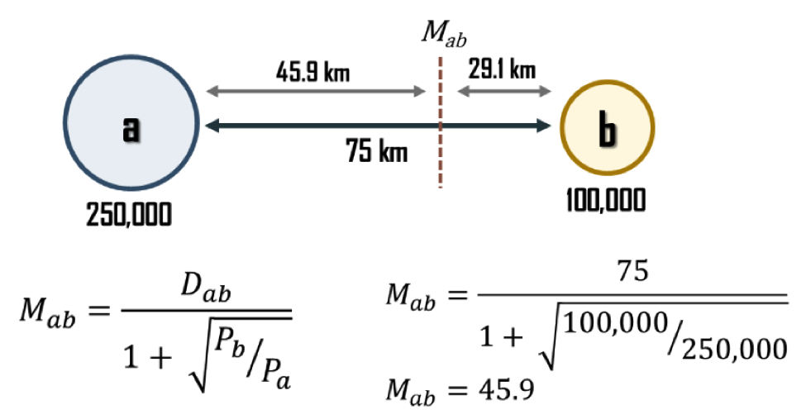
Retail gravity theory
Reilly’s law of retail gravitation, named after its developer, William Reilly, dealt with how large urbanized areas attracted customers from smaller communities.

Slide 31
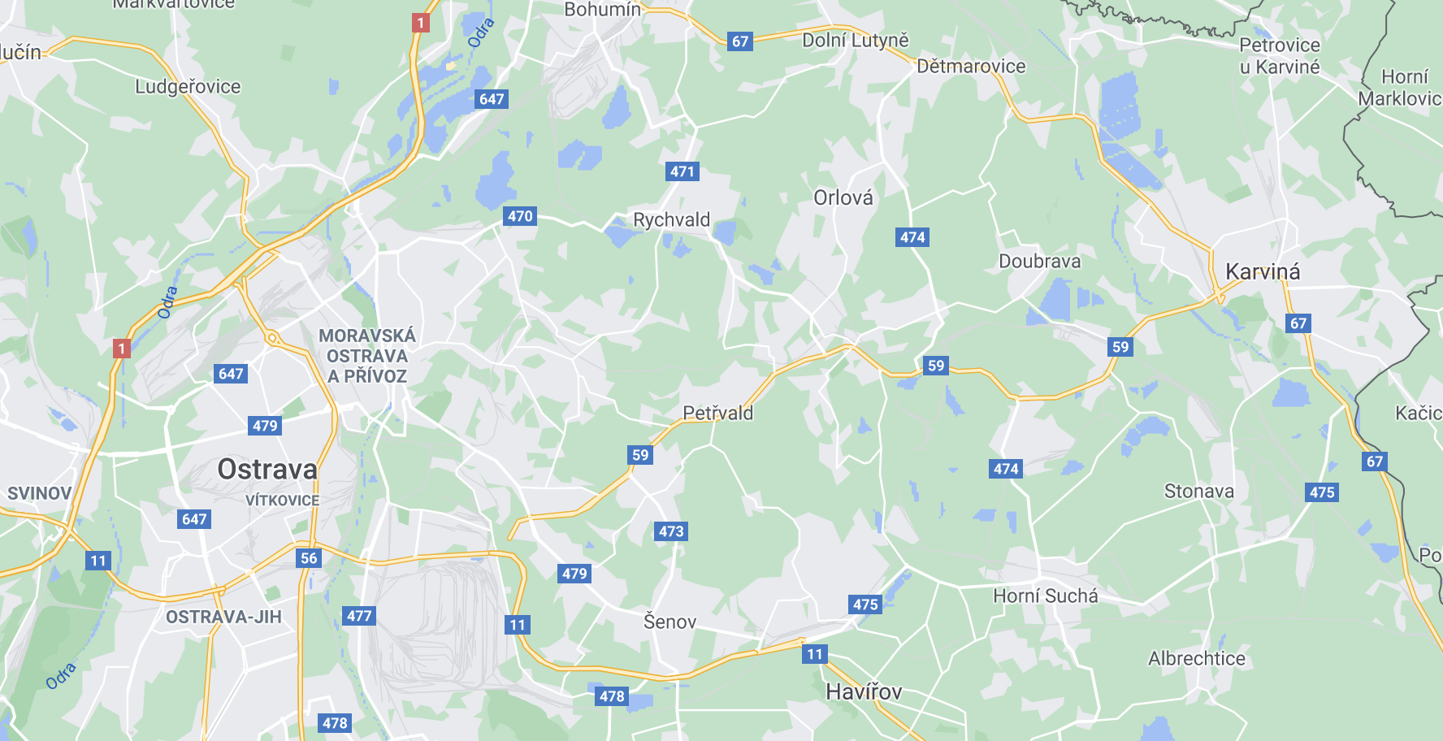
Retail gravity theory
Excercise: Find the breaking point between two cities: Ostrava and Karviná

Slide 32
Retail gravity theory
Retail gravity theory rests on two assumptions:
  the two competing cities are equally accessible from the major road and
  population is a good indicator of the differences in the goods and services available in different cities.
Consumers are attracted to the larger population centre not because of the city’s size, but because of the larger number of stores and wider product assortment available, thereby making the increased travel time worthwhile.

Slide 33
Saturation theory
Method for identifying attractive potential markets is based on retail saturation, which examines how the demand for goods and services in a potential trading area is being served by current retail establishments in comparison with other potential markets.

Slide 34
Saturation theory – 3 possible situations
Retail store saturation is a condition under which existing store facilities are utilized efﬁciently and meet customer needs. Retail saturation exists when a market has just enough store facilities for a given type of store to serve the population of the market satisfactorily and yield a fair proﬁt to the owners.
When a market has too few stores to satisfactorily meet the needs of the customer, it is understored. In this setting average store proﬁtability is quite high.
When a market has too many stores to yield a fair return on investment, it is overstored.

Slide 35
Saturation theory
One typically measures saturation, overstoring, and understoring in terms of the number of stores per thousand households.
A possible indicator of understored versus overstored markets is the index of retail saturation (IRS), which is the ratio of demand for a product or service divided by available supply.

Slide 36
Saturation theory formula
IRS = (H x RE) / RF
  IRS is the index of retail saturation for an area
  H is the number of households in the area
  RE is the annual retail expenditures for a particular line of trade per household in the area
  RF is the square footage of retail facilities of a particular line of trade in the area
IRS is essentially the sales per square foot of retail space in the marketplace for a particular line of retail trade
Retailers who identify and locate in markets where the index of retail saturation is high will be able to achieve a higher profit.

Slide 37

Saturation theory formula
IRS = (H x RE) / RF
  IRS is the index of retail saturation for an area
  H is the number of households in the area
  RE is the annual retail expenditures for a particular line of trade per household in the area
  RF is the square footage of retail facilities of a particular line of trade in the area

Slide 38

Thank you for your attention

