Slide 1

Retail management
Pricing

Slide 2
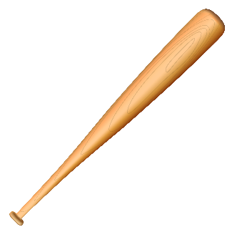

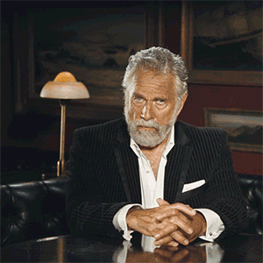
Baseball bat and ball cost 11 €.
Bat cost 10 € more than ball.
How much the ball costs?
1 + 11 = 12
1 €?
0,5 + 10,5 = 11

Slide 3
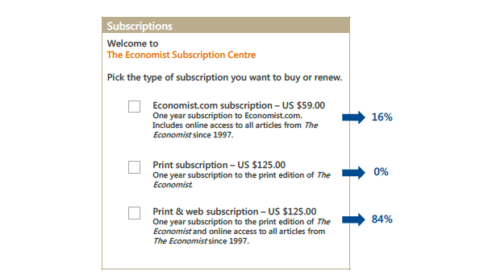
Relativity principle

Slide 4
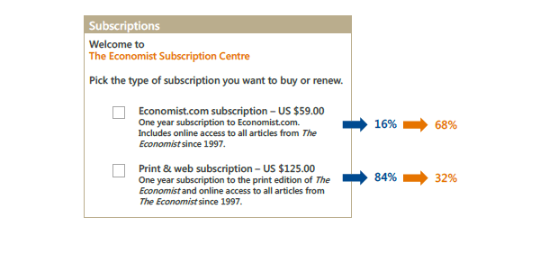

Slide 5
The Economist Subscription problem
Of the original high interest in the $ 125 (84%) printed and online subscription, the only version of interest-only version dropped to just 32%.
An anchor in the form of unnecessary options in the middle affected the overall perception of the offer.
An attractive third option (online + print) not only compared to the other (printed version only), but also with the first variation of online subscription.

Slide 6
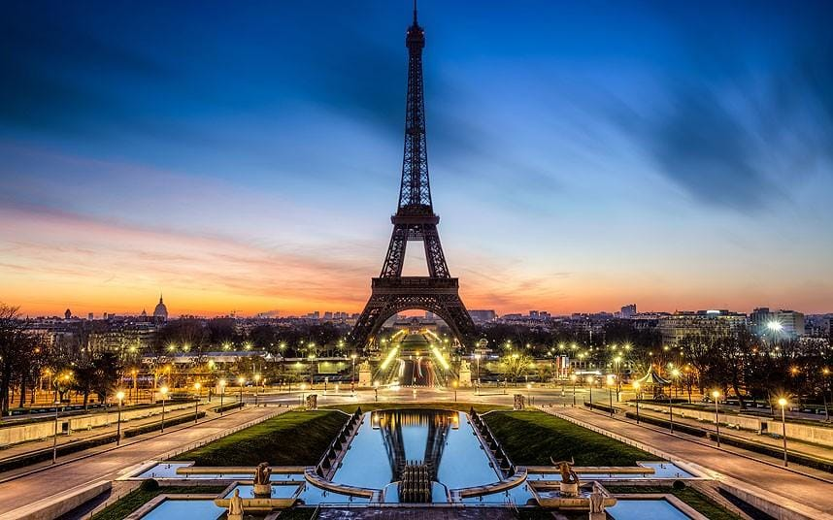
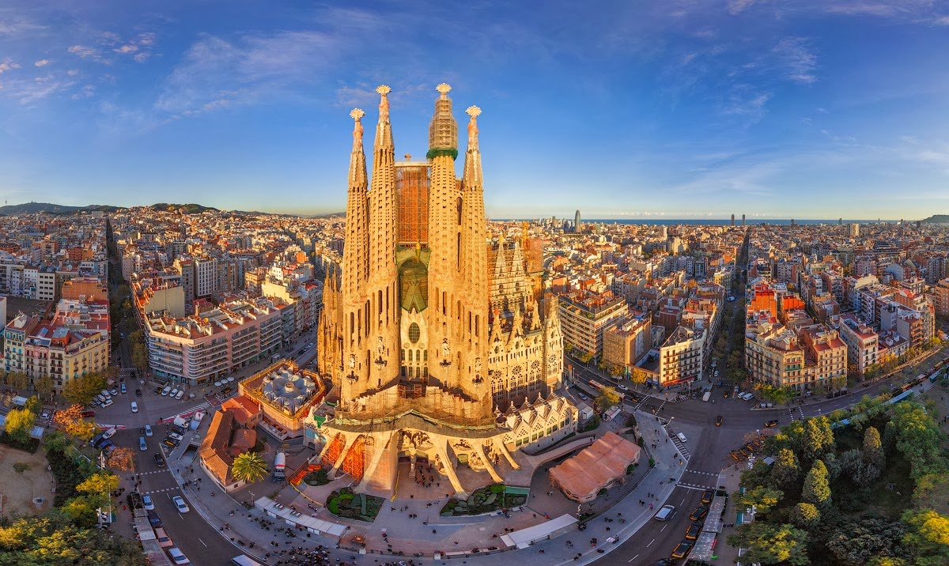
Where do you want to travel?

Slide 7
Paris or Barcelona?
Your choice
Trip to Barcelona All-inclusive, free transportation, you have to pay for your morning coffee,
Trip to Barcelona All-inclusive, free transportation,
Trip to Paris All-inclusive, free transportation,
2nd choice becomes more attractive compared to 1st choice and even compared to the 3rd one.
Ariely on irationality:
https://www.ted.com/talks/dan_ariely_asks_are_we_in_control_of_our_own_decisions/transcript#t-816260
Notes:
https://www.ted.com/talks/dan_ariely_asks_are_we_in_control_of_our_own_decisions/transcript#t-816260

Slide 8
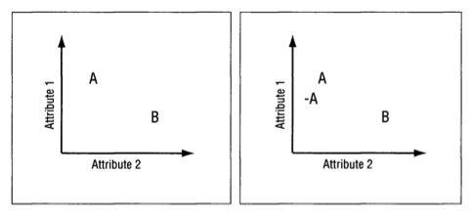
Anchoring
Notes:
In the left side of this illustration we see two options, each of which is better on a different attribute. Option (A) is better on attribute 1—let’s say quality. Option (B) is bet­ ter on attribute 2—let’s say beauty. Obviously these are two very different options and the choice between them is not simple. Now consider what happens if we add another op­ tion, called (-A) (see the right side of the illustration). This option is clearly worse than option (A), but it is also very similar to it, making the comparison between them easy, and suggesting that (A) is not only better than (—A) but also better than (B).

Slide 9
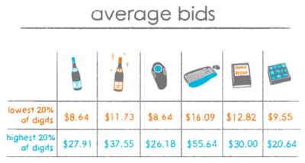
People lack preexisting subjective probability distributions over unknown quantities
Notes:
Woud you pay amout same as your last two digits of social number for these items?

Slide 10
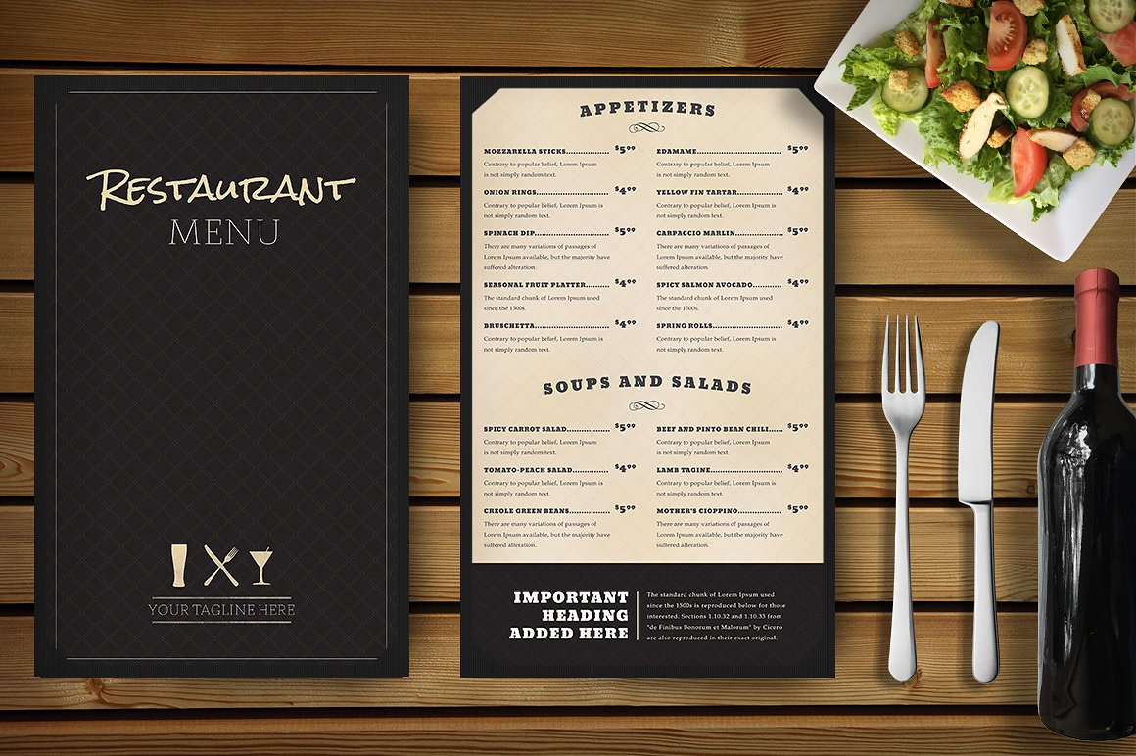
Removing currency denomination increases sales
15,-
vs
15,- €

Slide 11
Birthday number price effect
Implicit egotism resulting from consumers' positive self-associations affects their evaluations of product prices.
Increased preference for prices with endings equaling to one’s own birthday date.
Coulter and Grewal (2014)

Slide 12
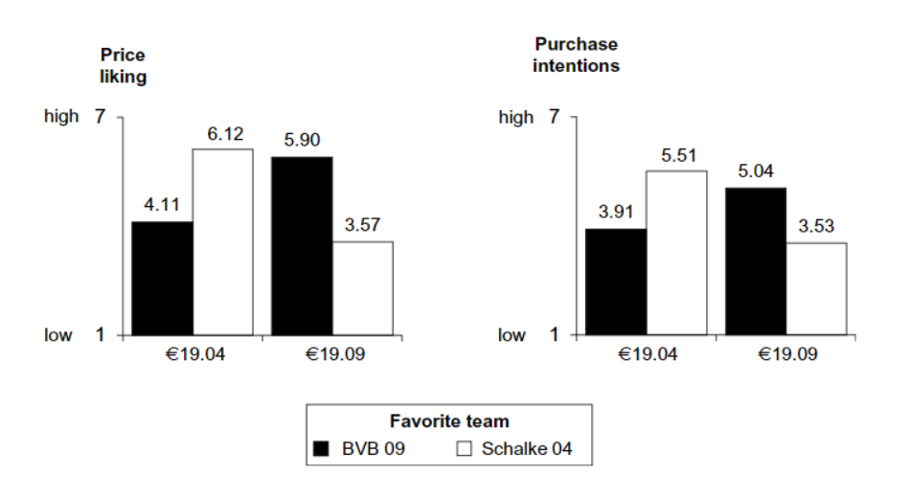
Housemann-Kopetzky and Köcher (2017)

Slide 13
Commas in price
1345 vs 1,345
11% difference in price perceptions

Slide 14
Fonts in pricing – how to promote price reduction?
Before 100 $ Now 79 $
vs
Before 100 $ Now 79 $

Slide 15
Consolidated surcharges
584 £
+ 10% tax
+ 3% shipping
584 £
+ 13% tax + shipping

Slide 16
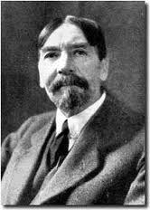
Price effects
Thorstein Veblen 1857 - 1929
Substitution effect
  Increase in price = reduction in demand
Veblen effect
  Increase in price = Increase in demand
Guttenberg effect
  Small increase in price = no change
  Radical increase in price = hectic changes

Slide 17
Types of the market and pricing process
B2B - Business to Business
  The price is usually determined for each contract in particular.
  Part of hard business bargaining.
B2C - Business to customer
  Fixed prices for all within the market.
  Prices are public and information accessible.
B2G - Business to Government
  The price is set in tenders and public contracts.

Slide 18
How to create a prices
  Cost-Oriented Methods
    In practice, they are often used.
    Costs determine the lower price limit.
    It leads to a mismatch between the interests of the customer and the company.
    Pricing adjusted to cost.
  Competitive methods
    Concentration on monitoring and adjustment of competition prices.
    Frequent in price leader markets.
  Value-oriented methods
    The price is crafted through the analysis of added value to customer.

Slide 19
Value-oriented pricing

Slide 20
Value-oriented pricing
One day in the mining business costs
  100.000 $
One hour:
  4.160 $
The price of the plug, which, thanks to its shape, saves one hour of work when drilling:
  3.000 $
Manufacturing costs:
  500 $

Slide 21
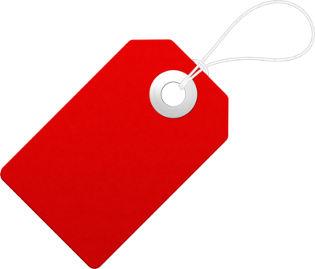

Price penetration strategy
Penetration or go to market strategy.
It is based on a very low price.
Fast market penetration and market share control.

Slide 22
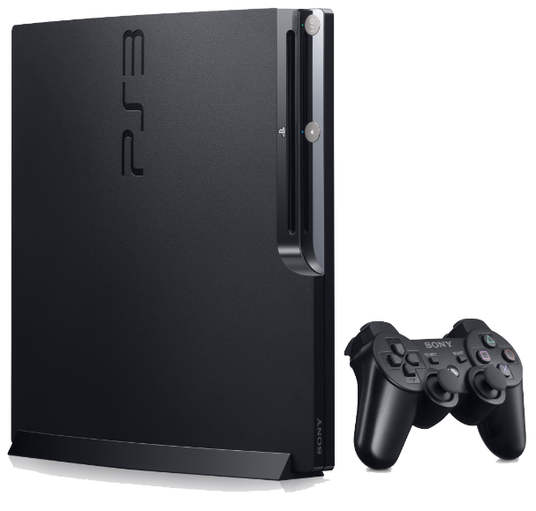
Skimming strategy
In a short period.
  High price on a fairly small market.
  New customers adapt to the price.
In a long period.
  High profits are likely to attract competition.
  The price cut will keep sales at the desired values.
  Branded and fashionable goods, technological novelties (gaming consoles, tablets, smartphones).

Slide 23
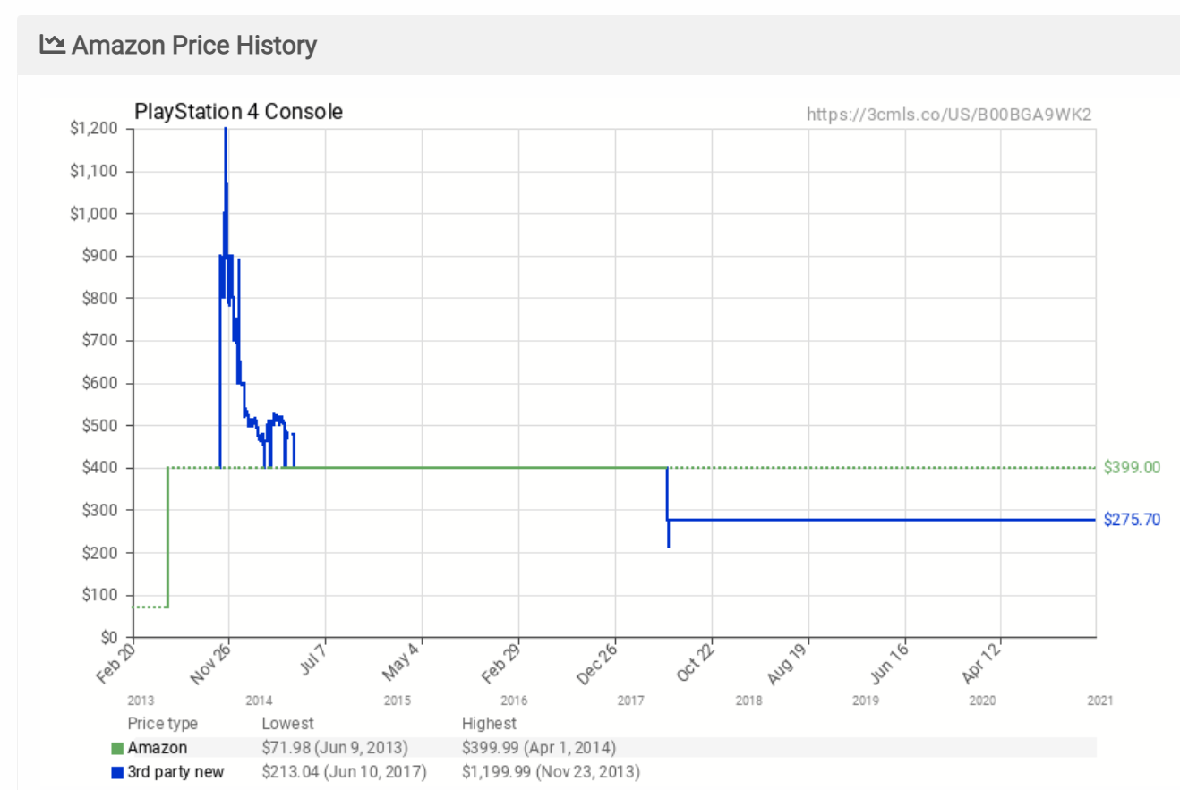
Skimming strategy

Slide 24
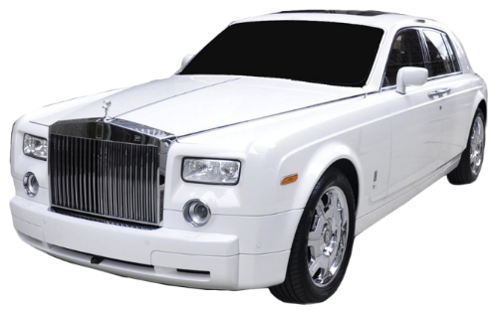
Premium pricing
High price throughout the product life cycle.
Decreasing the price would be perceived by customers as a loss of prestige.
Luxury brands (fashion, cars, jewelry, watches).
Premium price assumptions:
  The customer believes the goods are good quality.
  The product will allow it to reflect the social status of luxury.
  The cost of product failure is too high.

Slide 25
Skimming and premium pricing
They are a strategy of high prices.
The use of a high price carries certain assumptions:
  The product is unique, patent-protected
  Production is difficult
  The high price does repels certain customer segments
  The market is too small to attract competition
  The product requires highly qualified staff

Slide 26
Psychological price development
Consumers perceive mostly the first digit of the price and how many numbers it has. They do not care much about halter items. The meaning of the penny (cent) parts of the price increases with the strength of the currency.
This effect is magnified by the price tags where these items are printed in smaller font (3.⁹⁸ €).
Prices down to the last cents indicate to the consumer that the goods are sold at the lowest possible price.
The importance of setting the right price increases with the development of Internet servers to compare goods (Heureka.cz, Zbozi.cz).

Slide 27
Psychological price development
Price tactics
Using 1.99 instead of 2
All for XX, -
Monthly payments instead of the total price
Free stuff (X + 1 action)
Deploying high prizes and subsequent "drastic" DISCOUNT

Slide 28
Thank you

