Slide 1

Analytical Methods of Internal Environment
Ing. Šárka Zapletalová, Ph.D.
Department of Business Economics and Management
STRATEGIC MANAGEMENT

Slide 2

Outline of the lecture
Resources and capabilities
A resource based approach
Value-chain analysis
Scanning functional resources and capabilities

Slide 3
Introduction
Analysts must also look within the corporation itself to identify internal strategic factors - critical strengths and weaknesses that are likely to determine whether a firm will be able to take advantage of opportunities while avoiding threats.
This internal scanning, often referred to as organizational analysis, is concerned with identifying and developing an organization’s resources and competencies.

Slide 4
Resources and Capabilities
Resources are an organization’s assets and are thus the basic building blocks of the organization.
They include tangible assets, such as its plant, equipment, finances, and location, human assets, in terms of the number of employees, their skills, and motivation, and intangible assets, such as its technology (patents and copyrights), culture, and reputation.
Capabilities refer to a corporation’s ability to exploit its resources.
  A capability is functionally based and is resident in a particular function. Thus, there are marketing capabilities, manufacturing capabilities, and human resource management capabilities. When these capabilities are constantly being changed and reconfigured to make them more adaptive to an uncertain environment, they are called dynamic capabilities.

Slide 5
Resources and Capabilities
Four factors help a company to build and sustain competitive advantage - superior efficiency, quality, innovation, and customer responsiveness.
The durability of a company’s competitive advantage depends upon the height of barriers to imitation, the capability of competitors to imitate its innovation, and the general level of dynamism in the industry environment.
The distinctive competencies of an organization arise from its resources (its financial, physical, human, technological, and organizational assets) and capabilities (its skills at coordinating resources and putting them to productive use).
  If a company’s managers are to perform a good internal analysis, they need to be able to analyze the financial performance of their company, identifying how the strategies of the company relate to its profitability, as measured by the return on invested capital.

Slide 6
Resources and Capabilities
Barney, in his VRIO framework of analysis, proposes four questions to evaluate a firm’s competencies:
  Value: Does it provide customer value and competitive advantage?
  Rareness: Do no other competitors possess it?
  Imitability: Is it costly for others to imitate?
  Organization: Is the firm organized to exploit the resource?

Slide 7
Applying the VRIO
V
R
I
O
Sustainable Competitive Advantage
Competitive Disadvantage
Competitive Parity
Temporary Competitive Advantage
Temporary Competitive Advantage
Prostor pro doplňující informace, poznámky

Slide 8
Resource-Based Approach
Proposing that a company’s sustained competitive advantage is primarily determined by its resource endowments, Grant proposes a five-step, resource-based approach to strategy analysis.
  Identify and classify the firm’s resources in terms of strengths and weaknesses.
  Combine the firm’s strengths into specific capabilities and core competencies.
  Appraise the profit potential of these capabilities and competencies in terms of their potential for sustainable competitive advantage and the ability to harvest the profits resulting from their use. Are there any distinctive competencies?
  Select the strategy that best exploits the firm’s capabilities and competencies relative to external opportunities.
  Identify resource gaps and invest in upgrading weaknesses.

Slide 9
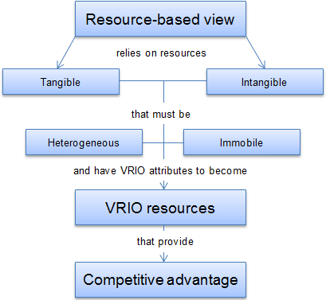
Resource-Based Approach
Prostor pro doplňující informace, poznámky

Slide 10
A Resource-Based Approach
Determining the sustainability of an advantage
Just because a firm is able to use its resources, capabilities, and competencies to develop a competitive advantage does not mean it will be able to sustain it.
Two characteristics determine the sustainability of a firm’s distinctive competency(ies): durability and imitability.
Durability is the rate at which a firm’s underlying resources, capabilities, or core competencies depreciate or become obsolete. New technology can make a company’s core competency obsolete or irrelevant.
  For example, Intel’s skills in using basic technology developed by others to manufacture and market quality microprocessors was a crucial capability until management realized that the firm had taken current technology as far as possible with the Pentium chip.

Slide 11
A Resource-Based Approach
Determining the sustainability of an advantage
Imitability is the rate at which a firm’s underlying resources, capabilities, or core competencies can be duplicated by others.
To the extent that a firm’s distinctive competency gives it competitive advantage in the marketplace, competitors will do what they can to learn and imitate that set of skills and capabilities.
Competitors’ efforts may range from reverse engineering (which involves taking apart a competitor’s product in order to find out how it works), to hiring employees from the competitor, to outright patent infringement.
A core competency can be easily imitated to the extent that it is transparent, transferable, and replicable.

Slide 12
A Resource-Based Approach
Determining the sustainability of an advantage
Transparency is the speed with which other firms can understand the relationship of resources and capabilities supporting a successful firm’s strategy.
  For example, Gillette has always supported its dominance in the marketing of razors with excellent R&D.
  A competitor could never understand how the Sensor or Mach 3 razor was produced simply by taking one apart.
  Gillette’s razor design was very difficult to copy, partially because the manufacturing equipment needed to produce it was so expensive and complicated.

Slide 13
A Resource-Based Approach
Determining the sustainability of an advantage
Transferability is the ability of competitors to gather the resources and capabilities necessary to support a competitive challenge.
  For example, it may be very difficult for a winemaker to duplicate a French winery’s key resources of land and climate, especially if the imitator is located in Iowa.
Replicability is the ability of competitors to use duplicated resources and capabilities to imitate the other firm’s success.

Slide 14
A Resource-Based Approach
Determining the sustainability of an advantage
Transferability is the ability of competitors to gather the resources and capabilities necessary to support a competitive challenge.
  For example, it may be very difficult for a winemaker to duplicate a French winery’s key resources of land and climate, especially if the imitator is located in Iowa.
Replicability is the ability of competitors to use duplicated resources and capabilities to imitate the other firm’s success.

Slide 15
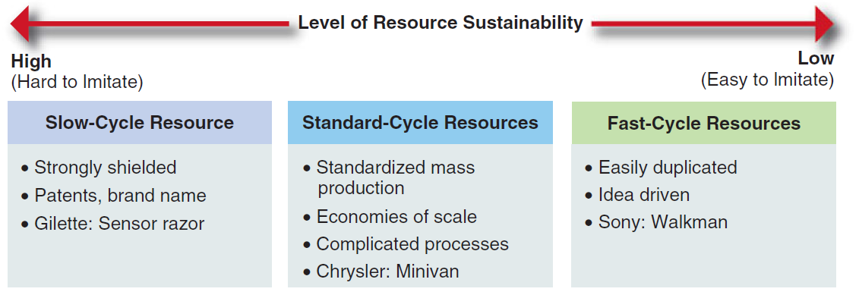
A Resource-Based Approach
Continuum of Resource Sustainability
An organization’s resources and capabilities can be placed on a continuum to the extent they are durable and can’t be imitated (that is, aren’t transparent, transferable, or replicable) by another firm.
SOURCE: Copyright © 1992 by the Regents of the University of California. Reprinted from the California Management Review, Vol. 34, No. 3.

Slide 16
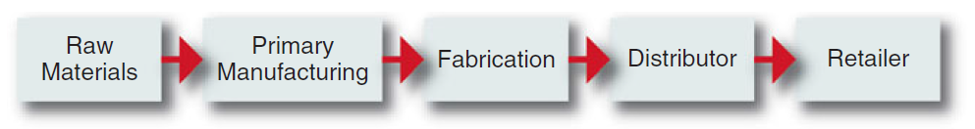
Value-Chain Analysis
A value chain is a linked set of value-creating activities that begin with basic raw materials coming from suppliers, moving on to a series of value-added activities involved in producing and marketing a product or service, and ending with distributors getting the final goods into the hands of the ultimate consumer.
The focus of value-chain analysis is to examine the corporation in the context of the overall chain of value-creating activities, of which the firm may be only a small part.
Typical Value Chain for a Manufactured Product

Slide 17
Value-Chain Analysis
Industry value chain
The value chains of most industries can be split into two segments, upstream and downstream segments.
  In the petroleum industry, for example, upstream refers to oil exploration, drilling, and moving of the crude oil to the refinery, and downstream refers to refining the oil plus transporting and marketing gasoline and refined oil to distributors and gas station retailers.
In analyzing the complete value chain of a product, note that even if a firm operates up and down the entire industry chain, it usually has an area of expertise where its primary activities lie. A company’s center of gravity is the part of the chain that is most important to the company and the point where its greatest expertise and capabilities lie - its core competencies.
  After a firm successfully establishes itself at this point by obtaining a competitive advantage, one of its first strategic moves is to move forward or backward along the value chain in order to reduce costs, guarantee access to key raw materials, or to guarantee distribution - this process, called vertical integration.

Slide 18
Value-Chain Analysis
Corporate value chain
Each corporation has its own internal value chain of activities.
Porter proposes that a manufacturing firm’s primary activities usually begin with inbound logistics (raw materials handling and warehousing), go through an operations process in which a product is manufactured, and continue on to outbound logistics (warehousing and distribution), to marketing and sales, and finally to service (installation, repair, and sale of parts).
Several support activities, such as procurement (purchasing), technology development (R&D), human resource management, and firm infrastructure (accounting, finance, strategic planning), ensure that the primary value chain activities operate effectively and efficiently.

Slide 19
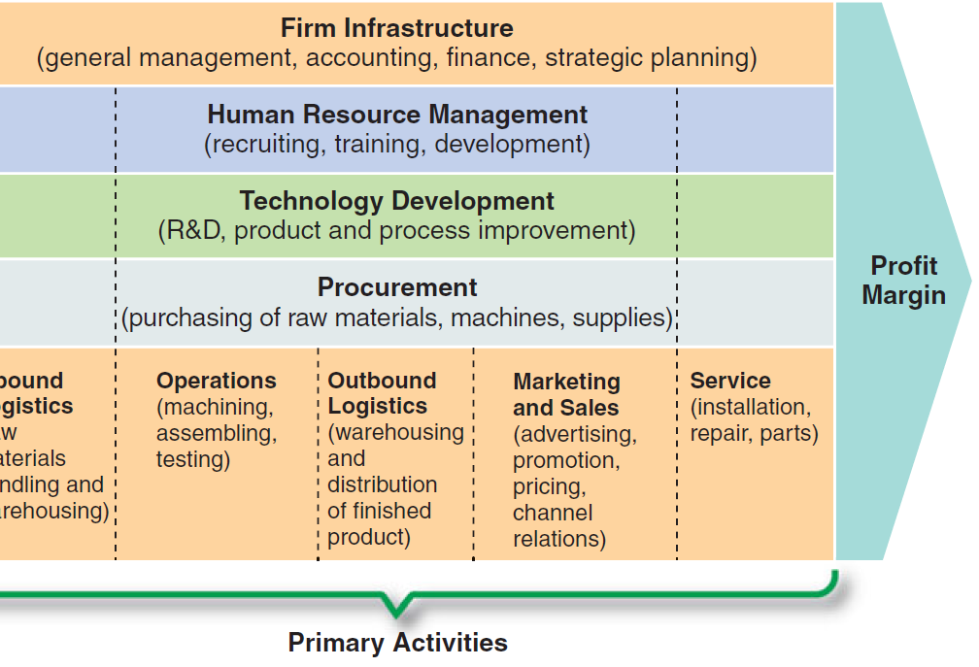
Value-Chain Analysis
Corporate value chain
SOURCE: COMPETITIVE ADVANTAGE: Creating and Sustaining Superior Performance by Michael E. Porter.

Slide 20
Value-Chain Analysis
Corporate value chain analysis involves the following three steps:
  Examine each product line’s value chain in terms of the various activities involved in producing that product or service.
  Examine the “linkages” within each product line’s value chain: Linkages are the connections between the way one value activity (for example, marketing) is performed and the cost of performance of another activity (for example, quality control).
  Examine the potential synergies among the value chains of different product lines or business units: Each value element, such as advertising or manufacturing, has an inherent economy of scale in which activities are conducted at their lowest possible cost per unit of output. If a particular product is not being produced at a high enough level to reach economies of scale in distribution, another product could be used to share the same distribution channel.

Slide 21
Scanning Functional Resources and Capabilities
The simplest way to begin an analysis of a corporation’s value chain is by carefully examining its traditional functional areas for potential strengths and weaknesses.
Functional resources and capabilities include not only the financial, physical, and human assets in each area but also the ability of the people in each area to formulate and implement the necessary functional objectives, strategies, and policies.
In addition to the usual business functions of marketing, finance, R&D, operations, human resources, and information systems/technology, structure and culture as key parts of a business corporation’s value chain.

Slide 22
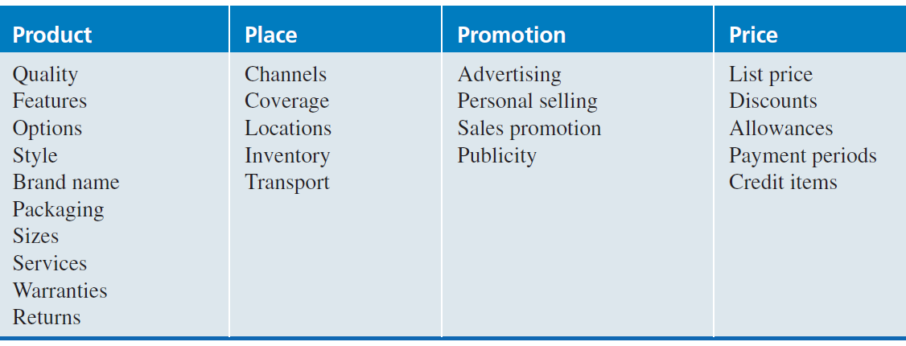
Scanning Functional Resources and Capabilities
Strategic Marketing Issues
The marketing manager is a company’s primary link to the customer and the competition. The manager, therefore, must be especially concerned with the market position and marketing mix of the firm as well as with the overall reputation of the company and its brands.
Marketing Mix Variables
SOURCE: KOTLER, PHILIP, MARKETING MANAGEMENT, 11th edition

Slide 23
Scanning Functional Resources and Capabilities
Product Life Cycle
The product life cycle is a graph showing time plotted against the monetary sales of a product as it moves from introduction through growth and maturity to decline.
Brand and Corporate Reputation
A brand is a name given to a company’s product which identifies that item in the mind of the consumer. Over time and with proper advertising, a brand connotes various characteristics in the consumers’ minds.
A corporate reputation is a widely held perception of a company by the general public. It consists of two attributes:
  stakeholders’ perceptions of a corporation’s ability to produce quality goods and
  a corporation’s prominence in the minds of stakeholders.

Slide 24
Scanning Functional Resources and Capabilities
Strategic Financial Issues
A financial manager must ascertain the best sources of funds, uses of funds, and control of funds.
  All strategic issues have financial implications. Cash must be raised from internal or external (local and global) sources and allocated for different uses. The flow of funds in the operations of an organization must be monitored.
The concept of financial leverage (the ratio of total debt to total assets) is helpful in describing how debt is used to increase the earnings available to common shareholders.
Capital budgeting is the analyzing and ranking of possible investments in fixed assets such as land, buildings, and equipment in terms of the additional outlays and additional receipts that will result from each investment.

Slide 25
Scanning Functional Resources and Capabilities
Strategic Research and Development Issues
The R&D manager is responsible for suggesting and implementing a company’s technological strategy in light of its corporate objectives and policies. The manager’s job, therefore, involves:
  choosing among alternative new technologies to use within the corporation,
  developing methods of embodying the new technology in new products and processes, and
  deploying resources so that the new technology can be successfully implemented.

Slide 26
Scanning Functional Resources and Capabilities
Strategic Human Resource (HRM) Issues
The primary task of the manager of human resources is to improve the match between individuals and jobs.
  Research indicates that companies with good HRM practices have higher profits and a better survival rate than do firms without these practices.
A good HRM department should know how to use attitude surveys and other feedback devices to assess employees’ satisfaction with their jobs and with the corporation as a whole.
HRM managers should also use job analysis to obtain job description information about what each job needs to accomplish in terms of quality and quantity.

Slide 27
Scanning Functional Resources and Capabilities
Strategic Information Systems/Technology Issues
The primary task of the manager of information systems/technology is to design and manager the flow of information in an organization in ways that improve productivity and decision making.
Information must be collected, stored, and synthesized in such a manner that it will answer important operating and strategic questions.
A corporation’s information system can be a strength or a weakness in multiple areas of strategic management.

