Slide 1
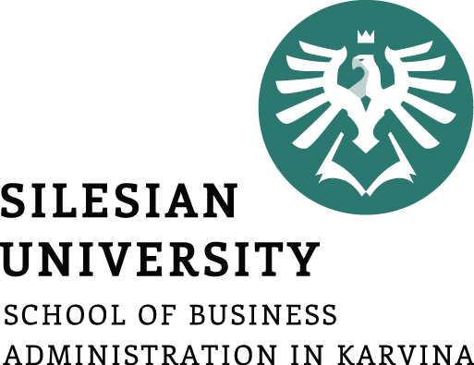
Corporate Strategy
Ing. Šárka Zapletalová, Ph.D.
Department of Business Economics and Management
STRATEGIC MANAGEMENT

Slide 2

Outline of the lecture
Strategy objectives
Strategy
Corporate strategy
Growth strategies
Stability strategies
Rentrenchment strategies

Slide 3
Introduction
A strategy is all about integrating organizational activities and utilizing and allocating the scarce resources within the organizational environment so as to meet the present objectives.
Corporate strategy is primarily about the choice of direction for the firm as a whole.
A strategy of a corporation forms a comprehensive master plan that states how the corporation will achieve its mission and objectives. It maximizes competitive advantage and minimizes competitive disadvantage.
The typical business firm usually considers three types of strategy: corporate, business, and functional.

Slide 4
Strategy Objectives
Objectives are the end results of planned activity.
They should be stated as action verbs and tell what is to be accomplished by when and quantified if possible.
The achievement of corporate objectives should result in the fulfillment of a corporation’s mission.
  In effect, this is what society gives back to the corporation when the corporation does a good job of fulfilling its mission.
The term goal is often used interchangeably with the term objective.
  We prefer to differentiate the two terms. In contrast to an objective, we consider a goal as an openened statement of what one wants to accomplish, with no quantification of what is to be achieved and no time criteria for completion. For example, a simple statement of “increased profitability” is thus a goal, not an objective, because it does not state how much profit the firm wants to make the next year. A good objective should be action-oriented and begin with the word to.

Slide 5
Strategy Objectives
Some of the areas in which a corporation might establish its goals and objectives are:
Profitability (net profits)
Efficiency (low costs, etc.)
Growth (increase in total assets, sales, etc.)
Shareholder wealth (dividends plus stock price appreciation)
Utilization of resources (ROE or ROI)
Reputation (being considered a “top” firm)
Contributions to employees
Contributions to society (taxes paid, participation in charities, providing a needed product or service)
Market leadership (market share)
Technological leadership (innovations, creativity)
Survival (avoiding bankruptcy)
Personal needs of top management

Slide 6
Strategy Objectives
S.M.A.R.T. is an acronym that is used to guide the development of measurable goals.
The first known use of the term occurs in the November 1981 issue of Management Review by George T. Doran. Since then, Professor Robert S. Rubin (Saint Louis University) wrote about SMART in an article for The Society for Industrial and Organizational Psychology. He stated that SMART has come to mean different things to different people.
To make sure goals are clear and reachable, each one should be:
Specific (simple, sensible, significant).
Measurable (meaningful, motivating).
Achievable (agreed, attainable).
Relevant (reasonable, realistic and resourced, results-based).
Time bound (time-based, time limited, time/cost limited, timely, time-sensitive).

Slide 7
Strategy
The word “strategy” is derived from the Greek word “stratçgos”; stratus (meaning army) and “ago” (meaning leading/moving).
Strategy is an action that managers take to attain one or more of the organization’s goals.
Strategy can also be defined as “A general direction set for the company and its various components to achieve a desired state in the future. Strategy results from the detailed strategic planning process”.
A strategy is all about integrating organizational activities and utilizing and allocating the scarce resources within the organizational environment so as to meet the present objectives.
Strategy is a well defined roadmap of an organization. It defines the overall mission, vision and direction of an organization. The objective of a strategy is to maximize an organization’s strengths and to minimize the strengths of the competitors.
Strategy, in short, bridges the gap between “where we are” and “where we want to be”.

Slide 8
Strategy
Features of Strategy
Strategy is significant because it is not possible to foresee the future. Without a perfect foresight, the firms must be ready to deal with the uncertain events which constitute the business environment.
Strategy deals with long term developments rather than routine operations, i.e. it deals with probability of innovations or new products, new methods of productions, or new markets to be developed in future.
Strategy is created to take into account the probable behavior of customers and competitors. Strategies dealing with employees will predict the employee behavior.

Slide 9
Strategy
A strategy of a corporation forms a comprehensive master plan that states how the corporation will achieve its mission and objectives. It maximizes competitive advantage and minimizes competitive disadvantage.
Armed with a mission, objectives, and completed external and internal analyses, a firm is ready to make its strategic choices. That is, a firm is ready to choose its "theory of how to gain competitive advantage."
The typical business firm usually considers three types of strategy: corporate, business, and functional.

Slide 10
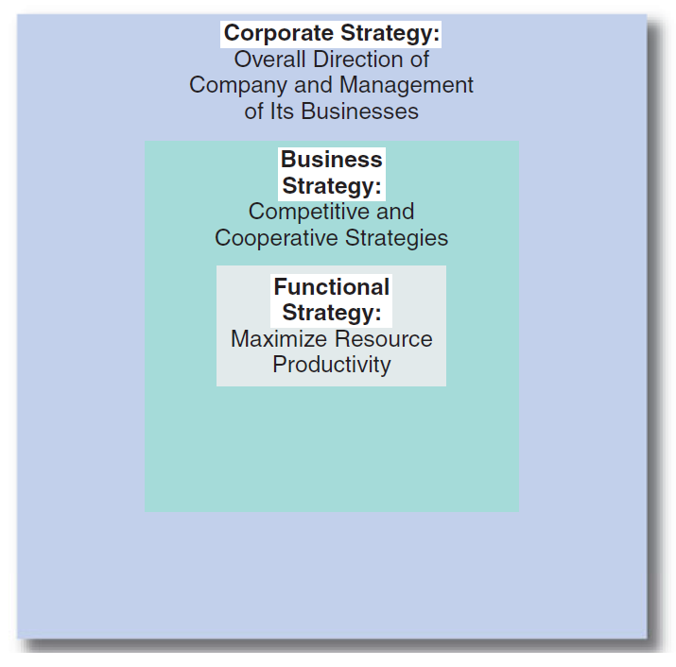
Strategy
Hierarchy of strategy

Slide 11
Corporate Strategy
Corporate strategy is primarily about the choice of direction for a firm as a whole and the management of its business or product portfolio.
This is true whether the firm is a small company or a large multinational corporation (MNC).
In a large multiple-business company, in particular, corporate strategy is concerned with managing various product lines and business units for maximum value.
In this instance, corporate headquarters must play the role of the organizational “parent,” in that it must deal with various product and business unit “children“.

Slide 12
Corporate Strategy
Corporate strategy, therefore, includes decisions regarding the flow of financial and other resources to and from a company’s product lines and business units.
Through a series of coordinating devices, a company transfers skills and capabilities developed in one unit to other units that need such resources.
In this way, it attempts to obtain synergy among numerous product lines and business units so that the corporate whole is greater than the sum of its individual business unit parts.
Corporate strategy deals with key issue facing the corporation as a whole: the firm’s overall orientation toward growth, stability, or retrenchment (directional strategy).

Slide 13
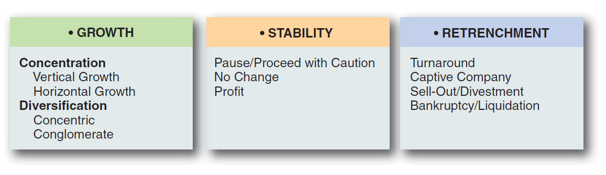
Corporate Strategy
A corporation’s directional strategy is composed of three general orientations (sometimes called grand strategies):
  Growth strategies expand the company’s activities.
  Stability strategies make no change to the company’s current activities.
  Retrenchment strategies reduce the company’s level of activities.

Slide 14
Corporate Strategy
Growth Strategies
Designed to achieve growth in sales, assets, profits, or some combination.
Continuing growth means increasing sales and a chance to take advantage of the experience curve to reduce the per-unit cost of products sold, thereby increasing profits.
  This cost reduction becomes extremely important if a corporation’s industry is growing quickly or consolidating and if competitors are engaging in price wars in attempts to increase their shares of the market.
A corporation can grow internally by expanding its operations both globally and domestically, or it can grow externally through mergers, acquisitions, and strategic alliances.
  A merger is a transaction involving two or more corporations in which stock is exchanged but in which only one corporation survives.

Slide 15
Corporate Strategy
Growth Strategies
The two basic growth strategies are concentration on the current product line(s) in one industry and diversification into other product lines in other industries.
Concentration
  If a company’s current product lines have real growth potential, concentration of resources on those product lines makes sense as a strategy for growth.
  The two basic concentration strategies are vertical growth and horizontal growth.

Slide 16
Corporate Strategy
Vertical Growth
Vertical growth can be achieved by taking over a function previously provided by a supplier or by a distributor.
The company, in effect, grows by making its own supplies and/or by distributing its own products.
This may be done in order to reduce costs, gain control over a scarce resource, guarantee quality of a key input, or obtain access to potential customers.

Slide 17
Corporate Strategy
Vertical Growth
Vertical growth results in vertical integration - the degree to which a firm operates vertically in multiple locations on an industry’s value chain from extracting raw materials to manufacturing to retailing.
  More specifically, assuming a function previously provided by a supplier is called backward integration (going backward on an industry’s value chain).
  Assuming a function previously provided by a distributor is labeled forward integration (going forward on an industry’s value chain).
  Transaction cost economics proposes that vertical integration is more efficient than contracting for goods and services in the marketplace when the transaction costs of buying goods on the open market become too great.

Slide 18
Vertical Integration
Level of integration
Industry value chain
none
partial
full
Raw materials
Intermediates
Production
Marketing and sale
Aftersales services
Prostor pro doplňující informace, poznámky

Slide 19
Vertical Integration
Industry value chain
forward integration
backward integration
balanced integration
Raw materials
Intermediates
Production
Marketing and sale
Aftersales services
Prostor pro doplňující informace, poznámky

Slide 20
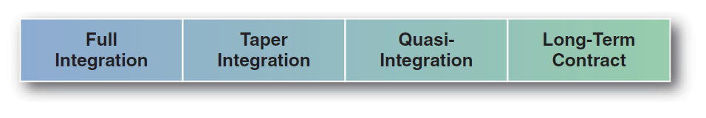
Corporate Strategy
Vertical Growth
Vertical growth results in vertical integration - the degree to which a firm operates vertically in Vertical Growth
Under full integration, a firm internally makes 100% of its key supplies and completely controls its distributors.
With taper integration (also called concurrent sourcing), a firm internally produces less than half of its own requirements and buys the rest from outside suppliers (backward taper integration).
With quasi-integration, a company does not make any of its key supplies but purchases most of its requirements from outside suppliers that are under its partial control (backward quasi-integration).

Slide 21
Corporate Strategy
Horizontal Growth
A firm can achieve horizontal growth by expanding its operations into other geographic locations and/or by increasing the range of products and services offered to current markets.
Horizontal growth results in horizontal integration - he degree to which a firm operates in multiple geographic locations at the same point on an industry’s value chain.
International Entry Options for Horizontal Growth
  Exporting: A good way to minimize risk and experiment with a specific product is exporting, shipping goods produced in the company’s home country to other countries for marketing.
  Licensing: Under a licensing agreement, the licensing firm grants rights to another firm in the host country to produce and/or sell a product.
  Franchising: Under a franchising agreement, the franchiser grants rights to another company to open a retail store using the franchiser’s name and operating system.

Slide 22
Horizontal Integration
Horizontal Integration
Vertical integration
Raw materials
A
B
Intermediates
Prostor pro doplňující informace, poznámky

Slide 23
Corporate Strategy
International Entry Options for Horizontal Growth
  Joint Ventures: Forming a joint venture between a foreign corporation and a domestic company is the most popular strategy used to enter a new country.
  Acquisitions: A relatively quick way to move into an international area is through acquisitions - purchasing another company already operating in that area.
  Green-Field Development: If a company doesn’t want to purchase another company’s problems along with its assets, it may choose green-field development and build its own manufacturing plant and distribution system.
  Production Sharing: Means the process of combining the higher labor skills and technology available in developed Countries with the lower-cost labor available in developing countries.
  Turnkey Operations: Turnkey operations are typically contracts for the construction of operating facilities in exchange for a fee.
  Management Contracts: A large corporation operating throughout the world is likely to have a large amount of management talent at its disposal.

Slide 24
Corporate Strategy
Diversification Strategies
Companies begin thinking about diversification when their growth has plateaued and opportunities for growth in the original business have been depleted.
The two basic diversification strategies are concentric and conglomerate.
  Growth through concentric diversification into a related industry may be a very appropriate corporate strategy when a firm has a strong competitive position but industry attractiveness is low. The search is for synergy, the concept that two businesses will generate more profits together than they could separately.
  Conglomerate (Unrelated) Diversification. When management realizes that the current industry is unattractive and that the firm lacks outstanding abilities or skills that it could easily transfer to related products or services in other industries.

Slide 25
Diversification Strategies
Types of diversification | Revenue from primary business | Examples
Single business | > 95% | Coca-Cola, Google, Facebook
Dominant business | 70% - 95% | Nestlé, Harley-Davidson
Related diversification | < 70%
- related-constrained |  | Nike, Johnson & Johnson
- related-linked |  | Amazon, Disney, GE
Unrelated diversification (conglomerate) | < 70% | Yamaha, Berkshire Hathaway
Prostor pro doplňující informace, poznámky

Slide 26
Corporate Strategy
Stability Strategies
Stability Strategy is a corporate strategy where a company concentrates on maintaining its current market position.
A company that adopts such an approach focuses on its existing product and market.
A few examples of this strategy are offering the same products to the same clients, not introducing new products, maintaining market share, and more.
Usually, a company that is satisfied with its current market share or position uses such a strategy. Also, a company following this strategy does not need any additional resources and work using the existing expertise of the workforce.
But, this strategy is useful only if there is a simple and stable environment.

Slide 27
Corporate Strategy
Types of Stability Strategies
No-change Strategy
As the name suggests, a company following this strategy does not take up any new activities. Instead, the company continues with its current business. Companies that are well established may go for this strategy.
Modest Growth Strategy
Under this, a company strives to achieve the same target as it did in the past. For example, if a company hit a 5% growth last year, then for the current year also, it targets the same percentage (making adjustments for inflation). It is the most relaxed approach as the risk is low, and the company does not need any additional efforts or resources.
Sustainable Growth Strategy
A company follows this strategy if it believes the external environment is not favorable. For instance, if the economy is in recession, or if there is a lack of financial resources.

Slide 28
Corporate Strategy
Types of Stability Strategies
Profit Strategy
If the objective of a company is to generate cash, then a company may adopt this strategy. A company pursuing this strategy may be willing to give up some of its market share to make cash.
Pause Strategy
A company adopts such a strategy if, in the past, it has enjoyed rapid growth. By using this strategy, the company wants to take some rest before pushing for growth again. Or, we can say, a company moves cautiously for sometime before pursuing growth. It is a temporary strategy. A company can use the rest period to make its production more efficient to exploit future opportunities.

Slide 29
Corporate Strategy
Retrenchment Strategies
Retrenchment strategy is a corporate level strategy that aims to reduce the size or diversity of organizational operations.
At times, it also becomes a means to ensure an organization’s financial stability. This is done by reducing the expenditure. A retrenchment strategy is a design to fortify an organization’s basic distinctive competence.
Besides, a retrenchment strategy also results in reduction of the number of employees, and sale of assets associated with discontinued product or service line. At other times, it involves restructuring of debt through bankruptcy proceedings; and in most extreme cases, liquidation of the firm.
A retrenchment strategy aims at the contraction of organization’s activities to improve performance. It is implemented to find out the problem areas and the steps to resolve them. This strategy is adopted when an organization suffers continuous losses.

Slide 30
Corporate Strategy
Types of Retrenchment Strategies
Turnaround
Divestiture Strategy
Liquidation Strategy
Captive Company Strategy
Harvest Strategy
Transformation Strategy
Leadership Strategy
Niche Strategy
Bankruptcy Strategy
End-Game Strategies

