Slide 1

Strategy Implementation
Ing. Šárka Zapletalová, Ph.D.
Department of Business Economics and Management
STRATEGIC MANAGEMENT

Slide 2

Outline of the lecture
Strategy implementation
Developing programes, budgets and procedures
Designing jobs implement strategy
International issues in strategy implementation
Staffing and directing in strategy implementation
Leading in strategy implementation

Slide 3
Introduction
To begin the implementation process, strategy makers must consider these questions:
  Who are the people who will carry out the strategic plan?
  What must be done to align the company’s operations in the new intended direction?
  How is everyone going to work together to do what is needed?
These questions and similar ones should have been addressed initially when the pros and cons of strategic alternatives were analyzed.

Slide 4
Strategy Implementation
Strategy implementation is the sum total of the activities and choices required for the execution of a strategic plan.
Strategy implementation is the process by which objectives, strategies, and policies are put into action through the development of programs, budgets, and procedures.
Although implementation is usually considered after strategy has been formulated, implementation is a key part of strategic management.
Strategy formulation and strategy implementation should thus be considered as two sides of the same coin.

Slide 5
Strategy Implementation
Environmental scanning and strategy formulation are crucial to strategic management but are only the beginning of the process.
The failure to carry a strategic plan into the day-to-day operations of the workplace is a major reason why strategic planning often fails to achieve its objectives.
For a strategy to be successfully implemented, it must be made action oriented. This is done through a series of programs that are funded through specific budgets and contain new detailed procedures.
Strategy is implemented by modifying structure (organizing), selecting the appropriate people to carry out the strategy (staffing), and communicating clearly how the strategy can be put into action (leading).

Slide 6
Strategy Implementation
Depending on how a corporation is organized, those who implement strategy will probably be a much more diverse set of people than those who formulate it.
In most large, multi-industry corporations, the implementers are everyone in the organization.
Vice presidents of functional areas and directors of divisions or strategic business units (SBUs) work with their subordinates to put together large-scale implementation plans.
Plant managers, project managers, and unit heads put together plans for their specific plants, departments, and units.
Therefore, every operational manager down to the first-line supervisor and every employee is involved in some way in the implementation of corporate, business, and functional strategies.

Slide 7
Strategy Implementation
A survey of Fortune 500 firms revealed that more than half of the corporations experienced the following 10 problems when they attempted to implement a strategic change. These problems are listed in order of frequency:
  Implementation took more time than originally planned.
  Unanticipated major problems arose.
  Activities were ineffectively coordinated.
  Competing activities and crises took attention away from implementation.
  The involved employees had insufficient capabilities to perform their jobs.
  Lower-level employees were inadequately trained.
  Uncontrollable external environmental factors created problems.
  Departmental managers provided inadequate leadership and direction.
  Key implementation tasks and activities were poorly defined.
  The information system inadequately monitored activities.

Slide 8
Developing Programs, Budgets and Procedures
The managers of divisions and functional areas work with their fellow managers to develop programs, budgets, and procedures for the implementation of strategy.
The purpose of a program is to make a strategy action oriented.
  Xerox management introduced a program called Lean Six Sigma. This program was developer to identify and improve a poorly performing process.
A matrix of change to help managers decide how quickly change should proceed, in what order changes should take place, whether to start at a new site, and whether the proposed systems are stable and coherent.

Slide 9
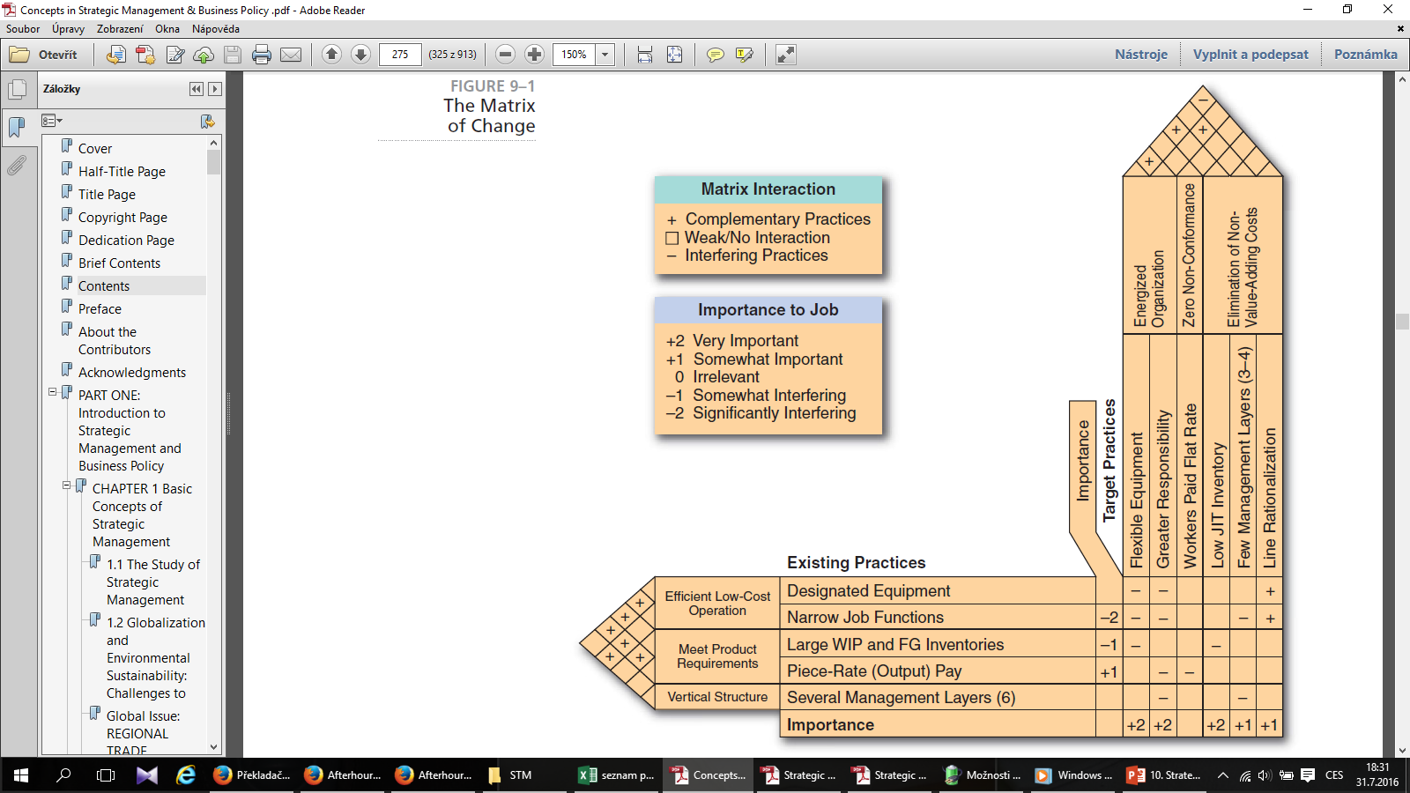
The Matrix of Change
Target practices (new programs) for a manufacturing plant are drawn on the vertical axis and existing practices (current activities) are drawn on the horizontal axis.
SOURCE: The Matrix of Change by E.1997. Brynjolfsson, A. A. Renshaw, and M. Van Alstyne. Sloan Management Review

Slide 10
Developing Programs, Budgets and Procedures
After programs have been developed, the budget process begins.
Planning a budget is the last real check a corporation has on the feasibility of its selected strategy. An ideal strategy might be found to be completely impractical only after specific implementation programs are costed in detail.
After the program, divisional, and corporate budgets are approved, procedures must be developed. Often called Standard Operating Procedures (SOPs), they typically detail the various activities that must be carried out to complete a corporation’s programs.
  Also known as organizational routines, procedures are the primary means by which organizations accomplish much of what they do.

Slide 11
Designing Jobs to Implement Strategy
Job design refers to the study of individual tasks in an attempt to make them more relevant to the company and to the employee(s).
To minimize some of the adverse consequences of task specialization, corporations have turned to new job design techniques: job enlargement (combining tasks to give a worker more of the same type of duties to perform), job rotation (moving workers through several jobs to increase variety), and job enrichment (altering the jobs by giving the worker more autonomy and control over activities).
The job characteristics model is a good example of job enrichment.

Slide 12
Staffing and Directing in Strategy Implementation
The implementation of new strategies and policies often calls for new human resource management priorities and a different use of personnel.
Such staffing issues can involve hiring new people with new skills, firing people with inappropriate or substandard skills, and/or training existing employees to learn new skills.
Research demonstrates that companies with enlightened talent-management policies and programs have higher returns on sales, investments, assets, and equity

Slide 13
Staffing and Directing in Strategy Implementation
To deal with integration issues, some companies are appointing special integration managers to shepherd companies through the implementation process.
  The job of the integrator is to prepare a competitive profile of the combined company in terms of its strengths and weaknesses, draft an ideal profile of what the combined company should look like, develop action plans to close the gap between the actuality and the ideal, and establish training programs to unite the combined company and to make it more competitive.
To be a successful integration manager, a person should have
  a deep knowledge of the acquiring company,
  a flexible management style,
  an ability to work in cross-functional project teams,
  a willingness to work independently, and
  (sufficient emotional and cultural intelligence to work well with people from all backgrounds.

Slide 14
Staffing and Directing in Strategy Implementation
Staffing Follows Strategy
As in the case of structure, staffing requirements are likely to follow a change in strategy.
  For example, promotions should be based not only on current job performance but also on whether a person has the skills and abilities to do what is needed to implement the new strategy.
Having formulated a new strategy, a corporation may find that it needs to either hire different people or retrain current employees to implement the new strategy.
One way to implement a company’s business strategy, such as overall low cost, is through training and development.

Slide 15
Staffing and Directing in Strategy Implementation
Staffing Follows Strategy
Executives with a particular mix of skills and experiences may be classified as an executive type and paired with a specific corporate strategy.
  For example, a corporation following a concentration strategy emphasizing vertical or horizontal growth would probably want an aggressive new chief executive with a great deal of experience in that particular industry - a dynamic industry expert.
Adiversification strategy, in contrast, might call for someone with an analytical mind who is highly knowledgeable in other industries and can manager diverse product lines - an analytical portfolio manager.

Slide 16
Staffing and Directing in Strategy Implementation
Staffing Follows Strategy
A corporation choosing to follow a stability strategy would probably want as its CEO a cautious profit planner, a person with a conservative style, a production or engineering background, and experience with controlling budgets, capital expenditures, inventories, and standardization procedures.
Weak companies in a relatively attractive industry tend to turn to a type of challengeoriented executive known as a turnaround specialist to save the company.
If a company cannot be saved, a professional liquidator might be called on by a bankruptcy court to close the firm and liquidate its assets.

Slide 17
Staffing and Directing in Strategy Implementation
Selection and Management Development
Selection and development are important not only to ensure that people with the right mix of skills and experiences are initially hired but also to help them grow on the job so that they might be prepared for future promotions.
  Executive succession is the process of replacing a key top manager.
A company can identify and prepare its people for important positions in several ways. One approach is to establish a sound performance appraisal system to identify good performers with promotion potential.
  A company should examine its human resource system to ensure not only that people are being hired without regard to their racial, ethnic, or religious background, but also that they are being identified for training and promotion in the same manner. Management diversity could be a competitive advantage in a multi-ethnic world.

Slide 18
Staffing and Directing in Strategy Implementation
Selection and Management Development
Many large organizations are using assessment centers to evaluate a person’s suitability for an advanced position.
  They use special interviews, management games, in-basket exercises, leaderless group discussions, case analyses, decision-making exercises, and oral presentations to assess the potential of employees for specific positions.
  Promotions into these positions are based on performance levels in the assessment center. Assessment centers have generally been able to accurately predict subsequent job performance and career success.
Job rotation - moving people from one job to another—is also used in many large Corporations to ensure that employees are gaining the appropriate mix of experiences to prepare them for future responsibilities. Rotating people among divisions is one way that a corporation can improve the level of organizational learning.

Slide 19
Staffing and Directing in Strategy Implementation
Problems in Retrenchment
Downsizing (sometimes called “rightsizing” or “resizing”) refers to the planned elimination of positions or jobs.
Consider the following guidelines that have been proposed for successful downsizing:
  Eliminate unnecessary work instead of making across-the-board cuts: Spend the time to research where money is going and eliminate the task, not the workers, if it doesn’t add value to what the firm is producing.
  Contract out work that others can do cheaper.
  Plan for long-run efficiencies: Don’t simply eliminate all postponable expenses, such as maintenance, R&D, and advertising, in the unjustifiable hope that the environment will become more supportive.
  Communicate the reasons for actions.
  Invest in the remaining employees.
  Develop value-added jobs to balance out job elimination.

Slide 20
Leading in Strategy Implementation
Implementation also involves leading through coaching people to use their abilities and skills most effectively and efficiently to achieve organizational objectives.
  Without direction, people tend to do their work according to their personal view of what tasks should be done, how, and in what order.
  They may approach their work as they have in the past or emphasize thosetasks that they most enjoy - regardless of the corporation’s priorities.
When implementing a new strategy, a company should take the time to assess strategy-culture compatibility.

Slide 21
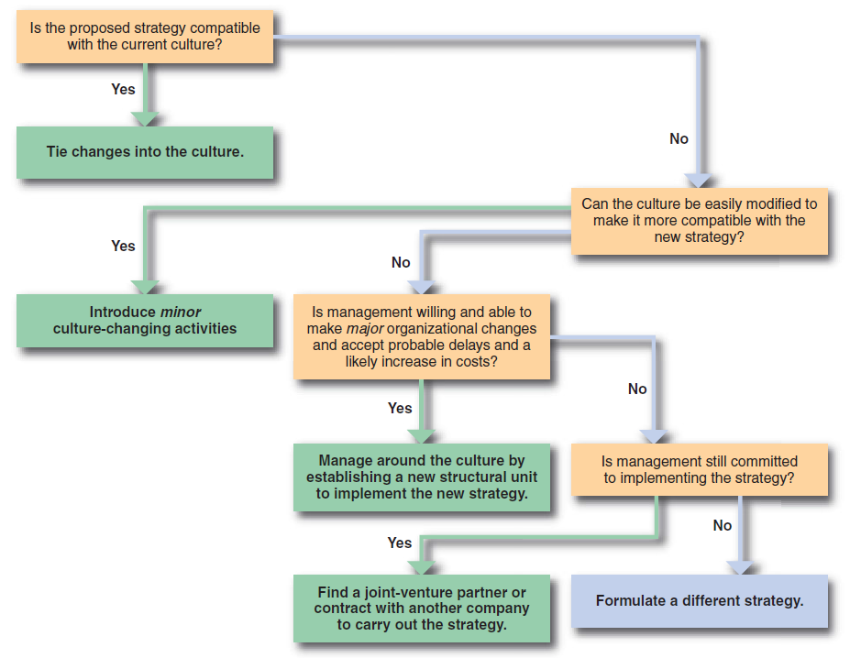
Leading in Strategy Implementation
Assessing Strategy–Culture Compatibility

Slide 22
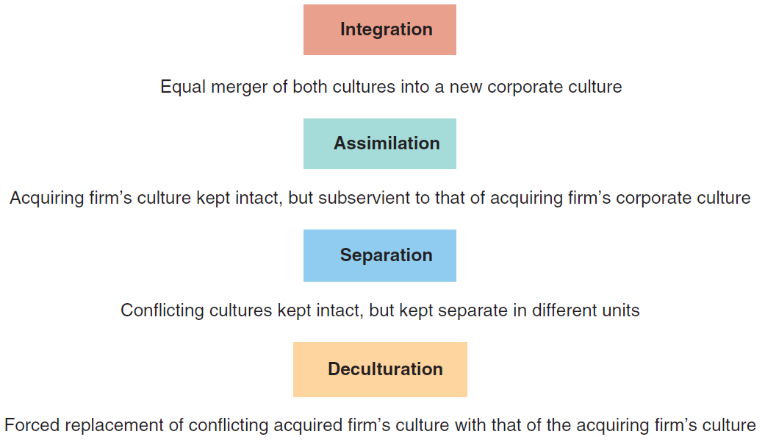
Leading in Strategy Implementation
Methods of Managing the Culture of an Acquired Firm
SOURCE: Based on A. R. Malezadeh and A. Nahavandi, 1990. “Making Mergers Work in Managing Cultures,” Journal of Business Strategy

Slide 23
Leading in Strategy Implementation
Action Planning
Activities can be directed toward accomplishing strategic goals through action planning.
At a minimum, an action plan states what actions are going to be taken, by whom, during what time frame, and with what expected results.
After a program has been selected to implement a particular strategy, an action plan should be developed to put the program in place.

Slide 24
Leading in Strategy Implementation
Action Planning
The resulting action plan to develop a new advertising program should include much of the following information:
  Specific actions to be taken to make the program operational
  Dates to begin and end each action
  Person (identified by name and title) responsible for carrying out each action
  Person responsible for monitoring the timeliness and effectiveness of each action
  Expected financial and physical consequences of each action
  Contingency plans

Slide 25
Leading in Strategy Implementation
Management by Objectives
Management By Objectives (MBO) is a technique that encourages participative decision making through shared goal setting at all organizational levels and performance Assessment based on the achievement of stated objective.
The MBO process involves:
  Establishing and communicating organizational objectives.
  Setting individual objectives (through superior-subordinate interaction) that help implement organizational ones.
  Developing an action plan of activities needed to achieve the objectives.
  Periodically (at least quarterly) reviewing performance as it relates to the objectives and including the results in the annual performance appraisal.

