Slide 1

THEORY OF RATIONAL CHOISE
LESSON III
Dr. Ingrid Majerova
Advanced Microeconomics/EVS/NAAMI

Slide 2
THEORY OF RATIONAL CHOISE
Outline of the lecture
Rational Choise
Consumer Theory
Consumer Preferences
Cardinal Approach to Measurement of Utility
Ordinal Approach to Measurement of Utility

Slide 3

THEORY OF RATIONAL CHOISE
RATIONAL CHOISE
People are rational creatures, with their own interests
"homo economicus“.
Every individual makes decisions addressed to maximize his personal well-being based on a reasonable assessment of all the facts.
Consumer makes the decision to such option that provides the greatest benefits (satisfaction) with the smallest effort.
Adam Smith (1723-1790), before Aristotle (350 l. Ex. K.), Francois Quesnay (ca. 1750) - the primary economic stimulus of everyone is his own interest

Slide 4

THEORY OF RATIONAL CHOISE
THEORY OF RATIONAL CHOISE
At present, the idea of "homo economicus" is known as the theory of rational consumer choice.
people make a variety of economic decisions based on the costs and utility (bank robber – benefits ˃ costs)
1992: Gary Becker (Nobel Prize in Economics in TRCh - applications for family crimes and human capital)
Is idea of TRCh realistic?

Slide 5
THEORY OF RATIONAL CHOISE
CONSUMER THEORY
The consumer consumes - select a combination of goods and services at a given level of income that bring the greatest possible utility
Two questions:
  WHICH COMBINATION IS THE BEST FOR ME?
  CAN I AFFORD THIS COMBINATION?
Certain precisely specified combinations of commodities – CONSUMER BASKET
A limited amount of financial resources that we have determined to combine - BUDGET CONSTRAINT OF CONSUMERS
Px. x + Py. y = I

Slide 6
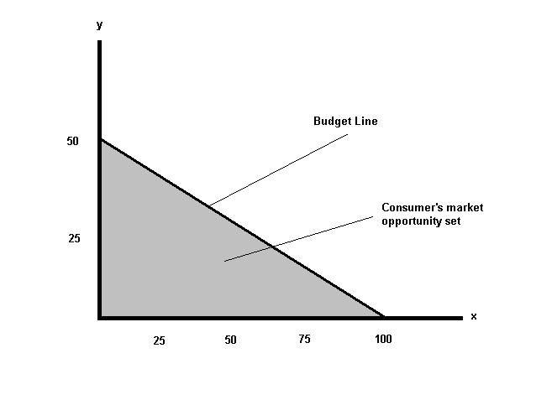
THEORY OF RATIONAL CHOISE
CONSUMER THEORY
A set of consumption baskets that consumer obtains by the budget constraint
MARKET OPPORTUNITY SET
Border of market opportunity set forms the BUDGET LINE (BL)

Slide 7
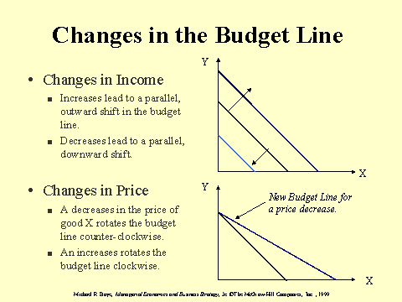
THEORY OF RATIONAL CHOISE
CHANGES IN THE BUDGET LINE

Slide 8
THEORY OF RATIONAL CHOISE
CONSUMER THEORY
budget line is negatively sloped line
slope expresses the willingness of consumers to substitute one commodity by another
slope is determined by dividing the price of the good x to the price of the good y (Px / Py)
slope is known in economic theory as the
MARGINAL RATE OF SUBSTITUTION IN THE EXCHANGE
MRSe = Px/Py

Slide 9
THEORY OF RATIONAL CHOISE
CONSUMER PREFERENCES
Consumer preferences - findings that one goods is better (more useful) than the other
How to describe the consumer's preferences?
UTILITY ...
we prefer goods x before y, if consumption of x brings better utility than the consumption of goods y
But how we can measure the utility?
two approaches - cardinal and ordinal version

Slide 10
THEORY OF RATIONAL CHOISE
CARDINAL APPROACH
cardinalism (origin of the word cardinal = crusial) considers utility as a measurable unit
cardinal units - utilities (Willian Stanley Jevons, 1871, neoclassical school)
other representatives - Carl Menger, Herrmann Heinrich Gossen
benefit is measured by the total utility and marginal utility
TOTAL UTILITY (TU) - utility from total consumption

Slide 11
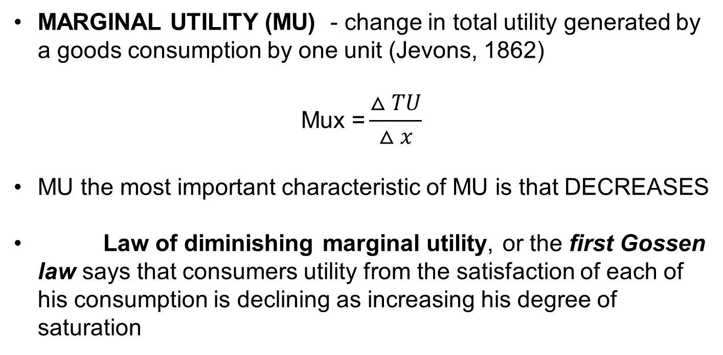
THEORY OF RATIONAL CHOISE
CARDINAL APPROACH
MARGINAL UTILITY (MU) - change in total utility generated by a goods consumption by one unit (Jevons, 1862)
$$\text{Mux}\text{ =}\frac{△TU}{△x}$$
MU the most important characteristic of MU is that DECREASES
Law of diminishing marginal utility, or the first Gossen law says that consumers utility from the satisfaction of each of his consumption is declining as increasing his degree of saturation

Slide 12
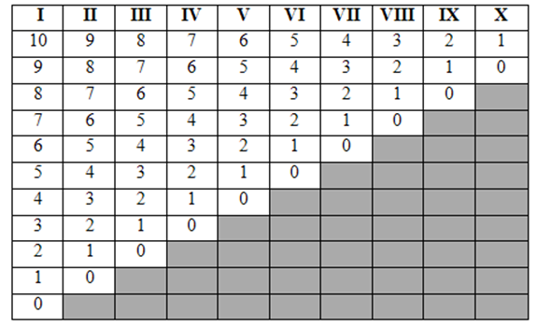
THEORY OF RATIONAL CHOISE
CARDINAL APPROACH
Consumers utility has tendency to decline with consumption growth for example: the amount of beer consumed after a busy tourist outlet
Carl Menger (1841-1921 Austrian School) expressed numerically the above law with a MENGER RANGE

Slide 13
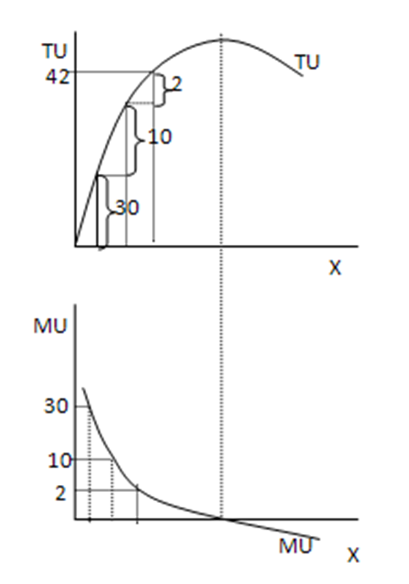

THEORY OF RATIONAL CHOISE
CARDINAL APPROACH
consumers utility increases more slowly with the growth of consumed quantity
SATURATION POINT
maxTU = MU equals 0
then the total utility is declining and marginal utility is negative

Slide 14
THEORY OF RATIONAL CHOISE
ORDINAL APPROACH
In contrast to the cardinalism this approach argues that the utility can not be measured, just to arrange to ordinal scale.
goods are arranged so that that with lowest utility is located prior that with the second lowest utility etc., etc.
representatives - Vilfredo Pareto, Francis Ysidro Egdeworth and John Richard Hiks
HOW THEN IS THIS APPROACH WORKING?

Slide 15
THEORY OF RATIONAL CHOISE
ORDINAL APPROACH
The base of this approach is indifference analysis, or the theory of consumer behavior (creator: Vilfredo Pareto).
The principle of consumer substitution - the consumer chooses, between goods that are substitutes, a combination that brings him the same satisfaction
graphically – INDIFFERENCE CURVE (IC), whose author is F.Y. Edgeworth (1881)
IC shows all baskets that bring the same level of utility - consumer is indifferent to the fact that basket he will consume.

Slide 16
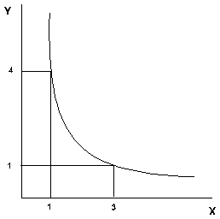
THEORY OF RATIONAL CHOISE
ORDINAL APPROACH
Slope of IC shows the degree of substitutability of two goods
THE RATE OF SUBSTITUTION
ratio, in which one goods is replaced by a second one

Slide 17
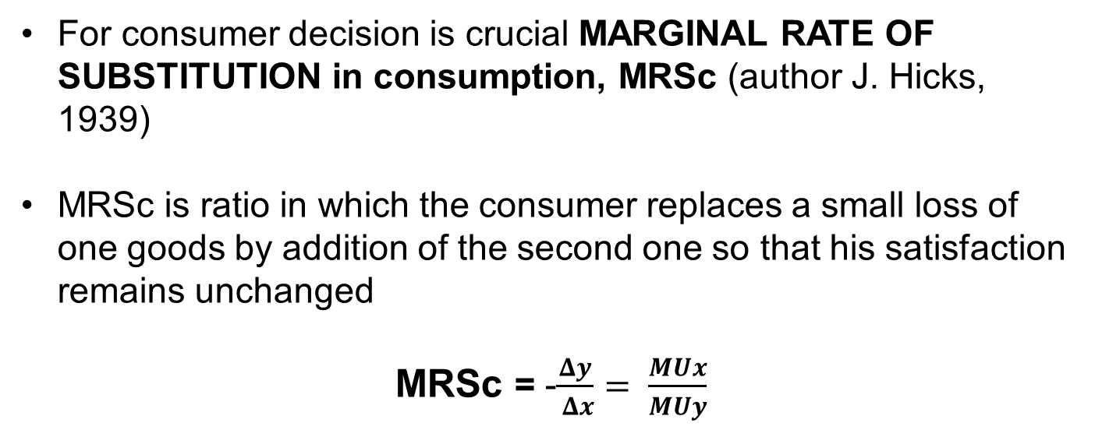
THEORY OF RATIONAL CHOISE
ORDINAL APPROACH
For consumer decision is crucial MARGINAL RATE OF SUBSTITUTION in consumption, MRSc (author J. Hicks, 1939)
MRSc is ratio in which the consumer replaces a small loss of one goods by addition of the second one so that his satisfaction remains unchanged
MRSc = -$\frac{Δy}{ Δx}= \frac{MUx}{MUy}$

Slide 18
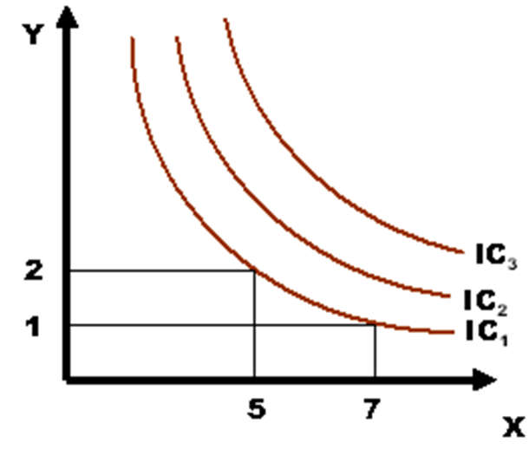
THEORY OF RATIONAL CHOISE
ORDINAL APPROACH
A set of indifference curves forms the INDIFFERENCE MAP
each upper curve shows higher utility of consumers

Slide 19
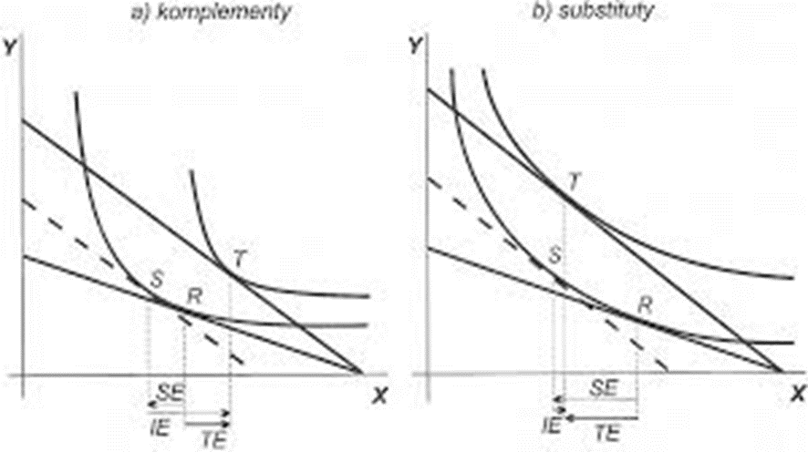
THEORY OF RATIONAL CHOISE
ORDINAL APPROACH
„Bending" of the curves is dependent on the degree of substitution:
a) limited degree of substitution (salad and Coca-Cola)
b) a high degree of substitution (a salad and mushrooms)
a) components b) substitutes

Slide 20
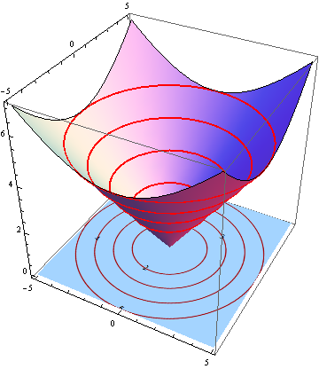
THEORY OF RATIONAL CHOISE
ORDINAL APPROACH
Alternative display of
INDIFFERENCE MAP

Slide 21
THEORY OF RATIONAL CHOISE
ORDINAL APPROACH
Characteristics of IC:
The curves are CONVEX to the beginning - the marginal rate of substitution increases as the consumer progresses along IC upwards (increasingly replaces the goods x by goods y)
The curves have a DECREASING SHAPE - a reduction in the consumption of one good is offset by increasing consumption of second one
Thecurves NEVER CROSS each other - if so, the consumer is irrational (not confess in his preferences and all combinations would be equally satisfactory).

Slide 22
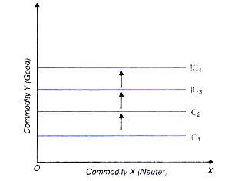
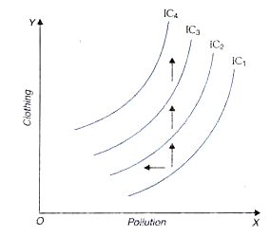
THEORY OF RATIONAL CHOISE
ORDINAL APPROACH
BUT! The above characteristics are valid for desirable goods (positive preferences)
The IC for goods (X) undesirable or neuter has different slope
a) undesirable goods b) neuter goods

Slide 23
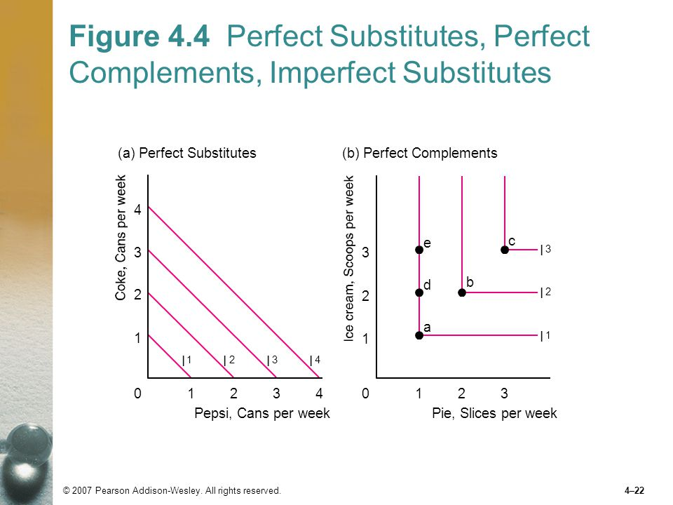
THEORY OF RATIONAL CHOISE
ORDINAL APPROACH
BUT!
The IC for perfect substitutes and perfect complements has different slope as well
a) perfect substitutes b) perfect complements

Slide 24
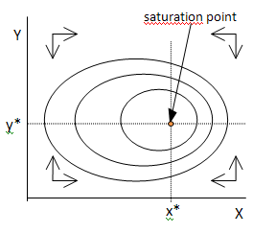
THEORY OF RATIONAL CHOISE
ORDINAL APPROACH
SATIATION AND POINT OF BLISS
Level of utility increases with approximation to the saturation point (which is the top of the "utility hill").

Slide 25
THEORY OF RATIONAL CHOISE
THANK YOU FOR YOUR ATTENTION…

