Slide 1

BEHAVIOUR OF FIRM IN IMPERFECT COMPETITION
LESSON IX
Dr. Ingrid Majerova
Advanced Microeconomics/EVS/NAAMI

Slide 2
BEHAVIOUR OF FIRM IN IMPERFECT COMPETITION
Outline of the lecture
Imperfect Competition
Firm Revenues in Imperfect Competition
Monopoly
Oligopoly
Monopolistic Competition

Slide 3
BEHAVIOUR OF FIRM IN IMPERFECT COMPETITION
IMPERFECT COMPETITION
Imperfect competition has three forms:
  Monopoly
  Oligopoly
  Monopolistic competition
We will focus on the characteristics of imperfect competition, which are common for all three forms.
The main feature of imperfect competition - the firm produces a differentiated product (or it has a significant share of the market).

Slide 4
BEHAVIOUR OF FIRM IN IMPERFECT COMPETITION
IMPERFECT COMPETITION
The fIrm can affect the market price (the rate of price influencing depends on the specific form of competition).
  Because of the form's product differs from those of other companies, the company can set its price.
Imperfect competition - a market in which is one seller (the firm), which may affect the market price.
Deciding of imperfectly competitive firm is more inclusive - to select the optimal production volume, determine the price, ...

Slide 5
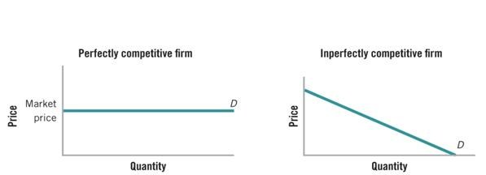
BEHAVIOUR OF FIRM IN IMPERFECT COMPETITION
INDIVIDUAL DEMAND

Slide 6
BEHAVIOUR OF FIRM IN IMPERFECT COMPETITION
MAIN CAUSES OF IMPERFECT COMPETITION
Cost conditions - in the form of so-called economies of scale. In the production of large volumes of production costs are calculated to a larger number of products = average costs with growth of production decline.
Barriers of competition:
  Legal restrictions - trademark, patent, copyright, ... gives owners exclusive rights to produce the product.
  Product differentiation - each producer comes to market with a production that differs from that of the competition.

Slide 7
BEHAVIOUR OF FIRM IN IMPERFECT COMPETITION
OTHER FACTORS OF IMPERFECT COMPETITION
Lack of awareness of market actors
Ownership of important production factor „in the hands“ of one firm
State intervention in the market mechanism (price regulation)
Political circumstances (the emergence of OPEC - the Organisation of Petrol Exporting Countries)

Slide 8
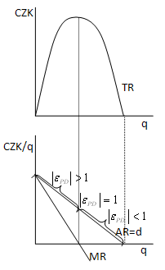

BEHAVIOUR OF FIRM IN IMPERFECT COMPETITION
REVENUES IN IMPERFECT COMPETITION
TOTAL REVENUES
MARGINAL AND AVERAGE REVENUES

Slide 9
BEHAVIOUR OF FIRM IN IMPERFECT COMPETITION
TOTAL REVENUES IN IMPERFECT COMPETITION
The total quantity of production is obtained from the equation
TR = P.Q
Total revenues may rise or fall (depending on the elasticity of demand for firm´s production).
  Demand is elastic - percentage growth in the quantity of soldproduction is greater than the percentage decrease in prices, so although price decreases, the total income grows.
  Demand is inelastic - percentage growth in the quantity of sold production is less than the percentage decrease in prices, if the firm reduces the price, its total income is decreasing.

Slide 10
BEHAVIOUR OF FIRM IN IMPERFECT COMPETITION
MARGINAL AND AVERAGE REVENUE IN IMPERFECT COMPETITION
Definition of unit revenues:
MARGINAL MR = △TR /△Q
AVERAGE AR = TR / Q = P
Two fundamental differences against the perfect competition:
  AR and MR curves have a negative slope, which is the result of a negative slope individual demand curves.
  The curve MR is not identical with the curve of the AR, but decreases faster.

Slide 11
BEHAVIOUR OF FIRM IN IMPERFECT COMPETITION
MARGINAL REVENUE IN IMPERFECT COMPETITION
Because demand curve decreases in the case of imperfect competition, marginal revenue (MR) decreases with the increase of production as well and must be lower than the price at which the last unit is sold (MR < P).
MR is, like TR, influenced by the elasticity of demand:
  MR > 0 - if demand is elastic
  MR = 0 - if demand is unitary elastic
  MR < 0 - if demand is inelastic

Slide 12
BEHAVIOUR OF FIRM IN IMPERFECT COMPETITION
MONOPOLY
Monopoly is the opposite of perfect competition.
The basic assumptions for the existence of a monopoly:
  Existence of a one producer (firm) on the market
  Product differentiation
  Barriers to entry by other firms in the industry
Because of the monopoly is the only producer of the goods, the production is the production the whole industry.
Individual demand = market demand

Slide 13
BEHAVIOUR OF FIRM IN IMPERFECT COMPETITION
EQUILIBRIUM OF MONOPOLY
Unlike the perfect competition individual demand curves decreases.
Marginal revenue curve decreases faster than the demand curve.
MR = MC
P > MC
A significant difference from the perfect competition is the fact that the monopoly itself sets the price of its production. Because it is the only producer on the market, sels at a price that maximizes its profits.
However, the buyer must be willing to accept this price.

Slide 14
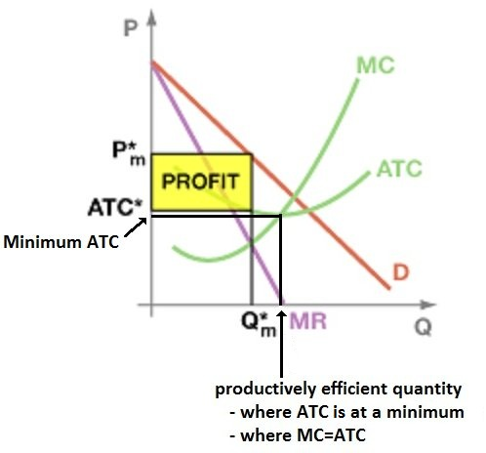
BEHAVIOUR OF FIRM IN IMPERFECT COMPETITION
REVENUES IN IMPERFECT COMPETITION
Price and quantum of production is different from that in perfect competition

Slide 15

BEHAVIOUR OF FIRM IN IMPERFECT COMPETITION
SUPPLY CURVE OF MONOPOLY
In terms of monopoly the supply curve does not exist, because there is not one relationship between price and quantity.
Firm in perfect competition may offer different quantities at different prices.
In a monopoly, the company may offer different quantities for the same price or the same quantities at different prices.
we can NOT clearly determine the supply curve of monopoly

Slide 16
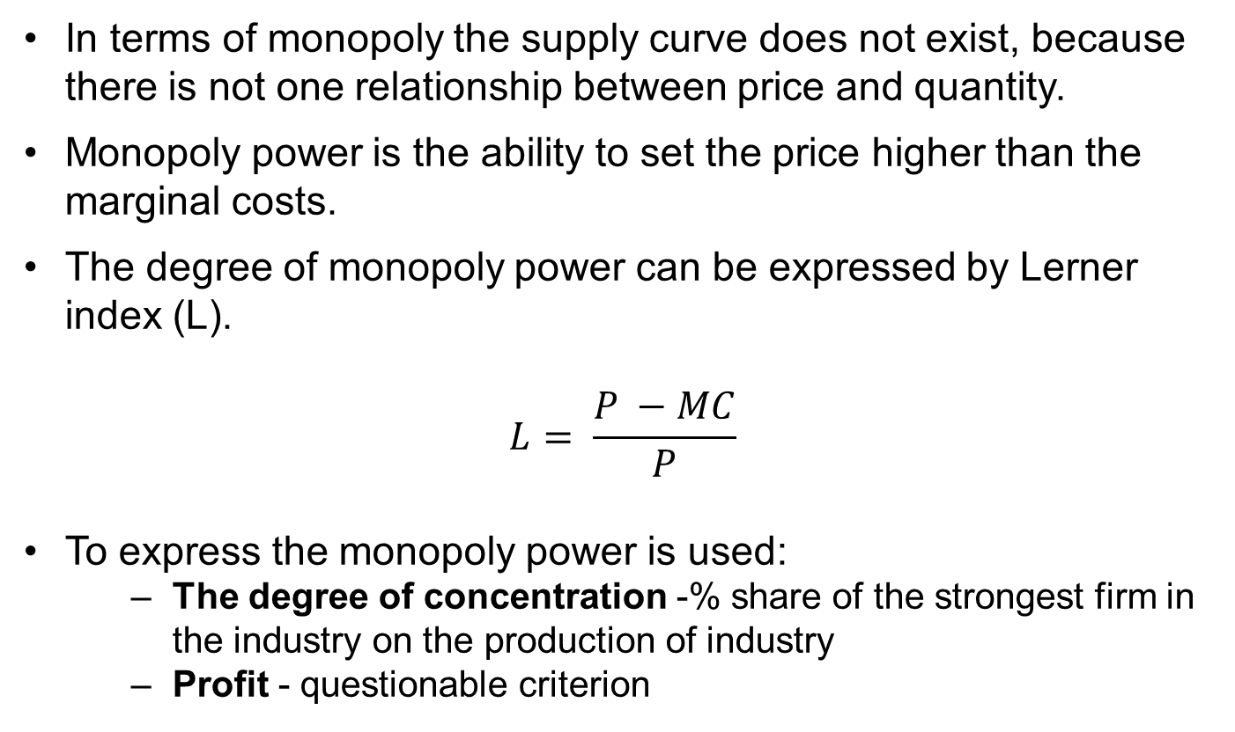
BEHAVIOUR OF FIRM IN IMPERFECT COMPETITION
THE MONOPOLY POWER
In terms of monopoly the supply curve does not exist, because there is not one relationship between price and quantity.
Monopoly power is the ability to set the price higher than the marginal costs.
The degree of monopoly power can be expressed by Lerner index (L).
$$L= \frac{P −MC}{P}$$
To express the monopoly power is used:
  The degree of concentration -% share of the strongest firm in the industry on the production of industry
  Profit - questionable criterion

Slide 17
BEHAVIOUR OF FIRM IN IMPERFECT COMPETITION
INEFFICIENCY OF THE MONOPOLY
Monopoly power, which leads to the determination of the price above the marginal cost, is in terms of society inefficient (inefficient production).
Monopoly is not led by a market mechanism for optimum utilization of social resources.
monopoly determines price - no market

Slide 18
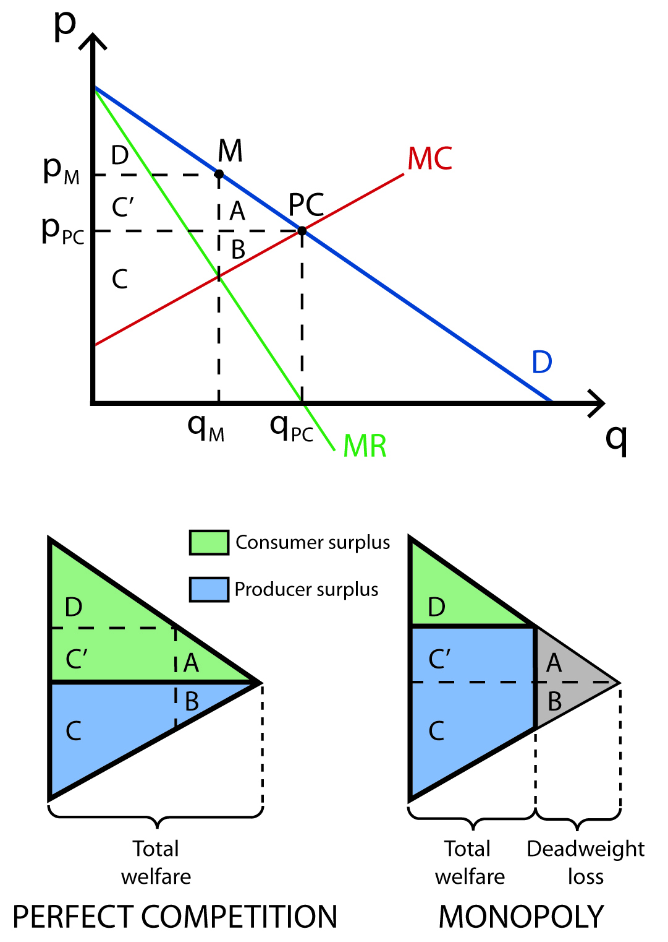
BEHAVIOUR OF FIRM IN IMPERFECT COMPETITION
SURPULUS OF PRODUCER AND CONSUMER
MONOPOLY
COMPARISON WITH PERFECT COMPETITION

Slide 19
BEHAVIOUR OF FIRM IN IMPERFECT COMPETITION
REGULATION OF THE MONOPOLY
In terms of monopoly, resources are not fully utilized that are available to the firm and those that are used, are used inefficiently.
The most important rectifier tools are:
  Antitrust laws - those prohibiting certain behavior in the marketplace and reduce the monopoly power of different ways.
  Tax policy
  The ability to convert a monopoly to state ownership
  Price regulation

Slide 20
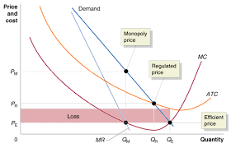
BEHAVIOUR OF FIRM IN IMPERFECT COMPETITION
PRICE REGULATION OF MONOPOLY
The price regulation alllows the monopoly to determine the price only so high that covers the average costs
By the price regulation the monopoly profit is not created and monopoly realizes only the normal profit

Slide 21

BEHAVIOUR OF FIRM IN IMPERFECT COMPETITION
MONOPSONY
Monopsony is the opposite of monopoly and represents a market in which is only one buyer
Monopsony power is the ability of the buyer to influence the price in his favor
It allows you to purchase goods at a lower price than in conditions of perfect competition
the state as the only buyer of military production

Slide 22
BEHAVIOUR OF FIRM IN IMPERFECT COMPETITION
OLIGOPOLY
Oligopoly is a market structure that prevails in practice.
Characteristic features of oligopoly:
  The existence of several companies in industry
  Usually differentiated product
  Barriers to entry that prevented attracting new firms
Behavior of firms in oligopoly is influenced by their mutual dependence (each firm produces a part of industry).
There are several models of oligopolies.

Slide 23
BEHAVIOUR OF FIRM IN IMPERFECT COMPETITION
OLIGOPOLY
Collusive oligopoly
Cartel
Oligopoly with dominant firm
Non-collusive oligopoly
  Cournot – Chamberlin´s – Stackelberg model
    DUOPOLY – only two sellers
    Game theory
  Sweezy’s Kinked Demand Curve Model

Slide 24
BEHAVIOUR OF FIRM IN IMPERFECT COMPETITION
COLLUSIVE OLIGOPOLY
Collusive oligopoly – it arises in a situation where several firms selling the same or similar products find that their prices are similar, and that the mutual price war would weaken them.
  More advantageous for them is to increase their profits by increasing prices on the market or by market division.
  Company enters into a secret agreement and set monopoly prices for individual companies or production quotas - each company oligopoly then behaves like a monopoly.
Cartel - agreement about advantageous cooperation (OPEC, the gas station ...).

Slide 25
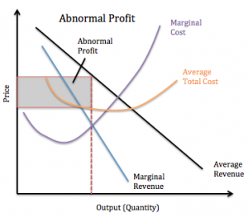
BEHAVIOUR OF FIRM IN IMPERFECT COMPETITION
COLLUSIVE OLIGOPOLY
The profit is like porfit of monopoly
abnormal profit

Slide 26
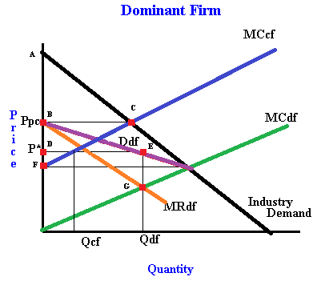
BEHAVIOUR OF FIRM IN IMPERFECT COMPETITION
OLIGOPOLY WITH DOMINANT FIRM
For the dominant firm is better to leave a part of market to weaker competitor
Smaller firm respect the prices of dominant firm in industry
WHY?

Slide 27
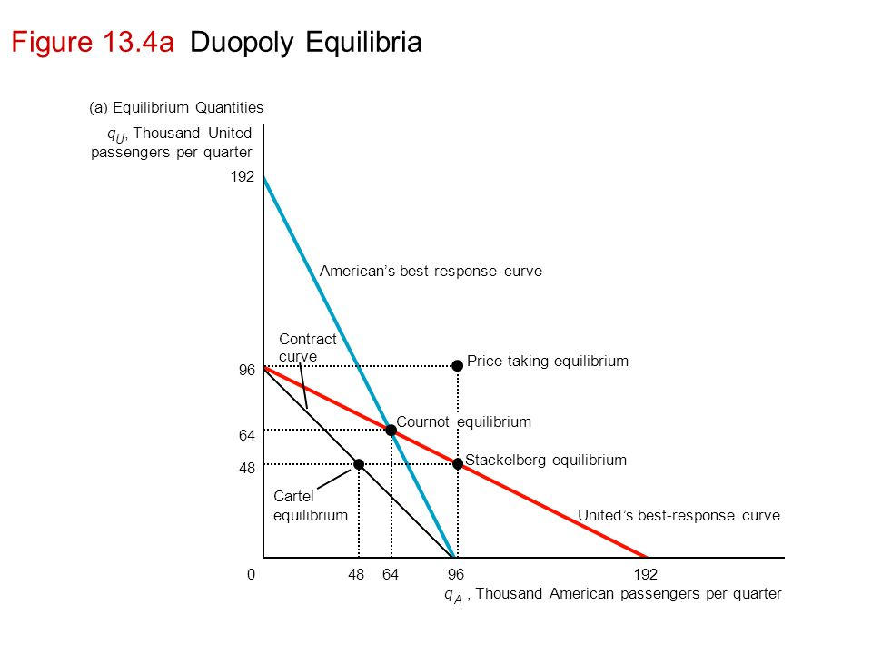

BEHAVIOUR OF FIRM IN IMPERFECT COMPETITION
DUOPOLY
He sellers are independent and have to také into account the efffect of his policy on his rival
Cournot – firms do not recognize their independence
Chamberlin – firms recognize it
Stackelberg – one firm is leader and one follower (extention of Cournot model)

Slide 28
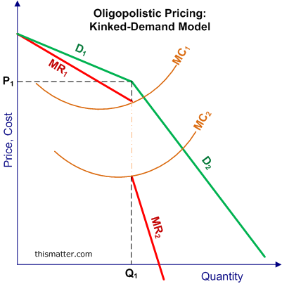
BEHAVIOUR OF FIRM IN IMPERFECT COMPETITION
KINKED DEMAND MODEL
Suppose, the prevailing price of an oligopoly product in the market is . If one seller increases the price above it, rival sellers will keep the prices of their products.
As a result of high price charged by the firm, buyers will shift to products of other sellers who have kept their prices at the old level.
Consequently, sales of the first seller will drop considerably.

Slide 29
BEHAVIOUR OF FIRM IN IMPERFECT COMPETITION
MONOPOLISTIC COMPETITION
Monopolistic competition is the closest to perfect competition.
Basic assumptions of monopolistic competition:
  A large number of firms in the industry
  A differentiated product
  The absence of entry barriers for firms into the industry
Each firm produces enough differentiated product that sets its own price - behaves like a monopoly.

Slide 30
BEHAVIOUR OF FIRM IN IMPERFECT COMPETITION
MONOPOLISTIC COMPETITION
Firm has a monopoly over its production and demand curve for production is highly elastic, because other companies offer substitutes.
In the short run - the firm can realize monopoly profits - the slope of the demand curve.
In the long run, however, this monopoly profit is compressed to zero due to movement between industries. Monopoly profits attract competition and demand for the firm's production drops. New companies are coming into the industry until the monopoly profit is zero.

Slide 31
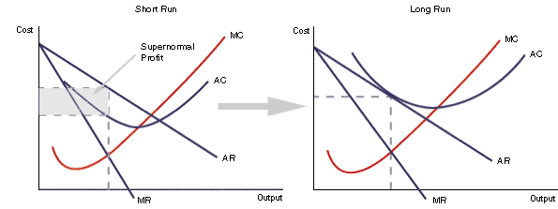
BEHAVIOUR OF FIRM IN IMPERFECT COMPETITION
MONOPOLISTIC COMPETITION

Slide 32
REVENUES, COSTS AND PROFIT
THANK YOU FOR YOUR ATTENTION…

