Slide 1

CAPITAL MARKET
LESSON XI
Dr. Ingrid Majerova
Advanced Microeconomics/EVS/NAAMI

Slide 2
CAPITAL MARKET
Outline of the lecture
Supply on the Capital Market
Supply of Capital in Short and Long Run
Demand on the Capital Market
Equilibrium
Returns of Capital

Slide 3

CAPITAL MARKET
CAPITAL AND CAPITAL MARKET
Capital - the savings converted into investments
Secondary (derived) factor of production
Three forms:
  Capital goods (construction, equipment and supplies)
  Financial capital (securities)
  Money capital (savings)
The price of capital - interest rate
capital = capital goods

Slide 4
CAPITAL MARKET
CAPITAL AND CAPITAL MARKET
Capital goods are not consumed in the production process at once = wear out, so that their value is not transferred to the new products at once, but gradually in the form of depreciation or amortization.
Depreciation represent a significant part of production costs and significantly affect the magnitude of profit.
Depreciation represent a significant source of means for the purchase of new capital goods to replace the already worn-out capital goods.

Slide 5
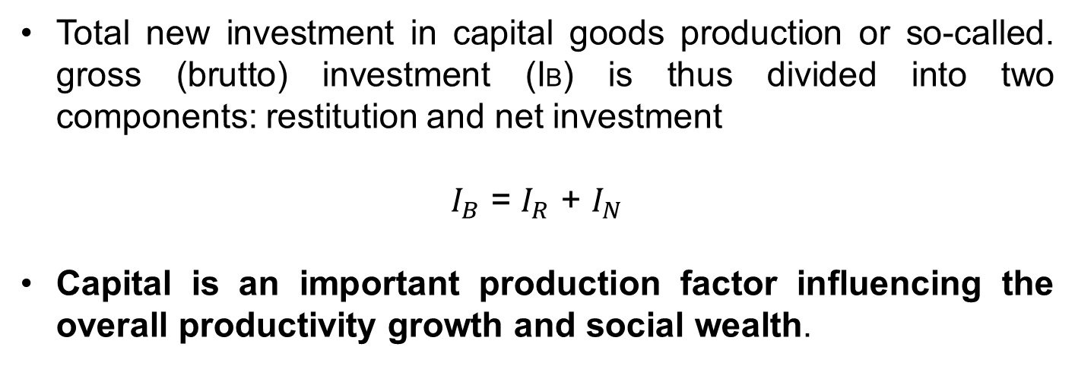
CAPITAL MARKET
CAPITAL AND CAPITAL MARKET
Total new investment in capital goods production or so-called. gross (brutto) investment (IB) is thus divided into two components: restitution and net investment
$I_{B}$ = $I_{R}$ + $I_{N}$
Capital is an important production factor influencing the overall productivity growth and social wealth.

Slide 6
CAPITAL MARKET
CAPITAL MARKET – CLASSICAL APPROACH
Supply of capital market consists the savings of economic subjects.
Savings (current and term deposits, insurance, etc.) of households receive on the capital market form of capital offered to firms
The demand for capital - given the need to finance the purchase of investment goods
Forms of fundraising - loans from banks, income from sale of own securities ect.

Slide 7
CAPITAL MARKET
CAPITAL MARKET
Here - supply of savings (domestic) meets the demand for these savings (firms)
The household must have a reason for savings (prefer immediate consumption) ....
  the reward for postponed consumption is interest
  households are not interested in the absolute amount of interest of the saved amount, but the interest rate

Slide 8
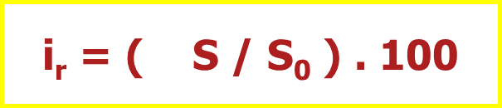
CAPITAL MARKET
SUPPLY ON THE CAPITAL MARKET – CREATING OF SAVINGS
Interest rate (ir) - the ratio of net interest from the saved amount over a given time period (usually one year) to this saved amount
△S = interest and S0 = savings
The interest rate is usually expressed as a percentage p. a. (for one year).

Slide 9


CAPITAL MARKET
SUPPLY ON THE CAPITAL MARKET – CREATING OF SAVINGS
At a given interest rate, the future value (S1) of the present amount (S0) after one year will be equal to:
it is generally possible the future value of the present amount from the year n (Sn) (assuming the interest rate does not change) expressed as follows:
  where (1 + i)n tells us how many times the initial deposit in n years will increase t a given interest rate

Slide 10

CAPITAL MARKET
SUPPLY ON THE CAPITAL MARKET – CREATING OF SAVINGS
present value S0 of future returns Sn (the amount you get for n years) will then, at a constant rate of interest, equal to:
where 1 / (1 + ir)n is discount, which shows how many times the present value of amounts Sn is lower, which is obtained at the end of the nth year on a constant interest rate ir

Slide 11
CAPITAL MARKET
SUPPLY ON THE CAPITAL MARKET – CREATING OF SAVINGS
assuming that there is no risk, households make decisions about savings at a given time preferences based on interest rates
the short run - the size of savings is given
the long run - growth of interest rate leads to the growth of savings
  savings are an increasing function of interest rates and are determined based on the time preference

Slide 12
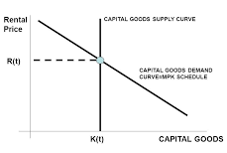
CAPITAL MARKET
SUPPLY ON THE CAPITAL MARKET (SHORT RUN)
Rental price
=
interest rate
Supply of capital is fixed in the short run

Slide 13
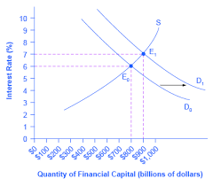
CAPITAL MARKET
SUPPLY ON THE CAPITAL MARKET (LONG RUN)
Supply curve of capital is increasing in the long run

Slide 14
CAPITAL MARKET
DEMAND ON THE CAPITAL MARKET
The rate of return from capital is therefore without the risk and uncertainty equal to the market interest rate in perfectly competitive conditions.
If the interest rate, ie cost of any additional unit of capital is lower than the revenue of the capital marginal product, firms will purchase additional units of capital and expand production up to the point when both variables equal.
Demand for capital is thus determined by the revenue of the capital marginal product and is dependent on the interest rate (with the growth of interest rate decreases the demand for capital and vice versa).

Slide 15
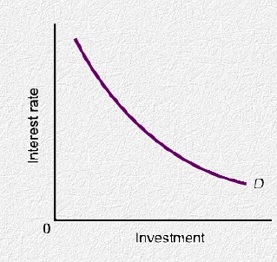
CAPITAL MARKET
DEMAND ON THE CAPITAL MARKET
Demand of capital is decreasing function of interest rate and is determined by revenue of marginal product.

Slide 16
CAPITAL MARKET
EQULIBRIUM ON THE CAPITAL MARKET
SHORT RUN
Intersection of the demand curve for capital and the supply curve for capital is a short-run point of equilibrium in which is determined short-run equilibrium interest rate at a supply of capital and at a demand function for capital
This rate equates supply with demand and create short-run market equilibrium on capital market.

Slide 17
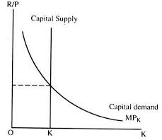
CAPITAL MARKET
EQUILIBRIUM ON THE CAPITAL MARKET
SHORT RUN
Equilibrium interest rate

Slide 18
CAPITAL MARKET
EQULIBRIUM ON THE CAPITAL MARKET
LONG RUN
In the long term it is expected that households may decide to offer greater savings when the interest rate rises
Supply on the capital market is therefore an increasing function of interest rates
Supply curve for capital (long run) has a positive slope, because with the growth of interest rate increased willingness of households to generate savings

Slide 19
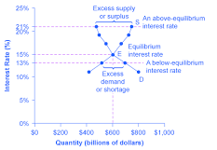
CAPITAL MARKET
EQUILIBRIUM ON THE CAPITAL MARKET
LONG RUN

Slide 20
CAPITAL MARKET
EQULIBRIUM ON CAPITAL MARKET
Equilibrium interest rate equalizes savings and investments.
Given the existing technology this rate stimulates a demand for capital, which corresponds to the capital reserve created in the previous period in the short run, respectively it exhaustes all savings, to which this interest rate encouraged the household in the long run.
Saving surpulus decline of interest rate decline of savings and increase of capital demand
Savings shortage- the opposite effect

Slide 21
CAPITAL MARKET
EQULIBRIUM ON CAPITAL MARKET
Interest rate fulfills the function of a market price that equals supply and demand, and its movements lead to establishing an equilibrium on the capital market
Interest rate thus fulfills two important functions:
  leads the household to sacrifice current consumption, and increased the supply of capital
  encourages firms to seek the most effective investment opportunities

Slide 22
CAPITAL MARKET
CAPITAL RETURNS
In deciding whether to invest at all, or where is best to invest, firms need some measure of capital return
Rate of capital return - shows the net return in monetary units per one year of each money unit of invested capital (% per year)
The estimation of the potential return rates from the investment project = the costs associated with the purchase of capital goods are calculated, the firm estimates the annual net returns and divides them with the calculated costs

Slide 23
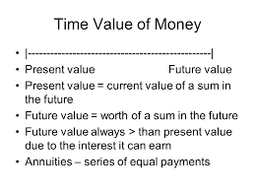
CAPITAL MARKET
PRESENT AND FUTURE VALUE OF CAPITAL

Slide 24
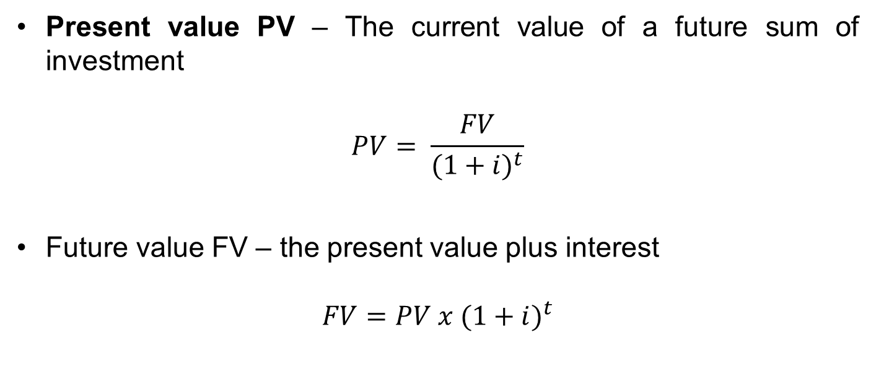
CAPITAL MARKET
CAPITAL RETURNS
Present value PV – The current value of a future sum of investment
$$PV= \frac{FV}{{(1+i)}^{t}}$$
Future value FV – the present value plus interest
$$FV=PV x ({1+i)}^{t}$$

Slide 25
CAPITAL MARKET
CAPITAL RETURNS
Firm chooses that opportunity for investment, which is associated with the highest present value of the expected flow of future revenues.

Slide 26
REVENUES, COSTS AND PROFIT
THANK YOU FOR YOUR ATTENTION…

