Slide 1

Informatics
Operating systems
Petr Suchánek
Informatics

Slide 2

Outline of the lecture
Operating system
Operating system services
Operating system Windows
Windows – Plug & Play
Windows – Drag & Drop
Windows - Multitasking
Windows – Taskbar
Windows – Start Menu
Windows – Settings
Windows - Applications

Slide 3
Operating system
An operating system (OS), in its most general sense, is software that allows a user to run other applications on a computing device.*
While it is possible for a software application to interface directly with hardware, the vast majority of applications are written for an OS, which allows them to take advantage of common libraries and not worry about specific hardware details.*
The application programs make use of the operating system by making requests for services through a defined application program interface (API). In addition, users can interact directly with the operating system through a user interface such as a command line or a graphical user interface (GUI).**
*https://www.techopedia.com/definition/3515/operating-system-os
**https://whatis.techtarget.com/definition/operating-system-OS

Slide 4
Operating system – examples*
Microsoft Windows 10 - PC and IBM compatible operating system. Microsoft Windows is the most common and used operating system.
Apple macOS - Apple Mac operating system. Today, the only Apple computer operating system is macOS.
Ubuntu Linux - A popular variant of Linux used with PC and IBM compatible computers.
Google Android - Operating system used with Android compatible phones and tablets.
iOS - Operating system used with the Apple iPhone and iPads.
Chromium - Google operating system used with Chromebooks.
OxygenOS - OnePlus' proprietary operating system.
*https://www.computerhope.com/jargon/o/os.htm

Slide 5
Operating system – services*
In a multitasking operating system, where multiple programs can be running at the same time, the OS determines which applications should run in what order and how much time should be allowed for each application before giving another application a turn.
It manages the sharing of internal memory among multiple applications.
It handles input and output to and from attached hardware devices, such as hard disks, printers and dial-up ports.
*https://whatis.techtarget.com/definition/operating-system-OS

Slide 6
Operating system – services*
It sends messages to each application or interactive user (or to a system operator) about the status of operation and any errors that may have occurred.
It can offload the management of batch jobs (for example, printing) so that the initiating application is freed from this work.
On computers that can provide parallel processing, an operating system can manage how to divide the program so that it runs on more than one processor at a time.
All major computer platforms (hardware and software) require and sometimes include an operating system, and operating systems must be developed with different features to meet the specific needs of various form factors.
*https://whatis.techtarget.com/definition/operating-system-OS

Slide 7
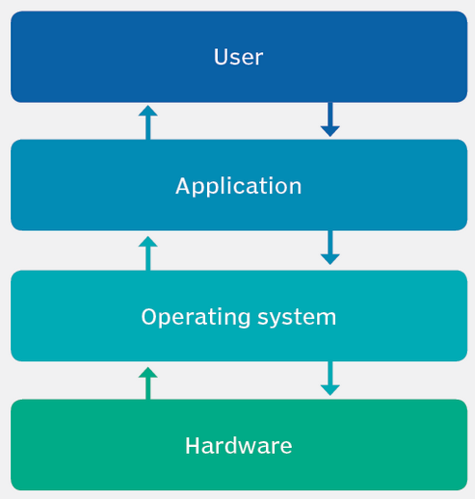
Operating system – services*/**
Program execution;
File system manipulation;
I/O operations;
Communication;
Resource allocation;
Error detection;
Accounting;
Protection.
*https://zitoc.com/operating-system-services/
**https://whatis.techtarget.com/definition/operating-system-OS

Slide 8
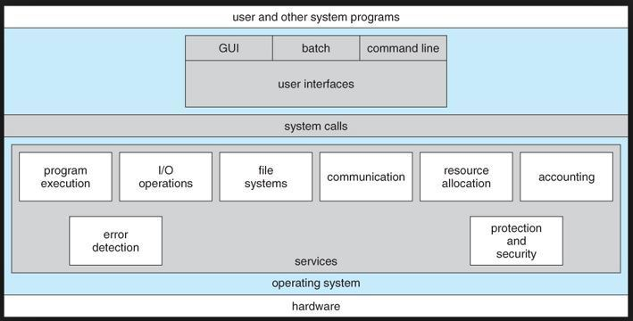
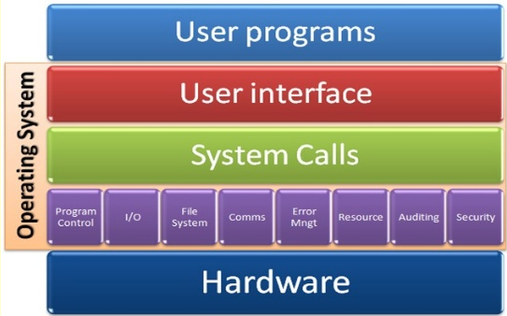
Operating system – services*/**
*https://zitoc.com/operating-system-services/
**https://zitoc.com/operating-system-services/

Slide 9
Operating system – Windows*/**
The first version of Windows, released in 1985, was simply a GUI offered as an extension of Microsoft’s existing disk operating system, or MS-DOS.
Windows 1.0 – 1985;
Windows 2.03 - 1987;
Windows 3.0 – 1990;
Windows 3.11 - 1993;
Windows NT – 1994;
Windows 95 – 1995;
Windows 98 - 1998;
Windows 2000 – 2000;
Windows XP - 2001;
Windows Vista – 2006;
Windows 7 - 2009;
Windows 8 – 2012;
Windows 10 – 2015.
*https://www.britannica.com/technology/Windows-OS
** https://en.wikipedia.org/wiki/List_of_Microsoft_Windows_versions

Slide 10
Windows – Plug & Play
Plug and Play, sometimes, abbreviated PnP, is a catchy phrase used to describe devices that work with a computer system as soon as they are connected.*
The user does not have to manually install drivers for the device or even tell the computer that a new device has been added. Instead the computer automatically recognizes the device, loads new drivers for the hardware if needed, and begins to work with the newly connected device.*
While Plug and Play usually refers to computer peripheral devices, such as keyboards and mice, it can also be used to describe internal hardware. For example, a video card or hard drive may be a Plug and Play device, meaning the computer will recognize it as soon as it is installed.*
*https://techterms.com/definition/plugandplay

Slide 11
Windows – Drag & Drop
A graphical user interface (GUI) capability that lets a user perform operations by moving the screen icon of an object into another window or onto another icon.*
On a regular screen, the icon is clicked with the mouse, and the button is held down while dragging.*
On a touchscreen, the icon is long tapped and held down while dragging.*
Drag and drop is a part of most graphical user interfaces, but is not found in all software.**
*https://www.pcmag.com/encyclopedia/term/41978/drag-and-drop
**https://www.techopedia.com/definition/6918/drag-and-drop

Slide 12
Windows – Drag & Drop
Copy and Move
  Files can be copied or moved by dragging their icons from one folder and dropping them on another folder's icon. Drag and drop also lets users position images on a page. In some cases, a document can be printed by dragging its icon to the printer icon.
Rearrange and Delete
  Icons can be rearranged on the screen or dragged to the trash can. In a smartphone or tablet, a long tap and drag and drop is used to rearrange and remove icons on the home screens. See icon, Win Drag and drop and long press.
*https://www.pcmag.com/encyclopedia/term/41978/drag-and-drop

Slide 13
Windows – Multitasking
Multitasking, in an operating system, is allowing a user to perform more than one computer task (such as the operation of an application program) at a time.*
The operating system is able to keep track of where you are in these tasks and go from one to the other without losing information.*
Being able to do multitasking doesn't mean that an unlimited number of tasks can be juggled at the same time. Each task consumes system storage and other resources. As more tasks are started, the system may slow down or begin to run out of shared storage.*
*https://whatis.techtarget.com/definition/multitasking

Slide 14
Windows – Taskbar
The taskbar is an element of an operating system located usually at the bottom of the screen.*
It allows you to locate and launch programs through Start and the Start menu, or view any program that is currently open.*
While there is nothing wrong with the default look of the taskbar, like other areas of Windows operating system, Windows 10’s taskbar can be customized in a number of ways without the help of third-party tools.**
*https://www.pcmag.com/encyclopedia/term/69267/win10-start-menu
**https://www.intowindows.com/13-ways-to-customize-the-windows-10-taskbar/

Slide 15

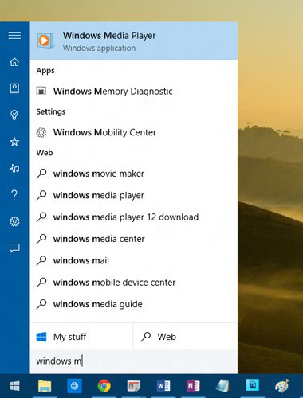
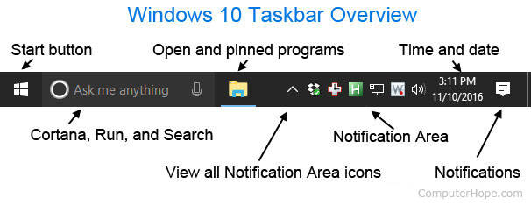
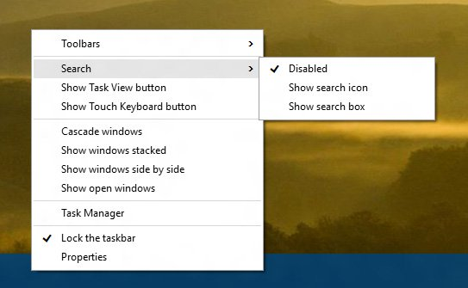
Windows – Taskbar
*https://www.computerhope.com/jargon/t/taskbar.htm
**

Slide 16
Windows – Taskbar
The taskbar is an element of an operating system located usually at the bottom of the screen.*
It allows you to locate and launch programs through Start and the Start menu, or view any program that is currently open.*
While there is nothing wrong with the default look of the taskbar, like other areas of Windows operating system, Windows 10’s taskbar can be customized in a number of ways without the help of third-party tools.**
*https://www.pcmag.com/encyclopedia/term/69267/win10-start-menu
**https://www.intowindows.com/13-ways-to-customize-the-windows-10-taskbar/

Slide 17
Windows – Taskbar - customization
https://www.howtogeek.com/225568/how-to-configure-and-customize-the-taskbar-in-windows-10/
https://www.intowindows.com/13-ways-to-customize-the-windows-10-taskbar/
https://docs.microsoft.com/en-us/windows/configuration/windows-10-start-layout-options-and-policies
https://www.pcmag.com/article/355897/7-ways-to-tweak-your-windows-10-taskbar

Slide 18
Windows – Start Menu
The Windows 10 Start menu is a table of contents to all the apps (programs), folders and contacts you use often.*
In Desktop mode, the Windows 10 Start menu (Anniversary Update) shows all apps on the left side and their counterpart live tiles on the right.*
Whether they function as "live" or not depends on the application.*
Any app from the All apps list on the left can be replicated as a tile on the right.*
*https://www.pcmag.com/encyclopedia/term/69267/win10-start-menu

Slide 19
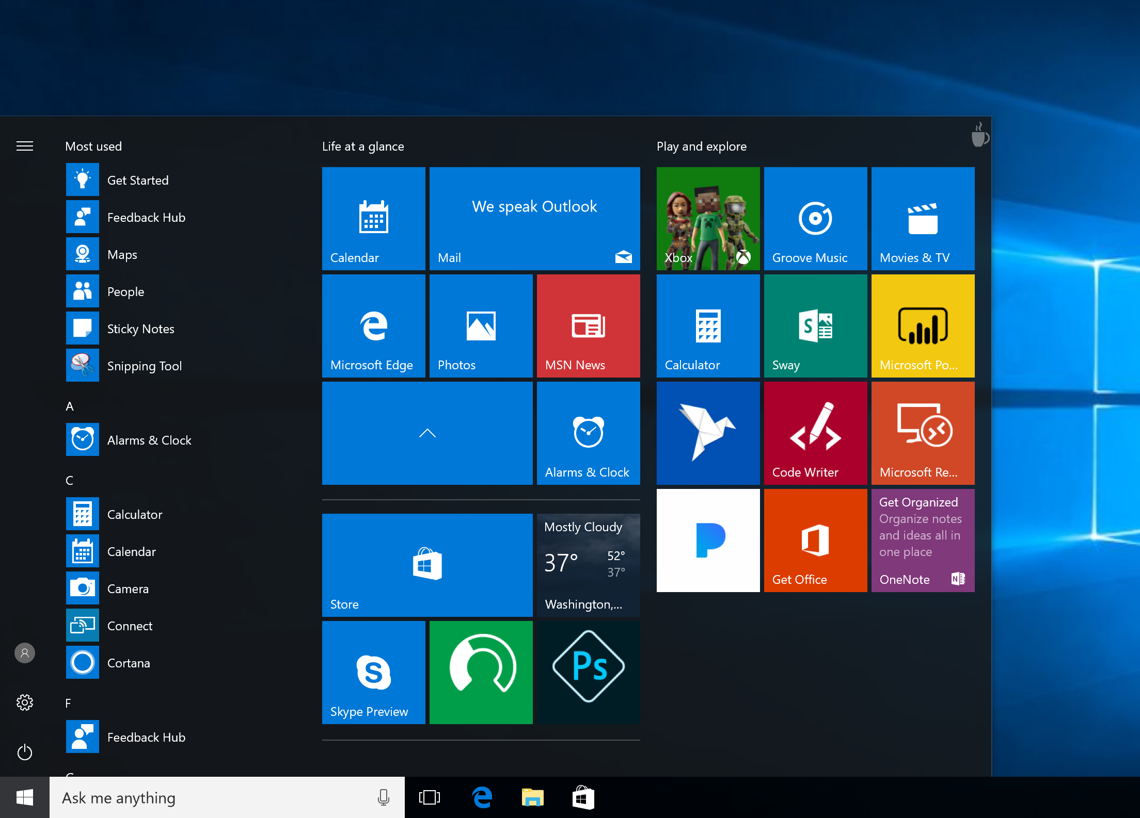
Windows – Start Menu
*https://mspoweruser.com/windows-10-creators-update-will-introduce-app-folders-for-the-start-menu-on-pcs/

Slide 20
Windows – Start Menu – Customization*
How to change the size of the Start Menu in Windows 10
How to enable full screen mode for the Start Menu in Windows 10
How to pin an application to the Start Menu in Windows 10
How to unpin an application from the Start Menu in Windows 10
How to change the size of tiles in the Start Menu in Windows 10
How to move tiles in the Start Menu in Windows 10
How to turn off living tiles in the Start Menu in Windows 10
How to change the color of the Start Menu in Windows 10
How to add folders to the Start Menu in Windows 10
How to rename groups of tiles in the Start Menu in Windows 10
*https://www.windowscentral.com/how-customize-your-start-menu-windows-10#sizeFirefoxHTML\Shell\Open\Command

Slide 21
Windows – Settings
Settings or Windows Settings (known as PC settings in Windows 8 and 8.1) is a component of Microsoft Windows.*
It allows the user to customize and configure the operating system. Microsoft intends it to eventually replace the existing Control Panel.*
*https://en.wikipedia.org/wiki/Settings_(Windows)

Slide 22
Windows – Settings
System;
Devices,
Phone (introduced in Windows 10 Fall Creators Update),
Network & Internet,
Personalization,
Apps (introduced in Windows 10 Creators Update),
Accounts,
Time & Language,
*https://en.wikipedia.org/wiki/Settings_(Windows)

Slide 23
Windows – Settings
Gaming (introduced in Windows 10 Anniversary Update);
Ease of Access;
Cortana (introduced in Windows 10 Fall Creators Update);
Privacy;
Update & Security;
Mixed Reality (introduced in Windows 10 Creators Update; appears only if a device meeting minimum HoloLens requirements is connected to the PC).
*https://en.wikipedia.org/wiki/Settings_(Windows)

Slide 24
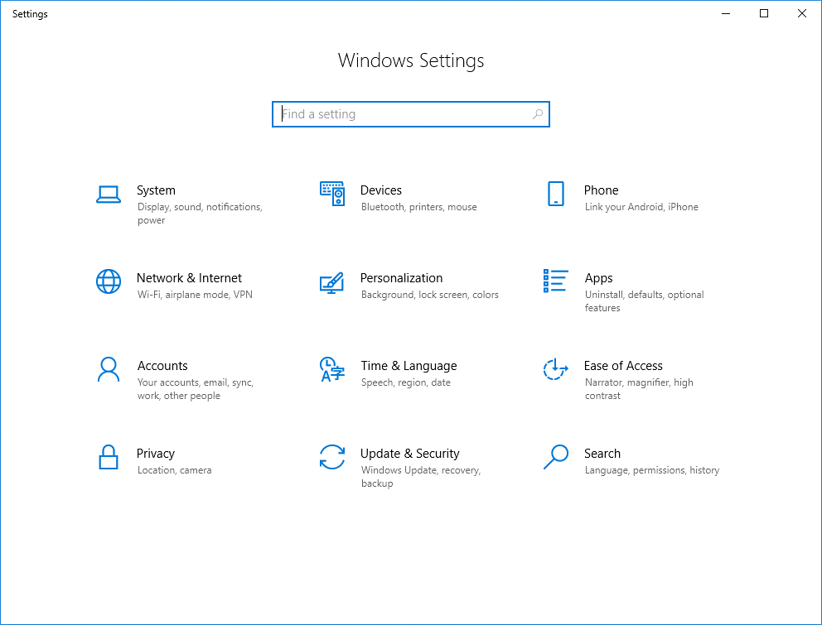
Windows – Settings*
*https://www.benecke.cloud/windows-10-modify-settings-page/

Slide 25
Windows – Settings
https://www.digitalcitizen.life/introducing-windows-10-ways-open-settings
https://www.isunshare.com/windows-10/3-ways-to-open-pc-settings-on-windows-10.html
https://www.makeuseof.com/tag/control-windows-10-settings-guide/
https://pixelprivacy.com/resources/windows-privacy-settings/
https://gadgets.ndtv.com/laptops/features/windows-10-7-default-settings-you-should-change-immediately-after-install-744550

Slide 26
Windows – Applications
https://www.computerworld.com/article/3199125/top-35-free-apps-for-windows-10.html#slide14
https://www.techradar.com/news/the-best-free-windows-10-apps
https://www.digitaltrends.com/computing/best-windows-apps/
https://www.digitalunite.com/technology-guides/computer-basics/windows-10/how-use-and-download-apps-windows-10
https://www.techrepublic.com/article/how-to-turn-off-background-apps-in-microsoft-windows-10/
https://www.laptopmag.com/articles/install-apps-windows-10

Slide 27
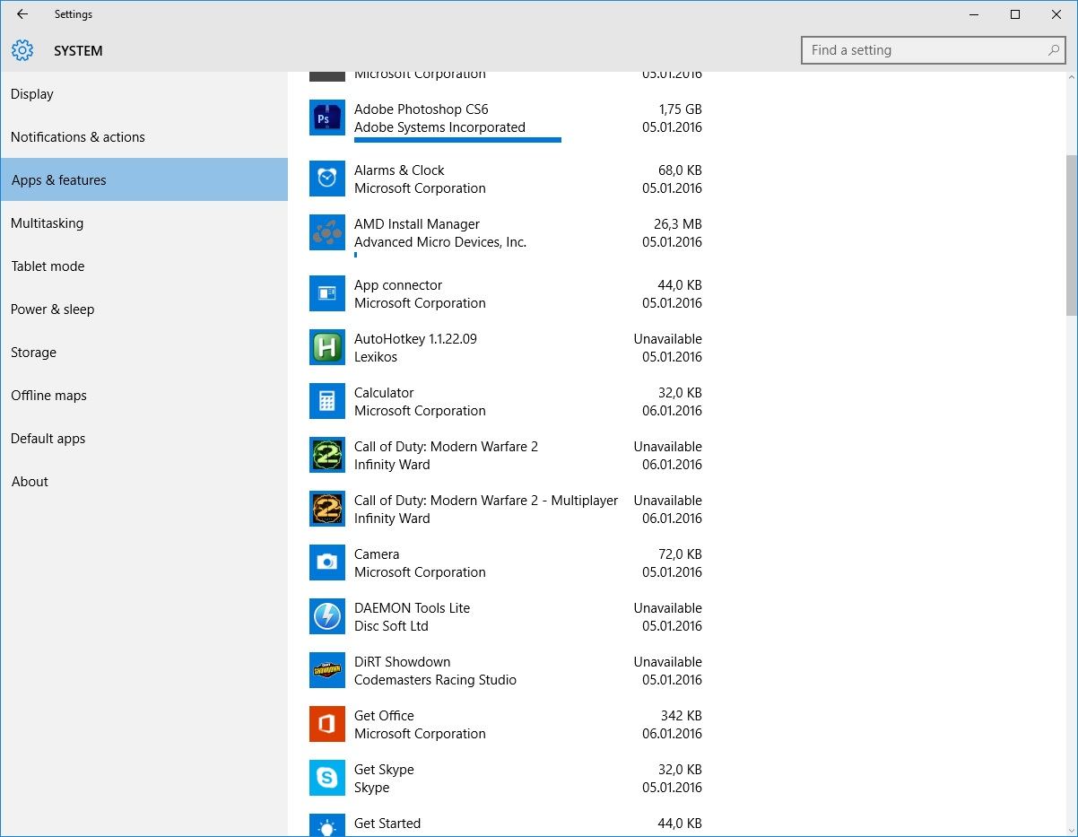
Windows – Applications*
*https://www.reddit.com/r/Windows10/comments/3zpk8g/what_are_those_progress_bars_in_apps_features/

Slide 28
The end
Thank you for your attention!
Any questions?

