Slide 1

Mathematics in economics
Lecture 10
Mgr. Jiří Mazurek, Ph.D.
Mathematics in Economics/PMAT

Slide 2
Lecture 10
Geometric function series
Geometric function series is defined as follows:
The series is convergent if , where q = f(x).
The sum is given as:

Slide 3
Lecture 10
Geometric function series – Problem 1
Find the range of convergence: .
Solution:
Expanding the sum yields:
Clearly, a1 = q = x.
Because , we have . The range of convergence:

Slide 4
Lecture 10
Geometric function series – Problem 2
Find the sum of the series: .
Solution:
We already know that a1 = q = x.
Using the formula for the sum yields:
This result is valid for all x satysfying

Slide 5
Lecture 10
Geometric function series – Problem 3
Find the range of convergence and a sum of the series:
Solution:
,
The convergence:
Which yields:
The sum:

Slide 6
Lecture 10
Problems to solve
Find the range of convergence and a sum of the series:

Slide 7
Lecture 10
Differential equations
Differential equation (DE) is an equation that includes given function y = f(x) and its derivatives.
Examples:
is a DE of the first order and degree 1.
is a DE of the first order and degree 2.
is a DE of the second order and
degree 3.

Slide 8
Lecture 10
Differential equations – Types of a solution
DE can have three types of solutions:
General solution
Particular solution
Singular solution

Slide 9
Lecture 10
Differential equations – Types of a solution
Example 1
Find general solution of DE and particular solution for a condition .
General solution:
We simply integrate DE:
Particular solution for the initial condition: we substitute x = 0 and y = 2 into general solution:
Which yields C = 2. Thus, particular solution is

Slide 10
Lecture 10
Differential equations – Types of a solution
Example 2
Find general solution of DE and particular solution for a condition y (1) = 2.
General solution:
We integrate DE:
Particular solution for the initial condition: we substitute x = 1 and y = 2 into general solution:
Which yields C = - 2. Thus, particular solution is

Slide 11
Lecture 10
Differential equations – Types of a solution
Example 3
Find general solution of DE and particular solution for a conditions and .
General solution:
Particular solution for the initial condition:
Which yields C1 = 0, C2 = 1. Thus, particular solution is:

Slide 12
Lecture 10
Differential equations – Separation of variables
One of the most used method for solving DE is separation of variables. In this method x and y variables are separated on the different sides of an equation before integration takes place.
It can be used when DE is separable:
or

Slide 13
Lecture 10
Differential equations – Separation of variables
Example 1
Find a general solution of .
The equation is separable: , so we separate both variables:
And integrate:
Which yields:

Slide 14
Lecture 10
Differential equations – Separation of variables
Example 2
Find a general solution of .
The equation is separable, so we separate and integrate:

Slide 15
Lecture 10
Differential equations – Separation of variables
Example 3
Find a general solution of .
The equation is separable, so we separate and integrate:

Slide 16
Lecture 10
Differential equations – Homogenous differential equations
A DE of the form such that
is called homogenous differential equation. It is solved via substitution: and .
Example: is homogenous, because:

Slide 17
Lecture 10
Differential equations – Homogenous differential equations – Example 1
Find a general solution of a homogenous DE:
We start with the substitution :

Slide 18
Lecture 10
Differential equations – Homogenous differential equations – Example 1 – cont.
And at the end we integratate:
which yields:

Slide 19
Lecture 10
Differential equations – Logistic equation and function
In economics, demographics and other disciplines appears a function called a logistic function.
This function arises as a solution to the following logistic equation:
For an initial condition the solution is:

Slide 20
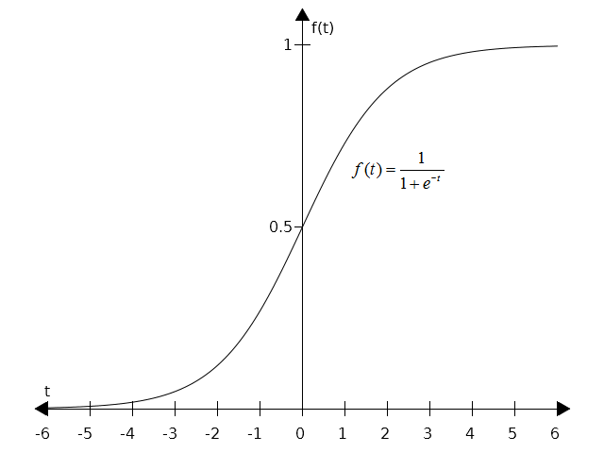
Lecture 10
Differential equations – Logistic equation and function

Slide 21
Lecture 10
Differential equations
Linear differential equations of the first order
By a linear differential equations of the first order we mean an equation of the form:
Assume that q(x) = 0:
This special equation is called homogenous, and is solved by separation of variables:

Slide 22
Lecture 10
Differential equations
Linear differential equations of the first order – cont.
And finally we obtain:

Slide 23
Lecture 10
Differential equations
Linear differential equations of the first order – Example 1
Find the general solution: .
Solution:
We follow the procedure from the previous slide:

Slide 24
Lecture 10
Linear differential equations of the first order
Problems to solve
Find the general solution:

Slide 25
Lecture 10
Thank you for your attention

