Slide 1

Mathematics in Economics
Lecture 3
Mgr. Jiří Mazurek, Ph.D.
Mathematics in Economics/PMAT

Slide 2
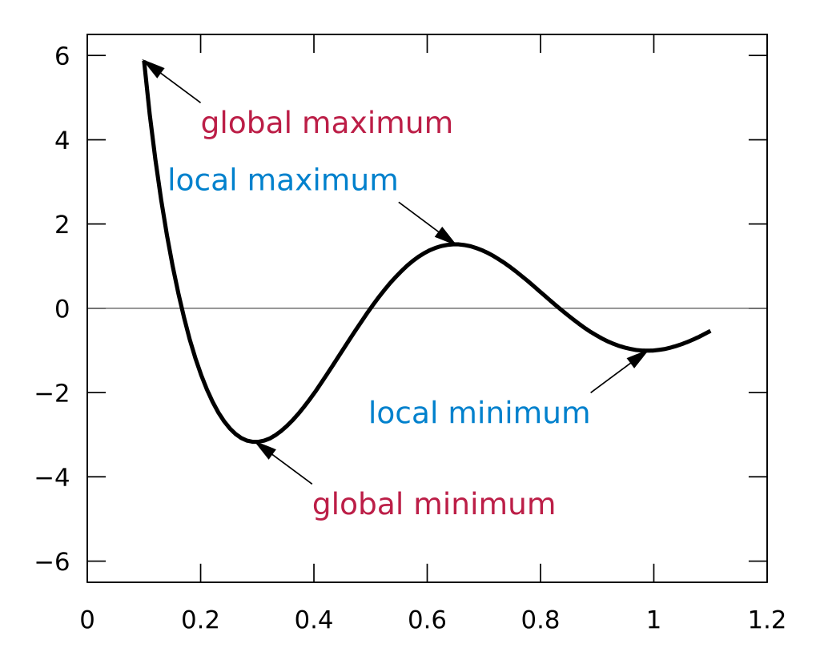
Function properties
Function properties
In this lecture we will examine the basic function properties.
Monotonicity: A function y = f(x) is called increasing on the interval J = (a,b) if:
Also, a function y = f(x) is increasing if f´(x) is positive on J.
Decreasing function is defined analogically.
Extrema: A function y = f(x) has
a local maximum at the point a
if on some neighborhood of a
the value f(a) is the highest.
A minimum is defined analogically.

Slide 3
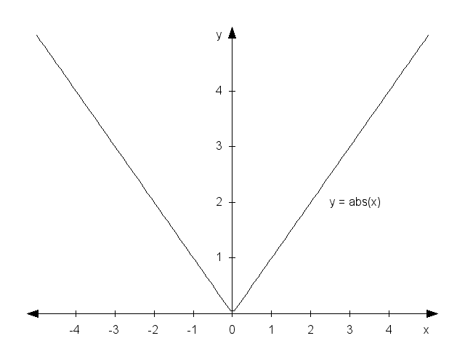
Function properties
Function properties
To find extremes of a function y = f(x), a first derivative test can be used: if a function has an extreme at a point a, and the derivative f´(a) exists, then f´(a) = 0. However, contrary is not true. Also, extremes might be at points where f´(x) does not exist, see the picture below:

Slide 4
Function properties
Function properties
The function y = f(x) is said to be even, if f (x) = f(-x) for all x.
Geometrically speaking, a function is even when its graph
is symmetrical with regard to the axis y.
The function y = f(x) is said to be odd, if f (x) = -f(-x) for all x.
Geometrically speaking, a function is odd when its graph
is symmetrical with regard to the point 0.
The function y = f(x) is said to be bounded from above, if all
values f(x) are lower than some real number H.
The function y = f(x) is said to be bounded from below, if all
values f(x) are higher than some real number L.
If a function is bounded from above and from below, it is
called bounded.

Slide 5
Function properties
Function properties
A function y = f(x) is called periodical if there exists real p
such that f(x) = f(x+np) for all n. The p is called a period.
Typical periodical functions are goniometric functions.
A function y = f(x) is called convex on the interval J,
if f´´(x) > 0 for all x from J. (It has a shape of a valley)
A function y = f(x) is called concave on the interval J,
if f´´(x) < 0 for all x from J. (It has a shape of a hill).
See the next slide.
Points at which the second derivative changes its sign
are called inflection points.

Slide 6
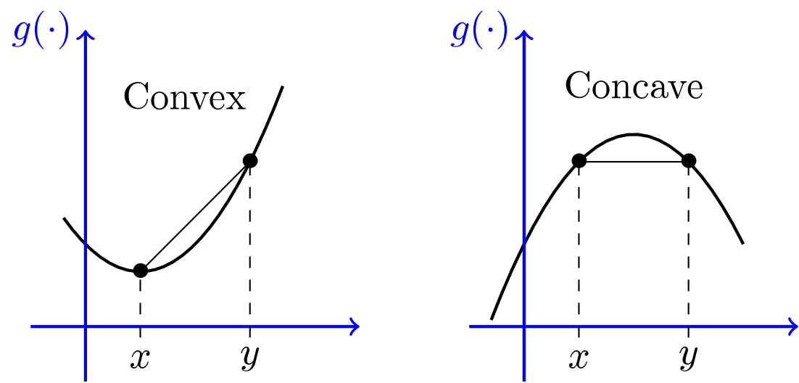
Function properties
Convex and concave functions

Slide 7
Function properties
A usual procedure
When examining function properties, we usually follow
the following structure:
1. Domain, odd/even, periodicity.
2. Limits at discontinuities and infinity.
3. Intersections with x and y axes.
4. The first derivative, its roots.
5. Extremes and monotonicity.
6. The second derivative and its roots.
7. Concave/convex intervals, inflection points
8. Asymptoties
9. Range.
10. A graph.

Slide 8
Function properties
Solved problem 1
Find the properties of the function .
We will follow the steps from the previous slide.
The domain: because the function is polynomial, D(f) = R.
Checking odd/even function requirements: the function is nor
even, nor odd. Also, it is not periodical.
2. Limits in infinity:

Slide 9
Function properties
Solved problem 1 - cont.
3. Intersections with axes:
Let x = 0, then y = 0. We have the first intercept [0,0].
Let y = 0, then
From the last equality we obtain two roots: x = 0 and x = 3.
Therefore, we attain two intercepts with the axis x: [0,0] and
[3,0]. The first intercept is the same as for axis y.
4. The first derivative: = 0.
The roots of this quadratic equality are x = 1 and x = 3.
These points are called stationary points and might be
Maximum, minimum or inflection point.

Slide 10
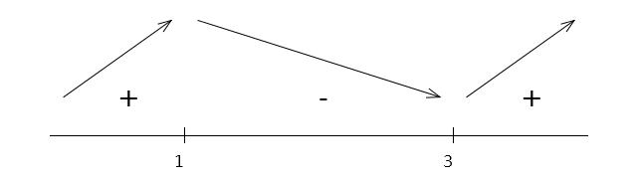
Function properties
Solved problem 1 - cont.
5. Extremes: by checking the signs of the first derivative
(see the picture below)
We find that for x = 1 the function has its local maximum,
and x = 3 is a local minimum. (Also, we could applied the
second derivative test).
Monotonicity: from the picture above we see that the function
is decreasing in (1,3) interval, and increasing elsewhere.

Slide 11
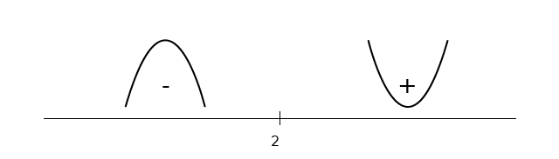
Function properties
Solved problem 1 - cont.
6. The second derivative: = 0.
The root: x = 2. In this point an inflection point could be.
7. We check whether the sign of the second derivative changes in 2: yes, so we have the inflection point (see the picture below).
From the picture, intervals of convexity and concavity are clear.

Slide 12
Function properties
Solved problem 1 - cont.
8. Asymptotes: asymptote is a line such that
the distance between the curve and the line approaches
zero as they tend to infinity. They can be vertical,
horizontal or oblique. In our case there is no horizontal or
vertical asymptote.
However, we can check an oblique asymptote y = ax + b:
If the result is not a real number, the asymptote does not exist.
9. Range of the function: D(f) = R.

Slide 13
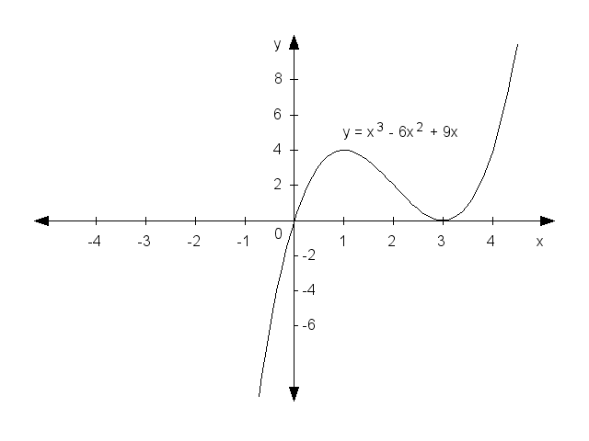
Function properties
Solved problem 1 - end
10. The graph:

Slide 14
Function properties
Solved problem 2
Find extremes of the function
Solution: we compute the first derivative and its roots:
The root is x = -1, it is the only stationary point. The nature of this point can be checked by sign of the derivative at both intervals on the left and right to -1. Because the derivative changes its sign from minus to plus, the point x = -1 is a local minimum.

Slide 15
Function properties
Solved problem 3
Find asymptotes of the function .
Solution: a vertical asymptote is determined from the domain
of a function. In our case, x cannot be 1, therefore there
exists the vertical asymptote x = 1.
A horizontal asymptote can be considered a special case of
an oblique asymptote, so we can skip it for a while.
The oblique asymptote y = ax + b:

Slide 16
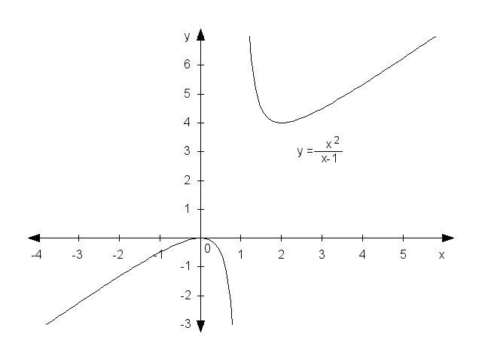
Function properties
Solved problem 3 – cont.
The graph of the function .

Slide 17
Function properties
Solved problem 4
Find extremes of the production function . Draw its graph.
Solution:
The first derivative is , we find roots of the first derivative: L = 0 and L = 1. By the use of the second derivative, or by checking signs of the first derivative, we obtain that L = 0 is a local minimum and L = 1 is a local maximum. Therefore, the highest (optimal) production is achieved when L = 1.
The graph is provided on the next slide.

Slide 18
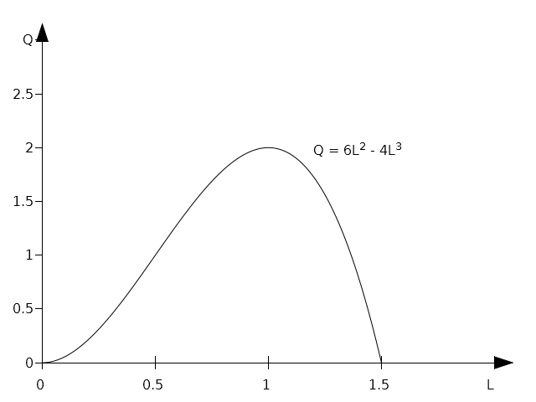
Function properties
Solved problem 4 – cont.

Slide 19
Function properties
Solved problem 5
Find extremes and draw the graph of the function:
Solution:
First, we compute the first derivative:
As can be seen, the roots of the equation y´ = 0 are
x = 0 and x = 2. By checking the signs we obtain:
x = 0 is a local minimum and x = 2 is a local maximum.

Slide 20
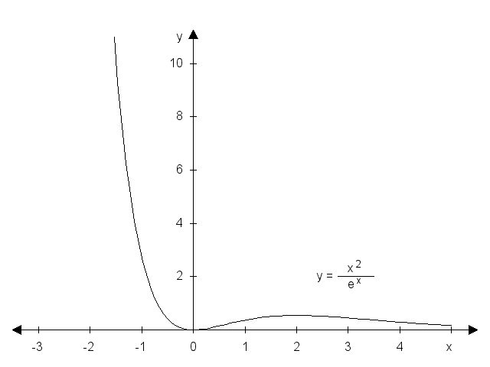
Function properties
Solved problem 5 – cont.

Slide 21
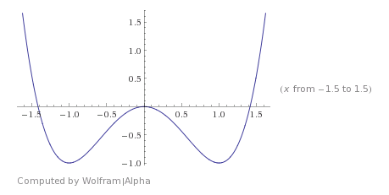
Function properties
Problems to solve 1 (Assignment 4)
Find all properties of the function .
Hint:

Slide 22
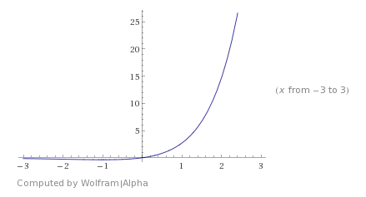
Function properties
Problems to solve 2 (Assignment 4)
Find all properties of the function .
Hint:

Slide 23
Function properties
Problems to solve 3 (Assignment 5)
Find extremes of the following functions:

Slide 24
Function properties
Problems to solve 3 (Assignment 5)
Find the maximum of total revenue function .
Find the minimum of total cost function: .
Find the maximum of the profit function: .
Find the maximum of total revenue function: .

Slide 25
Function properties
Thank you for your attention!

