Slide 1

Mathematics in economics
Lecture 10

Slide 2
Lecture 10
Definite integral
Newton´s definite integral:
In the definition above, F is a primitive function to f,
and a and b are the limits of the integral.
The result of definite integral is not a function, but a number!

Slide 3
Lecture 10
Definite integral – elementary properties
Generally, when computing definite integral, we use the
same table of elementary integrals as for an indefinite
integral.
The elementary properties of the definite integral:

Slide 4
Lecture 10
Definite integral – a use
The definite integral can be used to calculation of:
The square under or above given function,
The area of a 2D object,
The length of a curve,
The volume of a 3D object,
The area of a 3D object.

Slide 5
Lecture 10
Definite integral – An area under/above a function
Find:
Solution:
What does the number 7/3 mean?
It is the area below the function f(x) on the interval (1,2),
See the next slide for a picture.

Slide 6
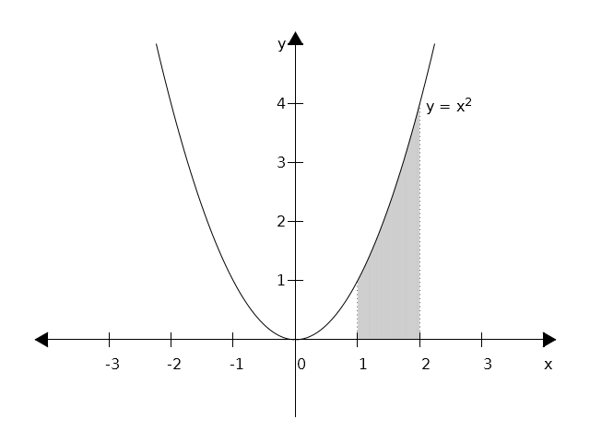
Lecture 10
Definite integral – An area under/above a function

Slide 7
Lecture 10
Definite integral – An area under/above a function
Find an area bounded by functions: , axis x,
x = -1 and x = 2.
Solution: We must divide the interval of integration
(-1,2) into two intervals: (-1,0) and (0,2) (WHY?):

Slide 8
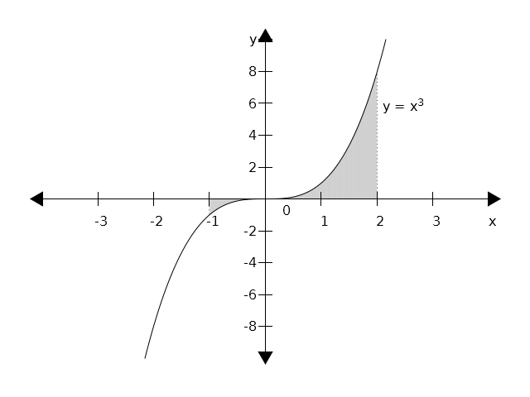
Lecture 10
Definite integral – An area under/above a function

Slide 9
Lecture 10
Definite integral – An area under/above a function
Problem 2
Find:
Solution:
This result means that the area under the function on
the interval (0,3) is 9.
Important note: if a function is positive on the interval
of integration, then the result will be a positive number.
However, for a negative function the result will be
negative!

Slide 10
Lecture 10
Definite integral – An area under/above a function
Problems 3 and 4
Find:
Solution:
Find:
Solution:

Slide 11
Lecture 10
Problems to solve - 1
Find:

Slide 12
Lecture 10
An area between two curves
Let f(x) and h(x) be two curves, S an area between them
And a and b their intersections.
Then S is given as follows:

Slide 13
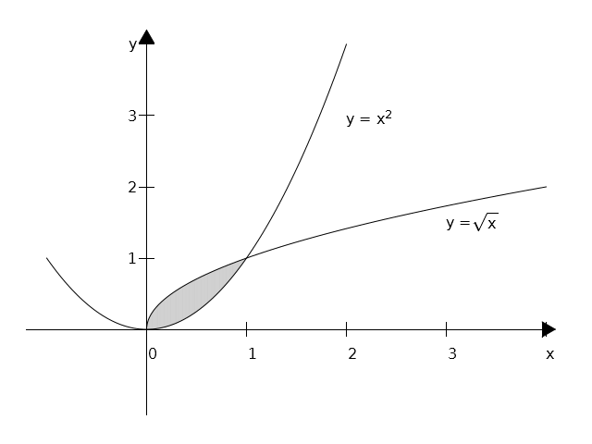
Lecture 10
An area between two curves – Problem 1
Find an are between two curves: and .
A picture:

Slide 14
Lecture 10
An area between two curves – Problem 1 cont.
Find an are between two curves: and .
Solution:
First, we find intersections: , hence x = 0 and x = 1.
Now, we can use the integral formula for the area:

Slide 15
Lecture 10
An area between two curves – Problem 2
Find an are between two curves: and .
Solution:
First, we find intersections: , hence x = 0 and x = 2.
Now, we can use the integral formula for the area:

Slide 16
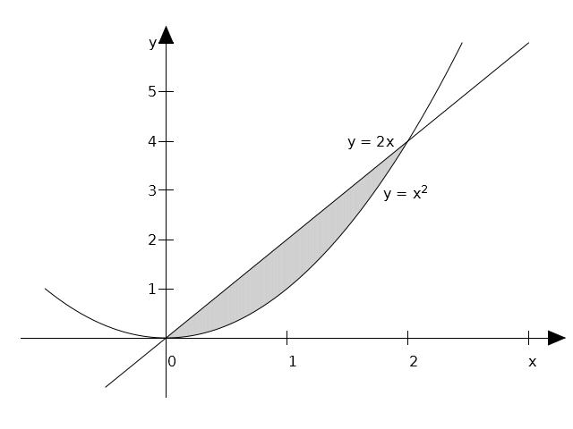
Lecture 10
An area between two curves – Problem 2 – cont.
Find an are between two curves: and .
A graph:

