Slide 1

Master thesis seminar (3)
Information about description of FT
IS Tematikon explanation
Cooperation with supervisor
Tomas Prazak
Vice-dean for Science and Research Department of Finance and Accounting

Slide 2
Dean‘s instruction
Dean's Instruction No. 4/2024 - The Implementation Procedure for the Description of the Final Theses
https://www.slu.cz/opf/en/file/cul/bcaf4dfe-bd39-4649-b67d-9704556cb431
Dean's Instruction No. 2/2025 - Description of Final Theses (SFE in winter semester)
https://www.slu.cz/opf/en/file/cul/35fc9d24-4439-4078-b902-082c0624f215
Dean's Instruction No. 3/2024 - Editing, Publishing and Storing Final Theses
https://www.slu.cz/opf/en/file/cul/c3371cdb-213b-4f3d-a1ab-9163237f0160

Slide 3
Schedule of Master’s thesis elaboration and defense
till October 31 - filling in the data for the description of the Master’s thesis in the IS SU, student after consultation with a supervisor must complete and insert FT description into IS
till April 29 - students have to upload digital version of the final thesis into IS SU.
This schedule is valid for the students graduating in summer semester.
June 2026 (June, 1 – 5) – state final exam and defense of the thesis

Slide 4
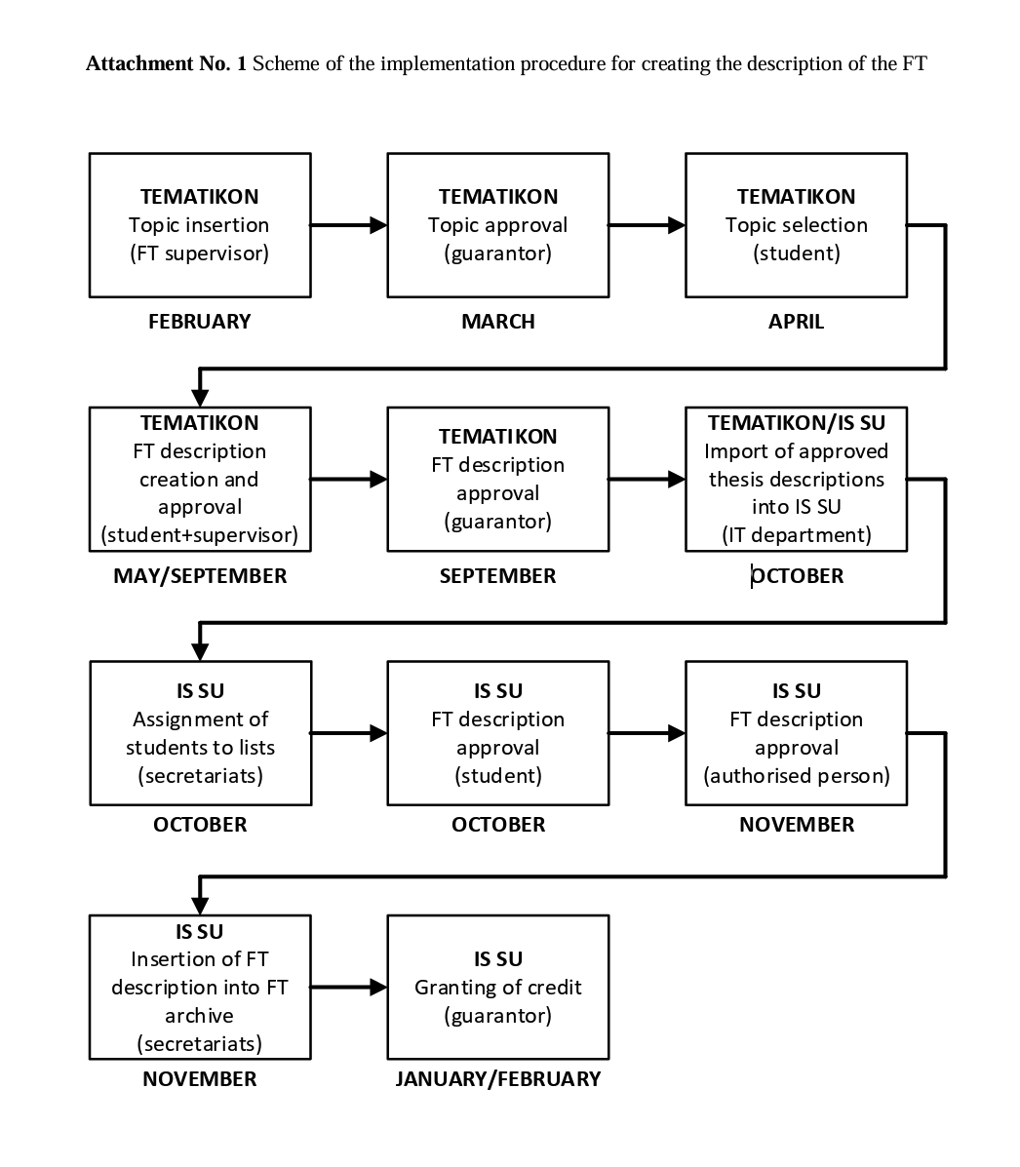
Schedule of Master’s thesis elaboration

Slide 5
Schedule of Master’s thesis elaboration and defense
till February 28, student after consultation with a supervisor must complete and insert FT description into IS Tematikon
This schedule is valid for the students graduating in February.

Slide 6
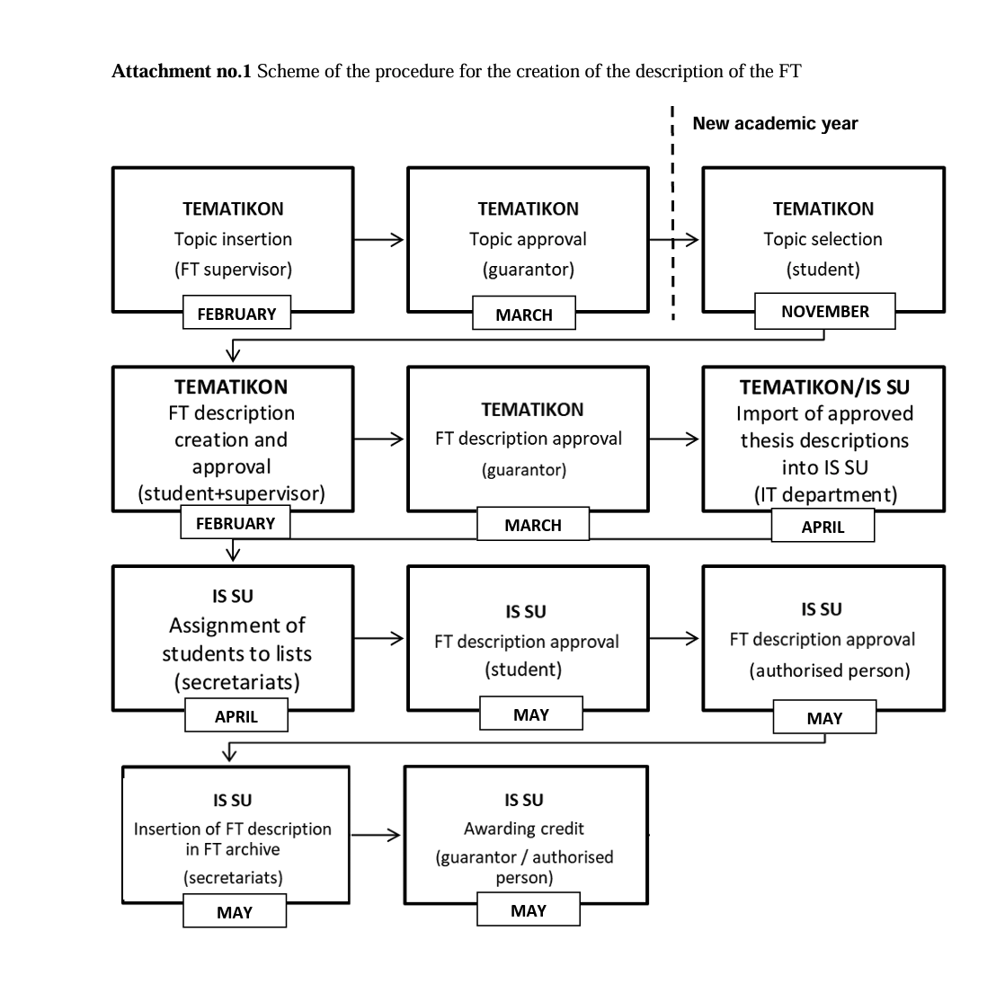
Schedule of Master’s thesis elaboration (winter)

Slide 7
Content of the FT description
Title in English
Schedule of elaboration including the day of submitting
Aim of the thesis (aim of the thesis is to evaluate, compare, create etc.)
Subject of the thesis – e. g. Thesis will focus on marketing mix of company XY (future time)
Data and methods – e. g. Questionnaire survey will be employed to evaluate the level of customer satisfaction with products of company XY … or…. Secondary data from Czech statistical office will be applied.
Structure – e.g. Theoretical part of the thesis will focus on determination of fundamental terms and relationships in the field of strategic management and main indicators applied in empirical part will be also defined … In empirical part, the use of marketing mix measures in the company XY will be evaluated.

Slide 8
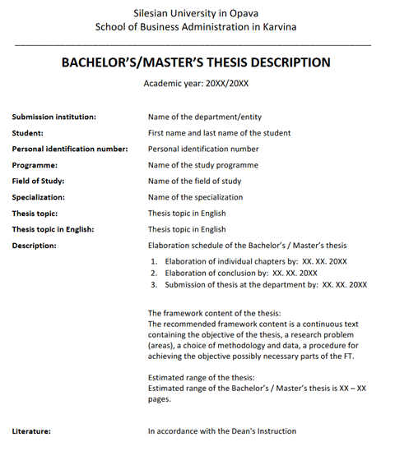
Sample of the structure of the documents for the description of the FT

Slide 9
The scope of the FT
The scope of the BT (not including Annexes) is set at 35 - 45 pages.
The scope of the MT is set at 45 - 65 pages.

Slide 10
The example of the structure of the description of FT
Title: Methods of evaluating the efficiency of the company
The aim of the master thesis is to evaluate the economic efficiency of the selected company. The annual reports of FIRM and industry values available at the portal of the Ministry of Industry and Trade of the Czech Republic will be used to prepare the master thesis. The data set will cover the period 2015-2020. The introductory part of the master thesis will describe the methods of evaluating the efficiency of the company. In the next part of the thesis the literature review regarding the firm‘s efficiency will be presented. Moreover, the financial statements will be explained. In the practical part of the master thesis will be evaluated the FIRM. The evaluation will be complemented by the recommendations to improve the firm‘s efficiency.

Slide 11
The example of the structure of the description of FT
Setting the aim of the master thesis is very important part of the description.
The aim is the answer to the question, ‘What are you doing?’
1. You need to clearly describe what your intentions are and what you hope to achieve. This is the aim.
2. Be very explicit. In the opening paragraphs, say, in simple terms, ‘the aim of the master thesis is to…’

Slide 12
The example of the structure of the description of FT
Methodology – used methods
Data – data collection:
primary data - one which is collected for the first time by the researcher through direct efforts and experience,
secondary data - the data already collected or produced by others.

Slide 13
Literature in the description
The minimum is 7 sources of literature in the description of FT.
Everything must be according to the citation standard!

Slide 14
Literature
[1] FORET, M., 2018. Marketing research: we know our customers. Brno: Computer Press. ISBN 978-80-251-2183-2.
[2] HINDLS, R., S. HRONOVA, J. SEGER and J. FISCHER, 2017. Statistics for Economists. 8th ed. Prague: Professional Publishing. ISBN 978-80-86946-43-6.
[3] JOBBER, D., 2015. Principles and Practice of Marketing. 6th ed. London: McGraw-Hill Education. ISBN 978-0-07-712330-7.
[4] KLUSOŇ, V., 2019. Ownership Dimension of Social Responsibility. Political Economy, 47 (6), 797-810. ISSN 0032-3233.
[5] KOZEL, R., L. MLYNÁŘOVÁ and H. SVOBODOVÁ, 2018. Modern methods and techniques of marketing research. Prague: Grada Publishing. ISBN 978-80-247-3527-6.
[6] VAŠTÍKOVÁ, M., 2018. Marketing of services - effectively and modernly. Prague: Grada Publishing. ISBN 978-80-247-2721-9.
[7] VYSEKALOVÁ, J., 2017. Customer Behavior: How to Uncover the Secrets of a Black Box. Prague: Grada Publishing. ISBN 978-80-247-3528-3.

Slide 15
Topic Selection in Tematikon

Slide 16
Schedule of Master’s thesis elaboration

Slide 17
Schedule of Master’s thesis elaboration (winter)

Slide 18
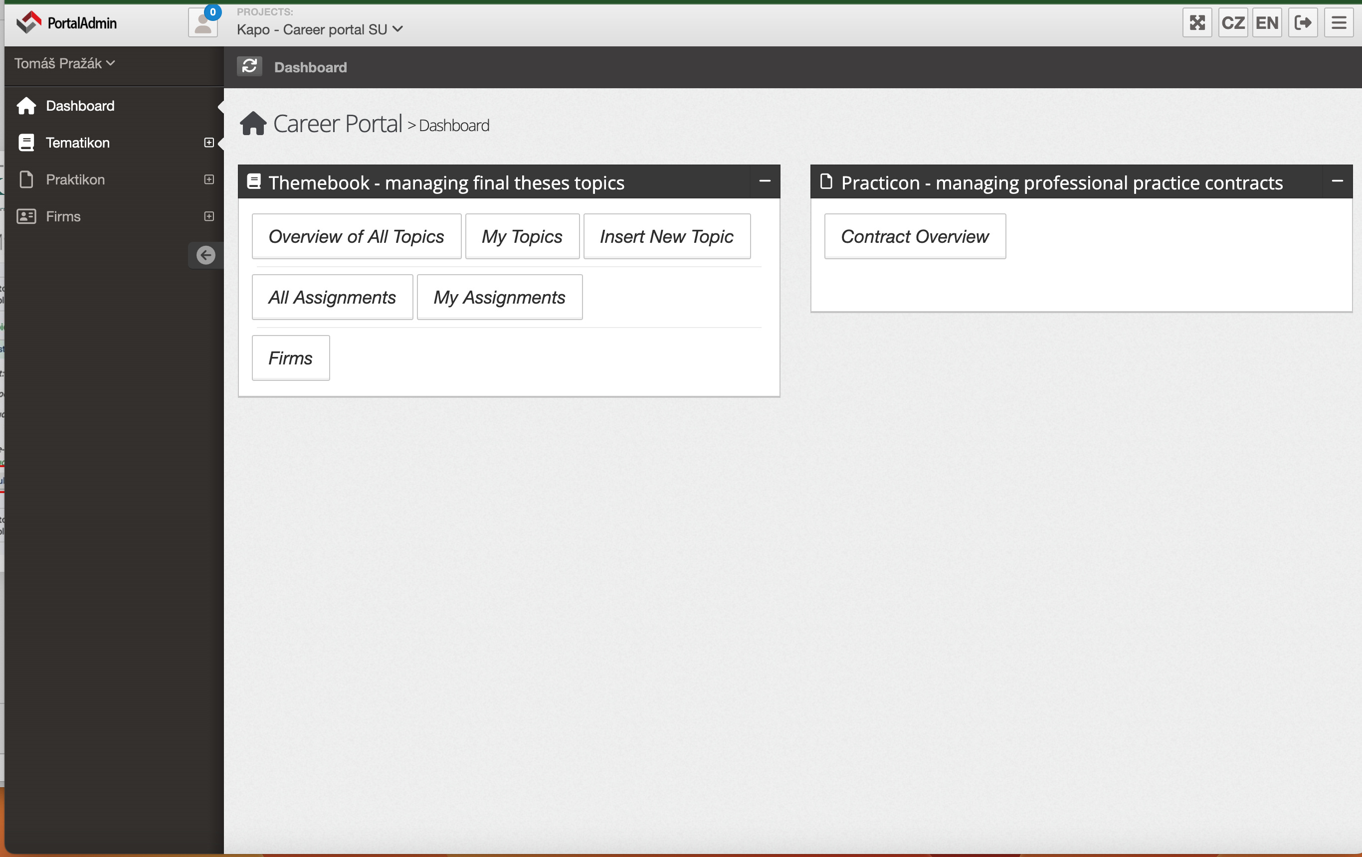
Topic Selection - overview
Notes:
csvukrs

Slide 19
Log in to the topic

Slide 20
Topic Selection – My topics
Notes:
csvukrs

Slide 21
Description creation and approval

Slide 22
Schedule of Master’s thesis elaboration (classic)

Slide 23
Schedule of Master’s thesis elaboration (winter)

Slide 24
My Assignments – Topic specification with Supervisor
Notes:
csvukrs

Slide 25
Approval in IS

Slide 26
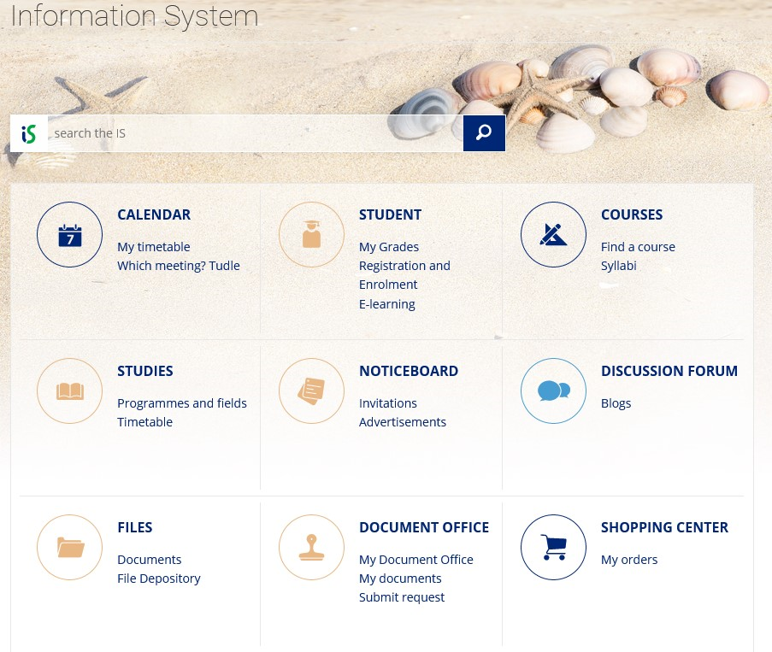
Work in IS

Slide 27
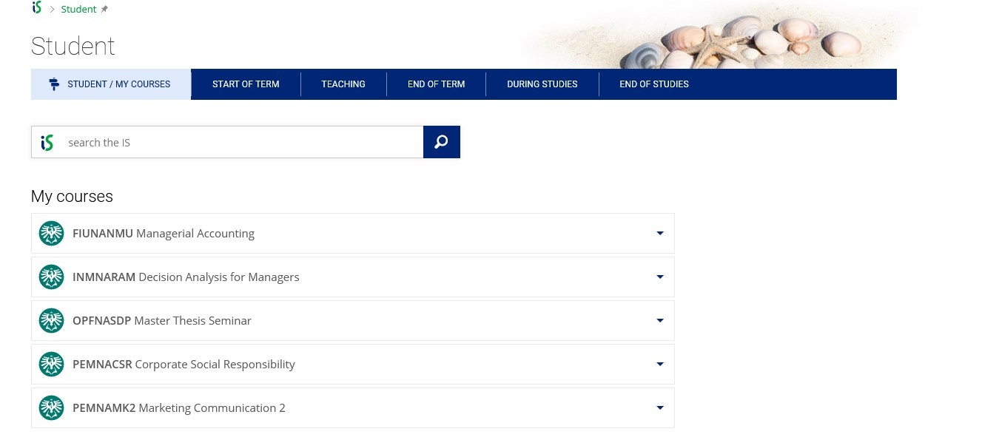
Work in IS

Slide 28
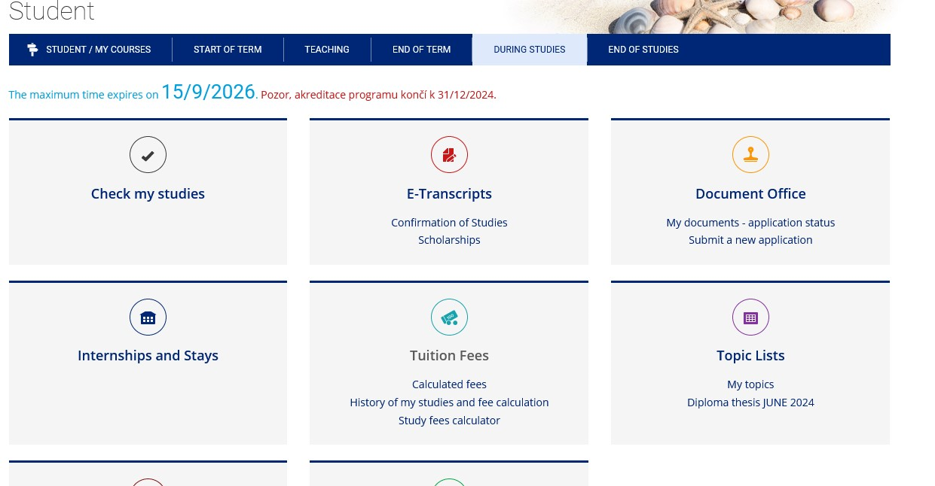
Work in IS
Select from menu
„my topics“

Slide 29
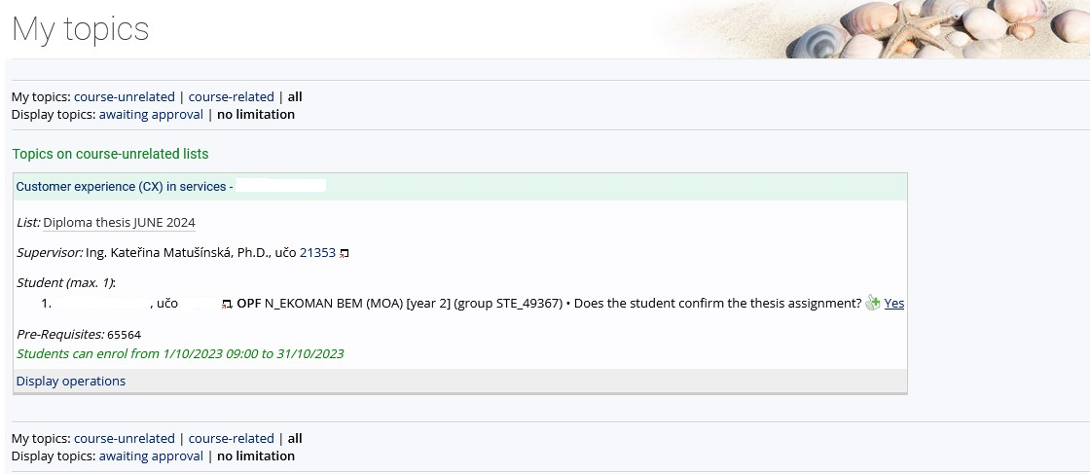
Work in IS
Student can see the topic of the thesis and his/her name
Now you can click on „display operations“ and after that you can edit title, content or literature

Slide 30
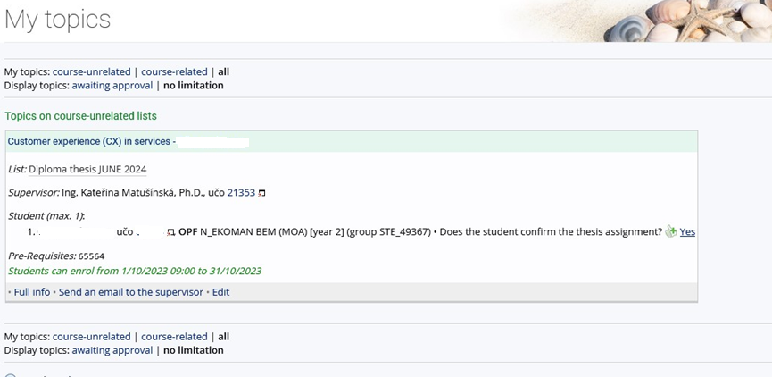
Work in IS
Now, you can see all available operations, most important is EDIT

Slide 31
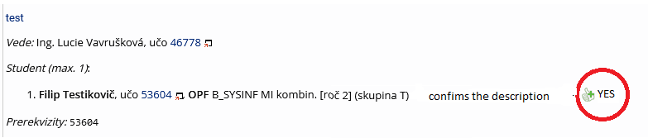
Work in IS
Final step:
The student must approve the correctness of the entered assignment in the IS SU.
CONFIRM THE WORD YES ONLY WHEN THE ASSIGNMENT IS COMPLETE AND CORRECT.

Slide 32
Citation methods in the text of the FT
All that is stated in the References in the wording of full bibliographic citations, must be continuously cited in the text, and the student uses the abbreviated citation method (the Harvard citation system), i.e. the surname of the author or authors (year of publication, in the case of direct or indirect citations the page or the range of pages, is stated).

Slide 33
Citation methods in the text of the FT
Smith (2020)
Smith (2020, p. 125)
Smith (2020, pp. 125-127)
Differences?

Slide 34
Citation methods in the text of the FT
The taken text can be cited in the following forms:
a) Direct citation - the text is taken literally from the original work and is in quotation marks.
b) Indirect citation (paraphrase) - the text is interpreted from the original work in own words, without changing the meaning of the text.
c) Citation for the entire work - only given if the author refers to the whole original work.

Slide 35
Citation methods in the text of the FT
Direct citation:
Novák (2010, p. 26) states that "the main drivers of the financial crisis were the US real estate price bubble, the lack of regulation of financial market supervision and the failure of credit rating agencies."
According to Pokorný and Polák (2007, p. 29), "the most significant risk for the Chinese economy for the next decade is the possibility of a sharp rise in inflation."
"The economic recession is usually accompanied by a decline in economic performance and an increase in the unemployment rate." (Novotný 2009, p. 297).

Slide 36
Citation methods in the text of the FT
Indirect citation:
As stated by Wang (2010, p. 96), the entry price is the value from which the assets are depreciated.
Significant factors of the economic recession in the Czech Republic included lower economic activity of companies due to the fall in exports and insufficient household consumption (Novak 2010, pp. 25-70).

Slide 37
Citation methods in the text of the FT
Citation for the whole work
The theory of macroeconomic shocks is described by Novotny (2009).
The most important contemporary textbook on marketing management is considered to be the textbook by Kotler and Keller (2013).
Banker et al. (2004) believe that the socialist economy showed a slowdown in the 1980s.

Slide 38
Dean's Instruction No. 3/2024 - Editing, Publishing and Storing Final Theses
https://www.slu.cz/opf/en/file/cul/c3371cdb-213b-4f3d-a1ab-9163237f0160

Slide 39
Thank you for your attention
Contact me:
Tomáš Pražák
prazak@opf.slu.cz
MS Teams – Tomáš Pražák
Office: A403

