Slide 1

Research methods I
Master thesis seminar
10.11.2025

Slide 2
You will need a pen and paper
(or digital notes)

Slide 3
Content
Research principles
Critically reviewing the literature
Data – information - knowledge
Using secondary data
Collecting primary data

Slide 4
1
Research principles

Slide 5
Research
Research is about systematically obtaining and analysing data to increase a knowledge about a topic in which we are interested. In undertaking research, we are trying to answer a question or address a problem, this often being referred to as ‘meeting the research aim’ or ‘addressing the research objectives’.
Rojon a Saunders, 2012

Slide 6


Data = evidence
No fortune telling
No philosophical views

Slide 7
You cannot solve a problem if there isn’t one!
You cannot overcome a challenge if there isn’t one!

Slide 8
Ask yourself: What business or society problem or challenge are you addressing in your master's thesis?
Be specific!

Slide 9
Problem or challenge
Defines a clear direction for the study, avoiding vague or overly broad topics.
Demonstrates the ability to address real-world business challenges, increasing the practical relevance of the research.
Makes it easier for supervisors and evaluators to assess the thesis based on the problem's importance and the effectiveness of the proposed solution.
Helps in developing research question and selecting appropriate methods and data collection techniques tailored to solving the specific problem.
The problem acts as a central reference point for structuring the analysis and discussion in the thesis.

Slide 10
Problem or challenge in various thesis types
Applied Thesis: Focuses on solving practical problems within a company or industry.
Academic/Research Thesis: Emphasizes theory-building or hypothesis testing based on data analysis.
Entrepreneurial Thesis: Involves developing a business plan, strategic plan, or new product/service concept.
All of these types has the same general structure – introduction, theoretical and practical part, recommendations and conclusions. Consult details of the thesis outline with your supervisor.

Slide 11
Applied thesis
An applied thesis focuses on solving a practical, real-world business problem, often for a specific organization or industry.
Purpose is to provide actionable solutions or recommendations based on research findings.
Examples:
  Developing a digital marketing strategy for a local company.
  Improving operational efficiency in a manufacturing firm.
  Optimizing the investment portfolio for a mid-sized asset management firm.
  Designing and/or developing enterprise information system or software application.
Key Elements:
  Problem identification and background analysis.
  Data collection (often involving company-specific data).
  Practical recommendations or implementation plan.

Slide 12
Academic/Research Thesis:
This type of thesis aims to contribute to academic knowledge by exploring theories, testing hypotheses, or building new frameworks.
Purpose is to advance our understanding within a specific area of business and management.
Examples:
  Testing the relationship between employee engagement and productivity in IT sector.
  Examining the effects of corporate social responsibility on brand perception.
  The Impact of Corporate Governance on Firm Performance: An Empirical Analysis of European Listed Companies
Key Elements:
  Literature review about what is already known.
  Rigorous data analysis (quantitative or qualitative).
  Theory development or validation.

Slide 13
Entrepreneurial Thesis
An entrepreneurial thesis focuses on developing a business idea or venture, often involving the creation of a detailed business plan or feasibility study for a new product, service, or start-up company.
Purpose is to apply entrepreneurial theories and frameworks to create a viable business concept, demonstrating market understanding and strategic planning skills.
Examples:
  Business plan for a tech start-up specializing in AI-driven customer service.
  Developing a feasibility study for a sustainable e-commerce platform targeting eco-conscious consumers.
  Designing a go-to-market strategy for a new mobile app targeting health.
Key Elements:
  Market Research, Value Proposition, Business Model, Financial Plan, Implementation Plan, etc.

Slide 14
Research question
It is a central theme of any research.
Every aspect of research must aim to answer it.
It determines the research strategy not the other way around!
It goes beyond the horizon of identifying the subject and object of research.
You can find explanation and examples here: https://www.youtube.com/watch?v=42-d2HdbyS8

Slide 15
Research question examples
What?
  What makes our employees leave for our competitors?
When?
  When is the optimal time for firms to engage in mergers and acquisitions within the banking sector?
Where?
  Where in the software development lifecycle can AI tools be integrated to achieve the highest productivity gains?

Slide 16
Research question examples
Who?
  Who are the most influential opinion leaders in shaping consumer preferences for sustainable products?
How?
  How can a start-up leverage crowdfunding to finance its product launch?
Why?
  Why do companies outsource marketing research?

Slide 17
If you have a question, you can start searching for answers.
First step in master thesis is to look into literature.

Slide 18
2
Critically reviewing the literature

Slide 19

Literature review is part of every thesis

Slide 20
Literature review main purpose
To discover explicit recommendations for further research. These can provide you with a superb justification for your own research question(s) and objectives;
to help you to avoid simply repeating work that has been done already;
to discover and provide an insight into research approaches, strategies and techniques that may be appropriate to your own research question(s) and objectives.
Saunders et al., 2009. Research methods for business students

Slide 21
Literature review specific purpose
Applied Thesis:
Provides a theoretical foundation for understanding the business problem being addressed.
Helps identify best practices, frameworks, and solutions previously applied in similar contexts.
Supports the development of a baseline analysis of the industry or company situation, guiding the methodology and practical recommendations.
Serves as a "cookbook" for writing the practical part, offering a step-by-step guide on how to structure the analysis, choose methods, and apply theoretical concepts effectively.

Slide 22
Literature review specific purpose
Academic/Research Thesis:
Establishes the theoretical background and existing body of knowledge related to the research topic.
Helps in identifying key theories, models, and hypotheses that will be tested or expanded upon in the thesis.
Reviews existing empirical studies, providing a foundation for the research questions and the formulation of hypotheses.
Identifies gaps in the literature, highlighting areas where further research is needed and justifying the study’s relevance.
Guides the choice of research methodology and data analysis techniques by reviewing standard approaches used in similar studies.

Slide 23
Literature review specific purpose
Entrepreneurial Thesis:
Reviews theoretical frameworks related to entrepreneurship, innovation, and business planning, which can be used to structure the business model.
Identifies successful strategies and pitfalls from previous start-up ventures, offering lessons learned for the new business concept.
Serves as a "cookbook" for writing the practical part, offering a step-by-step guide on how to structure the analysis, choose methods, and apply theoretical concepts effectively.

Slide 24
What is to be critical
To criticize normally means something negative:
  The flood situation is critical
  Critically endangered antelope species
  The patient's condition is critical
  Diplomats criticize Obama's actions
All science is built on the ability of people (peer reviewers) to critically evaluate other people‘s work.

Slide 25
What is to be critical
Ability to assess the validity and strength of arguments
Ability not to take information as automatically true and valid
Ability to see the wider context
Ability to critique using counter-arguments and provide effective feedback
Ability to critically evaluate one's own work

Slide 26
3
Data – information - knowledge

Slide 27
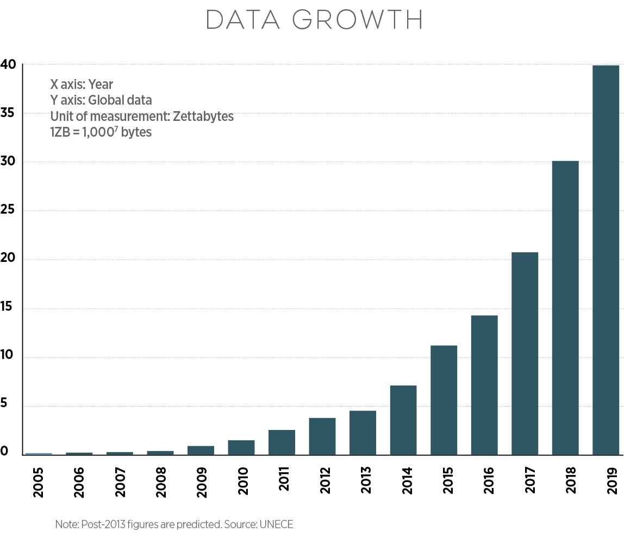
Data, information, knowledge

Slide 28
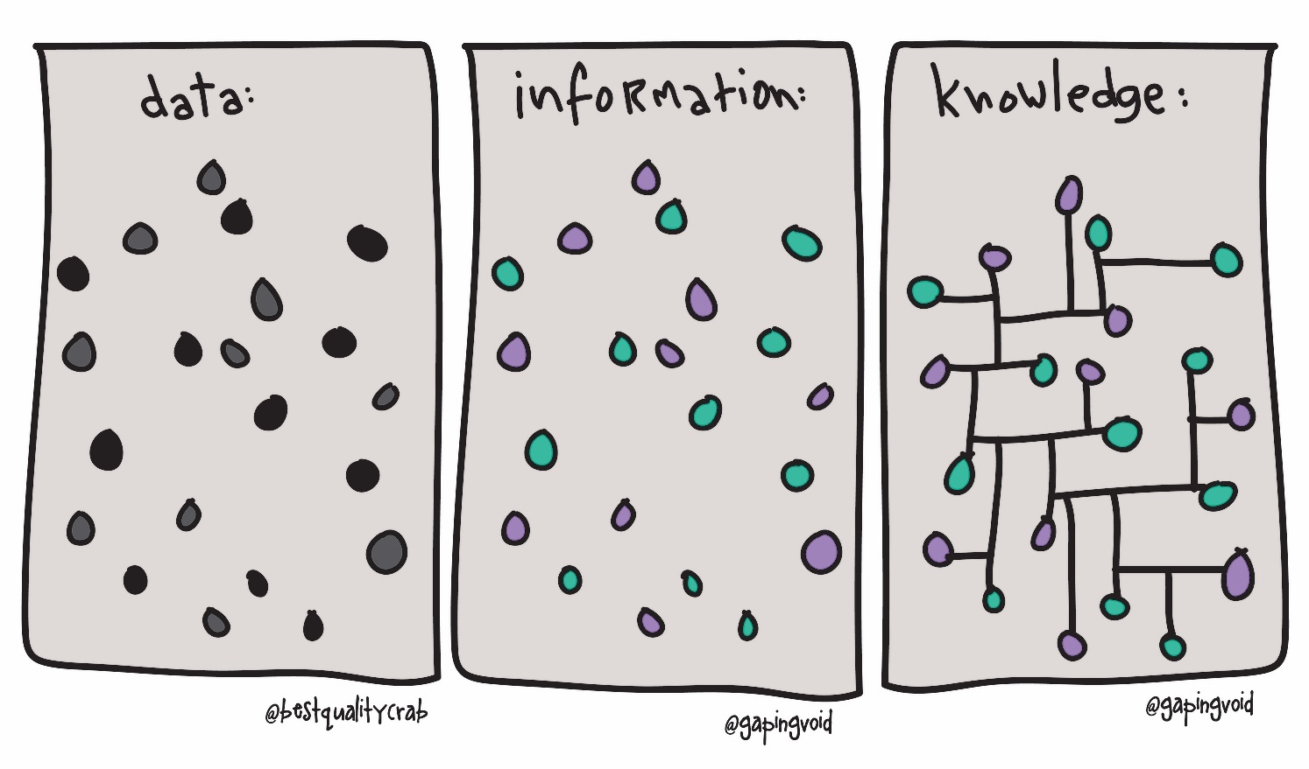

Slide 29
Data and information differences
Data is the most basic form of knowledge, e.g. the brand of butter sold to a particular customer in a certain town. This statistic is of little worth in itself but may become meaningful when combined with other data.
Information is a combination of data that provide decision-relevant knowledge, e.g. the brand preferences of customers in a certain age category in a particular geographic region.

Slide 30
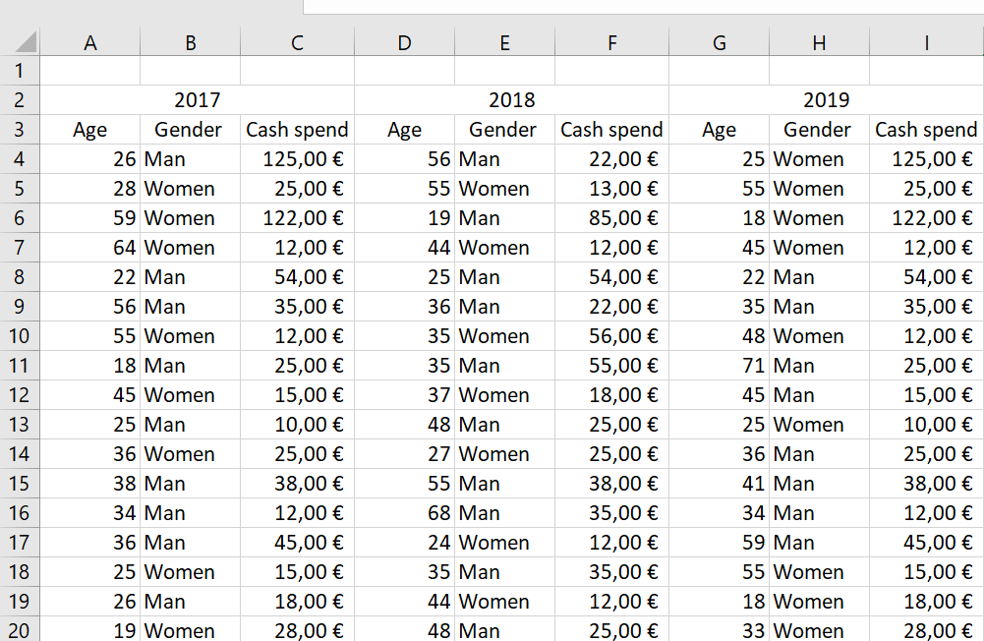
Can we make decision based on these customer data?

Slide 31
Age | 2017 | 2018 | 2019
18-29 | 15% | 10% | 6%
30-39 | 18% | 13% | 13%
40-49 | 26% | 22% | 15%
50-59 | 18% | 24% | 21%
60-69 | 15% | 18% | 25%
70+ | 8% | 13% | 20%

Slide 33
Notes:
Propojením informací vznikají znalosti.
Informace je základní stavební kámen komunikace

Slide 34
Research data types
Primary data
  Do not exist at the beginning of the research project
  Data collected throughout the project
Secondary data
  Data already existing
  Reports, statistical data, business data, reused data, analytical data.

Slide 35
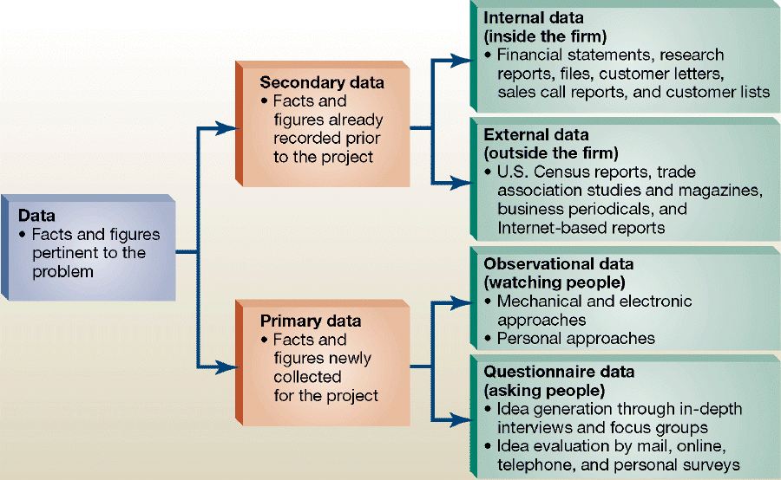

Slide 36
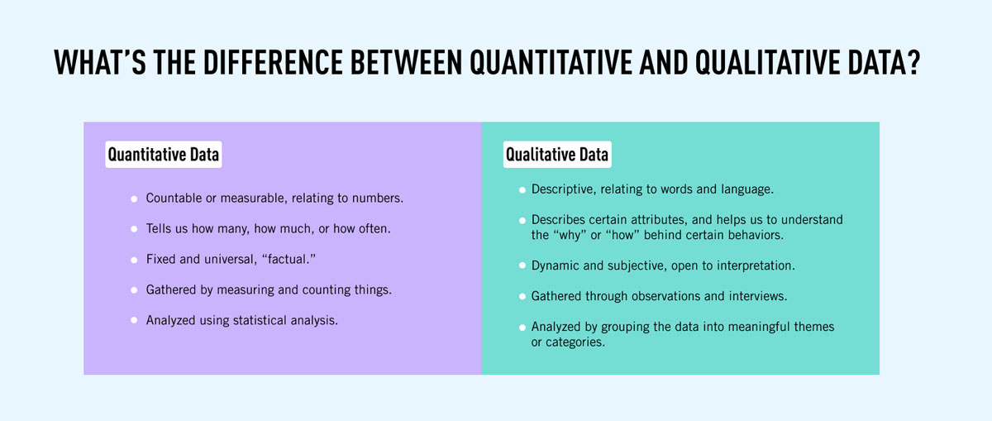

Slide 37
4
Using secondary data

Slide 38
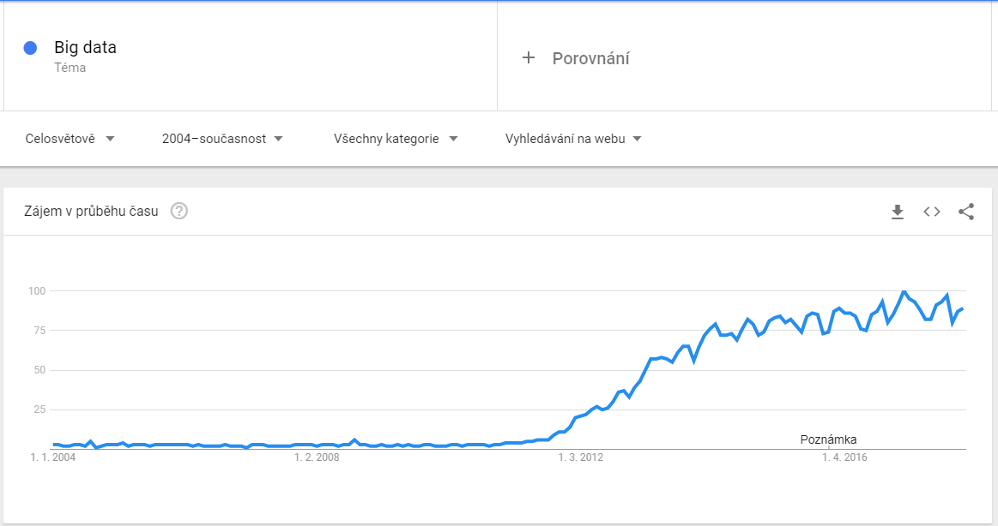

Slide 39
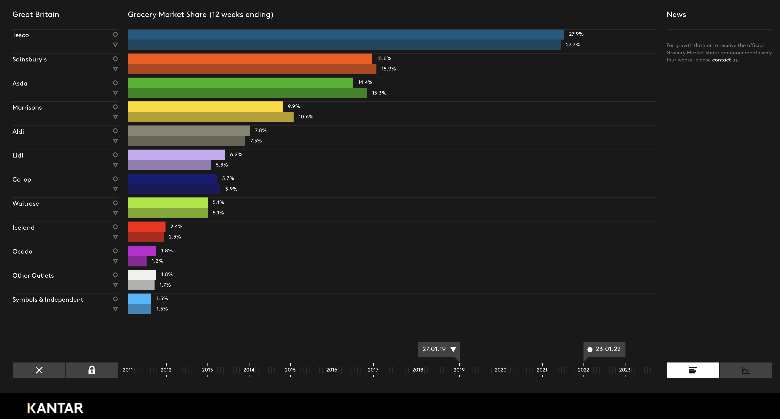
https://www.kantarworldpanel.com/

Slide 40
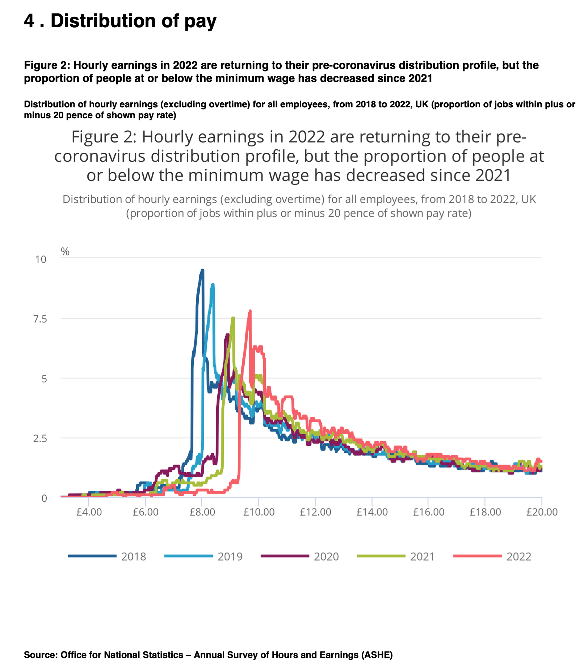
https://www.ons.gov.uk/employmentandlabourmarket/peopleinwork/earningsandworkinghours/bulletins/lowandhighpayuk/2022

Slide 41
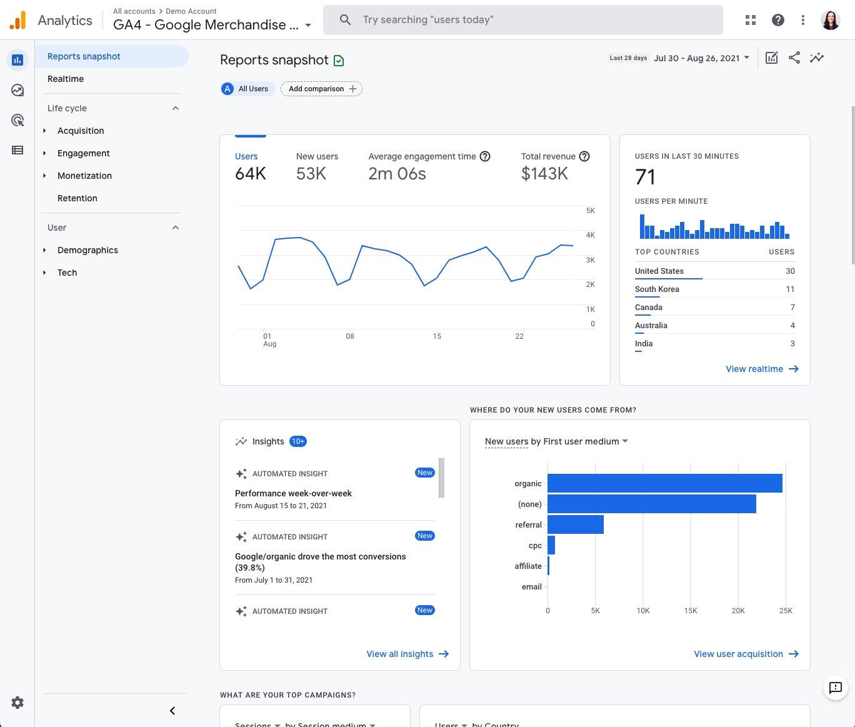

Slide 42
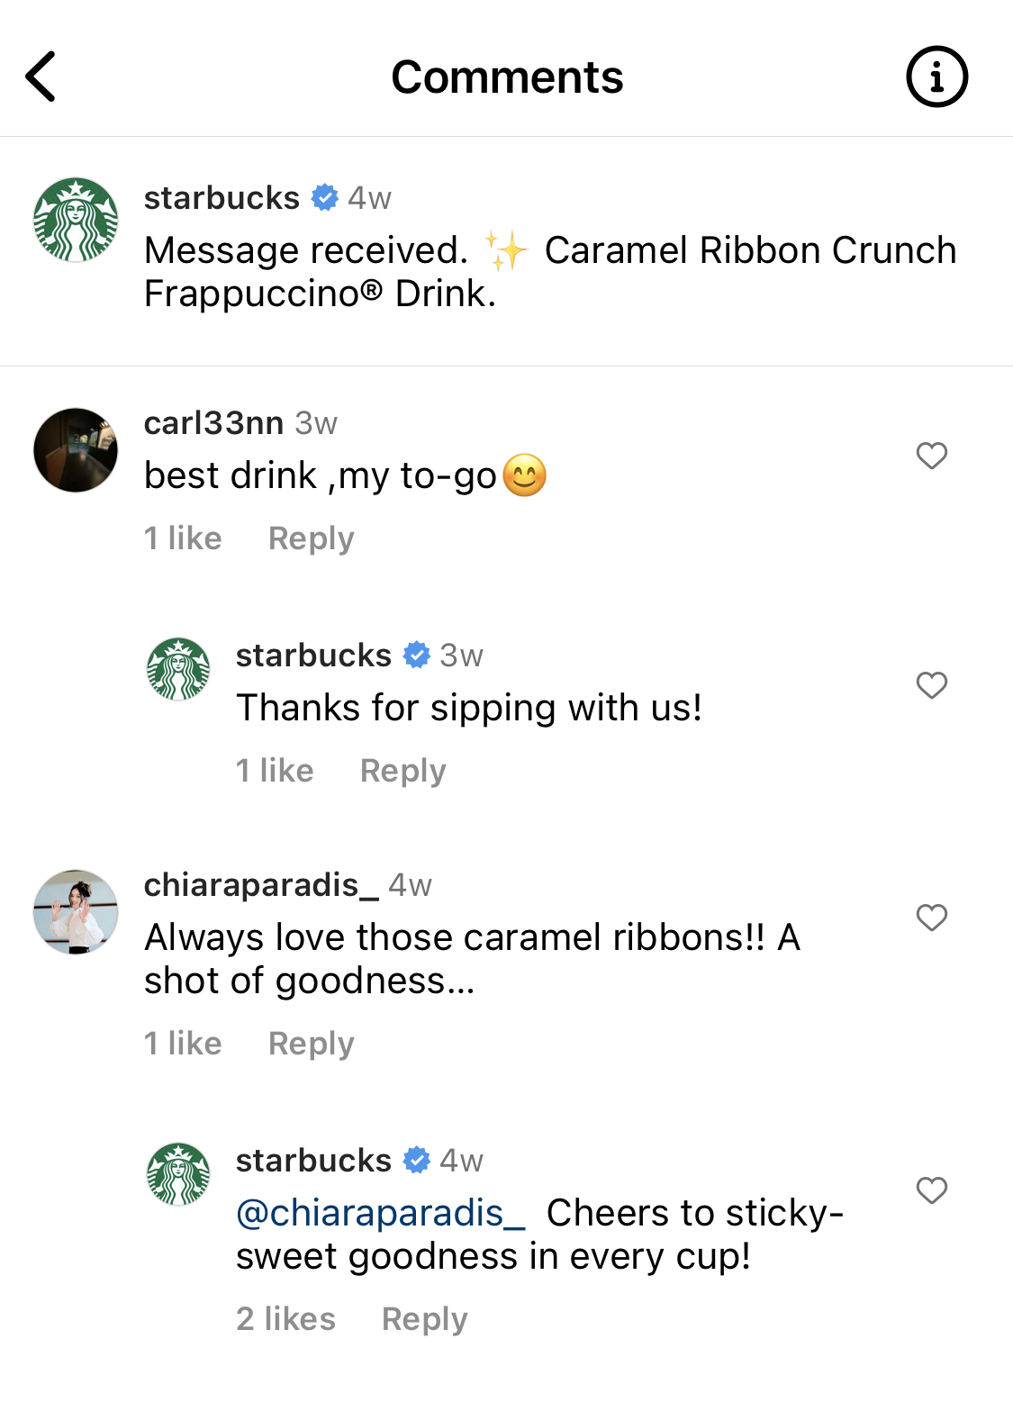

Slide 43
Advantages of secondary data
Cost and Time Efficiency:
Secondary data is typically less costly and quicker to obtain than primary data. Since it's already collected and often readily accessible, researchers can save significant resources in terms of both time and money.

Slide 44
Advantages of secondary data
Broad Scope and Variety:
Secondary data can provide a broad perspective that primary data might not be able to offer. It often includes a wide range of information collected for various purposes that can be useful for comprehensive research.

Slide 45
Advantages of secondary data
Longitudinal Analysis:
It enables researchers to conduct longitudinal studies, examining trends and developments over time, which would be resource-intensive or impossible to do using primary data.

Slide 46
Advantages of secondary data
Comparative Studies and Benchmarking:
Secondary data allows for comparisons across different studies, sectors, or countries. It can be used for benchmarking against industry standards or competitors.

Slide 47
Advantages of secondary data
Feasibility and Preliminary Insights: It helps in assessing the feasibility of research projects. Researchers can use secondary data to gain preliminary insights into a topic, which can guide the design and approach of primary research.
Supporting Primary Data: Secondary data can complement and reinforce findings from primary research, adding depth and context to the analysis.

Slide 48
Disadvantages of secondary data
Relevance Issues: The data may not be entirely relevant to the current research objectives or questions, as it was collected for a different purpose.
Quality and Accuracy Concerns: The accuracy and reliability of secondary data can be questionable, especially if the sources are not credible or the data collection methods were flawed.
Outdated Information: Secondary data might be outdated, making it less useful for current studies, particularly in fast-changing fields.

Slide 49
“Data collection methods were flawed…”
How do you know?
How can you critically evaluate secondary data?
By understanding the methods of primary data collection.

Slide 50
5
Collecting primary data

Slide 51
Sample and sample size
Sample is a part of population which, when collected properly, can produce results which are generalizable.
Greater the sample size more reliable the results are.
Reality = Parametr + Error
Population
People
Data
Statistics
Parametr
Sample

Slide 52
Sample and sample size
Two questions we need to adress:
  Who?
  How much?
Population
People
Data
Statistics
Parametr
Sample

Slide 53
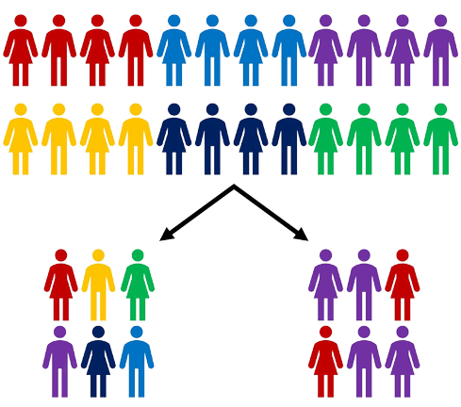

Slide 54
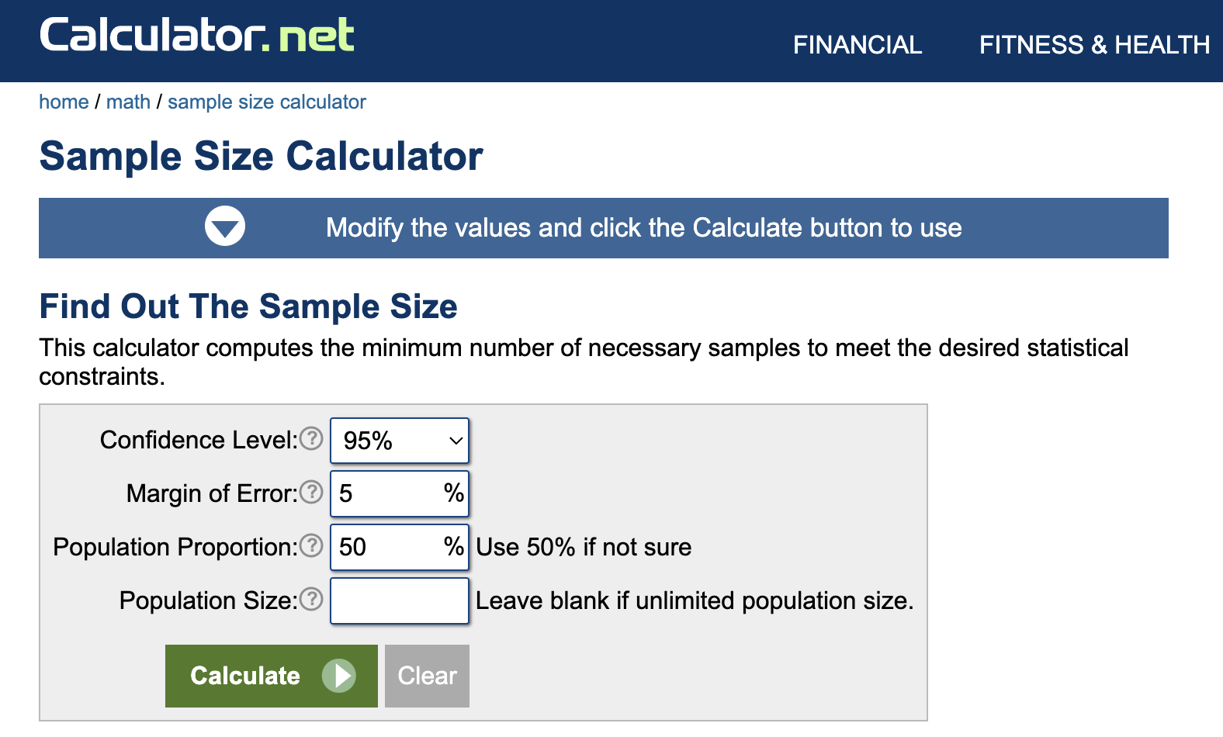
Minimum sample size

Slide 55
Favourite colour example
In a class, teacher ask students what is their favourite colour.
The realtime results goes like this:
Respondent | Answer | Results PINK in % | Results GREEN in % | Change
1 | Pink | 100 | 0 | No data
2 | Green | 50 | 50 | 50%
3 | Green | 33,5 | 66,5 | 16,5%
4 | Pink | 50 | 50 | 16,5%
5 | Green | 40 | 60 | 10%
6 | Green | 33,5 | 66,5 | 6,5%
7 | Green | 28 | 72 | 5,5%
8 | Pink | 37 | 63 | 9%
9 | Pink | 44 | 56 | 7%
10 | Pink | 50 | 50 | 6%

Slide 56

Sample size in qualitative studies
The data collection takes place as long as there is no condition in which further examination of the selected sample does not bring new substantial information.
Theoretical saturation
The goal of qualitative research is not generalization, so it is not the aim of the results to relate to the whole population but to reveal the connections and causes of a certain behavior of customers.

Slide 57
Primary data collection methods
Survey
  Interview
  Questionnaire
Observation
Experiment

Slide 58
Data collection techniques - qualitative
Deep interviews
Focus group discussions
Expert consultations
Observation

Slide 59
Data collection techniques - quantitative
Face to face interviews
Telephone interviews
Postal survey
Electronic survey
Observation
Experiment

Slide 60

Validity
Valid questions are those that give us answers exactly what we ask - what is the main goal of research.

Slide 61
Reliability
It expresses the degree of sustainability of research tools.
To what extent the question remains reliable and still valid in further iterations - for example, in other time, social and cultural conditions.

Slide 62
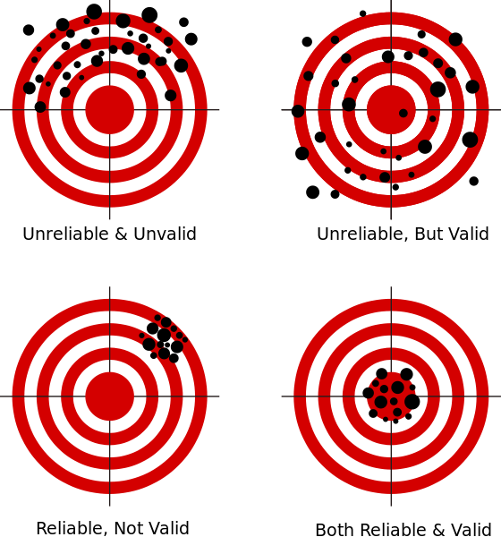

Slide 63
Type of questions
Open
Complete open
Open ended
Categorical
Scales
Dichotomic
Multiple
Labeled
Unlabeled
One answer
Multiple

Slide 64
Case Example

Slide 65
Defining the Research Question: You start by clearly defining your research question: "Do students who study a little every day score higher on tests compared to those who cram the night before?"
Literature Review: You do some background research by looking up existing studies or articles about study habits and academic performance. This helps you understand what's already known and how your research could add to it.
Hypothesis Formation: Based on your background research, you form a hypothesis, like "Students who study regularly will have higher test scores than those who cram."
Designing the Methodology: You decide how you will conduct your research. You choose to survey your classmates, asking about their study habits and recent test scores.

Slide 66
Data Collection: You systematically collect data by distributing your survey to a representative sample of students in your school.
Data Analysis: Once the surveys are returned, you analyze the data, looking for patterns and correlations between study habits and test scores.
Interpreting Results: Based on your analysis, you draw conclusions. For example, you might find that regular study leads to better scores, supporting your hypothesis.
Reporting: You prepare a report or presentation summarizing your research process, findings, and conclusions.
Reflecting on Limitations: You also consider any limitations of your study (like sample size or self-reported data) and suggest areas for further research.

Slide 67
Thank you

