Slide 1

The Enterprise theory
-
Cost function
Inventory
Net profit
.
Tomáš Pražák

Slide 2
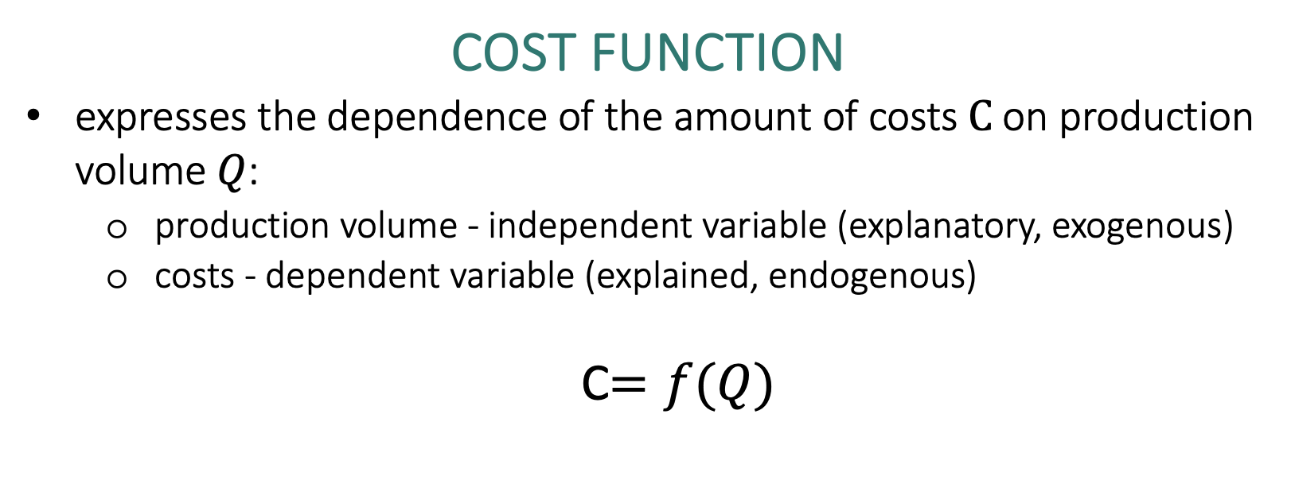
Cost function
expresses the dependence of the amount of costs$C$ on production volume $Q$:
  production volume - independent variable (explanatory, exogenous)
  costs - dependent variable (explained, endogenous)
  C$=f(Q)$

Slide 3
C = f ( Q ) = ( v x Q ) + F
C = V + F
where
F … total fixed costs [CZK]
v … unit variable costs [CZK/piece, CZK/kg, CZK/l, …]
V … total variable costs
Q … volume of production [pcs, kg, l, …]

Slide 4
  Use of cost functions in business practice
how the amount of costs changes depending on the volume of production
which part of the costs is dependent on the volume of production and which is not
the starting point for a more qualified decision in a number of areas:
  determine the amount of costs corresponding to different volumes of production
  competently determine the economic result
  determine what volume of production ensures the desired profit

Slide 5
Example: Lovers of theatrical performances of the children's theater can purchase a year-long season ticket for 2 children. The price of this season ticket is CZK 2,000. The entrance fee for one performance for one child in a popular line in the theater is 150 CZK.
What are the costs associated with visiting three shows with/without a season ticket if two children go to the theater?
How many times does a pair of children have to visit the theater to make the purchase of a season ticket worth it?

Slide 6
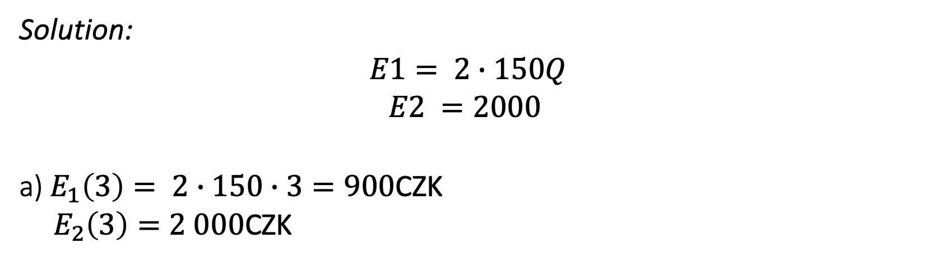
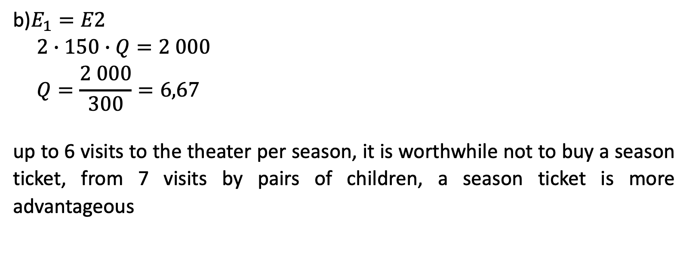
Solution:
$$E1= 2∙150Q$$
$$E2 =2000$$
a) $E_{1}\left(3\right)= 2∙150∙3=900$CZK
${ E}_{2}\left(3\right)=2 000$CZK
b)$E_{1}=E2$
$$2∙150∙Q=2 000$$
$$Q=\frac{2 000}{300}=6,67$$
up to 6 visits to the theater per season, it is worthwhile not to buy a season ticket, from 7 visits by pairs of children, a season ticket is more advantageous

Slide 7
The two-period method
it only works with data on two periods - with the maximum production volume Q _{MAX} and with a minimum production volume Q _{MIN} and their corresponding costs C _{QMIN} and C _{QMAX}
we insert the data into the general form of the cost function and then solve the resulting system of two linear equations
it should not be a period however extraordinary
C _{Qmax} = (v x Q _{max} ) + F
C _{Qmin} = (v x Q _{min} ) + F

Slide 8
Example: The following table shows data on production volumes and total costs in individual months of last year of the company XYZ, s.r.o. Use the two-period method to determine the cost function.
 | Production volume [pcs] | Costs [CZK]
January | 10,500 | 165,000
February | 9,500 | 148,000
March | 9,000 | 145,000
April | 10,600 | 151,000
May | 10,400 | 163,000
June | 9,200 | 148,000
July | 8,500 | 135,000
August | 9,600 | 145,000
September | 10,000 | 167,000
October | 10,800 | 158,000
November | 11,000 | 162,000
December | 10,900 | 161,000

Slide 9
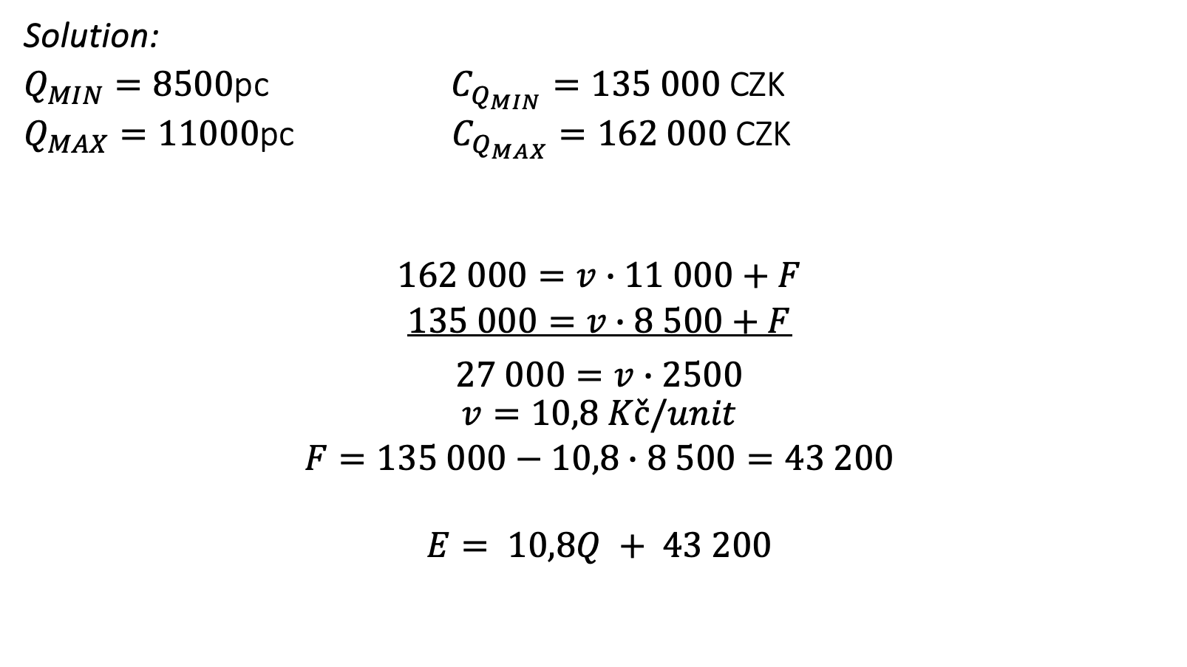
Solution:
$Q_{MIN}=8500$pc $C_{Q_{MIN}}=135 000$CZK
$Q_{MAX}=11000$pc $C_{Q_{MAX}}=162 000$ CZK
$$162 000=v∙11 000+F$$
$$135 000=v∙8 500+F$$
$$\begin{matrix}27 000=v∙2500 \\ \begin{aligned}v=10,8 Kč/unit \\ F=135 000−10,8∙8 500=43 200 \\ \\ E= 10,8Q + 43 200\end{aligned}\end{matrix}$$

Slide 10
The Enterprise theory
-
Purchasing and inventory management
.

Slide 11
  purchase
one of the basic corporate functions
it is implemented by all types of businesses
organizationally secured by the purchasing department

Slide 12
Stages of the buying process
purchase initiation
specification of requirements (necessity, nature, scope)
market analysis of possible suppliers
selection of a suitable supplier
wording of the order
implementation of logistics activities associated with the entry of the delivery into the company
delivery payment
supplier performance evaluation

Slide 13
  Stocks
  current assets of the business
  the result of a purchase or business activity
  they always bind themselves with funds
  To have or not to have? Can you do business without inventory?

Slide 14
  Types of supplies
I. Classification of stocks by species
production stocks:
  raw materials, basic material, operating substances, spare parts, packaging
  tangible assets whose consumption period is less than 1 year
work in progress inventory
stocks of finished goods
goods

Slide 15
II. Breakdown of stocks according to functional components
current stock – to ensure expected consumption in the period between two deliveries
insurance stock – to cover possible deviations in supplies or consumption
technological stock – if the material needs to be modified before it is released for consumption, its amount results from the production technology

Slide 16
seasonal ( occasional ) supply – compensates for expected fluctuations in supply or consumption
speculative stock - to achieve an extraordinary profit by a suitable purchase
emergency stock - ensures the survival of the business in the event of unforeseen events

Slide 17
III. Breakdown of stocks according to capacity calculations
minimum stock – stock status at the moment before a new delivery
maximum stock – the highest stock level reached at the time of a new delivery
immediate stock :
  actual physical inventory - the actual stock level in the warehouse
  disposition stock – actual stock reduced by already applied requirements for delivery (goods ready for dispatch)
  balance stock – disposition stock increased by the size of stock deliveries ordered but not yet received (material on the way)

Slide 18
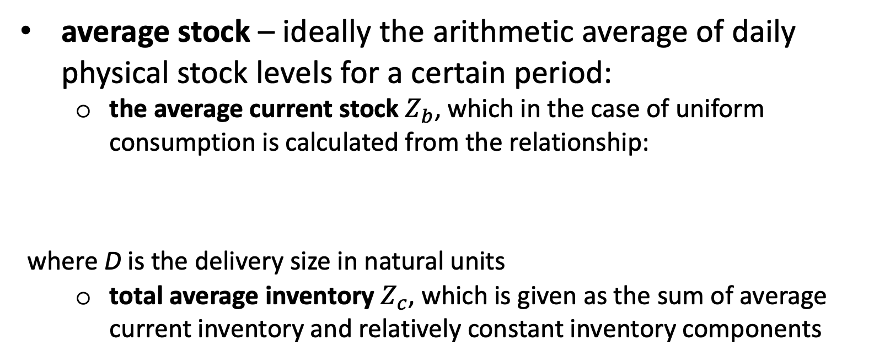
average stock – ideally the arithmetic average of daily physical stock levels for a certain period:
  the average current stock $Z_{b}$, which in the case of uniform consumption is calculated from the relationship:
where D is the delivery size in natural units
  total average inventory $Z_{c}$, which is given as the sum of average current inventory and relatively constant inventory components

Slide 19
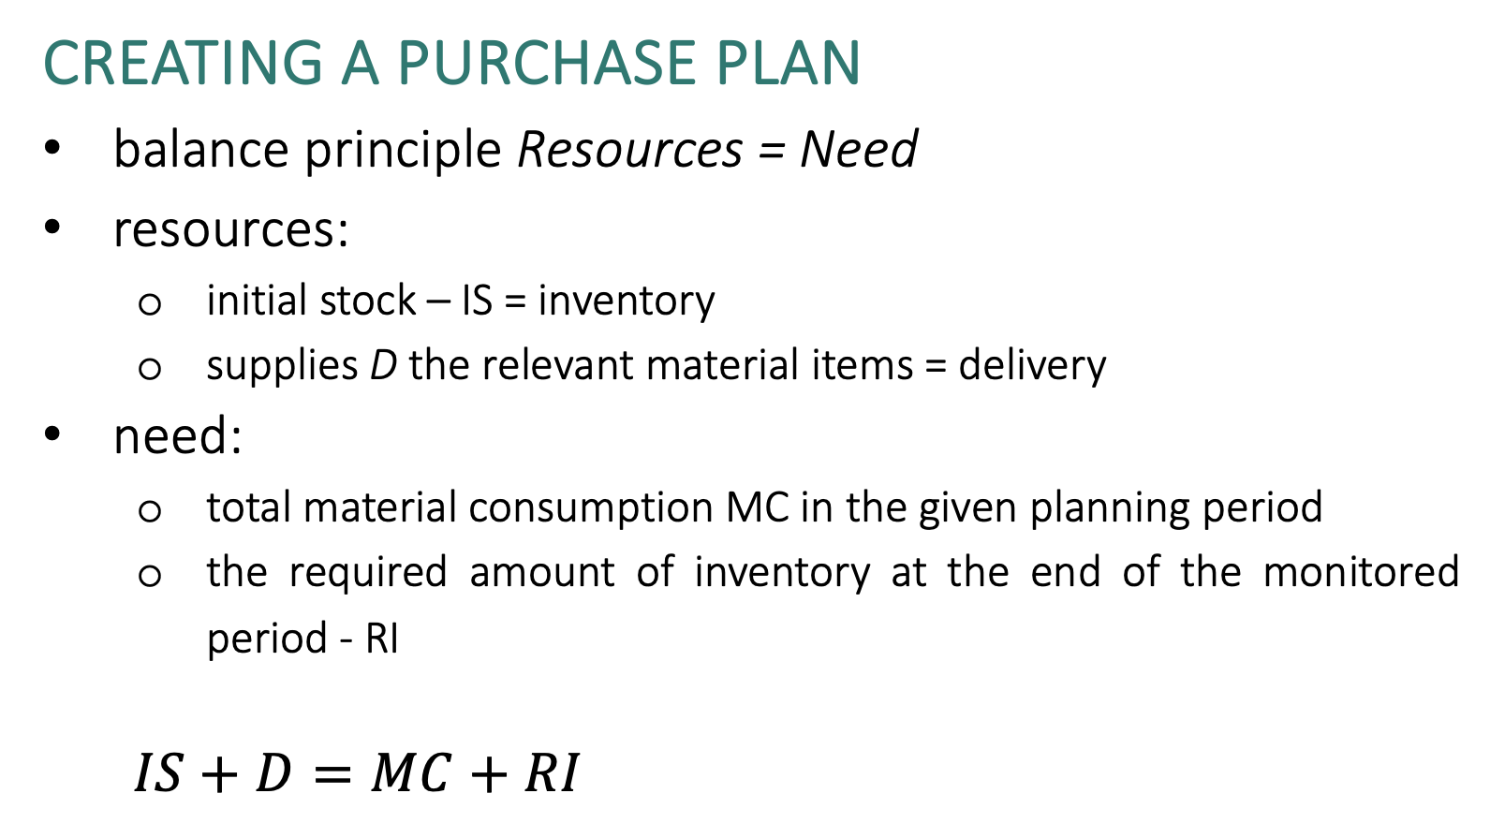
  Creating a purchase plan
balance principle Resources = Need
resources:
  initial stock – IS = inventory
  supplies D the relevant material items = delivery
need:
  total material consumption MC in the given planning period
  the required amount of inventory at the end of the monitored period - RI
  $IS+D=MC+RI$

Slide 20
  The hotel is planning shopping activities for the next month of November. On average, 600 liters of juice are consumed in the hotel per day. Juices are stored in 0.5 l bottles. At the end of November, the hotel plans to have a stock of 2,500 bottles. At the beginning of November, this stock will be 2,600 bottles. How many bottles of juice must the hotel order for November?

Slide 21
  Resources = Needs
  No. inventory + purchase (delivery) = consumption + ending inventory
  2600 + x = 36000 + 2500
  Purchase = 35,900 pcs

Slide 22
Sales
S = (p x Q )
where
p ... selling price per piece [CZK/piece]
Q … volume of production [pcs, kg, l, …]

Slide 23
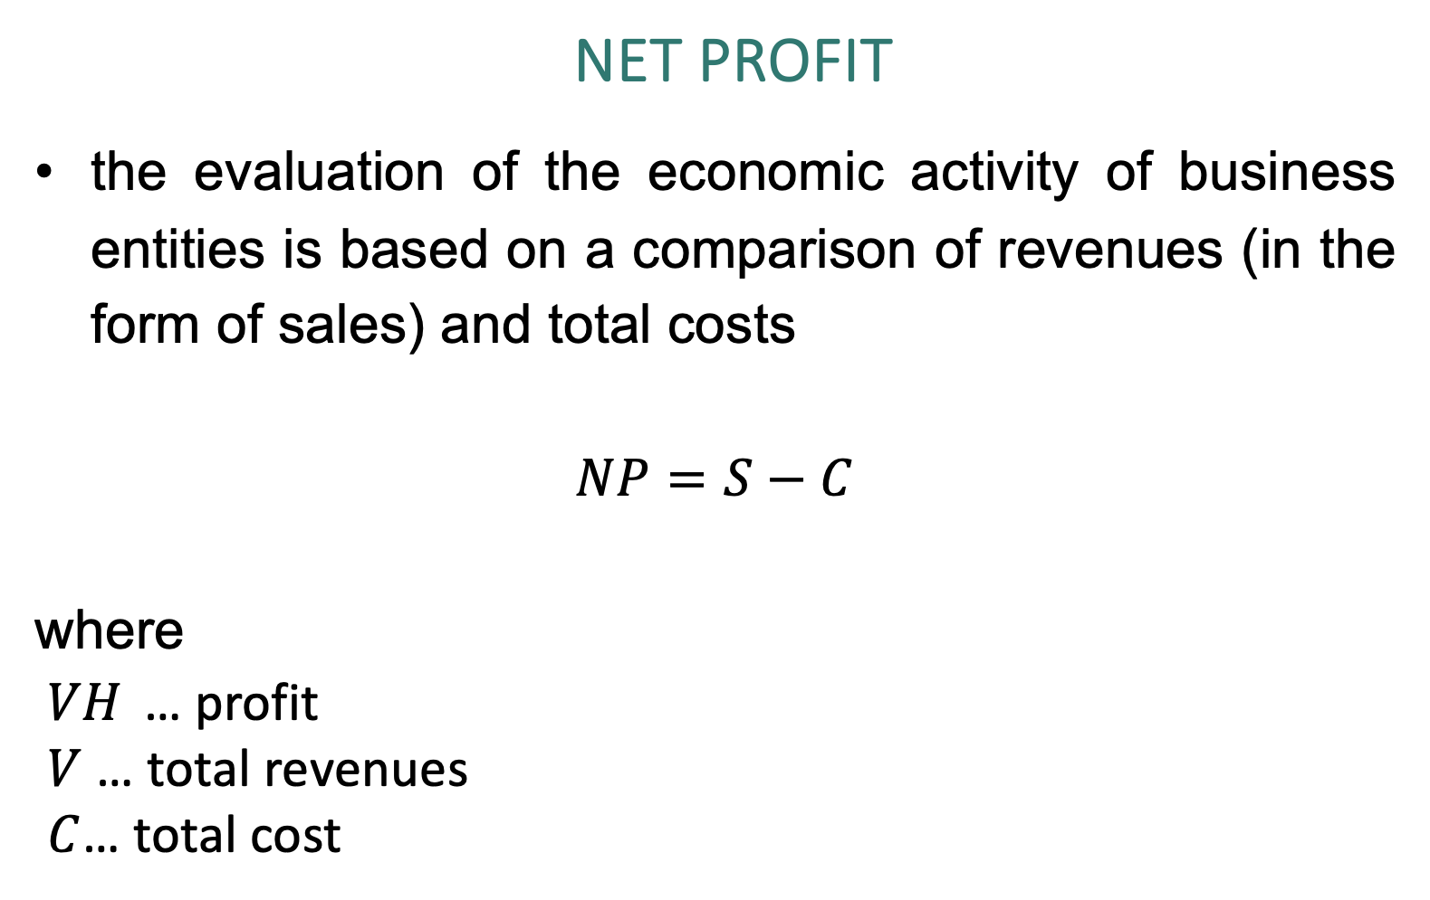
NET Profit
the evaluation of the economic activity of business entities is based on a comparison of revenues (in the form of sales) and total costs
$$NP=S−C$$
where
$VH$ … profit
$V$ … total revenues
$C$… total cost

Slide 24
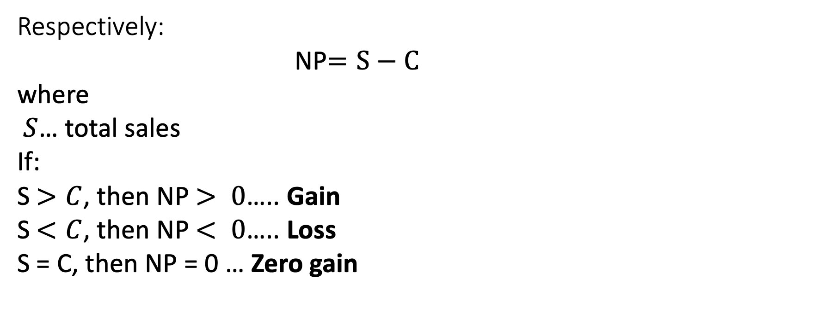
Respectively:
NP$=S−C$
where
$S$… total sales
If:
S$>C$, then NP$> 0$….. Gain
S$<C$, then NP$< 0$….. Loss
S = C, then NP = 0 … Zero gain

Slide 25

If we substitute
S$= p  Q$
C$=V+ F$
C$=v  Q + F$
to NP
then
NP$=(p ∗ Q) –\left(v ∗ Q+ F\right)$

Slide 26
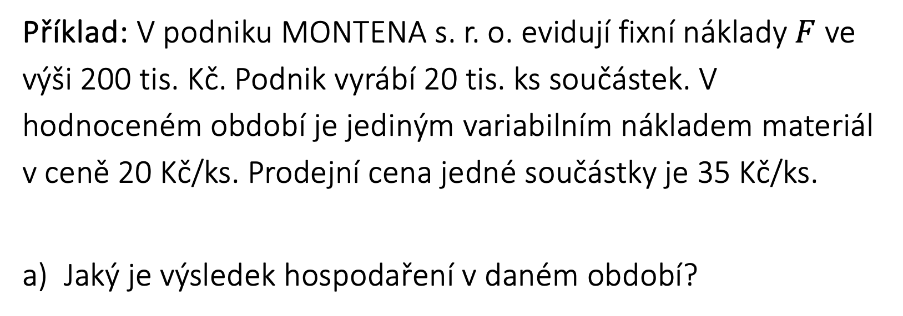
Example: In the company MONTENA s.r.o. they record fixed costs $F$in the amount of 200 thousand. CZK. The company produces 20 thousand pcs of components. In the evaluated period, the only variable cost is material at a price of CZK 20/piece. The selling price of one component is 35 CZK/pc.
What is the economic result in the given period?

Slide 27
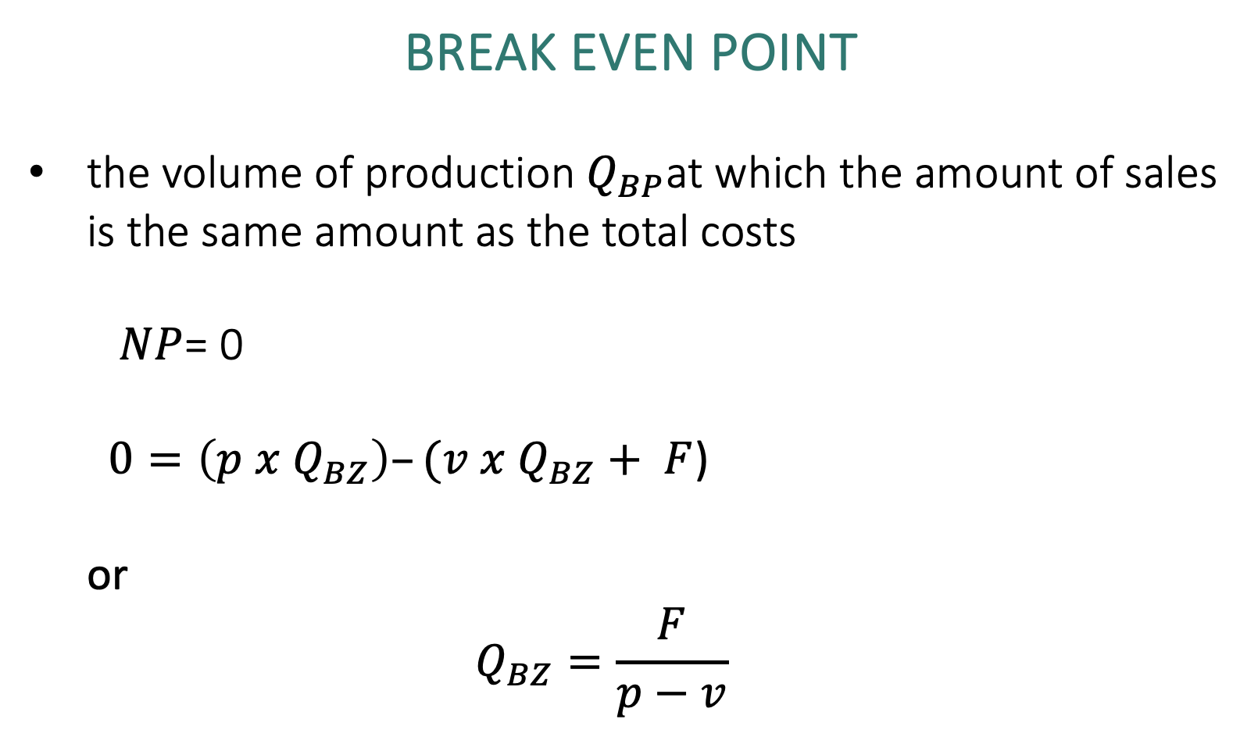
Break Even point
the volume of production $Q_{BP}$at which the amount of sales is the same amount as the total costs
  $NP$= 0
  $0=\left(p x Q_{BZ}\right)–(v x Q_{BZ}+ F$)
  or
  $$Q_{BZ}=\frac{F}{p−v}$$

Slide 28
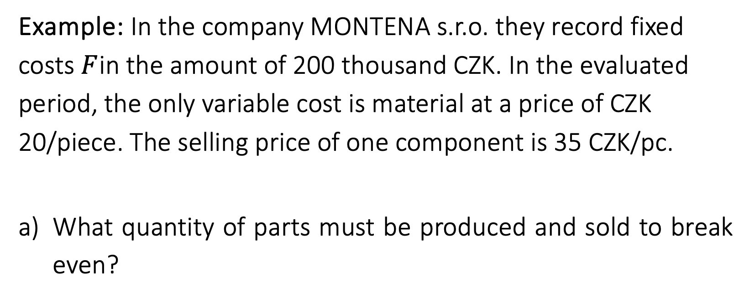
Example: In the company MONTENA s.r.o. they record fixed costs $F$in the amount of 200 thousand CZK. In the evaluated period, the only variable cost is material at a price of CZK 20/piece. The selling price of one component is 35 CZK/pc.
What quantity of parts must be produced and sold to break even?

