Slide 1

Capital Structure and Financial Leverage
Ing. Žaneta Rylková, Ph.D.
Managerial Economics

Slide 2
Economic problem 1
A company with an EBIT of CZK 4 000 000 uses a total capital of CZK 16 000 000. How does its financial leverage function if the interest rate on its debt is 9% per annum?

Slide 3
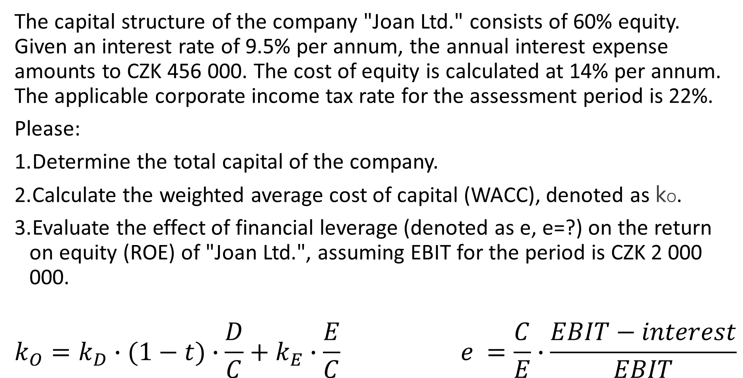
Economic problem 2
The capital structure of the company "Joan Ltd." consists of 60% equity. Given an interest rate of 9.5% per annum, the annual interest expense amounts to CZK 456 000. The cost of equity is calculated at 14% per annum. The applicable corporate income tax rate for the assessment period is 22%.
Please:
Determine the total capital of the company.
Calculate the weighted average cost of capital (WACC), denoted as kO​.
Evaluate the effect of financial leverage (denoted as e, e=?) on the return on equity (ROE) of "Joan Ltd.", assuming EBIT for the period is CZK 2 000 000.
$$k_{O}=k_{D}∙(1−t)∙\frac{D}{C}+k_{E}∙\frac{E}{C} e =\frac{C}{E}∙\frac{EBIT−interest}{EBIT}$$

