Slide 1

Seminar to the lecture 9: Inventory management
Ing. Žaneta Rylková, Ph.D.
Managerial Economics

Slide 2
Economic problem 1
On average, 0.6 liters of fruit drink are consumed to prepare one portion of breakfast for customers at the EURO Hotel in Opava. The hotel operates 24 hours a day, including Saturdays, Sundays, and public holidays, and serves 80 breakfasts per day.
At the beginning of June (30 days) and July (31 days), the stock of fruit drinks corresponds to four days’ worth of consumption.
Tasks:
Calculate the total fruit drink consumption in June and July.
Determine the amount of fruit drink delivery required in June.
Identify the deadline for the first fruit drink delivery in July.

Slide 3
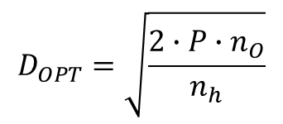
Economic problem 2
Son, an entrepreneur, is working on optimizing his inventory and determining the optimal delivery size. He is aware that the activities preceding each order are quite demanding, costing CZK 5 000 per delivery. In addition, transport costs are CZK 10 000 per delivery, and acceptance costs amount to CZK 5 000.
He has calculated that the annual holding cost per unit of material is CZK 50, which includes interest paid on trade loans used to finance inventory. On top of that, the cost of operating the warehouse and maintaining inventory records is CZK 150 per unit.
The initial stock of material is 9 000 units, and the required final stock is 12 000 units. The price per unit of material is CZK 1 500, and the planned annual consumption of material is 100 000 units.
Determine:
The optimal delivery size
The number of deliveries per year
$$D_{OPT}=\sqrt{\frac{2∙P∙n_{O}}{n_{h}}}$$

