Slide 1

Strategic Management
Course Information: https://is.slu.cz/predmet/opf/zima2024/PEMNASMA?lang=en
Consultation: Wednesday and Thursday
(better to have an appointment in advance)
Contact Details: shariq@opf.slu.cz
Room: B205

Slide 2
Important Information
Requirements on students
(Total sum of points 100)
Active participation in seminars and case studies solution –
10% of points
2. Seminar paper and defence of the seminar paper
(no later than 15. 12. 2025) –
10% of points
3. Continuous test
(in the week 27. 10. – 31. 10. 2025) –
20% of points
4. Final written exam –
60% of points
Consultation: Wednesday and Thursday
(better to have an appointment in advance)
Contact Details: shariq@opf.slu.cz
Room: 205

Slide 3
Learning outcomes
Strategic Decision-Making Process
External Environment
  Societal Environment
  Industrial Environment
External Factor Analysis Summary (EFAS)
SWOT & TOWS (Threats & Opportunities)
Strategic Factor Analysis Summary (Threats & Opportunities)
Industrial Organization Model of Above-Average Returns

Slide 4
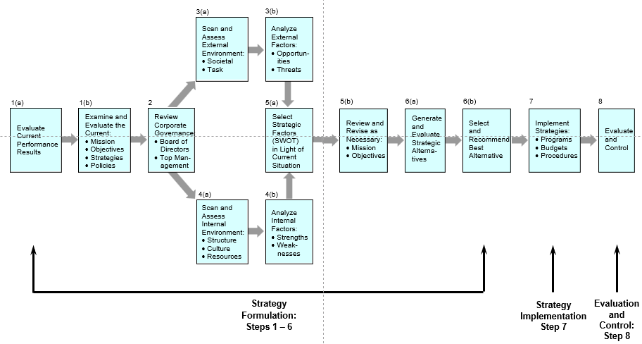
Strategic Decision-Making Process

Slide 5
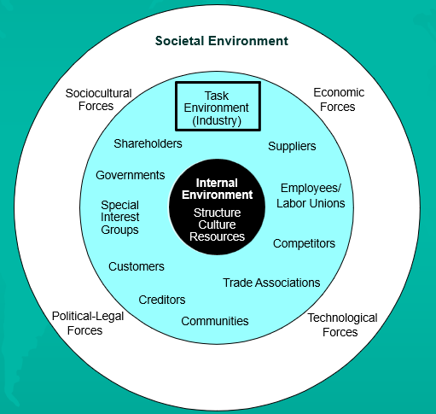
Environmental Scanning

Slide 6
External Environment
A) Societal Environment
B) Industrial Environment

Slide 7
A) Societal Environment

Slide 8
General Environment Components

Slide 9
General Environment Components

Slide 10
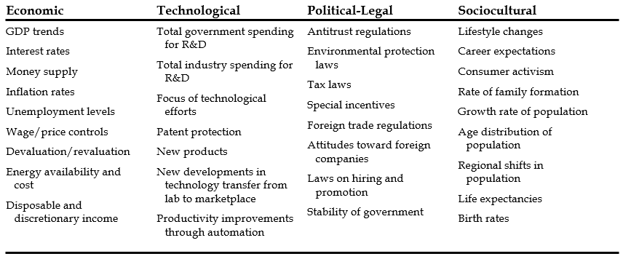
Factors involved in Pest analysis

Slide 11
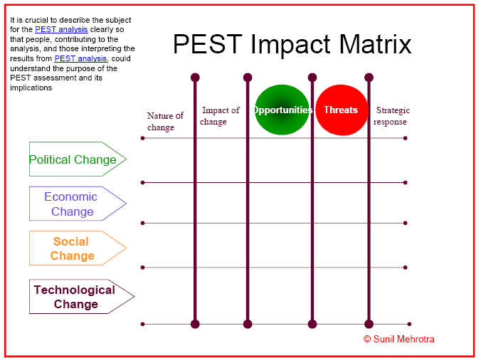

Slide 12
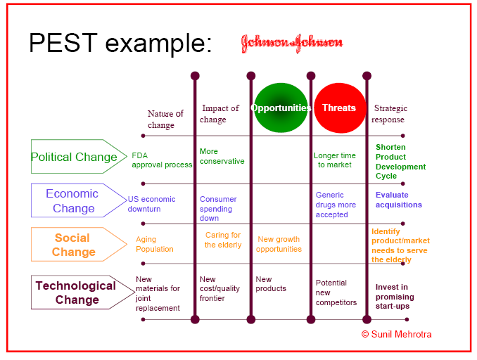

Slide 13
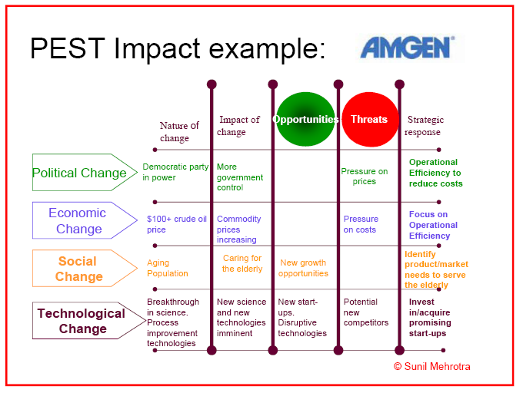

Slide 14
B) Industrial Environment

Slide 15
External Factor Evaluation Matrix
Summarize & evaluate:
Economic
Demographic
Governmental
Social
Environmental
Technological
Cultural
Political
Competitive

Slide 16
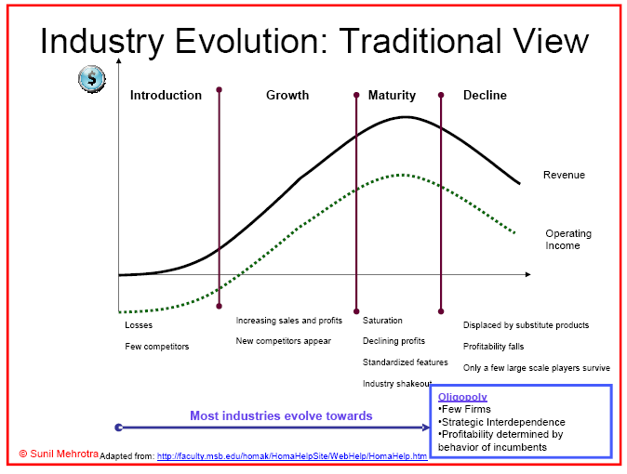

Slide 17
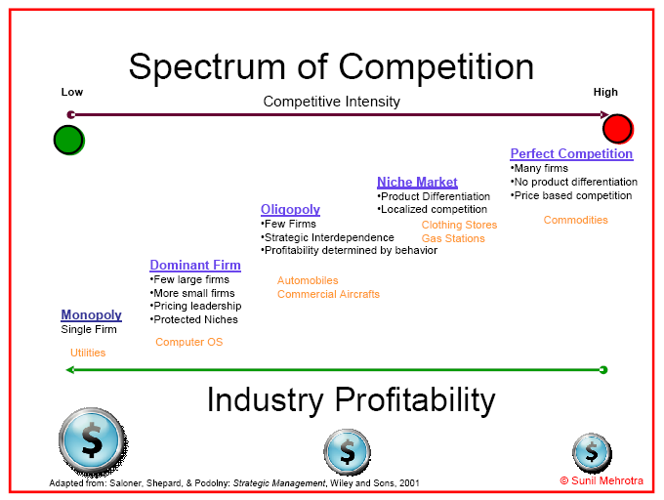

Slide 18
Question 1: What are the
Industry’s Dominant Economic Traits?
Market size and growth rate
Scope of competitive rivalry
Number of competitors and their relative sizes
Prevalence of backward/forward integration
Entry/exit barriers
Nature and pace of technological change
Product and customer characteristics
Scale economies and experience curve effects
Capacity utilization and resource requirements
Industry profitability

Slide 19
Relevance of
Key Economic Features of Industry
Economic Feature
Strategic Importance
Market Size
Small markets don’t tend to attract new firms; large markets attract firms looking to acquire rivals with established positions in attractive industries
Market growth rate
Fast growth breeds new entry; slow growth spawns increased rivalry & shake-out of weak rivals
Capacity surpluses/shortages
Surpluses push prices & profit margins down; shortages pull them up
Industry profitability
High-profit industries attract new entrants; depressed conditions lead to exit
Entry/exit barriers
High barriers protect positions and profits of existing firms; low barriers make existing firms vulnerable to entry
Product is big-ticket item for buyers
More buyers will shop for lowest price
Standard products
Buyers have more power because it’s easier to switch from seller to seller
Rapid technological change
Raises risk; investments in technology facilities/equipment may become obsolete before they wear out
Capital requirements
Big requirements make investment decisions critical; timing becomes important; creates a barrier to entry and exit
Vertical integration
Raises capital requirements; often creates competitive & cost differences among fully vs. partially vs. non-integrated firms
Economies of scale
Increases volume & market share needed to be cost competitive
Rapid product innovation
Shortens product life cycle; increases risk because of opportunities for leapfrogging

Slide 20
Question 2: What Is Competition Like and How Strong Are the Competitive Forces?
Objective
To identify
  Main sources of competitive forces
  Strength of these forces
Key analytical tool
  Five Forces Model of Competition

Slide 21
Five Forces Model of Competition
Substitute Products
(of firms in
other industries)
Suppliers of Key Inputs
Rivalry
Among
Competing
Sellers
Buyers
Potential
New
Entrants

Slide 22
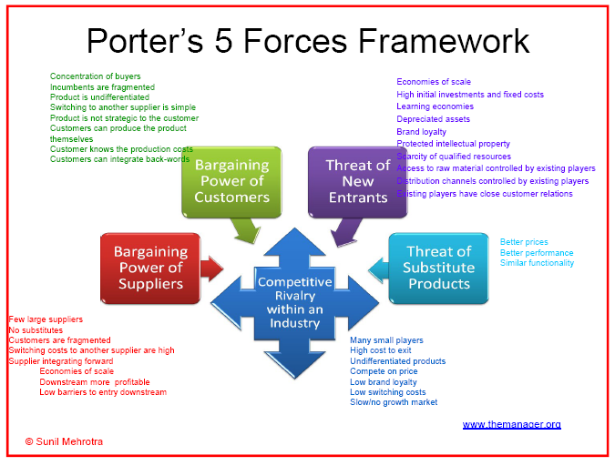

Slide 23
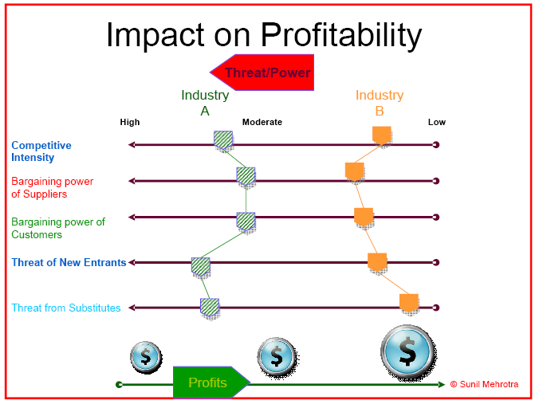

Slide 24
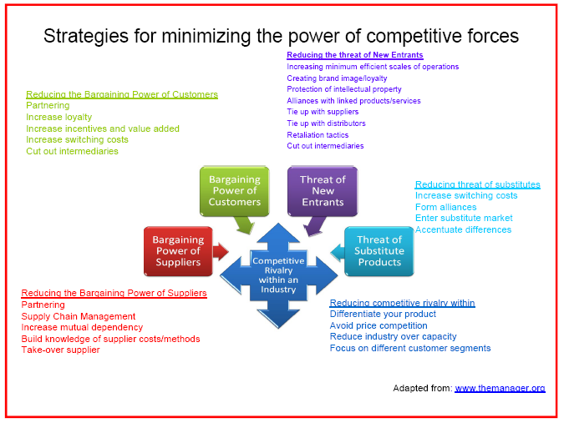

Slide 25
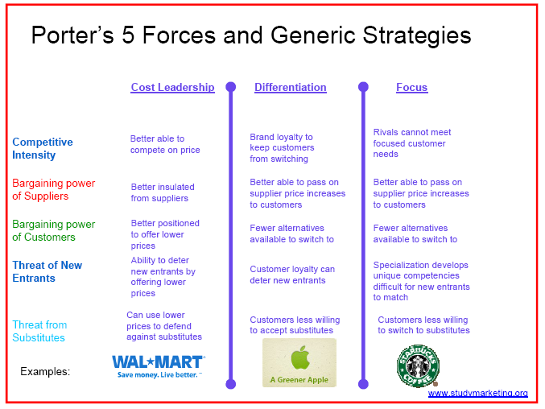

Slide 26
Scanning the External Environment
Analysis of Societal Environment
Economic, Sociocultural, Technological, Political-Legal Factors
Market
Analysis
Community
Competitor
Analysis
Analysis
Supplier
Analysis
Selection of
Interest Group
Strategic Factors
Governmental
Analysis
• Opportunities
Analysis
• Threats

Slide 27
External Factor Analysis Summary (EFAS)
External
Strategic Factors
Rating
Weighted
Score
Weight
Comments
Opportunities
Threats
Total Weighted Score
1
2
3
4
5
1.00
Notes: 1. List opportunities and threats (5–10 each) in column 1. 2. Weight each factor from 1.0 (Most Important) to 0.0 (Not Important) in Column 2 based on that factor’s probable impact on the company’s strategic position. The total weights must sum to 1.00. 3. Rate each factor from 5 (Outstanding) to 1 (Poor) in Column 3 based on the company’s response to that factor. 4. Multiply each factor’s weight times its rating to obtain each factor’s weighted score in Column 4. 5. Use Column 5 (comments) for rationale used for each factor. 6. Add the weighted scores to obtain the total weighted score for the company in Column 4. This tells how well the company is responding to the strategic factors in its external environment.
Source: T. L. Wheelen and J. D. Hunger, “External Strategic Factors Analysis Summary (EFAS).” Copyright © 1991 by Wheelen and Hunger Associates. Reprinted by permission.

Slide 28
UST—Key External Factors
Opportunities
Weight
Rating
Weighted
score
Global markets untapped
.15
1
.15
Increased demand
.05
3
.15
Astronomical Internet growth
.05
1
.05
Pinkerton leader in discount market
.15
4
.60
More social pressure to quit smoking
.10
3
.30
Threats
Legislation against the tobacco industry
.10
2
.20
Production limits on tobacco
.05
3
.15
Smokeless market SE region U.S.
.05
2
.10
Bad media exposure from FDA
.10
2
.20
Clinton Administration
.20
1
.20
TOTAL
1.00
2.10

Slide 29
SWOT Analysis
Internal Environment
Strengths
Weaknesses
External Environment
Opportunities
Threats

Slide 30
TOWS Matrix
INTERNAL
Strengths (S)
Weaknesses (W)
FACTORS
(IFAS)
List 5 – 10 internal
List 5 – 10 internal
EXTERNAL
strengths here
weaknesses here
FACTORS
(EFAS)
Opportunities (O)
SO Strategies
WO Strategies
List 5 – 10 external
Generate strategies here
Generate strategies here
opportunities here
that use strengths to take
that take advantage of
advantage of opportunities
opportunities by
overcoming weaknesses
Threats (T)
ST Strategies
WT Strategies
List 5 – 10 external
Generate strategies here
Generate strategies here
threats here
that use strengths to
that minimize weaknesses
avoid threats
and avoid threats
Source: Adapted from Long-Range Planning, April 1982, H. Weihrich, “The TOWS Matrix—A Tool for Situational Analysis” p. 60. Copyright 1982, with kind permission from H. Weihrich and Elsevier Science Ltd. The Boulevard, Langford Lane, Kidlington OX5 1GB, UK.

Slide 31
TOWS Matrix: Maytag as Example
Strengths (S)
Weaknesses (W)
INTERNAL
S1 Quality Maytag Culture
S2 Experience top management
S3 Vertical integration
S4 Employee relations
S5 Hoover’s international
orientation
W1 Process-oriented
W2 Distribution channels
W3 Financial position
W4 Global positioning
W5 Manufacturing facilities
FACTORS
(IFAS)
EXTERNAL
FACTORS
(EFAS)
Opportunities (O)
SO Strategies
WO Strategies
O1 Economic integration of
European community
O2 Demographics favor quality
O3 Economic development,
Asia
O4 Opening Eastern Europe
O5 Trend toward super stores
Expand Hoover’s presence in continental Europe by improving quality & reducing costs
Emphasize superstore channel for all non-Maytag brands
Use worldwide Hoover dis-
tribution channels for Hoover
and Maytag
Find joint venture partners in
Eastern Europe & Asia
Expand Hoover’s presence in continental Europe by improving quality & reducing costs
Emphasize superstore channel for non-Maytag brands
Threats (T)
ST Strategies
WT Strategies
T1 Increasing government
regulation
T2 Strong US competition
T3 Whirlpool & Electrolux
positioned for global economy
T4 New product advances
T5 Japanese companies
Acquire Raytheon’s appliance business
Merge with major Japanese home appliance company
Sell off non-Maytag brands; defend Maytag’s US niche.
Sell off Dixie-Narco division to
reduce debt
Emphasize cost reduction to reduce break-even point
Sell out to Raytheon or a
Japanese firm.
Source: Adapted from Long-Range Planning, April 1982, H. Weihrich, “The TOWS Matrix—A Tool for Situational Analysis” p. 60. Copyright 1982, with kind permission from H. Weihrich and Elsevier Science Ltd. The Boulevard, Langford Lane, Kidlington OX5 1GB, UK.

Slide 32
Strategic Factor Analysis Summary (SFAS)
1
2
3
4
Duration
5
6
Key Strategic Factors
(Select the most important opportunities/threats from EFAS, Table 3.4 and the most important strengths and weaknesses from IFAS, Table 4.2)
Total Score
Rating
Weighted
Score
INTERMEDIATE
Weight
SHORT
LONG
Comments
Notes: 1. List each of your key strategic features developed in your IFAS and EFAS tables in Column 1. 2. Weight each factor from 1.0 (Most Important) to 0.0 (Not Important) in Column 2 based on that factor’s probable impact on the company’s strategic position. The total weights must sum to 1.00. 3. Rate each factor from 5 (Outstanding) to 1 (Poor) in Column 3 based on the company’s response to that factor. 4. Multiply each factor’s weight times its rating to obtain each factor’s weighted score in Column 4. 5. For duration in Column 5, check appropriate column (short term—less than 1 year; intermediate—1 to 3 years; long term—over 3 years.) 6. Use Column 6 (comments) for rationale used for each factor.
Source: T. L. Wheelen and J. D. Hunger, “Strategic Factors Analysis Summary (SFAS).” Copyright © 1997 by Wheelen and Hunger Associates. Reprinted by permission.

Slide 33
Strategic Factor Analysis Summary (SFAS): Maytag as Example
Key Strategic Factors
(Select the most important opportunities/threats from EFAS, Table 3.4 and the most important strengths and weaknesses from IFAS, Table 4.2)
S1 Quality Maytag culture (S)
S3 Hoover’s international orientation (S)
W3 Financial position (W)
W4 Global positioning (W)
O1 Economic integration of
European Community (O)
O2 Demographics favor quality (O)
O5 Trend to super stores (O + T)
T3 Whirlpool and Electrolux (T)
T5 Japanese appliance companies (T)
Total Score
Duration
Rating
Weighted
Score
INTERMEDIATE
Weight
SHORT
LONG
Comments
.10
.10
.10
.15
.10
.10
.10
.15
.10
5
3
2
2
4
5
2
3
2
.50
.30
.20
.30
.40
.50
.20
.45
.20
X
X
X
X
X
X
X
X
X
Quality key to success
Name recognition
High debt
Only in N.A., U.K., and Australia
Acquisition of Hoover
Maytag quality
Weak in this channel
Dominate industry
Asian presence
1.00
3.05
Notes: 1. List each of your key strategic features developed in your IFAS and EFAS tables in Column 1. 2. Weight each factor from 1.0 (Most Important) to 0.0 (Not Important) in Column 2 based on that factor’s probable impact on the company’s strategic position. The total weights must sum to 1.00. 3. Rate each factor from 5 (Outstanding) to 1 (Poor) in Column 3 based on the company’s response to that factor. 4. Multiply each factor’s weight times its rating to obtain each factor’s weighted score in Column 4. 5. For duration in Column 5, check appropriate column (short term—less than 1 year; intermediate—1 to 3 years; long term—over 3 years.) 6. Use Column 6 (comments) for rationale used for each factor.
Source: T. L. Wheelen and J. D. Hunger, “Strategic Factors Analysis Summary (SFAS).” Copyright © 1997 by Wheelen and Hunger Associates. Reprinted by permission.

Slide 34
Industrial Organization Model of Above-Average Returns

Slide 35
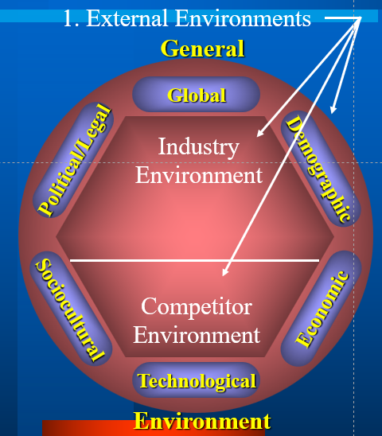
Industrial Organization Model of Above-Average Returns
1. Strategy dictated by the external environments of the firm (what opportunities exist in these environments?)
2. Firm develops internal skills required by external environment (what can the firm do about the opportunities?)

Slide 36
Four Assumptions of the I/O Model
1. The external environment is assumed to possess pressures and constraints that determine the strategies that would result in above-average returns
2. Most firms competing within a particular or within a certain segment of it are assumed to control similar strategically relevant resources and to pursue similar strategies in light of those resources

Slide 37
Four Assumptions of the I/O Model
3. Resources used to implement strategies are highly mobile across firms
4. Organizational decision makers are assumed to be rational and committed to acting in the firm’s best interests, as shown by their profit-maximizing behaviors

Slide 38
I/O Model of Above-Average Returns
Industrial Organization Model
1. Study the external environment, especially the industry environment
  economies of scale
  barriers to market entry
  diversification
  product differentiation
  degree of concentration of firms in the industry
The External Environment

Slide 39
I/O Model of Above-Average Returns
Industrial Organization Model
2. Locate an attractive industry with a high potential for above-average returns
The External Environment
An Attractive Industry
Attractive industry: one whose structural characteristics suggest above-average returns

Slide 40
I/O Model of Above-Average Returns
Industrial Organization Model
3. Identify the strategy called for by the attractive industry to earn above-average returns
The External Environment
An Attractive Industry
Strategy Formulation
Strategy formulation: selection of a strategy linked with above-average returns in a particular industry

Slide 41
I/O Model of Above-Average Returns
Industrial Organization Model
4. Develop or acquire assets and skills needed to implement the strategy
The External Environment
An Attractive Industry
Strategy Formulation
Assets and Skills
Assets and skills: those assets and skills required to implement a chosen strategy

Slide 42
I/O Model of Above-Average Returns
Industrial Organization Model
5. Use the firm’s strengths (its developed or acquired assets and skills) to implement the strategy
The External Environment
An Attractive Industry
Strategy Formulation
Assets and Skills
Strategy implementation: select strategic actions linked with effective implementation of the chosen strategy
Strategy Implementation

Slide 43
I/O Model of Above-Average Returns
Industrial Organization Model
Industrial Organization Model
The External Environment
The External Environment
An Attractive Industry
An Attractive Industry
Strategy Formulation
Strategy Formulation
Assets and Skills
Assets and Skills
Superior returns: earning of above-average returns
Strategy Implementation
Strategy Implementation
Superior Returns
Superior Returns

Slide 44
THANK YOU

