Slide 1

Strategic Management
Course Information: https://is.slu.cz/predmet/opf/zima2024/PEMNASMA?lang=en
Consultation: Wednesday and Thursday
(better to have an appointment in advance)
Contact Details: shariq@opf.slu.cz
Room: B205

Slide 2
Important Information
Requirements on students
(Total sum of points 100)
Active participation in seminars and case studies solution –
10% of points
2. Seminar paper and defence of the seminar paper
(no later than 15. 12. 2025) –
10% of points
3. Continuous test
(in the week 27. 10. – 31. 10. 2025) –
20% of points
4. Final written exam –
60% of points
Consultation: Wednesday and Thursday
(better to have an appointment in advance)
Contact Details: shariq@opf.slu.cz
Room: 205

Slide 3
Learning outcomes
Business Model
Mission
Vision
Objectives
Strategy

Slide 4
“Without a strategy the organization is like a ship without a rudder, going around in circles. It's like a tramp; it has no place to go."
(Joel Ross and Michael Kami)

Slide 5
Strategic Management
BASIC CONCEPTS OF STRATEGIC MANAGEMENT

Slide 6
Thinking Strategically: The Three Big Strategic Questions
1. Where are we now?
2. Where do we want to go?
Business(es) to be in and market positions to stake out?
Buyer needs and groups to serve?
Outcomes to achieve?
3. How do we get there?

Slide 7
What is Strategy?
A company’s strategy consists of the set of competitive moves and business approaches that management is employing to run the company
Strategy is management’s “game plan” to
Attract and please customers
Stake out a market position
Conduct operations
Compete successfully
Achieve organizational objectives

Slide 8
What is a Business Model?
A company’s business model addresses “How do we make money in this business?”
Business model is about creating value for the customer and generating revenue from that created value
Is the strategy that management is pursuing capable of delivering good bottom-line results?
Do the revenue-cost-profit economics of the company’s strategy make good business sense?
Look at the revenue streams the strategy is expected to produce
Look at the associated cost structure and potential profit margins
Do the resulting earnings streams and ROI indicate the strategy makes sense and that the company has a viable business model?

Slide 9
The Five Tasks of Strategic Management
Task 1
Task 2
Task 3
Task 4
Task 5
Develop a
Strategic
(a)Mission
and
(b)Vision
Set
Objectives
Craft a
Strategy
to Achieve
Objectives
Implement
and
Execute
Strategy
Monitor,
Evaluate,
and Take
Corrective
Action
Revise as
Needed
Revise as
Needed
Improve/
Change
Improve/
Change
Recycle
as Needed

Slide 10
Task 1(a): Mission

Slide 11
Mission Versus Vision
Mission Statement Answers the Question
Vision Statement Answers the Question
“What is Our
Business?”
“What Do We Want
to Become?”

Slide 12
Characteristics of a Mission Statement
Defines current business activities
Highlights boundaries of current business
Conveys
Who we are,
What we do, and
Where we are now
Company specific, not generic — so as to give a company its own identity
A company’s mission is not to make a profit !
The real mission is always—“What will we do to make a profit?”

Slide 13
Broad or Narrow Mission Statements?
Narrow enough to specify real arena of interest
Serve as
Boundary for what to do and not do
Beacon of where top management intends to take firm
Diversified companies have broader business definitions than single-business enterprises

Slide 14
Definitions: Broad vs. Narrow Scope
Broad Definition
Furniture
Telecommunications
Beverages
Global mail delivery
Travel & tourism
Narrow Definition
Wrought-iron lawn furniture
Long-distance telephone service
Soft drinks
Overnight package delivery
Caribbean cruises

Slide 15
Mission Statements for Functional Departments
Spotlights department’s
Role and scope of activities
Direction which department needs to pursue
Contribution to firm’s overall mission

Slide 16
Mission Statements of Functional Departments
HUMAN RESOURCES
To contribute to organizational success by developing effective leaders, creating high performance teams, and maximizing the potential of individuals.
CORPORATE SECURITY
To provide services for the protection of corporate personnel and assets through preventive measures and investigations.

Slide 17
Task 1(b): Vision

Slide 18
Three Elements of a Strategic Vision
Mission (use it as a starting point)
Vision (develop a vision that spells out a course to pursue)
Communication of the vision in a clear and exciting manner

Slide 19
Developing a Strategic Vision
Involves thinking strategically about
Firm’s future business plans
Where to “go”
Tasks include
Creating a roadmap of the future
Deciding future business position
Providing long-term direction
Giving firm a strong identity

Slide 20
Characteristics of a Strategic Vision
1. A roadmap of a company’s future
Future technology-product-customer focus
Geographic and product markets to pursue
Capabilities to be developed
Kind of company management is trying to create

Slide 21
Characteristics of a Strategic Vision
Charts a company’s future strategic course
Defines the business makeup for 5 years (or more)
Specifies future technology-product-customer focus
Indicates capabilities to be developed
Requires managers to exercise foresight

Slide 22
Questions to Address in Developing a Strategic Vision
1. What changes are occurring in the market arena(s) where we operate and what implications do these changes have for our future direction?
2. What new or different customer needs should we be moving to satisfy?
3. What new or different buyer segments should we be concentrating on?
4. What new geographic or product markets should we be pursuing?
5. What should the company’s business makeup look like in 5 years?
6. What kind of company should we be trying to become?

Slide 23
Why is a Strategic Vision Important?
A managerial imperative exists to look beyond today and think strategically about
Impact of new technologies
How customer needs and expectations are changing
What it will take to outrun competitors
Which promising market opportunities ought to be aggressively pursued
External and internal factors driving what a company needs to do to prepare for the future

Slide 24
TASK 1: Match the company with their statements:
Statement | Company
1. To be the world`s best quick service restaurant. | A AutoNation
2. To be the most respected global financial services company. | B Avon
3. To become the beauty company most women turn to worldwide. | C Barnes & Noble
4. To provide a global trading platform where practically anyone can trade practically anything. | D CarMax
5. To operate the best speciality retail business in America, regardless of the product we sell. | E Citibank
6. To provide our customers great quality cars at great prices with exceptional customer service. | F Darden Restaurants
7. To nourish and delight everyone we serve. | G eBay
8. To be American` s best run, most profitable automotive retailer. | H Estee Lauder
9. Bringing the best to everyone we touch. | I Facebook
10. To be the world` s largest & best platform for online communities to share & connect. | J Kelly Services
11. To give everyone the power to create and share ideas and information instantly, without barriers. | K KFC
12. To bet he best worldwide provider of higher-value staffing services and the center for quality employment opportunities. | L Manpower
13. To sell food in a fast, friendly environment that appeals to pride-conscious, health-minded consumers. | M McDonald` s
14. To serve our customers, employees, shareholders and society by providing a broad range of staffing services and products. | N Reddit
15. To give the people the power to share and make the world more open and connected. | O Twitter

Slide 25
Task 2: Objectives

Slide 26
Two Types of Objectives Are Required
Financial Objectives
Outcomes that improve a firm’s financial performance
Strategic Objectives
Outcomes that strengthen a firm’s competitiveness and long-term market position

Slide 27
Strategic Management Principle
Every company needs both strategic and financial objectives!

Slide 28
Short-Range Versus Long-Range Objectives
Short-Range objectives
Targets to be achieved soon
Serve as stair steps for reaching long-range performance
Long-Range objectives
Targets to be achieved within 3 to 5 years
Prompt actions now that will permit reaching targeted long-range performance later

Slide 29
Task 3: Strategy

Slide 30
Basic Elements of the Strategic Management Process
Environmental
Strategy
Strategy
Evaluation
Scanning
Formulation
Implementation
and
Control

Slide 31
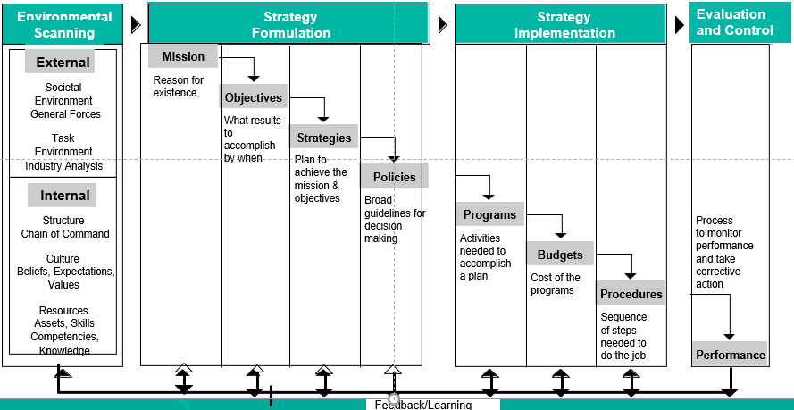
Strategic Management Process
Strategic Management Model

Slide 32
Benefits of Strategic Management
Proactive in shaping organization’s future
Initiate and influence activities
Formulate better strategies (Systematic, logical, rational approach)

Slide 33
Benefits of Strategic Management
Financial benefits
Improvement in sales
Improvement in profitability
Improvement in productivity

Slide 34
The How That Define a Firm's Strategy
How to grow the business
How to please customers
How to outcompete rivals
How to respond to changing market conditions
How to manage each functional piece of the business and develop needed organizational capabilities
How to achieve strategic and financial objectives

Slide 35
Strategic Approaches
Strategy as design ------------------ Rationality
Strategy as experience ------------ Intuition
Strategy as Ideas ------------------- Innovation

Slide 36
Objectives should be SMART
Specific
Measurable
Achievable
Realistic
Time related

Slide 37
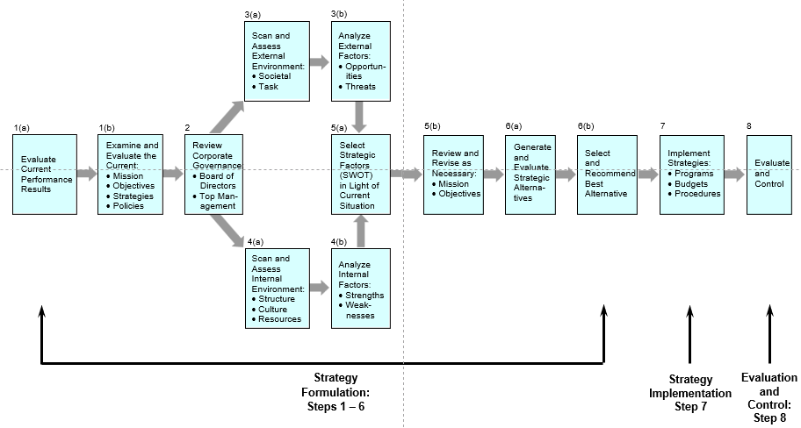
Strategic Decision-Making Process

Slide 38
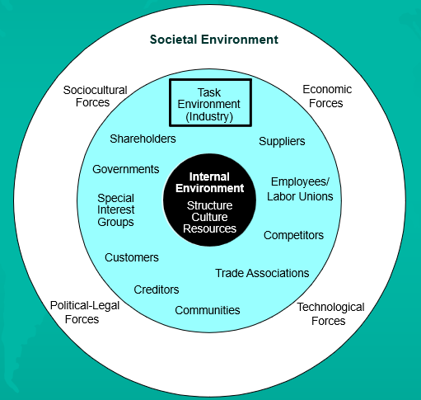
Environmental Scanning (coming lectures)

Slide 39
THANK YOU

