Slide 1

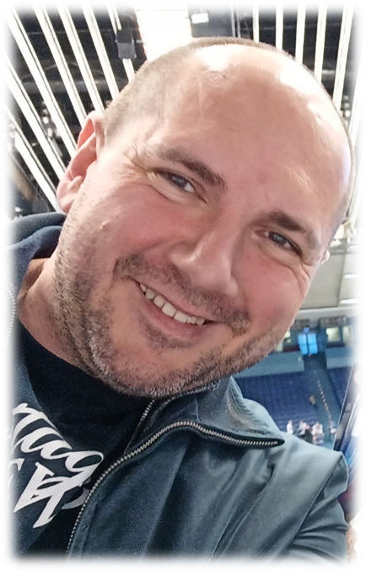
Circular Economy
Pavel Adámek, Ing., Ph.D.
adámek@opf.slu.cz
Department of Business Economics and Management
Corporate Social Responsibility Specialist
Guarantor of the master's course Corporate Social Responsibility
Business Sustainability and ESG
Blended Intensive Programme
22.04.2025

Slide 2
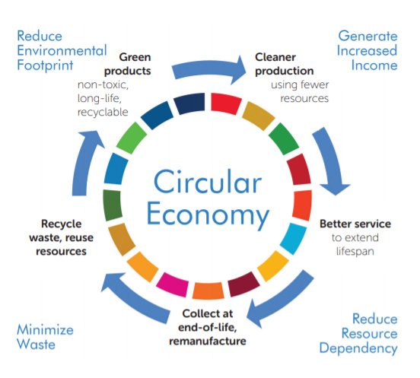
Content
1. Meaning and Introduction of Circular Economy
2. European Approach
3. Circular Economy Action Plan
4. Stories for grab (best practice)
Source: (2025), https://thecsrarena.com/how-much-do-you-know-about-the-concept-of-circular-economy/"

Slide 3

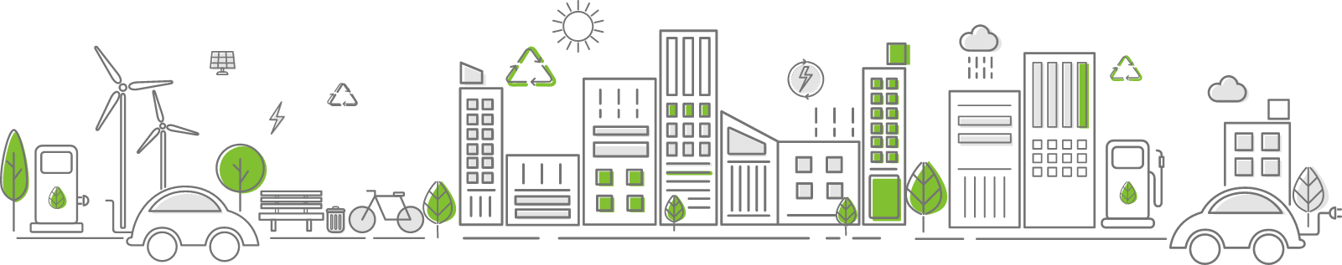
Lecture overview
So, what does the circular economy really mean?
What are the principles of the circular economy?
Why should every company be interested in it?
Are there any examples of good practice in implementing circular economy principles?
We will be looking for answers to these issues. The „stories for grab“ will help you to understand the practical implications.

Slide 4
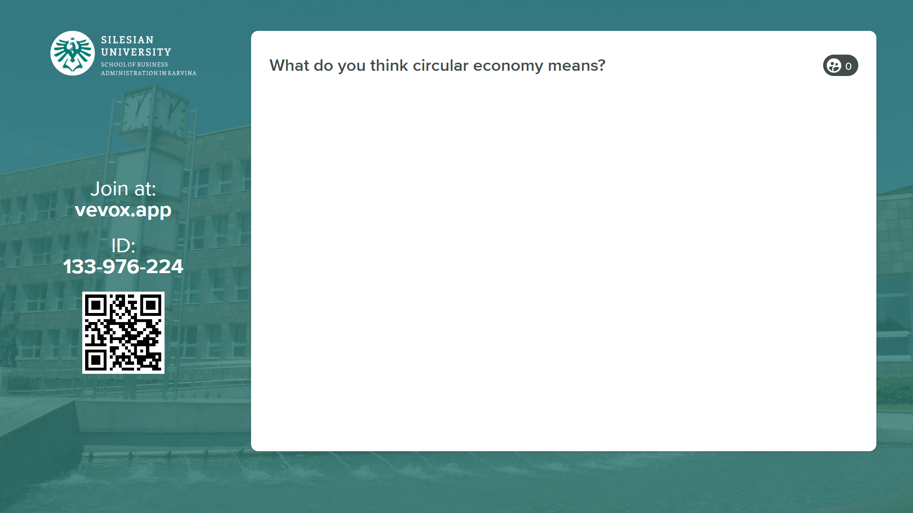
Lecture overview

Slide 5
Why should we be interested in circular principles?
Climate change is ongoing as global mean temperatures have already increased by 1.1–1.3°C compared to pre-industrial levels. Global annual greenhouse gas (GHG) emissions are still rising due to increasing consumption of fossil fuels, land-use change and other anthropogenic sources of emissions, resulting in an ever- growing stock of GHGs in the atmosphere.
On current trends, it is estimated the world will be 2.1–3.5 °C warmer by the end of this century compared to 1850. The last time global surface temperatures were sustained at or above 2.5°C higher than 1850–1900 was over 3 million years ago. (Source: Climate Change 2021 – The Physical Science Basis (IPCC, October 2021)
The issue of climate change is to a large extent an energy problem. Much of the climate change debate still revolves around abatement of energy-related emissions, for example the combustion of fossil fuels in cars or the provision of electricity and heat to households or industries from coal-fired power plants. This energy-oriented debate stresses the need to substantially upscale renewable energy sources, accelerate coal-phase out in power plants, speed-up renovation and energy efficiency measures in buildings and industrial operations. (Source: Completing the Picture, How the Circular Economy Tackles Climate Change (Ellen MacArthur Foundation, Material Economics, 2019), p. 13)
This focus is understandable and highly relevant given that emissions directly related to energy are responsible for around 55% of global emissions. (Source: Completing the Picture, How the Circular Economy Tackles Climate Change (Ellen MacArthur Foundation, Material Economics, 2019), p. 13)
Because…

Slide 6
Why should we be interested in circular principles?
Less discussed are the emissions that result from material production, which occupy as significant a share in global GHG emissions as agriculture, forestry and land use.
Globally, the share of GHG emissions from material production – solid materials including metals, wood, construction minerals and plastics – grew from 15% to 23% in the period from 1995 to 2015 (Hertwich, 2019).
These material-related emissions are also often termed “embodied carbon”, as a large portion of fossil fuels had to be combusted to produce them and/or large volumes of CO2 were released into the atmosphere from the associated industrial processes (process emissions). Energy-intensive industries such as primary production of steel, cement, chemical and aluminium, and major demand sectors that consume these materials, including buildings and vehicles, are major sources of such emissions.
Because…

Slide 7
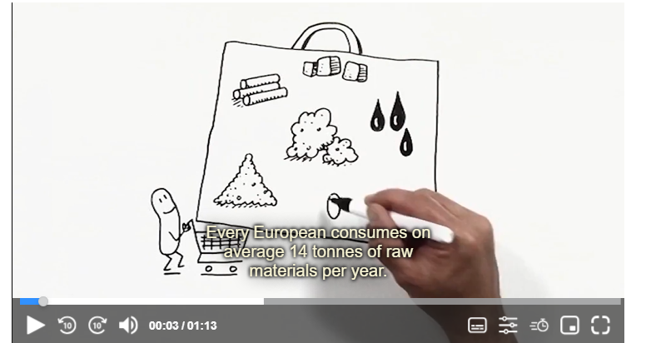
The circular economy is a system where materials never become waste and nature is regenerated.
In a circular economy, products and materials are kept in circulation through processes like maintenance, reuse, refurbishment, remanufacture, recycling, and composting.
The circular economy tackles climate change and other global challenges, like biodiversity loss, waste, and pollution, by decoupling economic activity from the consumption of finite resources.
The circular economy is based on three principles, driven by design:
Eliminate waste and pollution
Circulate products and materials (at their highest value)
Regenerate nature
1. Meaning and Introduction of Circular Economy
Source: https://www.europarl.europa.eu/topics/en/article/20151201STO05603/circular-economy-definition-importance-and-benefits

Slide 8
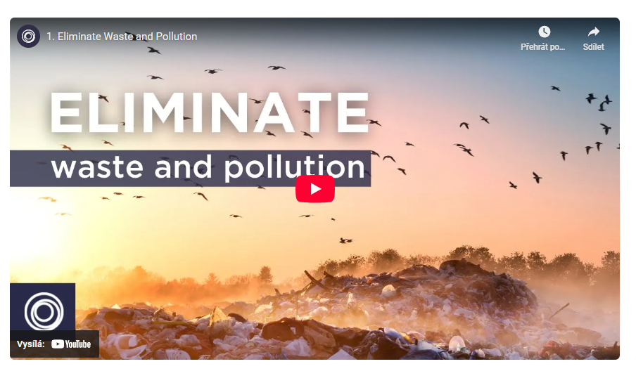
1. Principle – Eliminate waste and pollution
Currently, our economy works in a take-make-waste system. We take raw materials from the Earth, we make products from them, and eventually we throw them away as waste. Much of this waste ends up in landfills or incinerators and is lost. This system can not work in the long term because the resources on our planet are finite.
The problem (and the solution) starts with design
For many products on the market, there is no onward path after they are used. Take a crisp packet, for example. These multi-material flexible plastic packages cannot be reused, recycled or composted, so end up as waste. For products like these, waste is built in. They are designed to be disposable.
Source: 2025, https://www.ellenmacarthurfoundation.org/eliminate-waste-and-pollution

Slide 9
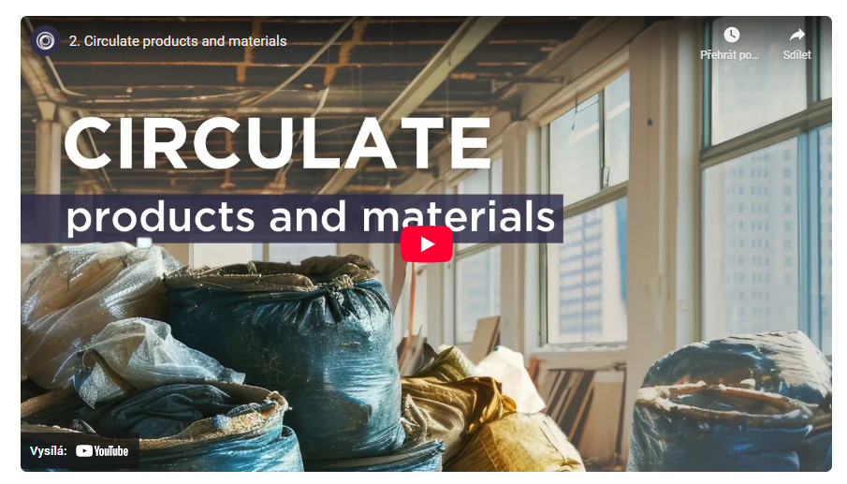
2. Principle – Circulate products and materials
This means keeping materials in use, either as a product or, when that can no longer be used, as components or raw materials. This way, nothing becomes waste and the intrinsic value of products and materials are retained.
There are a number of ways products and materials can be kept in circulation and it is helpful to think about two fundamental cycles – the technical cycle and the biological cycle.
In the technical cycle, products are reused, repaired, remanufactured, and recycled. In the biological cycle, biodegradable materials are returned to the earth through processes like composting and anaerobic digestion.
Source: 2025, https://www.ellenmacarthurfoundation.org/eliminate-waste-and-pollution

Slide 10
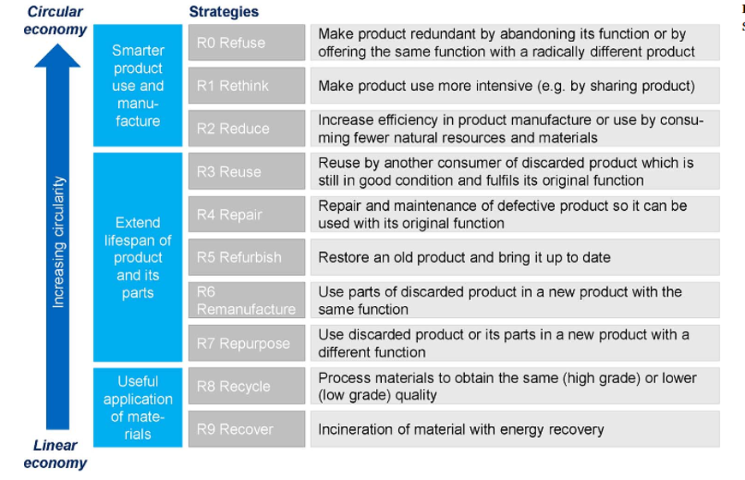

2. Principle – Circulate products and materials
Source: 2025, https://www.europarl.europa.eu/topics/en/article/20151201STO05603/circular-economy-definition-importance-and-benefits

Slide 11
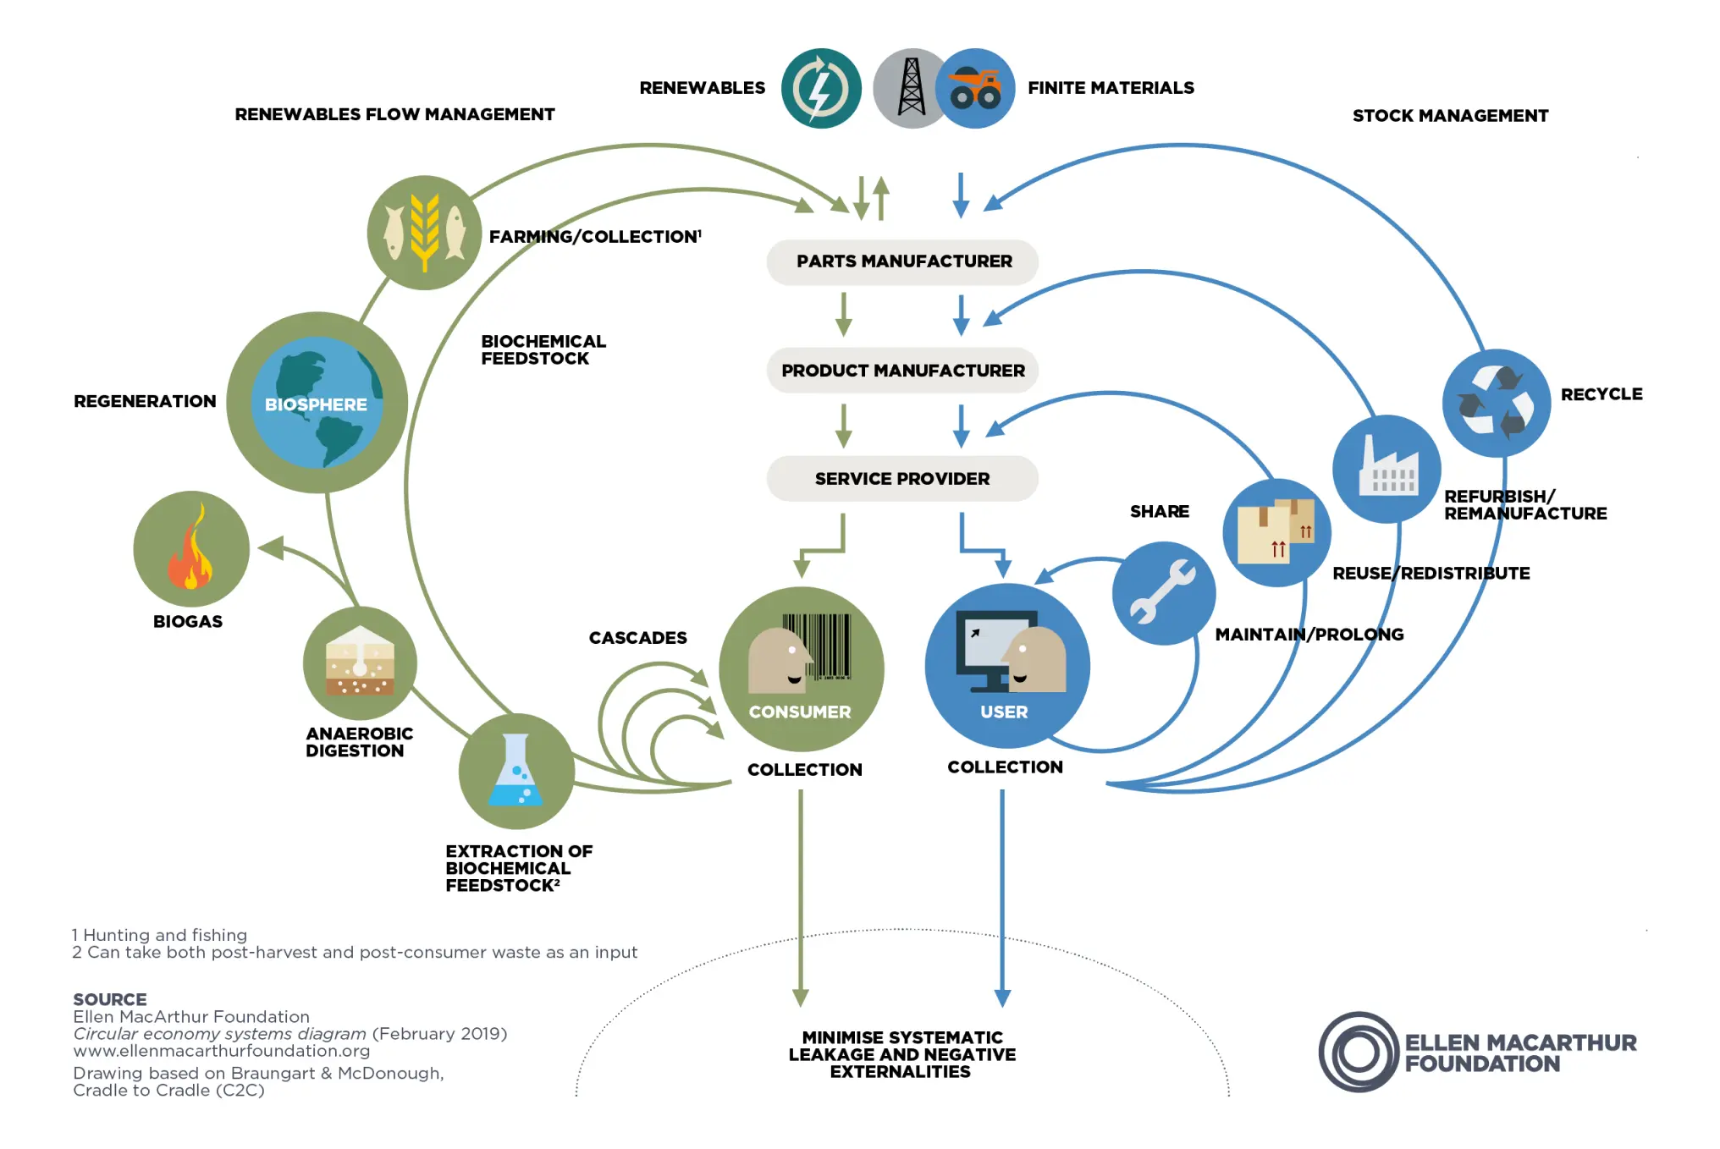
2. Principle – Circulate products and materials
Butterfly diagram – Ellen MacArthur Foundation,
Source: https://www.ellenmacarthurfoundation.org/circulate-products-and-materials
Source: 2025, https://www.europarl.europa.eu/topics/en/article/20151201STO05603/circular-economy-definition-importance-and-benefits

Slide 12
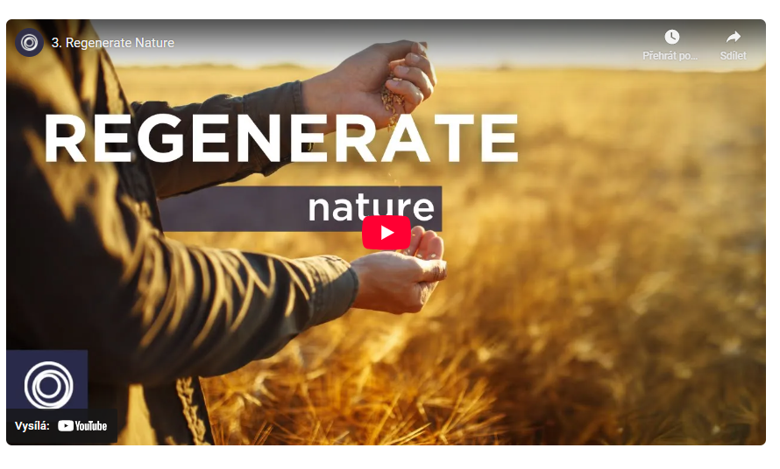
3. Principle – Regenerate nature
It means to support natural processes and leave more room for nature to thrive.
From extraction to regeneration.
By shifting our economy from linear to circular, we shift the focus from extraction to regeneration. Instead of continuously degrading nature, we build natural capital. We employ farming practises that allow nature to rebuild soils and increase biodiversity, and return biological materials to the earth.
Main issues:
The food industry
More space for nature
Tackling climate change
Source: 2025, https://www.ellenmacarthurfoundation.org/eliminate-waste-and-pollution

Slide 13
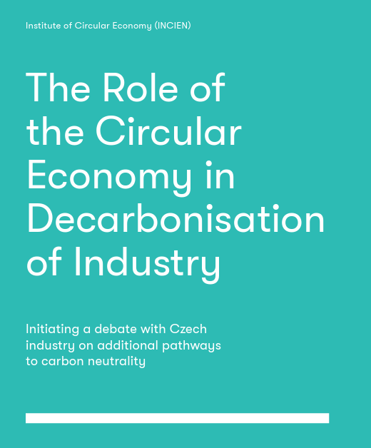
Circular Economy - summarization
Circular supply models, which replace traditional material inputs derived from virgin resources with bio-based, renewable, or recovered materials.
Resource recovery models, which recycle waste and scrap into secondary raw materials, diverting waste from Circular supply Resource recovery final disposal while displacing demand for extraction and processing of virgin natural resources.
Product life extension models, such as repair and remanufacturing, which extend the use period of existing products, slow the flow of constituent materials through the economy, and reduce the rate of resource extraction and waste generation.
Sharing models, which facilitate the sharing of under-utilised products, and reduce demand for new products.
Product service system models, where services rather than products are marketed, improving incentives for green product design and more efficient product use.
We can distinguish between a narrower scope for CE that focuses on waste utilization and resource efficiency and a broader view that also includes service-based and sharing-oriented models.
From the many available definitions of CE, we have used as a reference framework the OECD’s definition that differentiates the following five key business models:
Source: 2022, INCIEN, The Role of the Circular Economy in Decarbonisation of Industry, https://incien.org/en/think-tank/

Slide 14
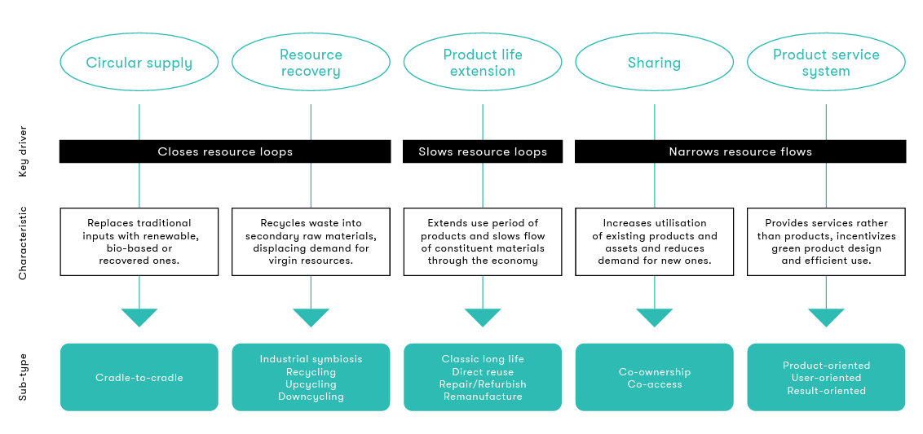
Circular Economy - summarization
Source: 2022, INCIEN, The Role of the Circular Economy in Decarbonisation of Industry, https://incien.org/en/think-tank/

Slide 15
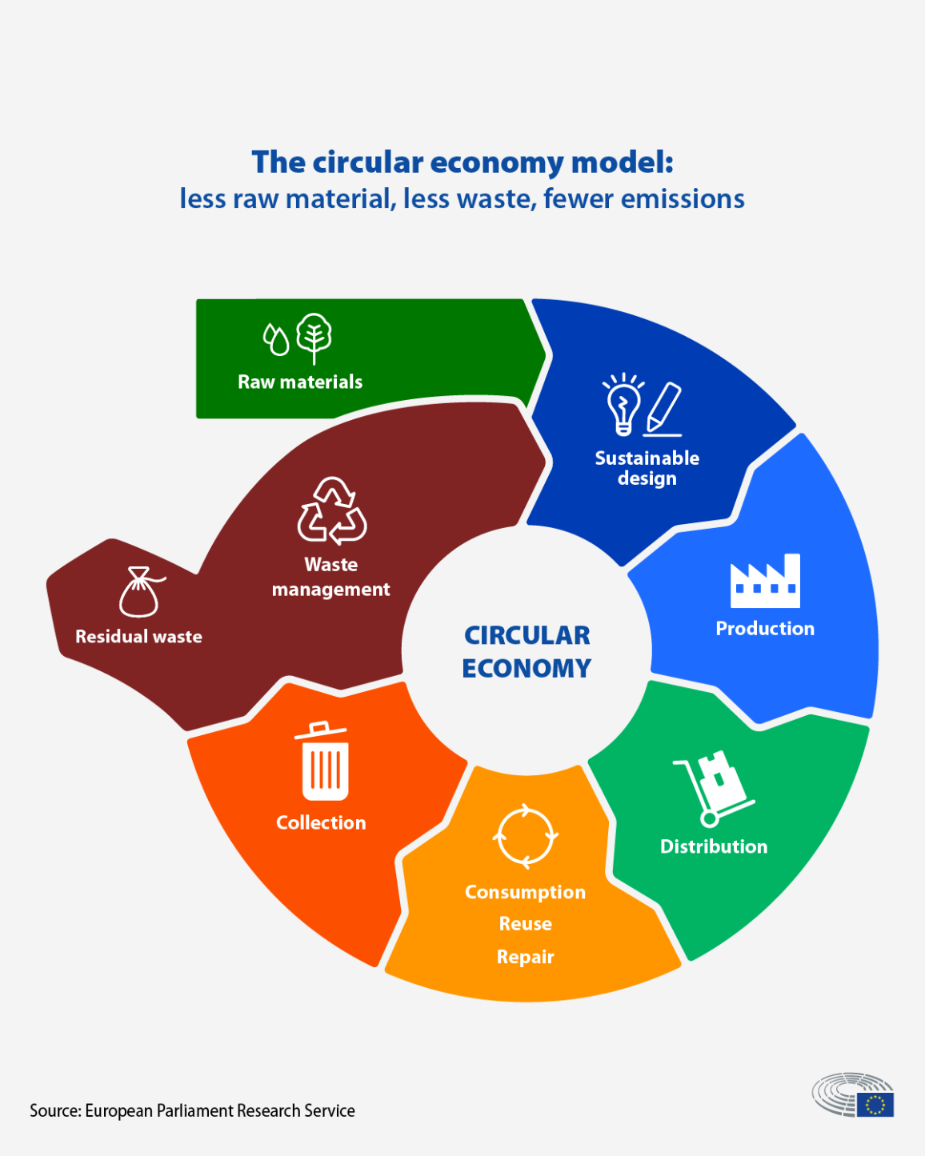
The EU’s transition to a circular economy will reduce pressure on natural resources and will create sustainable growth and jobs. It is also a prerequisite to achieve the EU’s 2050 climate neutrality target and to halt biodiversity loss.
2. European aproach to circularity

Slide 16

The EU’s transition to a circular economy will reduce pressure on natural resources and will create sustainable growth and jobs. It is also a prerequisite to achieve the EU’s 2050 climate neutrality target and to halt biodiversity loss.
2. European aproach to circularity

Slide 17
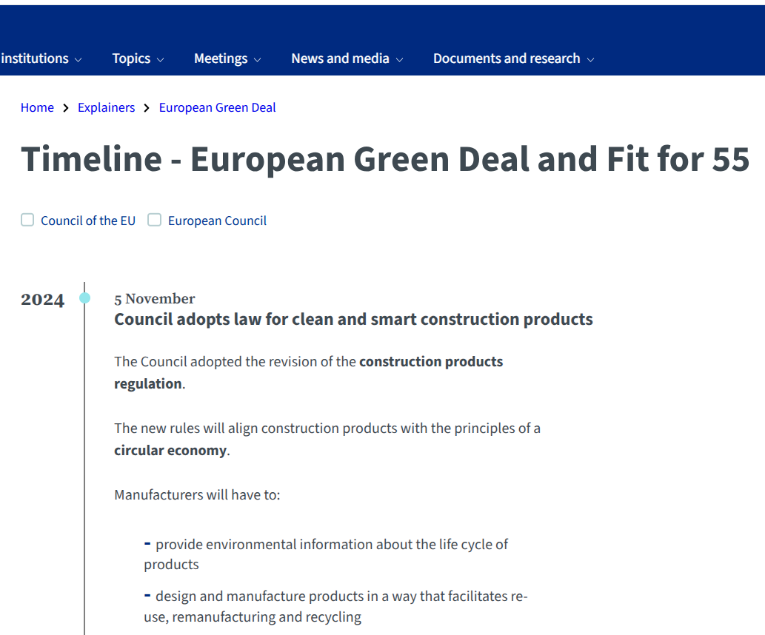
European Green Deal
The European Green Deal is the EU’s growth strategy. Launched in 2019, it consists of a package of policy initiatives, which set the EU on the path to a green transition, with the ultimate goal of reaching climate neutrality by 2050.
It is the EU's contribution to the Paris Agreement, which the EU and all its countries ratified and which set the goal of keeping global warming to maximum +1.5°C compared to pre-industrial levels.
It underlines the need for all policy areas to contribute to fighting climate change. The strategy supports measures across economic sectors covering energy, transport, industry, agriculture, sustainable finance and more.
Under the Green Deal, the Council – together with the European Parliament as co-legislators – have adopted legislation which has turned the strategy’s vision into laws and rules which are applied in all EU member states.
Source: 2025, https://www.consilium.europa.eu/en/policies/european-green-deal/timeline-european-green-deal-and-fit-for-55/

Slide 18
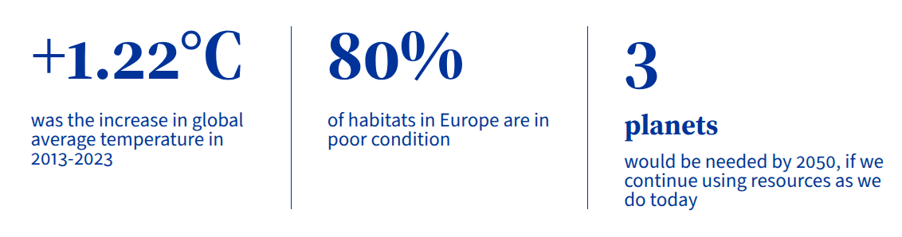
Why we need the Green Deal
Europe’s future depends on a healthy planet.
Our current economic and consumption patterns do not match what the planet can offer and are detrimental to the environment and nature. We and our economy are fully dependent on a functioning environment and ecosystems.
While the green transition will have a high cost as it requires large investment in transforming our economic model, the cost of inaction will be much greater. Estimates say that if we do nothing to tackle climate change, by the end of the century global damages could amount to up to 12% of the GDP.
Source: 2025, https://www.consilium.europa.eu/en/policies/european-green-deal/#what

Slide 19
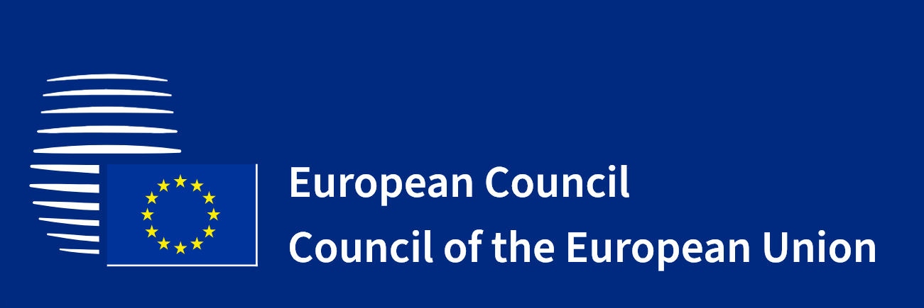
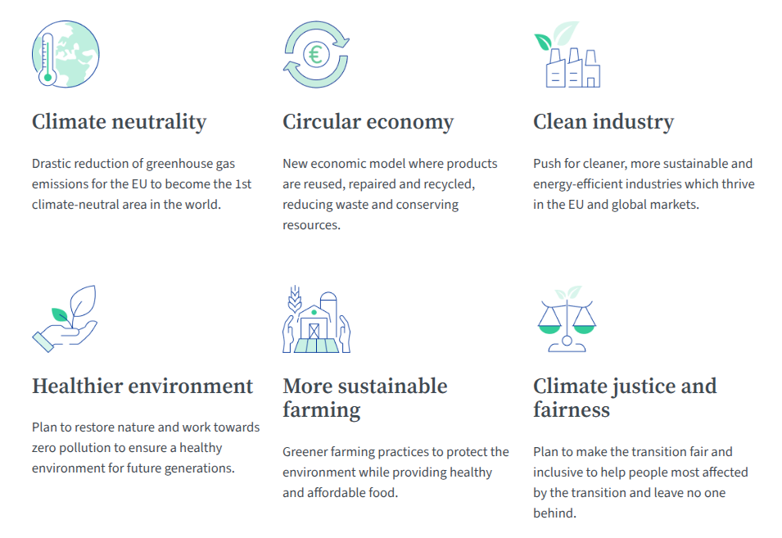
Key goals of the Green Deal
Source: 2025, https://www.consilium.europa.eu/en/policies/european-green-deal/#what

Slide 20
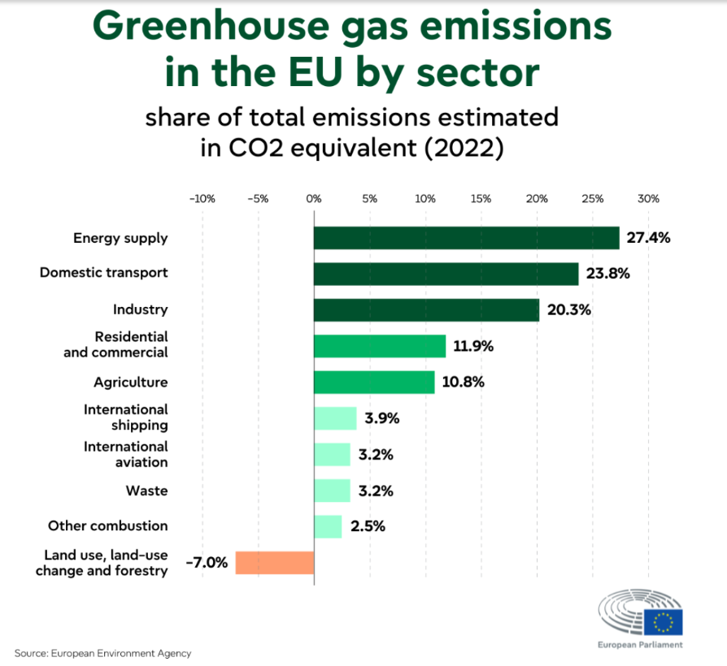
Benefits: why do we need to switch to a circular economy?
Protecting the environment
  Reusing and recycling products would slow down the use of natural resources, reduce landscape and habitat disruption and help to limit biodiversity loss.
  A reduction in total annual greenhouse gas emissions. Industrial processes and product use are Responsible for 9 % of greenhouse gas emissions in EU.
  Packaging is a growing issue and, on average, the average European generates nearly 180 kilos of packaging waste per year.
Source: 2025, https://www.europarl.europa.eu/topics/en/article/20180301STO98928/greenhouse-gas-emissions-by-country-and-sector-infographic

Slide 21
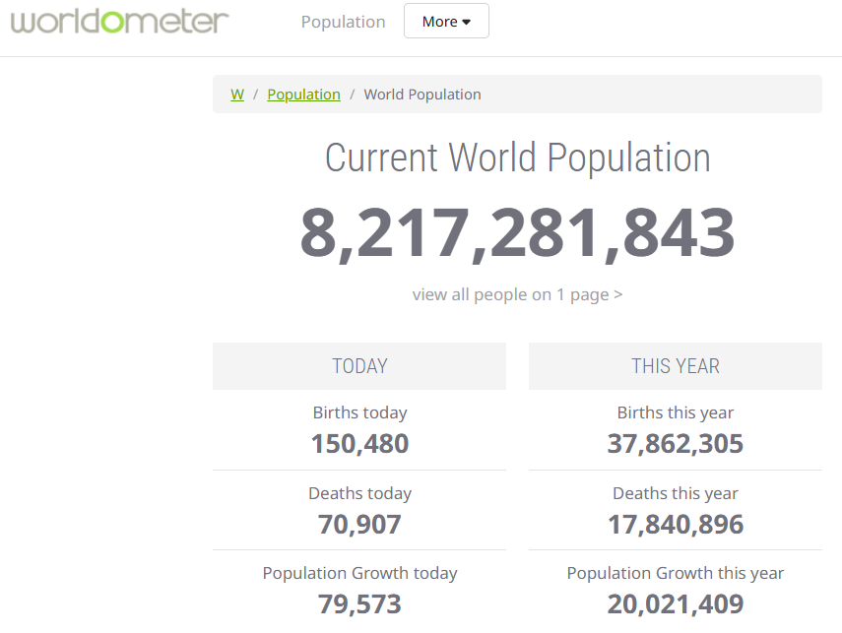
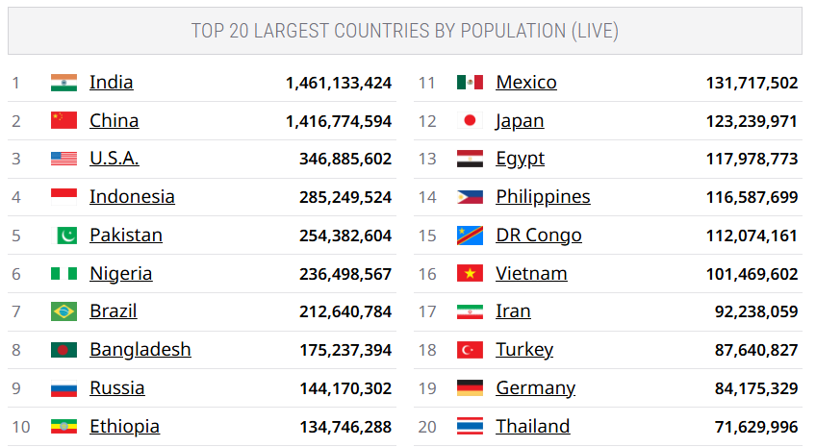
Benefits: why do we need to switch to a circular economy?
Reduce raw material dependence
The world's population is growing and with it the demand for raw materials. However, the supply of crucial raw materials is limited.
Finite supplies also means some EU countries are dependent on other countries for their raw materials. According to Eurostat, the EU imports about half of the raw materials it consumes.
The total value of trade (imports plus exports) of raw materials between the EU and the rest of the world in 2023 was €165 billion. Exports were lower than imports, so this resulted in a trade deficit of €29 billion.
This especially applies to critical raw materials, needed for the production of technologies that are crucial for achieving climate goals, such as batteries and electric engines.
Source: 2025, https://www.worldometers.info/world-population/#top20

Slide 22
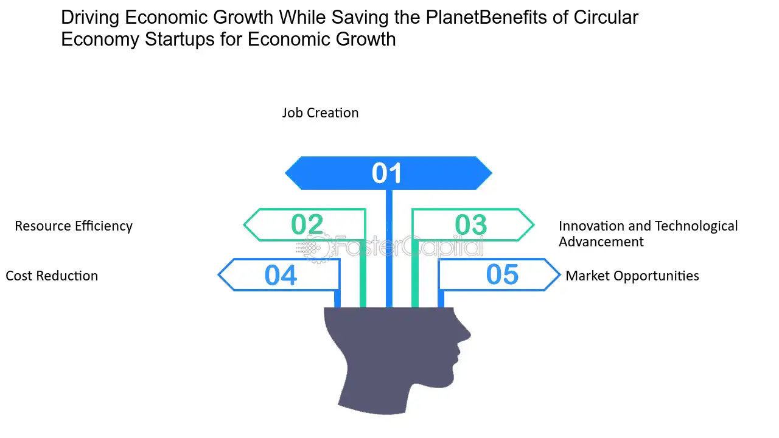
Benefits: why do we need to switch to a circular economy?
Create jobs and save consumers money
  Moving towards a more circular economy could increase competitiveness, stimulate innovation, boost economic growth and create jobs (700,000 jobs in the EU alone by 2030).
  Redesigning materials and products for circular use would also boost innovation across different sectors of the economy.
  Consumers will be provided with more durable and innovative products that will increase the quality of life and save them money in the long term..
Source: 2025, https://www.worldometers.info/world-population/#top20
Source: 2025, https://fastercapital.com/startup-topic/Benefits-of-Circular-Economy.html

Slide 23
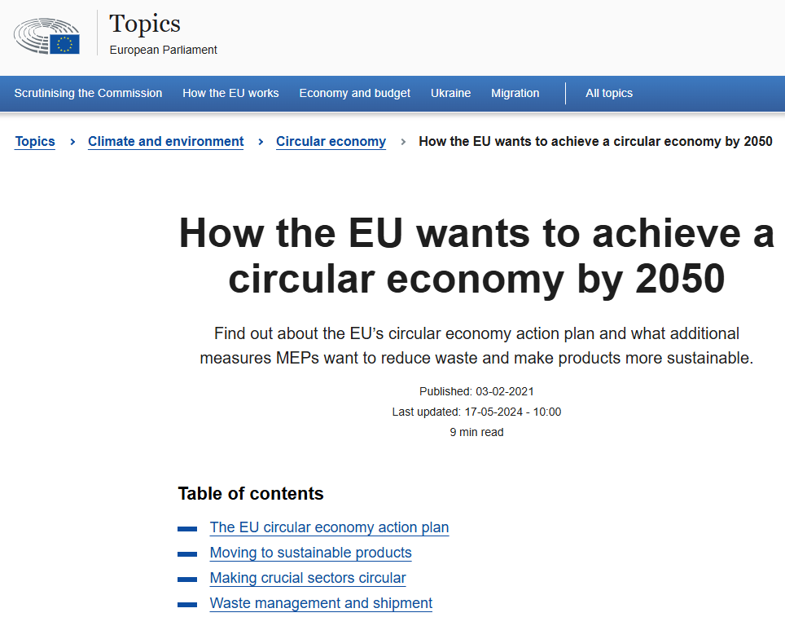
2020, the European Commission presented the circular economy action plan, which aims to promote more sustainable product design, reduce waste and empower consumers, for example by creating a right to repair. There is a focus on resource intensive sectors, such as electronics and ICT, plastics, textiles and construction.
2021, the Parliament adopted a resolution on the new circular economy action plan demanding additional measures to achieve a carbon-neutral, environmentally sustainable, toxic-free and fully circular economy by 2050, including tighter recycling rules and binding targets for materials use and consumption by 2030.
2022, the Commission released the first package of measures to speed up the transition towards a circular economy, as part of the circular economy action plan. The proposals include boosting sustainable products, empowering consumers for the green transition, reviewing construction product regulation, and creating a strategy on sustainable textiles.
2022, the Commission proposed new EU-wide rules on packaging. It aims to reduce packaging waste and improve packaging design, with for example clear labelling to promote reuse and recycling; and calls for a transition to bio-based, biodegradable and compostable plastics.
What is the EU doing to become a circular economy?
Answer for the question could be found in 4 milestones…
3. Circular Economy Action Plan
Source: 2025, https://www.europarl.europa.eu/topics/en/article/20210128STO96607/how-the-eu-wants-to-achieve-a-circular-economy-by-2050

Slide 24
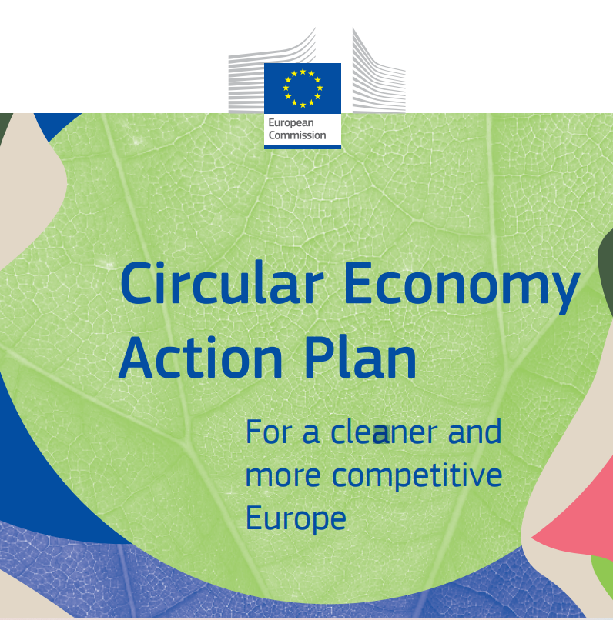
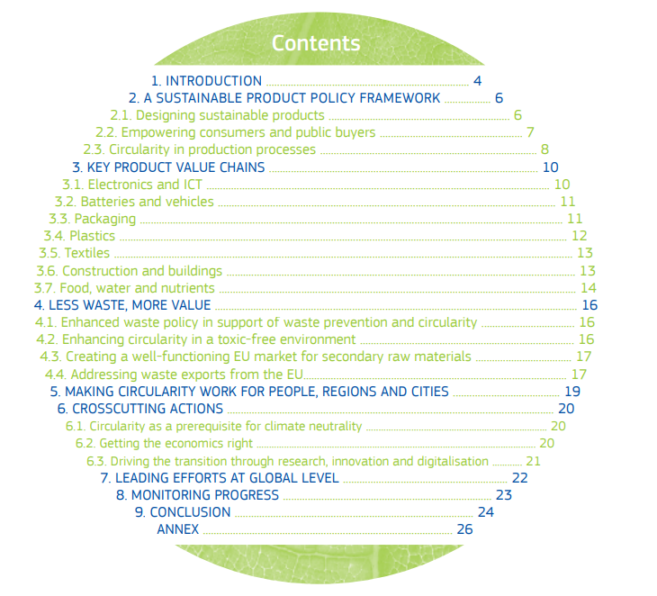
Circular Economy Action Plan - For a cleaner and more competitive Europe
For downloading in your Language: https://eur-lex.europa.eu/legal-content/EN/TXT/?qid=1583933814386&uri=COM:2020:98:FIN

Slide 25
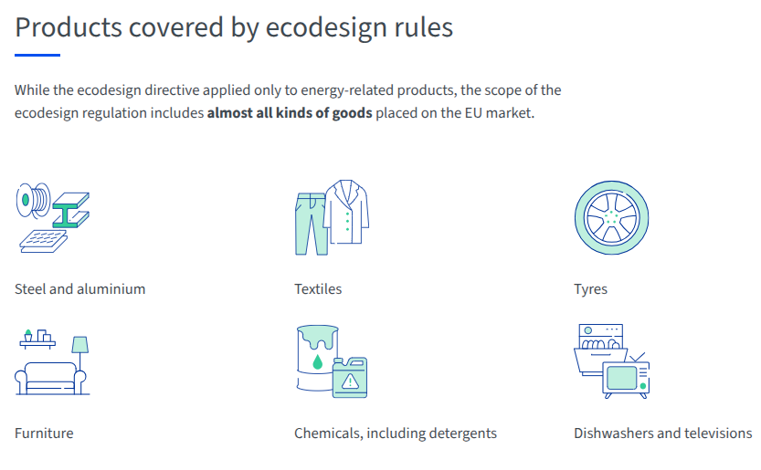
Circular Economy – European Action
Circular economy action plan
Designing sustainable products – Ecodesign (environmental requirements, digital product passport, prohibit the cestruction on certain unsold consumer goods (textiles and footwear). „Right to repair“ policy.
Empowering consumers
  have access to reliable information to make the right green choices
  be better protected against unfair green claims
  be better informed about the repairability of products before purchase
  Green Claims directive (rules address greenwashing)
Targeting key sectors
  Electronics and ICT, batteries and waste batteries, packaging,
  Plastics, textiles
Reducing waste
Source: 2025, https://www.consilium.europa.eu/en/policies/circular-economy/
Source: 2025, https://www.consilium.europa.eu/en/policies/ecodesign-requirements-for-more-sustainable-products/

Slide 26
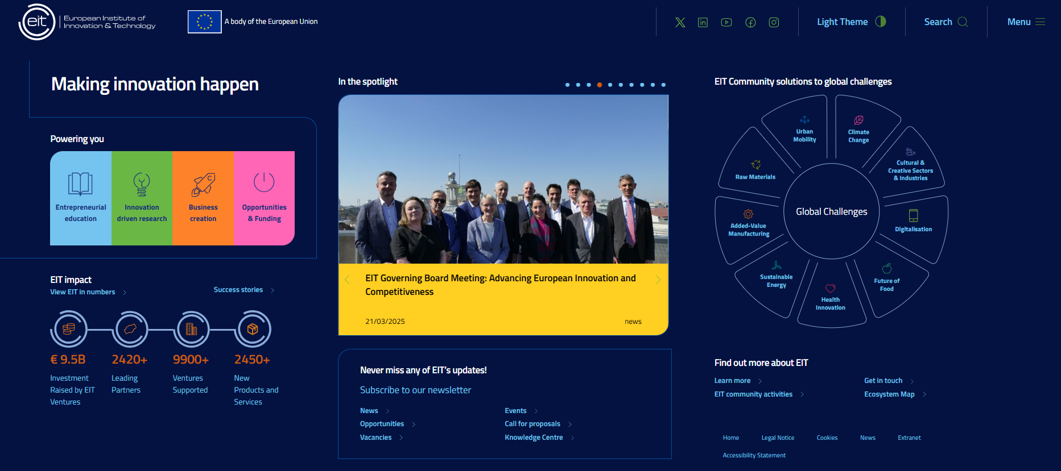
The European Institute of Technology and Innovation (EIT)
Use the link for European Institute of Technology and Innovation (for additional information). https://www.eit.europa.eu/
Notes:
Use the link for European Institute of Technology and Innovation (for additional information).

Slide 27
Showcasing examples of best practices in the circular economy is essential for several reasons:
Inspiration and Motivation
Real-world examples demonstrate that circular principles are not just theoretical—they work in practice. This inspires others, especially businesses, to adopt similar models.
Proof of Concept
Companies built on circular principles serve as living proof that such models can be economically viable, competitive, and scalable.
Knowledge Sharing
Best practices highlight specific strategies, technologies, and business models that can be adapted and replicated in other contexts, accelerating the transition to a more sustainable economy.
Building Trust and Legitimacy
Showcasing successful companies builds credibility and helps overcome skepticism among stakeholders, including investors, customers, and policymakers.
Encouraging Innovation
Highlighting successful circular businesses encourages others to innovate and experiment with new ways of creating value without waste.
Policy and Education Impact
Best practices inform policy development and serve as valuable teaching tools in education and professional training.
4. Stories for grab

Slide 28
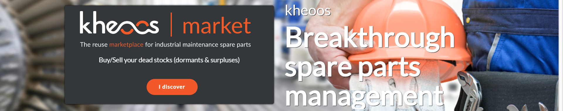
4. Storries for grabs – start-ups awarded from European Institute of Technology
kheoos is the B-to-B market place for industrial maintenance parts, favouring the connection between manufacturers, distributors, brokers and industrialists.
kheoos is the community platform that allows manufacturers managing maintenance parts to automatically build their customized catalogue and benefit from advanced services to lower their inventory levels, reduce their risk of breakage, find rare pieces and resell their dormant stock.
Source: https://kheoos.com/en/reuse-your-industrial-maintenance-spare-parts/
Notes:
T

Slide 29
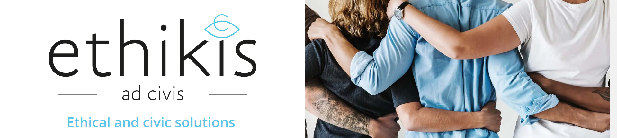

Storries for grabs – start-ups awarded from European Institute of Technology
ethikis, a social enterprise promoting ethical consumption and use, was awarded the prize for their LONGTIME® product label. This label, a certified stamp of approval, informs consumers that the product is durable and long-lasting. This aims to guide consumers towards more informed and responsible decision making when buying products.
Source: https://longtimelabel.com/en/
Notes:
T

Slide 30
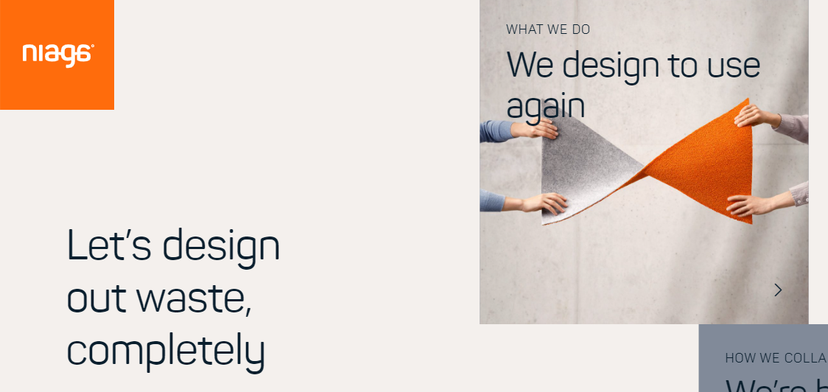
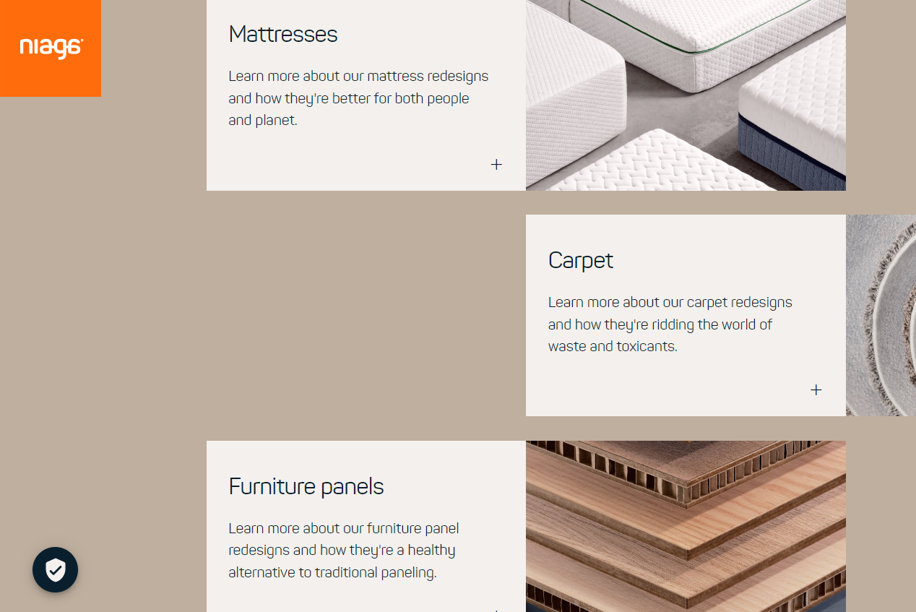
Storries for grabs – start-ups awarded from European Institute of Technology
Niaga’s solution is a scannable tag for products like mattresses and carpets that enables consumers to see exactly what they are made of and, crucially, how to recycle them. In this way, the Niaga® tag helps to keep valuable materials in the loop for future generations and significantly reduce waste.
Source: https://www.niaga.world/en
Notes:
T

Slide 31
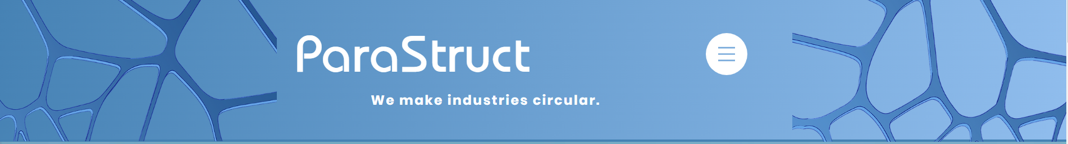
Storries for grabs – start-ups awarded from European Institute of Technology
An Alpine mission to decarbonise construction
Technicians and scientists witnessing the effects of climate change in the Alpine region came together to form the start-up ParaStruct. Their mission is to decarbonise the construction industry and reduce resource inefficiencies with an advanced 3D power-printing technology that enables the recycling of construction waste into high-quality materials for re-use.

Slide 32
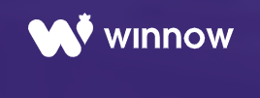
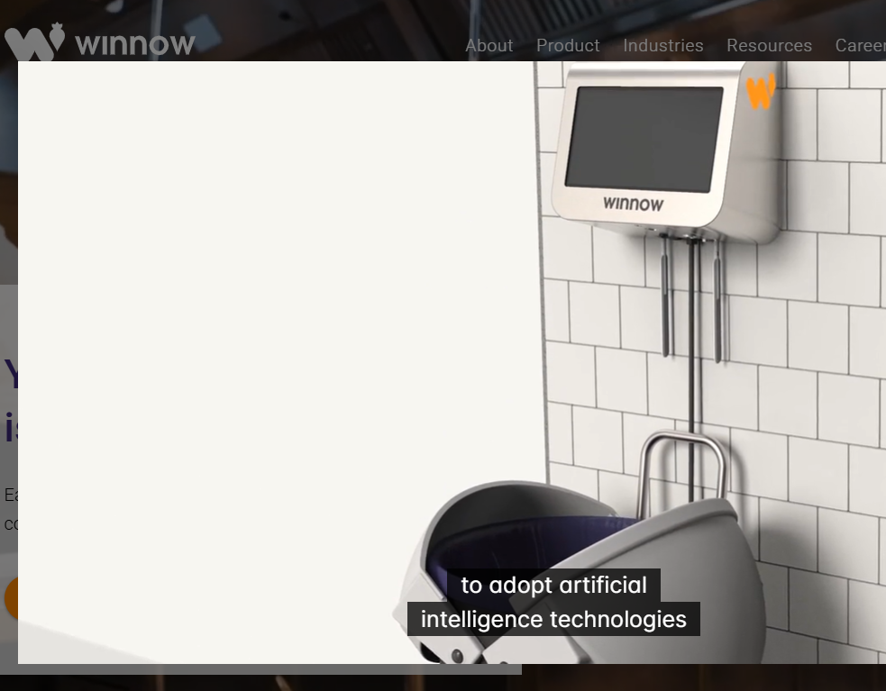
Storries for grabs
British start-up Winnow has developed smart meters that analyse trash. They are used in commercial kitchens to measure what food gets thrown away, and then identify ways to reduce waste.
  Up to a fifth of food purchased can be wasted in some kitchens, and Winnow has managed to cut that in half in hundreds of kitchens across 40 countries, saving its customers over $25 million each year in the process.
  That is the equivalent of preventing one meal from going to waste every seven seconds. This innovation earned Winnow the Circular Economy Tech Disruptor Award.
Source: https://www.winnowsolutions.com/
Notes:
Play video on Winnow website.

Slide 33
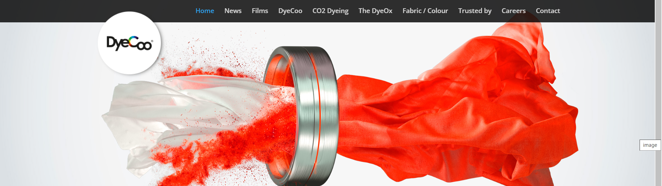
Storries for grabs
DyeCoo, based in Weesp, the Netherlands. Company has developed a process of dyeing cloth that uses no water at all, and no chemicals other than the dyes themselves. It uses highly pressurised “supercritical” carbon dioxide, halfway between a liquid and a gas, that dissolves the dye and carries it deep into the fabric.
The carbon dioxide then evaporates, and is in turn recycled and used again. 98% of the dye is absorbed by the cloth, giving vibrant colours. And because the cloth doesn’t need to dry, the process takes half the time, uses less energy, and even costs less. The company already has partnerships with major brands like Nike and IKEA.
Source: https://dyecoo.com/
Notes:
The textiles industry uses vast quantities of water and chemicals and produces huge amounts of toxic waste, which is a major problem in countries like China, India, Bangladesh, Vietnam and Thailand. But Dutch company DyeCoo has developed a process of dyeing cloth that uses no water at all, and no chemicals other than the dyes themselves.

Slide 34
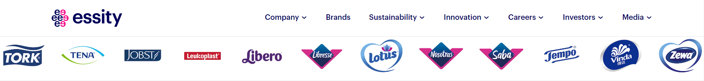
Storries for grabs
Essity is a global leader in sustainable solutions for hygiene and health, dedicated to improving well-being through products and services, essential for everyday life. Sustainability is an integral part of their business focusing on value creation for people, nature and society, critical to success and profitability.
They engage customer channels through our brands using three sustainability platforms:
  Well-being
  More from less
  Circularity
  At least 1/3 of all their innovations should improve society or the environment each year. Materials and energy will be recovered from all waste from all production sites by 2030.
Notes:
Watch a video and website for additional information in sustainability, circularity.

Slide 35
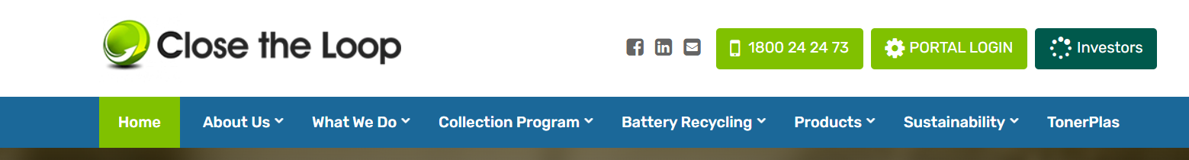
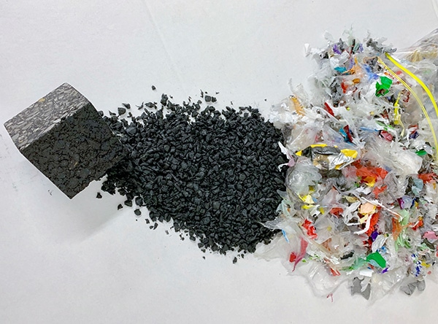
Storries for grabs
This Australian company has spent more than a decade recovering value from old printer cartridges and soft plastics. Their new innovation turns these materials into roads.
The products are mixed in with asphalt and recycled glass to produce a higher-quality road surface that lasts up to 65% longer than traditional asphalt.
In every kilometre of road laid, the equivalent of 530,000 plastic bags, 168,000 glass bottles and the waste toner from 12,500 printer cartridges is used in the mix.
So instead of ending up in landfill, all that waste is given a new life, getting us where we need to go.

Slide 36
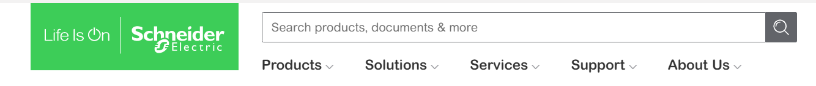
Storries for grabs
French-based Schneider Electric, which specialises in energy management and automation, won the Award for the Circular Economy Multinational.
Employing 142,000 people in more than 100 countries, it uses recycled content and recyclable materials in its products, prolongs product lifespan through leasing and pay-per-use, and has introduced take-back schemes into its supply chain.
Circular activities now account for 12% of its revenues, and will save 100,000 metric tons of primary resources from 2018-2020.

Slide 37
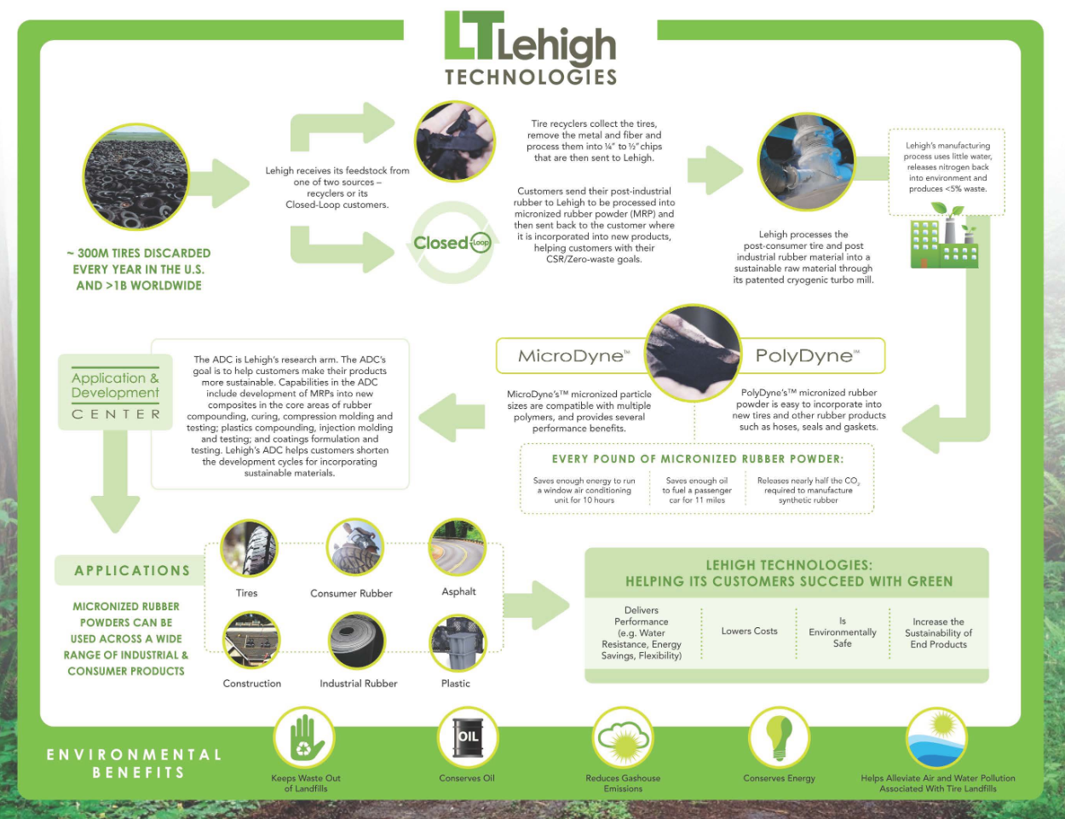
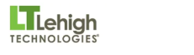
Storries for grabs
This Atlanta firm turns old tyres and other rubber waste into something called micronized rubber powder, which can then be used in a wide variety of applications from tyres to plastics, asphalt and construction material.
Five hundred million new tyres have been made using its products, earning it the Award for Circular Economy SME.
Source: https://www.lehightechnologies.com/the-company/what-we-do

Slide 38
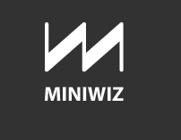
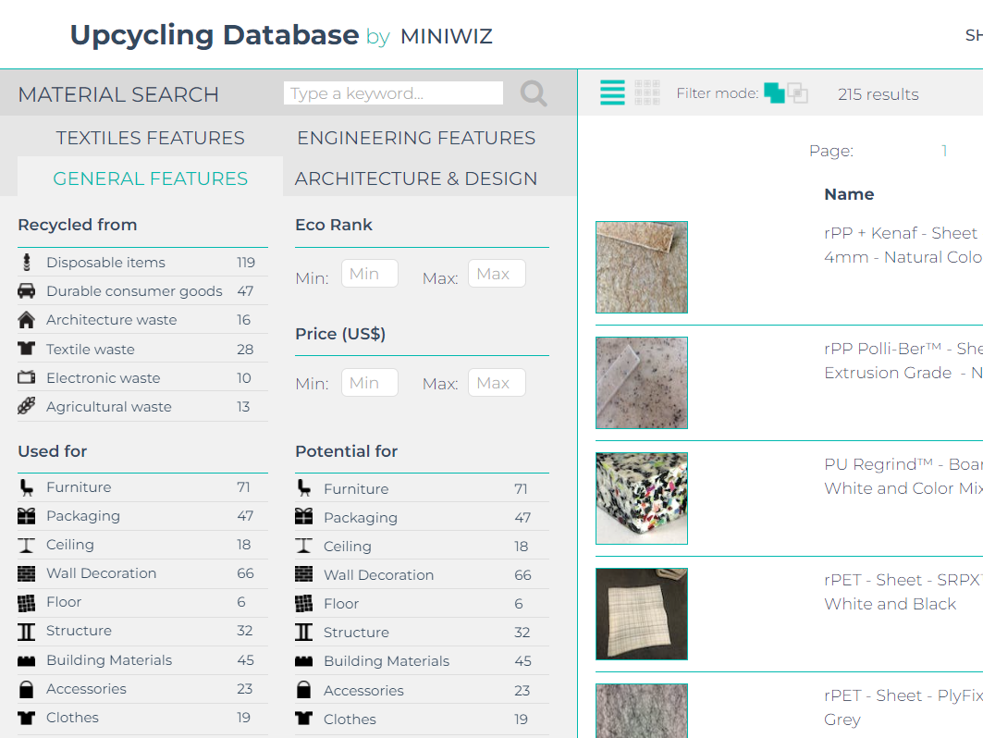
Storries for grabs
For the founder of Miniwiz, Arthur Huang, there is no such thing as trash. He is for upcycling - turning old materials into something new. As he admits, this isn’t a new idea - until the 20th century reusing whatever was lying around was the norm. But he is taking this principle to new levels, with the scientists and engineers in his Miniwiz Trash Lab inventing over 1,000 new sustainable materials and applications.
The Trashpresso machine is the ultimate expression of sustainable upcycling. It is a mobile upcycling plant that can be transported in two shipping containers to its customers. Once there, it turns 50kg of plastic bottles an hour into a low-cost building material, using no water, and only solar power.

Slide 39
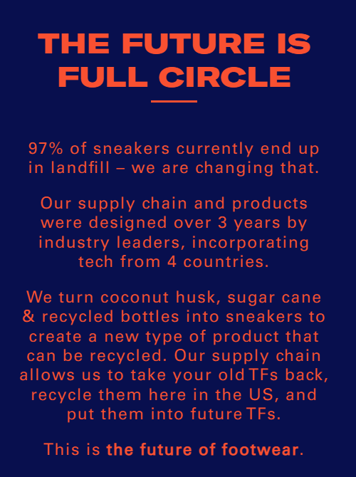
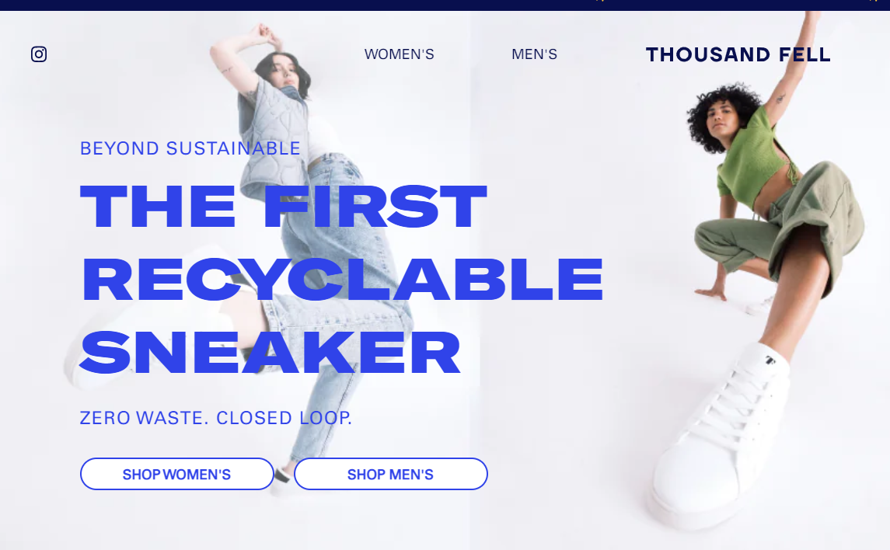
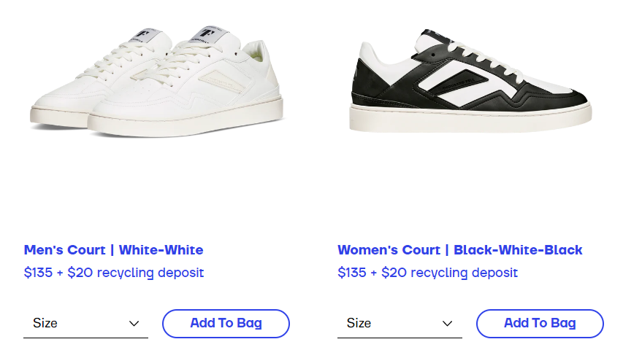
Storries for grabs
Thousand Fell is already making a name for itself as an environmentally-conscious manufacturer with shoes made from sustainable materials such as coconut husk and sugar cane, and even recycled plastic bottles,
Now, in partnership with TerraCycle and UPS, the maker has launched a special recycling incentive. Customers can return old pairs of Thousand Fell shoes back to the manufacturer. Thousand Fell will then recycle the returned footwear and send customers $20 that can be used toward a new pair of shoes.

Slide 40
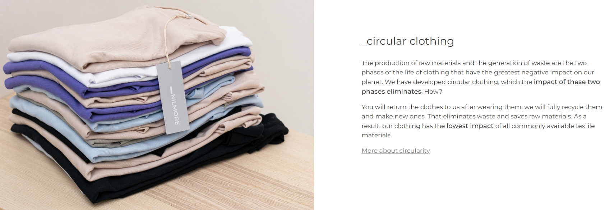
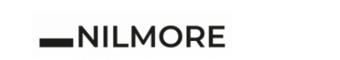
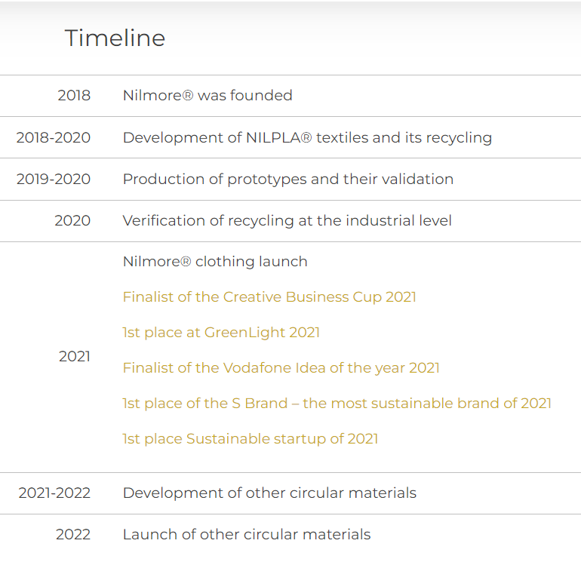
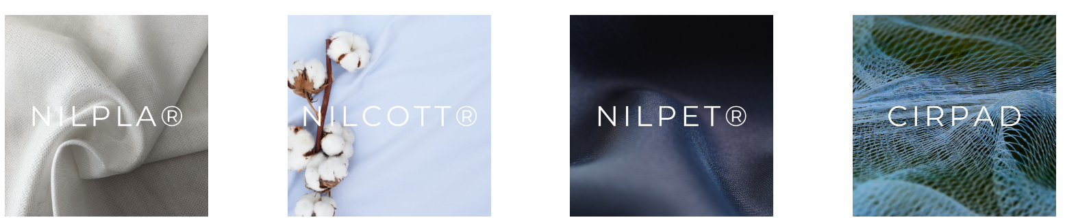
Storries for grabs
Czech company NILMORE _returning clothes for recycling
Do you no longer want our clothes? Is it worn or did it just go out of fashion? You can return it to us through our network of Nilmore® Circular Points. For each returned piece you will receive a 100 CZK discount, which you can use for the next purchase! If you have purchased a product from one of our partners

Slide 41
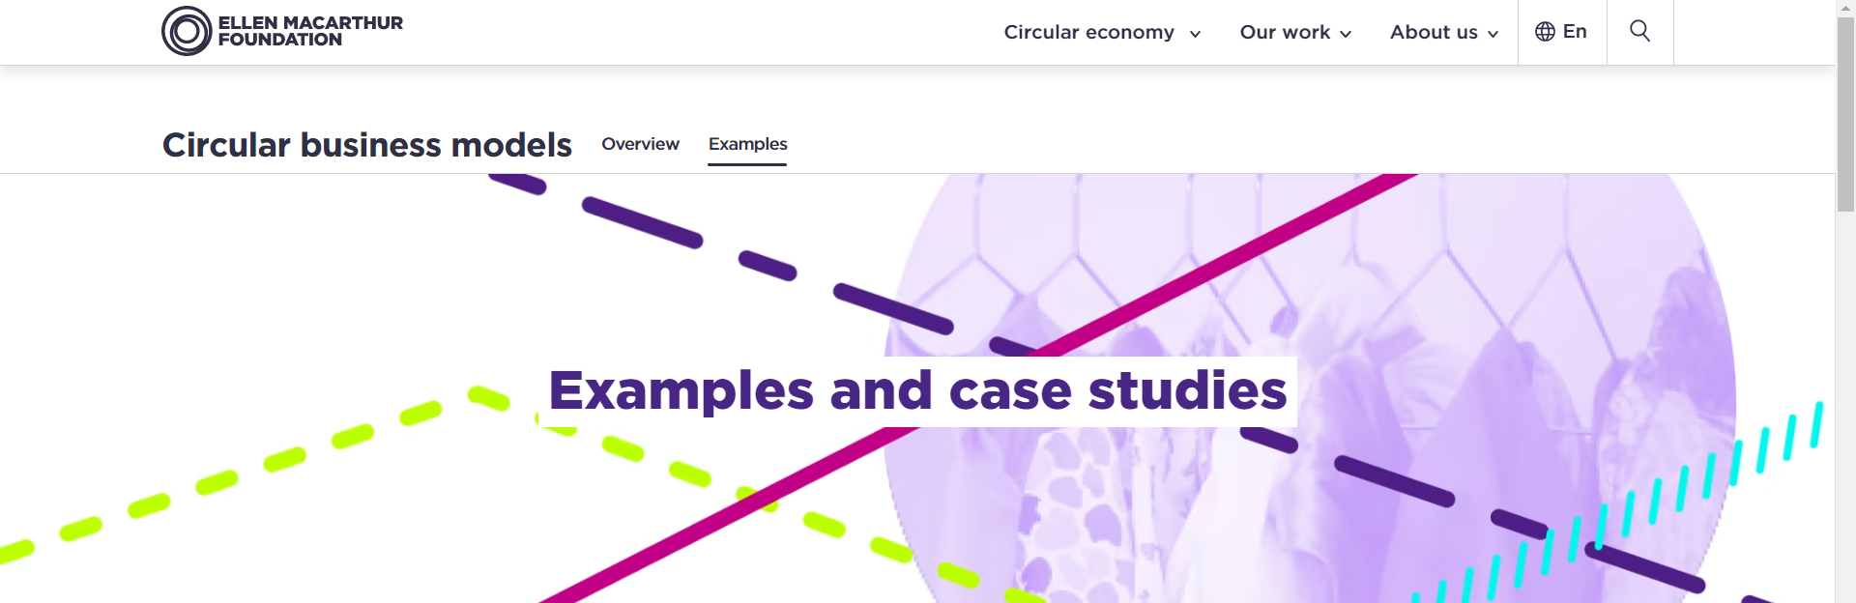

Impact on business concepts in new forms of business models
Circular Business models
(ELLEN MACARTHUR FOUNDATION)
10 Circular Business Model Examples (Circular value chains through data / Circular product design / Use, reuse, share, and repair )
10 Examples of Circular Economy Solutions (Industrial symbiosis / The Danish deposit and return systém for recycling cans and bottles / Denmark´s first circular soucial housing project / Recycling of artificial turf / Closed loop in reuse packaging-as-service / Re-using old bricks to build a greener future)
Circulars Awards Program

Slide 42



Explore publication…
Experiences from Denmark and New York on closing the loop through partnerships and circular business models
How business models can accelerate the transition to a circular economy
A circular economy as an opportunity
for successful innovations of Czech firms

Slide 43

Explore …
European Parliament/News/Priorities/Circular economy
Circular economy and waste reduction
Moving towards a resource-efficient society
Find out what the European Parliament is doing to ensure our resources are managed in a more sustainable way.
https://www.europarl.europa.eu/news/en/headlines/priorities/circular-economy

Slide 44


Slide 45
Use the infographic
and try to draw it!

Slide 46
Key Takeaways
Waste = Food: The concept of circular economy is based on the idea of zero waste. This principle requires continuous cycling and recycling of materials and products rather than discarding them as waste. This principle aligns with nature’s course wherein one species’ waste is another species’ food.
Resilience through diversity: CE demands that the production and consumption systems should leverage on the biodiversity in the ecosystem and the diversity in the human economic space (in terms of resources) to reboot the system at all times such that inputs for the production process are sourced from the supply chain. This ensures resources continue to flow continuously within the circle, as opposed to the linear approach.
Energy from Renewable Resources: CE requires that energy be sourced from renewable sources; it emphasizes Solar energy, wind power and tidal power as against the popular use of oil and gas. This is not unconnected with the natural system wherein plants generate their food through sunlight.
Think in Systems: A central message of CE is the need to work as inter-connected systems rather than stand-alone units. CE works better with different groups working together to create effective flows of materials and information to keep the circle unbroken. As a result of this principle, global success of the CE concept thrives on collaborations and partnership.

Slide 47

Key Takeaways

Slide 48

Thank you…
Name: Pavel Adámek, Ph.D.
Corporate Social Responsibility Specialist
Guarantor of the master's course CSR
E-mail address: adamek@opf.slu.cz

