Slide 1

ENVIRONMENT, SOCIAL AND GOVERNANCE
Pavel Adámek, Ing., Ph.D.
adámek@opf.slu.cz
Department of Business Economics and Management
Corporate Social Responsibility Specialist
Guarantor of the master's course Corporate Social Responsibility
Business Sustainability and ESG
Blended Intensive Programme
6th May, 2025

Slide 2

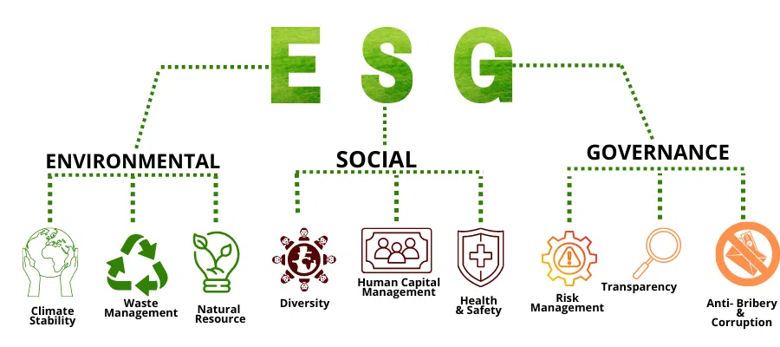
Content
Introduction to Corporate Social Responsibility
The CSR Hierarchy (The Pyramid of CSR)
The triple bottom line (Corporate, Social, and Environmental pillar)
The Evolution of CSR – Timeline of key CSR events
European Sustainability Reporting Standards
Source: https://sigmaearth.com/what-is-an-esg-statement/

Slide 3

CSR means responsibility among firms to meet the needs of their stakeholders, and a responsibility among stakeholders to hold firms to account for their actions. (Chandler, 2023).
It is related to, but can be distinguished from, environmental, social and governance policy (ESG), which is more about how investors see the company.
The criteria ensure that a business is being socially responsible and held accountable, which is in the best interest of shareholders and potential investors.
Corporate social responsibility (CSR) is about the impact an organisation makes on society, the environment and the economy.
CSR and relation to ESG?
1. Introduction to Corporate Social Responsibility

Slide 4
1. Introduction to Corporate Social Responsibility
So what is the point of ESG?
Having an effective CSR programme contributes positively to all stakeholders as well as adding value for the organisation itself, and ensures it operates in a sustainable way.
ESG stands for environmental, social, and governance, and is a holistic framework that measures the sustainable and ethical behaviour of a business.
It´s becoming a core strategy for companies - how to maximize the interests of stakeholders and shareholders.
Formal consequences?
The burgeoning interest in corporate environmental, social and governance (ESG) information from investors, society, central bankers and others has led to welcome developments in reporting frameworks, codes, rules and practices.
Frameworks that promote further integration between non-financial and financial reporting.
European Commission has introduced the Corporate Sustainability Reporting Directive (CSRD) which sets disclosure rules - mandatory European Sustainability Reporting Standards.
Source: ESG Disclosure Handbook, WBSC, 2019, https://docs.wbcsd.org/2019/04/ESG_Disclosure_Handbook.pdf

Slide 5

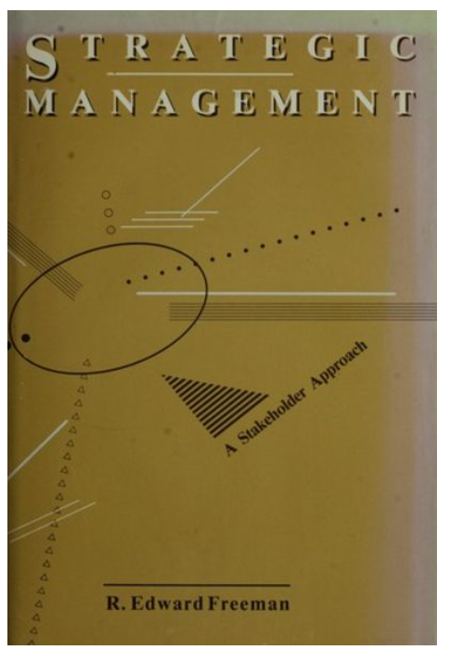
1. Introduction to Corporate Social Responsibility
This raises the question, what is a „VALUE"?
For a deeper understanding, let's look at Stakeholder Theory...
The first definition of stakeholder approach was articulated by R. Edward Freeman, who in his 1984 book Strategic Management: A Stakeholder Perspective developed what has come to be known as Stakeholder Theory.
Stakeholder Theory addresses the question of what or who really matters to corporations.
Like stakeholder theory, CSR implies that an organization identifies its various stakeholder groups and then attempts to balance their respective needs within the organization´s overall strategy.
Management should not only consider its shareholders in the decision making process, but also anyone who is affected by business decisions.
Source: https://www.youtube.com/watch?v=epxmG3YRgok

Slide 6

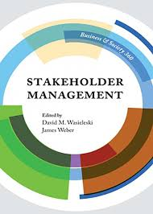

1. Introduction to Corporate Social Responsibility
Stakeholder Theory challenges the traditional view of the firm: shareholders/stockholders are the owners of the company. An inclusive stakeholder approach makes commercial sense, allowing the firm to maximize shareholder wealth, while also increasing total value added.
Today, CSR is focused on a stakeholder model which has become widely accepted among contemporary business organizations.
Stakeholder theory argues that there are other parties involved with a legitimate “stake” in business decisions, including:
Communities and their governmental bodies
NGOs and other community groups
Employees and unions
Suppliers and customers
…
Source: https://www.youtube.com/watch?v=epxmG3YRgok

Slide 7
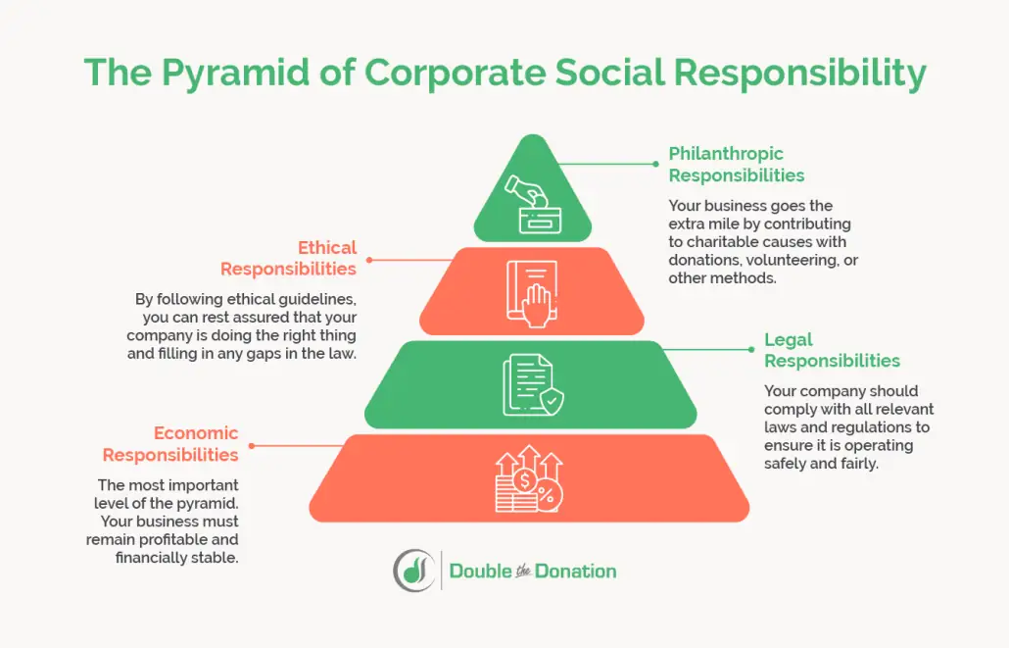
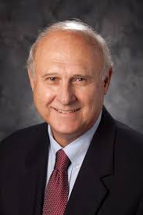
2. The CSR Hierarchy (The Pyramid of CSR)
Defined by Archie B. Carroll in 1991.
Demonstrates the hierarchy of responsibilities in an organization.
Economic, Legal, Ethical, Philanthropic responsibilities.
The logic is that an organization must fulfil a lower level and move to a higher level.
Argues that only by fulfilling all of these responsibilities together can effective CSR be achieved.
Source: https://doublethedonation.com/pyramid-of-corporate-social-responsibility/

Slide 8
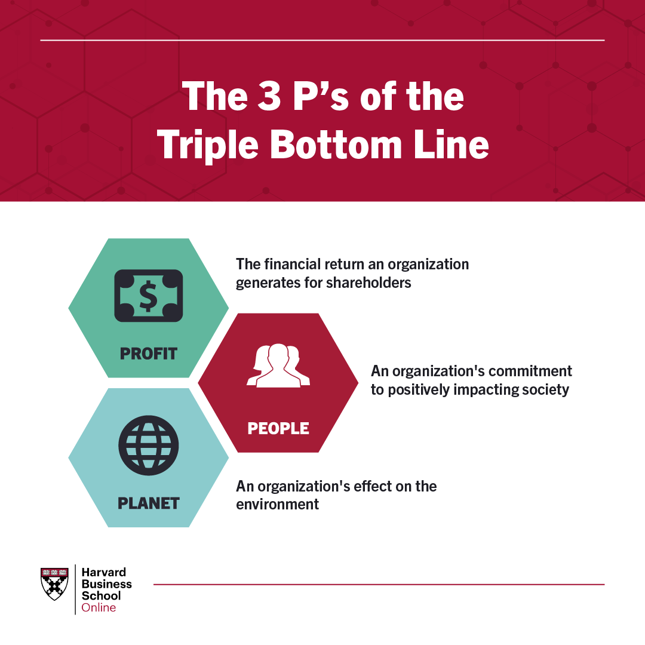

3. The triple bottom line (Corporate, Social, and Environmental pillar)
The triple bottom line (TBL, John Elkington, 1994)
The triple bottom line of business or triple responsibility.
Simply put, it is a principle according to which companies focus not only on economic profit, but also on social and environmental aspects.
Profit – Economic pillar
People – Social pillar
Planet – Environmental pillar
Source: https://online.hbs.edu/blog/post/what-is-the-triple-bottom-line

Slide 9
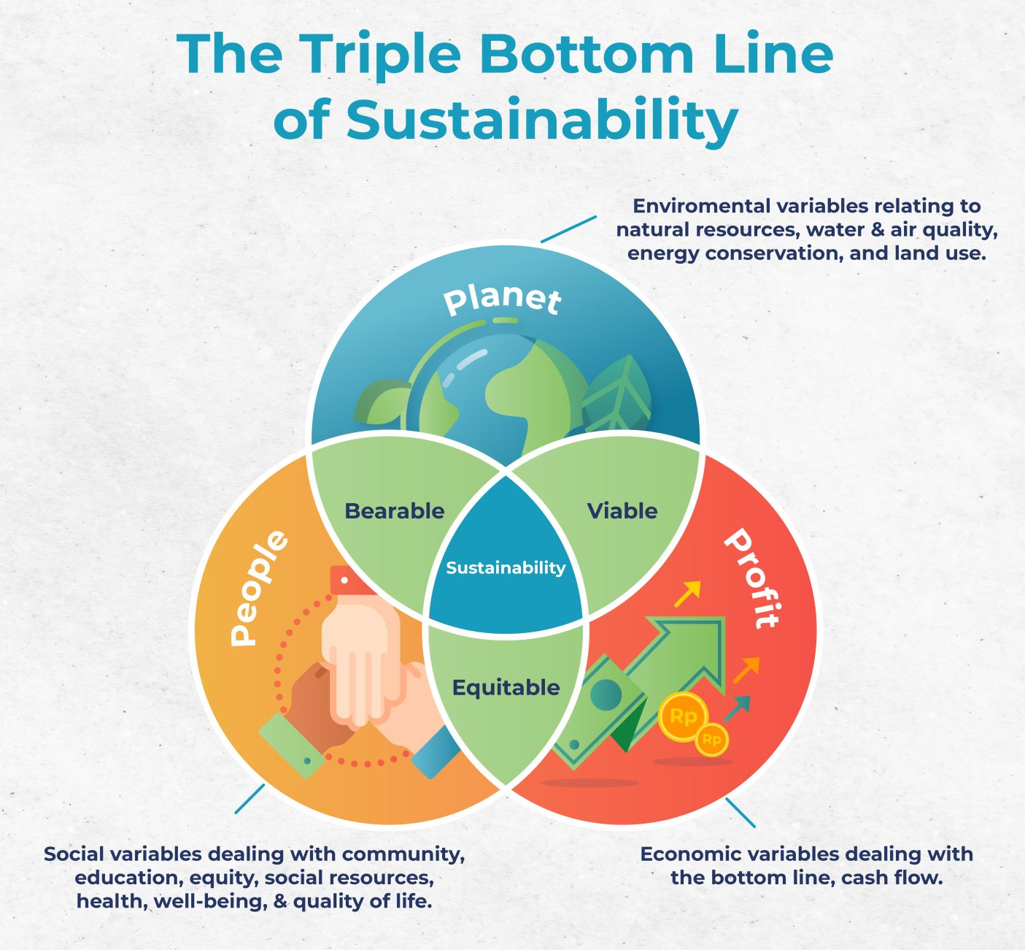

2. The triple bottom line (Corporate, Social, and Environmental pillar)
Source: https://online.hbs.edu/blog/post/what-is-the-triple-bottom-line

Slide 10
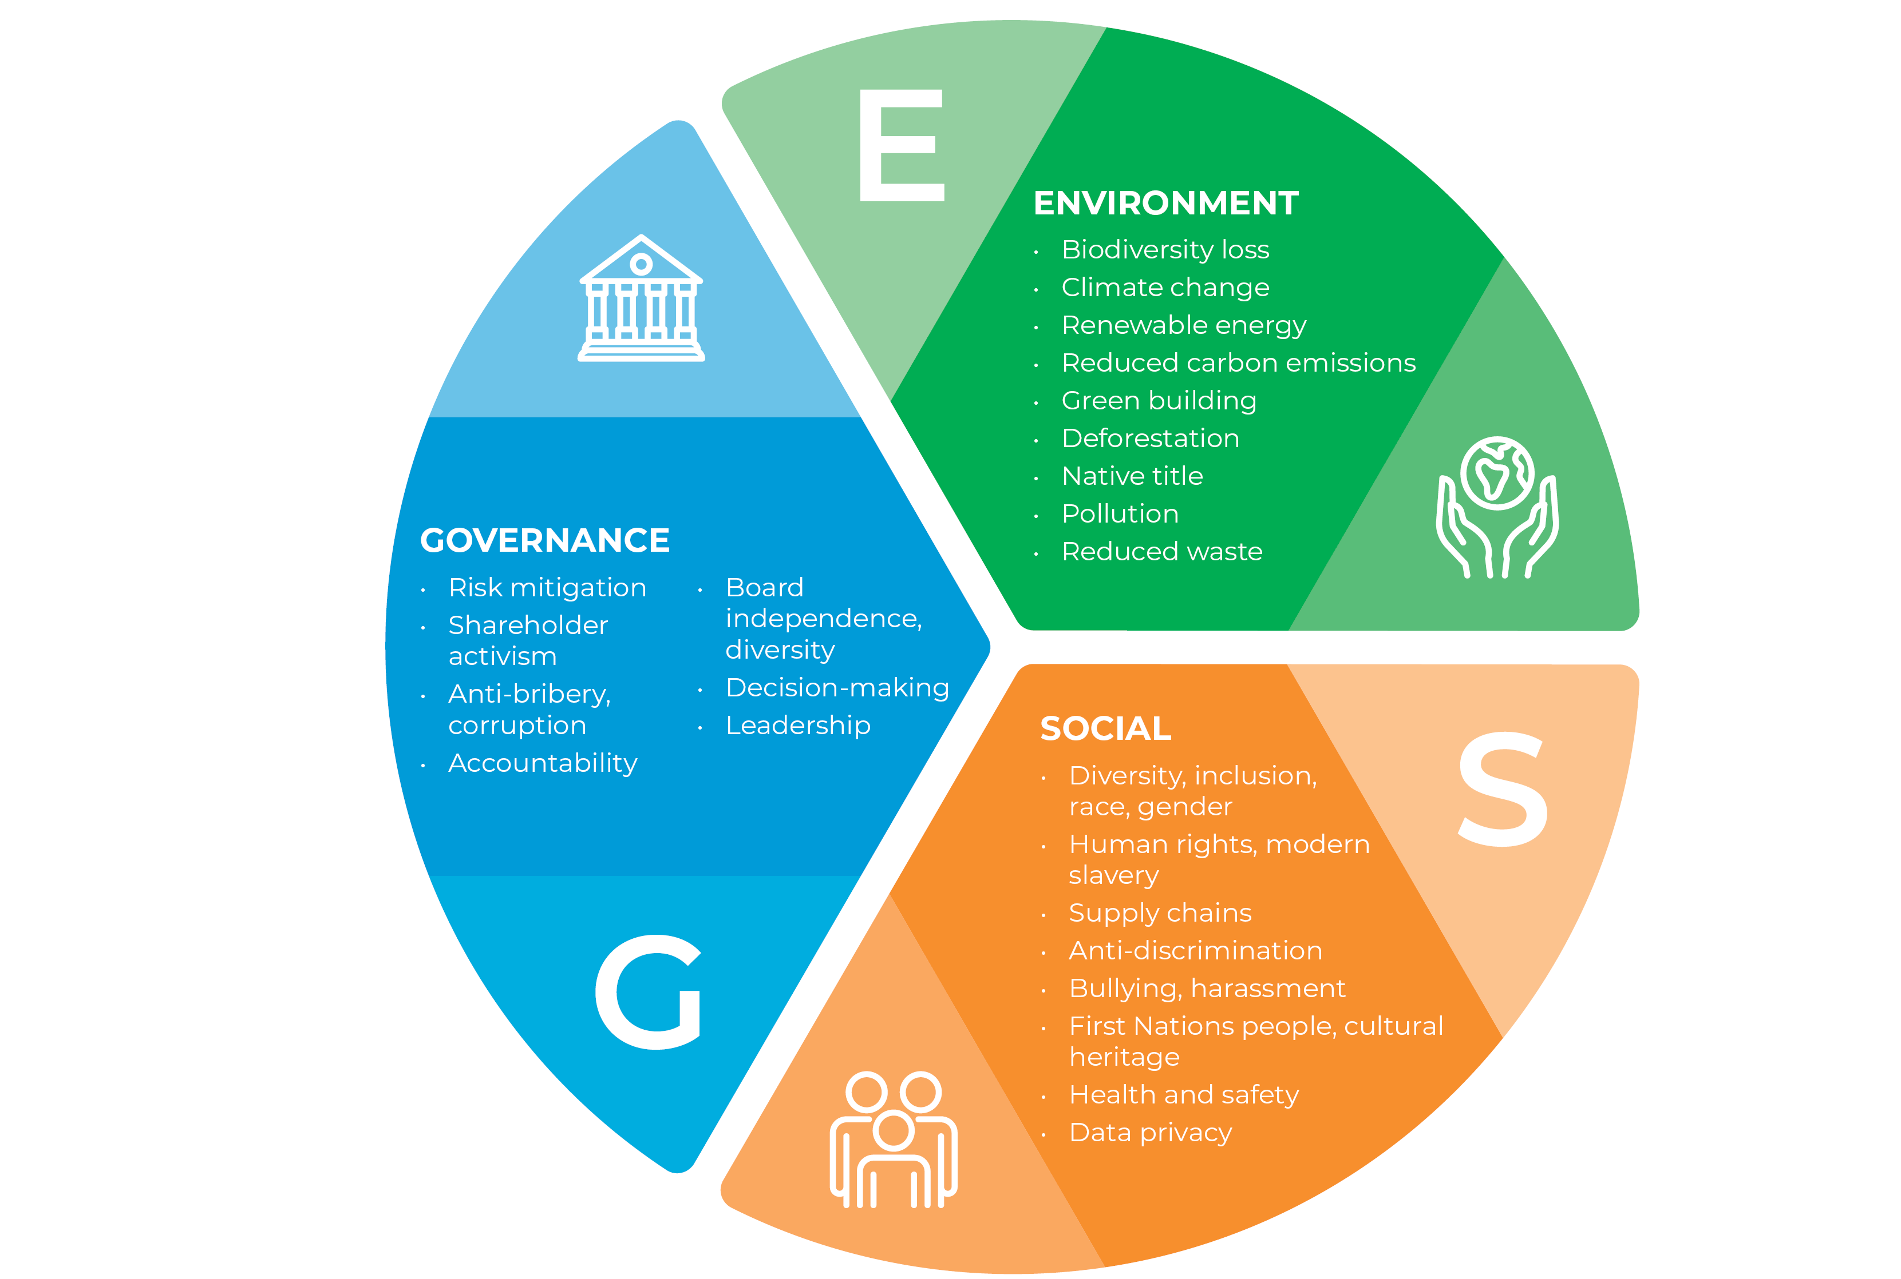
Source: https://www.holdingredlich.com/environmental-social-and-governance-esg-explained-five-important-considerations-for-companies-and-their-lawyers

Slide 11
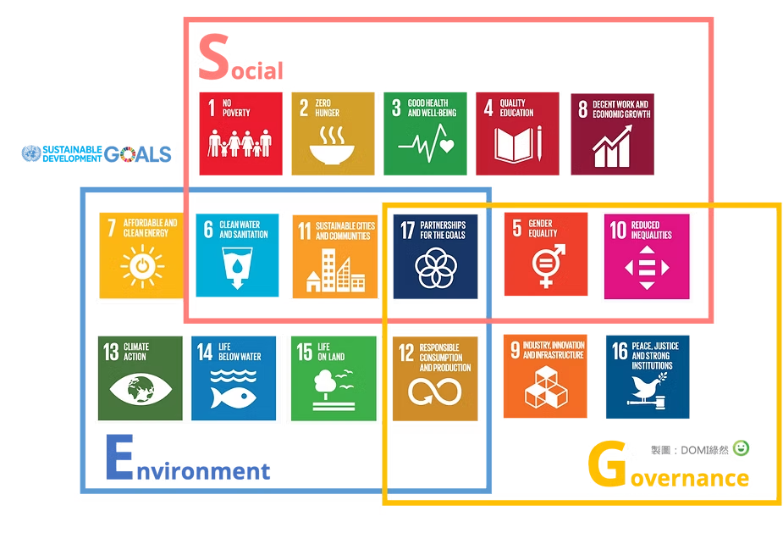
Source: https://www.domiearth.com/en/post/what-is-esg

Slide 12
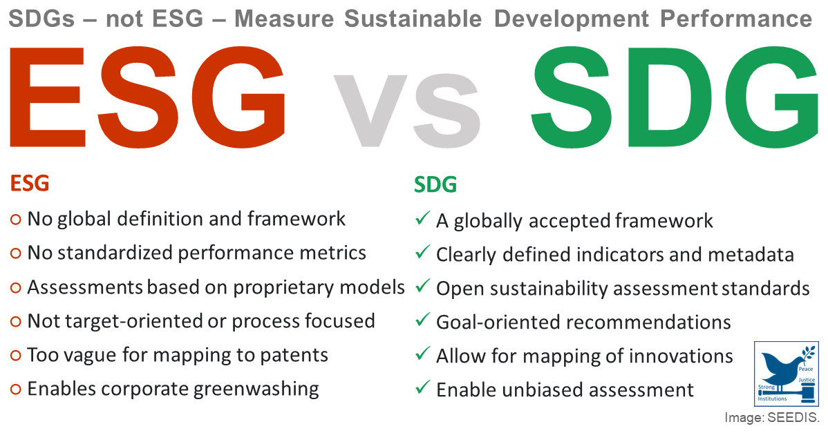
Source: https://buildaction.org/abstracts/sdg-vs-esg-which-measures-sustainability-better/#

Slide 13
Examples of activities in the Environmental pillar (1/1)
CSR Topics | CSR Activities | Examples
Environmental Policy | Management | Environmental strategy, use of standards (ISO 14001, EMAS), environmental audit
 | Supply Chain | Environmental criteria for supplier selection
 | Stakeholder Engagement | Cooperation on environmental activities, suggestions for improving environmental practices
 | Communication | Environmental training, information about the company’s environmental policy
 | Climate Change | Measures to reduce carbon footprint
 | Energy Saving | Measures and equipment for energy saving (proper insulation, energy-efficient technologies, heating regulation)
Energy and Water | Renewable Resources | Use of solar energy, biomass
 | Water Saving | Measures and equipment for saving water
 | Utility Water | Use of utility water in production processes, for watering greenery or toilets
Waste and Recycling | Sorting and Recycling | Sorting and recycling paper, plastic, toner, cartridges, and other materials
 | Waste Minimization | Double-sided printing, returnable barrels for drinking water, optimization of the production process

Slide 14
Examples of activities in the Environmental pillar (1/2)
CSR Topics | CSR Activities | Examples
Transport | Employee commuting | Promotion of environmentally friendly commuting
 | Business travel | Reduction of business trips (videoconferencing)
 | Goods transport | Optimization of logistics
Products and Packaging | Eco-friendly products | Products or services with an eco-label
 | Packaging materials | Minimization of packaging materials, eco-friendly packaging materials
Procurement | Eco-friendly purchasing | Recycled paper, ecological cleaning products, energy-efficient products
 | Local suppliers | Purchasing from local suppliers

Slide 15

LEGO – Commitment to Sustainability?
Lego is the first and only toy company to be named a World Wildlife Fund Climate Savers Partner, committing to reducing its carbon footprint.
By 2030, the toymaker plans to use environmentally friendly materials in all of its core products and packaging – and has already taken key steps to achieve this goal.
In 2018, the company introduced 150 botanical pieces made from sustainably sourced sugarcane.
Along with these changes, the toymaker has committed to investing $164 million in its Center for Sustainable Materials, where researchers are experimenting with bio-based materials that can be implemented into the manufacturing process.

Slide 16

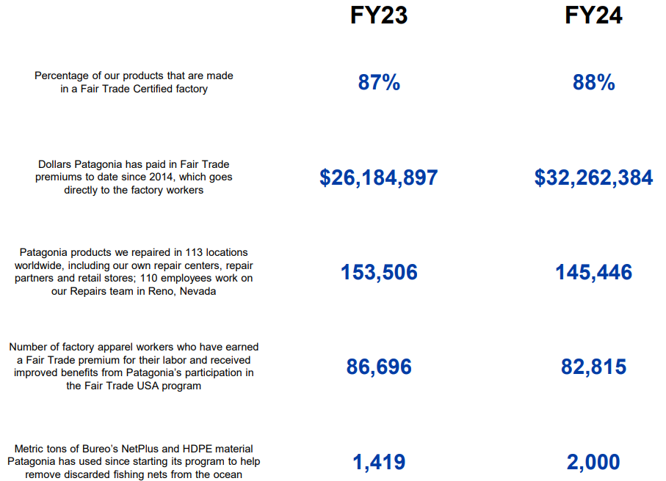

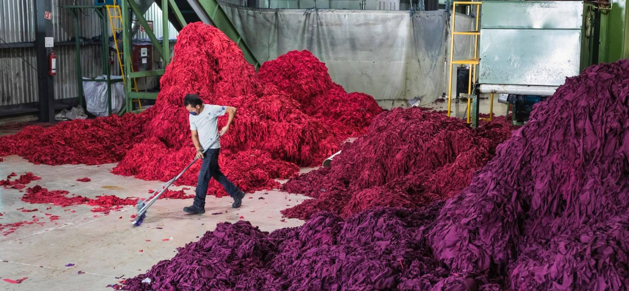

Source: https://www.patagonia.com/on/demandware.static/-/Library-Sites-PatagoniaShared/default/dw2f8292a3/PDF-US/Patagonia-2023-2024-BCorp-Report.pdf

Slide 17
Examples of activities in the Social pillar (1/1)
CSR Topic | CSR Activity | Examples
Employee Engagement and Communication | Collecting Feedback | Satisfaction survey, complaint tracking and resolution
 | Employee Involvement in Decision-Making | Gathering suggestions for improving company performance, employee impact on CSR focus
 | Internal Communication | Use of internal communication tools, informing job applicants about CSR
Work Reward and Compensation | Financial Compensation | Appropriate salary compensation, sports and relaxation opportunities, cultural activities, social events for employees
 | Non-financial Benefits | Extra vacation time, personal comfort (laptop, car, phone), commuting allowance, employee events
Education and Development | Employee Training | Training, courses, mentoring
 | Professional Development | Career development plans

Slide 18
Examples of activities in the Social pillar (1/2)
CSR Topic | CSR Activity | Examples
Health and Safety | Company Policy | Rules, measures, training
 | Health Services | Contribution to premium healthcare, vaccinations
Work–Life Balance | Flexible Work Forms | Flexible working hours, home office, reduced hours, shift work, job sharing
 | Care for Children, Seniors, or Sick Persons | Childcare allowance, psychological counselling
 | Employees on Parental Leave | Contact during parental leave, support for return to work
Outplacement | Support for Laid-off Employees | Financial assistance, job search help, retraining and education
Equal Opportunities | Anti-discrimination Measures | Preventing discrimination in recruitment and the workplace
 | Workplace Diversity | Promoting diversity (women, ethnic minorities, disabled, seniors)
Support for Local Community | Corporate Volunteering | Employees volunteering during working hours (manual work or knowledge sharing)
 | Matching Fund | Company doubles funds raised by employees
 | Charity Events | Charity balls, auctions, raffles

Slide 19
Examples of activities in the Social pillar (1/3)
CSR Topic | CSR Motion | Examples
Community Support | Corporate Donations | Financial or material support, offering services at a discount or for free, renting out company premises
 | Corporate Volunteering | Employees performing volunteer work during working hours (manual work or knowledge sharing)
 | Corporate Investment in Local Community | Long-term strategic involvement in the local community or partnerships with non-profit organizations
 | Commercial Activities in the Local Community | Shared marketing, sponsorship
 | In-house Corporate Projects | Own public-benefit projects
 | Fair Trade, Ethnocatering | Use of Fair Trade products and ethnocatering at corporate events, receptions, breakfasts
Cooperation with Schools and Universities | Cooperation with Students | Student internships, work placements, excursions, thesis consultations
 | Support for Education | Support of student activities, lending or donating technology, participation in teaching
Stakeholder Engagement | Employee Involvement | Corporate volunteering, matching fund, charity events involving employees
 | Customer Involvement | Engaging customers in company CSR activities
 | Business Partner Involvement | Involving business partners in CSR activities

Slide 20
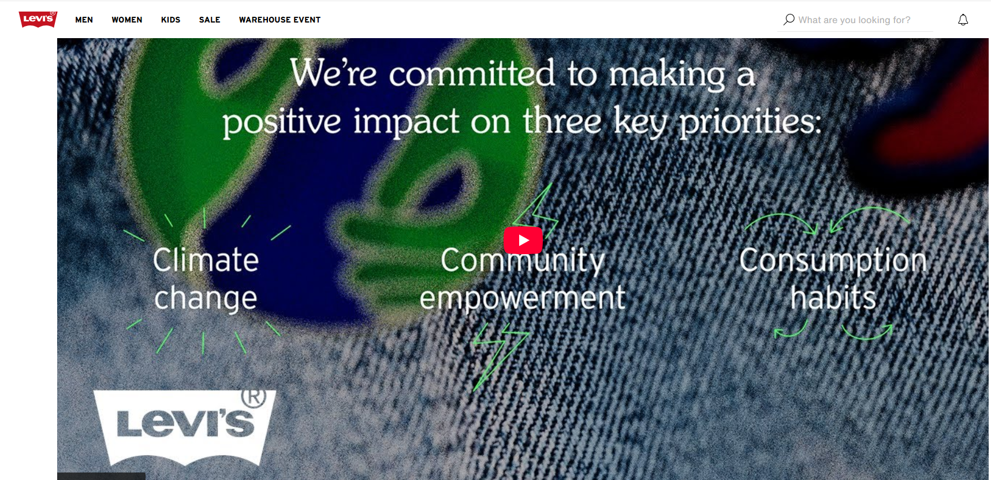
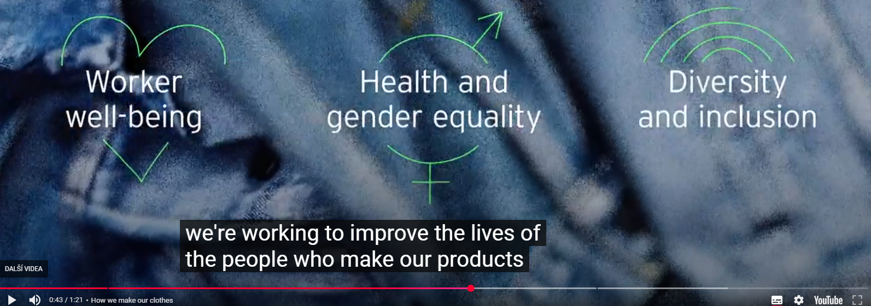
Levi Strauss’s Social Impact
In 1991, the brand created its Terms of Engagement, which established its global code of conduct for the supply chain and set standards for employee rights, a safe working environment and an environmentally friendly manufacturing process.
Since 2011, the Worker Well-being initiative has expanded to 12 countries, benefiting more than 100,000 workers. In 2016, the brand expanded the initiative, promising to expand the program to more than 300,000 workers and produce more than 80% of its products in Worker Well-being factories by 2025. The initiatives have proven to be a driver of business success.

Slide 21

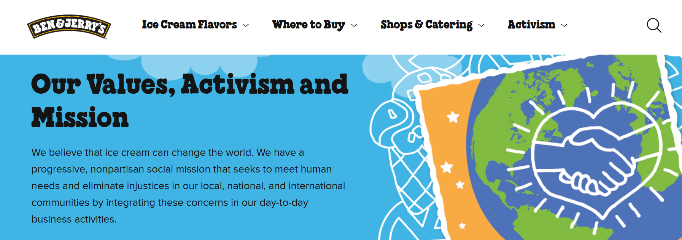
Ben & Jerry’s Social Mission
In 2012, the company became a certified B Corporation - a business that balances purpose and profit by meeting the highest standards of social and environmental performance, public transparency and legal accountability.
Ben & Jerry's Foundation in 1985, an organization dedicated to supporting civic movements that drive social change. The foundation awards approximately $2.5 million in grants to organizations each year. Grant recipients include the United Workers Association, which works to end poverty and human rights, and the Clean Air Coalition, which works for health and environmental justice.
Source: https://www.benjerry.com/values

Slide 22
Examples of activities in the Governance pillar (1/1)
CSR Topic | CSR Activity | Examples
Corporate Governance and Management | Transparency | Publishing financial and non-financial information
 | Code of Conduct | Code of ethics and its practical use
 | Corporate Image | Monitoring and measuring company image
 | Feedback Gathering | Satisfaction survey, complaint registration and resolution
Responsible Customer Approach | Customer Involvement in Decision-Making | Collecting suggestions for product/service improvement, customer influence on CSR focus
 | Product and Service Quality | Use of quality standards (e.g., ISO 9001)
 | Customer Education | Preventive or service training, safety training
Supplier and Business Partner Relations | Supplier Selection | Inclusion of CSR criteria in supplier selection
 | Feedback Gathering | Supplier satisfaction surveys, complaint handling
 | Business Relations | Timely invoice payments, monitoring CSR practices in the supply chain
 | CSR Promotion | Involving suppliers in CSR activities
Marketing and Advertising | Product Information | Providing clear and accurate information about products/services
 | Shared Marketing | Use of marketing activities for joint promotion of the company and charity
 | Advertising Ethics | Adhering to ethical advertising codes (e.g., issued by the Advertising Council)

Slide 23

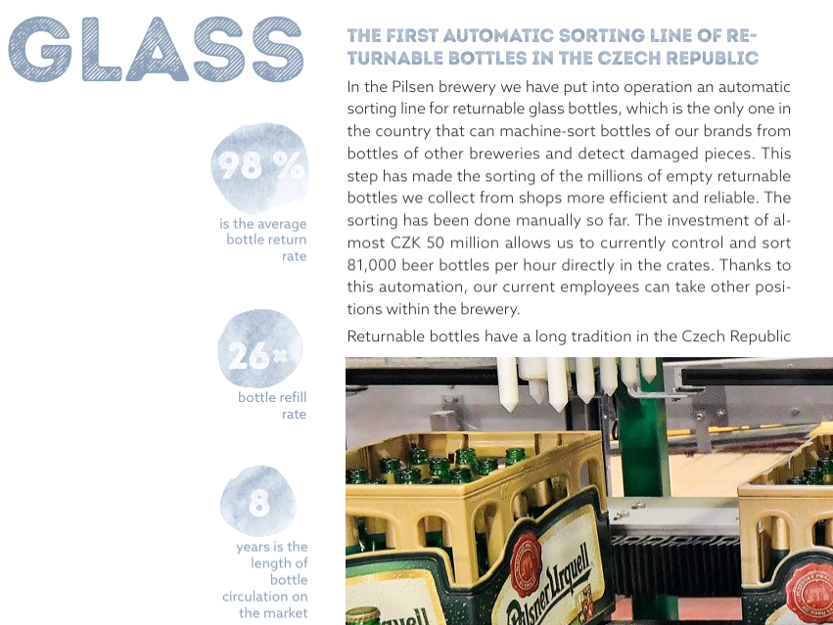
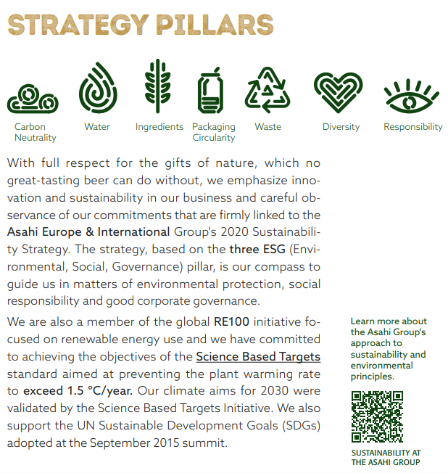
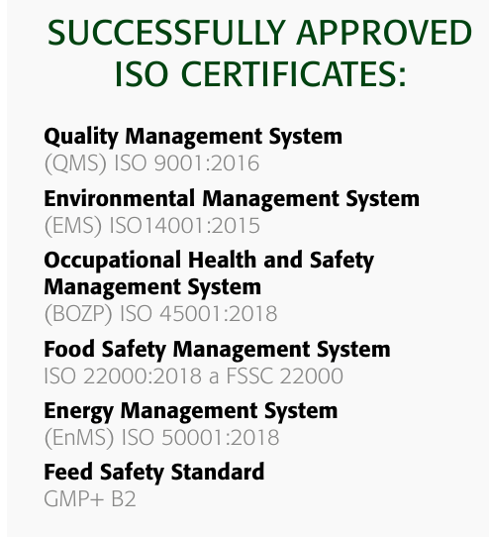
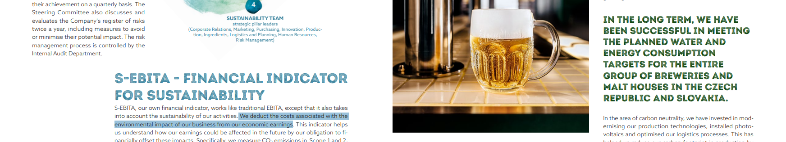
Source: https://udrzitelnost.prazdroj.cz/en/homepage-en/

Slide 24

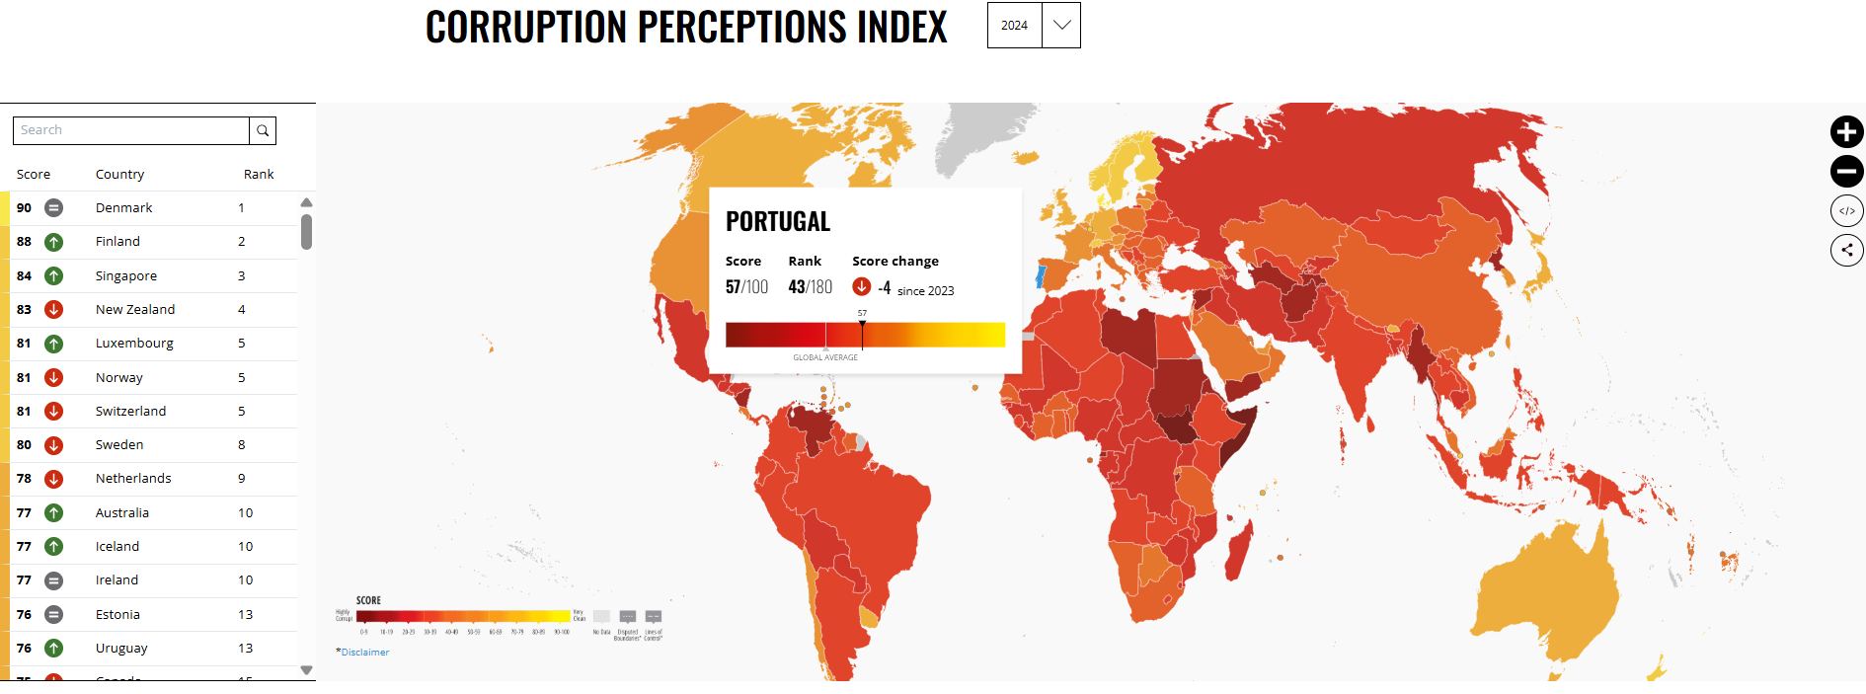
Source: https://www.transparency.org/en/cpi/2024

Slide 25
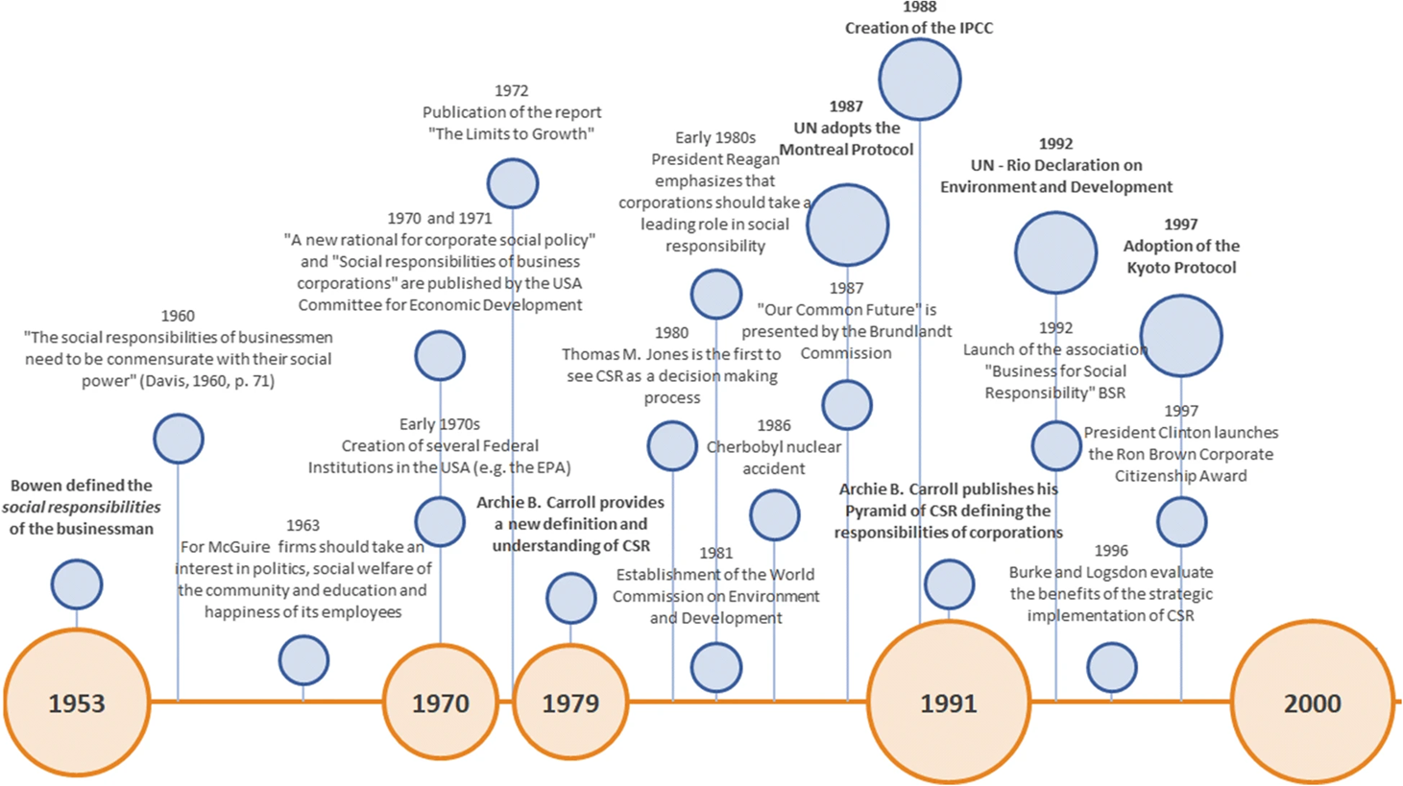
Timeline of key CSR events
Source: Latapí Agudelo, M.A., Jóhannsdóttir, L. & Davídsdóttir, B. A literature review of the history and evolution of corporate social responsibility. Int J Corporate Soc Responsibility 4, 1 (2019).

Slide 26
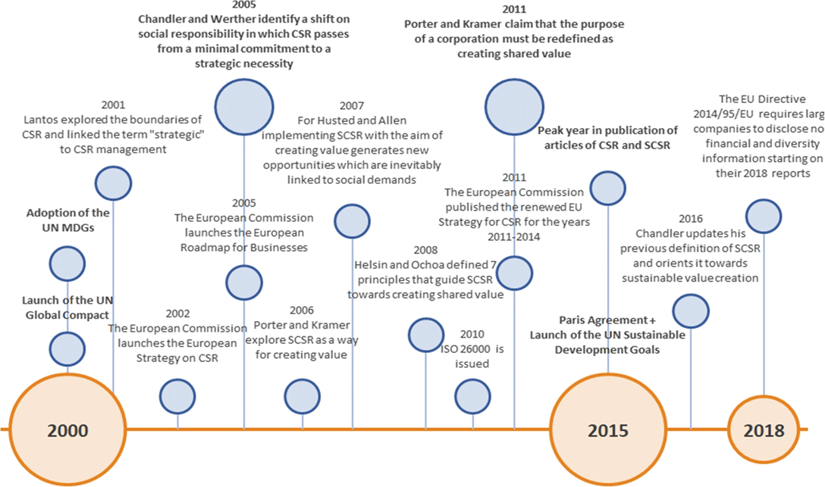
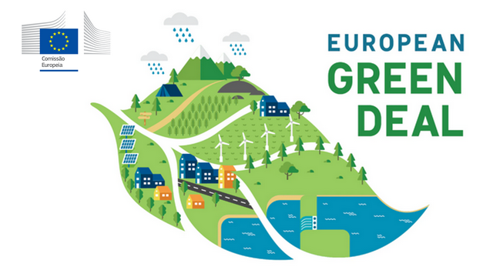
Timeline of key CSR events
Next ?!?
Source: Latapí Agudelo, M.A., Jóhannsdóttir, L. & Davídsdóttir, B. A literature review of the history and evolution of corporate social responsibility. Int J Corporate Soc Responsibility 4, 1 (2019).

Slide 27
5. European Sustainability Reporting Standards (ESRS)
So the question is, how to measure and report all this?
Corporate responsibility within the European Union has taken a significant leap forward with the implementation of the Corporate Sustainability Reporting Directive (CSRD). https://eur-lex.europa.eu/legal-content/en/TXT/?uri=CELEX:32023R2772
This directive serves as a cornerstone of the EU’s comprehensive strategy to enhance corporate transparency, integrate sustainability into core business strategies, and foster long-term growth.
At the heart of this directive are the European Sustainability Reporting Standards (ESRS), which are designed to standardise how companies report on environmental, social, and governance (ESG) factors, ensuring that sustainability disclosures are consistent, comparable, and actionable across the EU. https://finance.ec.europa.eu/capital-markets-union-and-financial-markets/company-reporting-and-auditing/company-reporting/corporate-sustainability-reporting_en#legislation
For detailed view of the structure ESRS and metrics look at https://cfrr.worldbank.org/sites/default/files/2023-12/Updated%20to%20be%20used%20from%20MONIKA%20BROM.pdf
Global Reporting Initiative (GRI) is a globally recognised framework for reporting on a wide range of sustainability topics. ESRS integrates GRI principles into its social and environmental disclosure requirements, enabling comprehensive and detailed reporting that is consistent with international best practices. https://www.globalreporting.org/standards/
Source: https://www.apiday.com/blog-posts/what-are-the-esrs

Slide 28
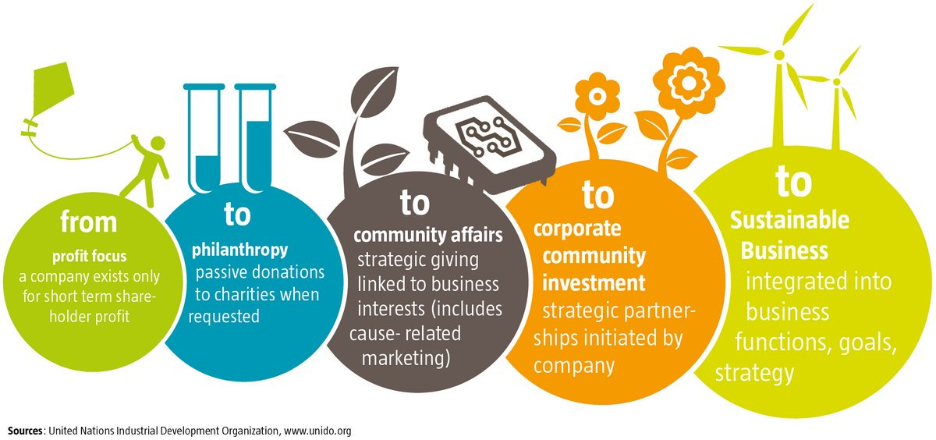
Key takeaways

Slide 29

Thank you!
Pavel Adámek, Ing., Ph.D.
adamek@opf.slu.cz

